Slide 1


FABRICATION OF WEAR AND GEAR WARM
MECHAINSM
A MINOR PROJECT REPORT
Submitted by
K.ROHITH (927622BME073)
C.SABARISH (927622BME074)
S.SABARIVIJAY (927622BME075)
BACHELOR OF ENGINEERING
IN
MECHANICAL ENGINEERING
M.KUMARASAMY COLLEGE OF ENGINEERING, KARUR
ANNA UNIVERSITY CHENNAI 600 025 NOV 2023
1

Slide 2


FABRICATION OF WEAR AND GEAR WARM MECHAINSM
A MINOR PROJECT REPORT
Submitted by
K.ROHITH (927622BME073)
C.SABARISH (927622BME074)
S.SABARIVIJAY (927622BME075)
BACHELOR OF ENGINEERING
IN
MECHANICAL ENGINEERING
M.KUMARASAMY COLLEGE OF ENGINEERING,
KARUR
ANNA UNIVERSITY CHENNAI 600 025
NOV 2023
2

Slide 3
M.KUMARASAMY COLLEGE OF ENGINEERING,KARUR
BONAFIDE CERTIFICATE
Certified that this project report “FABRICATION OF” WEAR AND GEAR WARM MECHANISM is the bonafide work of “C.SABARISH
(927622BME074),S.SABARIVIJAY (927622BME075),K.ROHITH (927622BME073)”Who carried out the project work under the academic year of 2023-2024- under my super vision. Certified further, that to the best of my knowledge the work reported herein does not form part of any other project report or dissertation on the basis of which a degree or award was conferred on an earlier occasion on this or any other candidate.
SIGNATURE
SIGNATURE
Dr. K.C.KEERTHIVASAN M.Tech,Ph.d., SUPERVISOR
Dr. M. MOHAN PRASAD M.E.,MBA.,Ph.D.
HEAD OF THE DEPARTMENT
Department of mechanical engineering, M.Kumarasamy college of engineering, Thalavapalayam karur-639 113
Department of mechanical engineering, M.Kumarasamy college of engineering Thalavapalayam karur-639 113
Submitted for the viva voice examination held on
INTERNAL EXAMINER
EXTERNAL EXAMINER
3

Slide 4
DECLARATION
We affirm that the project titled “WEAR AND GEAR EARM MECHANISM” Being submitted in partial fulfillment of for the award og Bachelor of Engineering, is the original work carried out by us. It has not formed the part of any other project or dissertation on the basis which a degree or award was conferred on an earlier occasion on thisor any other candidate.
Student Name
Signature
1.SABARISH
2.S.SABARIVIJAY
3.K.ROHITH
Name and sign of the supervisor with date:
4

Slide 5
ACKNOWLEDGEMENT
Our sincere thanks to Thiru. M. Kumarasamy, Chairman and Dr. K. Ramakrishnan, B.E, Secretary of M. Kumarasamy College of Engineering for providing extra ordinary infrastructure, which helped us to complete the project in time.
It is a great privilege for us to express our gratitude to our esteemed Principal Dr.B.S. Murugan M.E., Ph.D. for providing us right ambiance for carrying out the project work.
We would like to thank Dr. M. Mohan Prasad M.E, MBA., Ph.D, Head, Department of Mechanical Engineering, for their unwavering moral support throughout the evolution of the project.
We offer our whole hearted thanks to our internal guide Dr. K.C. Keerthivasan M.Tech., Ph.D.,Professor Department of Mechanical Engineering, for her/his constant encouragement, kind co-operation, valuable suggestions and support rendered in making our project a success.
We offer our whole hearted thanks to our project coordinator Dr M.Loganathan M.E.,Ph.D,. Department of Mechanical Engineering, for his constant encouragement, kind co-operation, valuable suggestions and support rendered in making our project a success.
We glad to thank all the Teaching and Non-Teaching Faculty Members of Department ofMechanical Engineering for extending a warm helping hand and valuable suggestions throughout the project.
5

Slide 6
PROGRAM OUTCOMES
The following are the program outcomes of Engineering Graduates: Engineering Graduates will be able to
1. Engineering knowledge: Apply the knowledge of mathematics, science engineering fundamentals, and an engineering specialization to the solution of complex engineering problems.
2. Problem analysis: Identify, formulate, review research literature, and analyze complex engineering problems reaching substantiated conclusions using first principles of mathematics, natural sciences, and engineering sciences.
3. Design/development of solutions: Design solutions for complex engineering problems and design system components or processes that meet the specified needs with appropriate consideration for the public health and safety, and the cultural, societal, and environmental considerations.
4. Conduct investigations of complex problems: Use research-based knowledge and research methods including design of experiments, analysis and interpretation of data, and synthesis of the information to provide valid conclusions.
5. Modern tool usage: Create, select, and apply appropriate techniques, resources and modern engineering and IT tools including prediction and modeling to complex engineering activities with an understanding of the limitations.
6

Slide 7
6. The engineer and society: Apply reasoning informed by the contextual knowledge to assess societal, health, safety, legal and cultural issues and the consequent responsibilities relevant to the professional engineering practice.
7. Environment and sustainability: Understand the impact of the professional engineering solutions in societal and environmental contexts, and demonstrate the knowledge of, and need for sustainable development.
8. Ethics: Apply ethical principles and commit to professional ethics and responsibilities and norms of the engineering practice.
9. Individual and team work: Function effectively as an individual, and as a member or leader in diverse teams, and in multidisciplinary settings.
10. Communication: Communicate effectively on complex engineering activities with the engineering community and with society at large, such as, being able to comprehend and write effective reports and design documentation, make effective presentations, and give and receive clear instructions.
11. Project management and finance: Demonstrate knowledge and understanding of the engineering and management principles and apply these to one’s own work, as a member and leader in a team, to manage projects and in multidisciplinary environments.
12. Life-long learning: Recognize the need for, and have the preparation and ability to engage in independent and life-long learning in the broadest context of
13. technological change.
7

Slide 8
TABLE OF CONTENT
CHAPTER NO.
CONTENT PAGE NO
9
10 11 12
13
14 16
17
18
19
20 21 22
24
25
26 27
 | Abstract
1 | Introduction
2 | Litrature review
3 | Working principle
4 | Major components
4.1 | Spur gear
4.2 | Helical gear
4.3 | Screw gear
4.4 | Double healical
5 | Mechanical load
5.1 | Shaft
5.2 | Ball bearing
6 | Metal frame
7 | Materials used
8 | Cost estimation
9 | Conclusion
10 | Reference
8

Slide 9
CHAPTER -1
ABSTRACT
The fabrication of a spur gear with a load mechanism involves designing and constructing a gear system capable of handling specific loads. The spur gear framework supports a load weight through precise engineering, ensuring optimal functionality. This project aims to enhance the understanding of gear systems' load-bearing capabilities and their applications in practical scenarios. The abstract emphasizes the significance of the load mechanism, detailing the gear's ability to withstand and distribute forces effectively. By exploring the relationship between the spur gear framework and applied loads, this project contributes valuable insights into the practical implications for various industries requiring robust and reliable machinery.
By exploring the relationship between the spur gear framework and applied loads, this project contributes valuable insights into the practical implications for various industries requiring robust and reliable machinery
. This project aims to enhance the understanding of gear systems' load-bearing capabilities and their applications in practical scenarios. The abstract emphasizes the significance of the load mechanism, detailing the gear's ability to withstand and distribute forces effectively.
9

Slide 10
CHAPTER 2
INTRODUCTION
The fabrication of a spur gear involves intricate design and precision to ensure optimal performance. The load mechanism is a crucial aspect, where the spur gear is subjected to varying forces. In this process, a spur gear frame is employed to support and distribute the load weight efficiently. The introduction of load weight is essential to simulate real-world conditions and assess the gear's resilience. By applying a specified load to the spur gear within the frame, engineers can evaluate its durability, tooth engagement, and overall functionality under stress.
Gears are mostly used in the mechanical field for power transmission, this project report on stress analysis of spur gears. Spur gear made of cast iron is considered as the conventional model in this project. The conventional model is optimized with carbon fiber high modulus material and the analysis is carried out. Boundary constraints are defined and the total deformations for model are calculated and the results are tabulated
10

Slide 11
Chapter-3
LITERATURE REVIEW
A gear or “gear wheel” is a rotating machine part having cut teeth, or cogs, which mesh with another toothed part in order to transmit power. Two or more gears working in tandem are called a transmission and produce a mechanical advantages through a gear ratio and thus may be considered a simple machine. Gears are mostly used in the mechanical field for power transmission, this project report on stress analysis of spur gears. Spur gear made of cast iron is considered as the conventional model in this project. The conventional model is optimized with carbon fiber high modulus material and the analysis is carried out. Boundary constraints are defined and the total deformations for model are calculated and the results are tabulated
The load mechanism is a crucial aspect, where the spur gear is subjected to varying forces. In this process, a spur gear frame is employed to support and distribute the load weight efficiently. The introduction of load weight is essential to simulate real-world conditions and assess the gear's resilience.
11

Slide 12
CHAPTER-4
WORKING PRINCIPLE
The fabrication of a spur gear involves creating a toothed wheel to transmit motion. A spur gear frame, under load, employs a weight mechanism. The working principle is based on the gear's teeth engaging to transfer force efficiently. As the frame bears a load, the gear redistributes this weight, demonstrating the fundamental concept of spur gear systems. This load-bearing mechanism is crucial for applications requiring precise and reliable power transmission, commonly found in various mechanical systems, from industrial machinery to automotive components.
12

Slide 13
CHAPTER-5
MAJOR COMPONENTS
1. Spur gear
2. Helical gear
3. Screw gear
4. Double helical gear
5.1 SPUR GEAR
A gear or cogwheel is a rotating machine part having cut like teeth, or cogs, which mesh with another toothed part to transmit torque. Geared devices can change the speed, torque, and direction of a power source. Gears almost always produce a change in torque, creating a mechanical advantage, through their gear ratio, and thus may be considered a simple machine. The teeth on the two meshing gears all have the same shape.^{[1]} Two or more meshing gears, working in a sequence, are called a gear train or a transmission. A gear can mesh with a linear toothed part, called a rack, producing translation instead of rotation.
The gears in a transmission are analogous to the wheels in a crossed, belt pulley system. An advantage of gears is that the teeth of a gear prevent slippage.
13

Slide 14
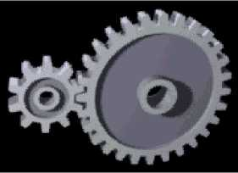
When two gears mesh, if one gear is bigger than the other, a mechanical advantage is produced, with the rotational speeds, and the torques, of the two gears differing in proportion to their diameters.
In transmissions with multiple gear ratios—such as bicycles, motorcycles, and cars—the term "gear" as in "first gear" refers to a gear ratio rather than an actual physical gear. The term describes similar devices, even when the gear ratio is continuous rather than discrete, or when the device does not actually contain gears, as in a continuously variable transmission
5.2 HELICAL GEAR
Helical or "dry fixed" gears offer a refinement over spur gears. The leading edges of the teeth are not parallel to the axis of rotation, but are set at an angle. Since the gear is curved, this angling makes the tooth shape a segment of a helix. Helical gears can be meshed in parallel or crossedorientations. The former refers to when the shafts are parallel to each other; this is the most common orientation. In the latter, the shafts are non-parallel, and in this configuration the gears are sometimes known as "skew gears".
14

Slide 15
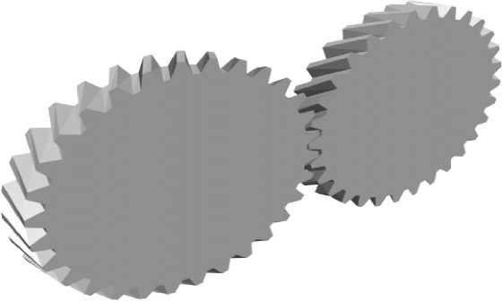
The angled teeth engage more gradually than do spur gear teeth, causing them to run more smoothly and quietly. With parallel helical gears, each pair of teeth first make contact at a single point at one side of the gear wheel; a moving curve of contact then grows gradually across the tooth face to a maximum, then recedes until the teeth break contact at a single point on the opposite side. In spur gears, teeth suddenly meet at a line contact across their entire width, causing stress and noise. Spur gears make a characteristic whine at high speeds. For this reason spur gears are used in low-speed applications and in situations where noise control is not a problem, and helical gears are used in high-speed applications, large power transmission, or where noise abatement is important. The speed is considered high when the pitch line velocity exceeds 25 m/s.
A disadvantage of helical gears is a resultant thrust along the axis of the gear, which must be accommodated by appropriate thrust bearings, and a greater degree of sliding friction between the meshing teeth, often addressed with additives in the lubricant.
15

Slide 16
5.3 SCREW GEAR
For a "crossed" or "skew" configuration, the gears must have the same pressure angle and normal pitch; however, the helix angle and handedness can be different. The relationship between the two shafts is actually defined by the helix angle(s) of the two shafts and the handedness, as defined:
Is the helix angle for the gear. The crossed configuration is less mechanically sound because there is only a point contact between the gears, whereas in the parallel configuration there is a line contact.
Quite commonly, helical gears are used with the helix angle of one having the negative of the helix angle of the other; such a pair might also be referred to as having a right-handed helix and a left-handed helix of equal angles. The two equal but opposite angles add to zero: the angle between shafts is zero—that is, the shafts are parallel. Where the sum or the difference (as described in the equations above) is not zero, the shafts are crossed. For shafts crossed at right angles, the helix angles are of the same hand because they must add to 90 degrees.
5.4 DOUBLE HELICAL
Double helical gears overcome the problem of axial thrust presented by single helical gears by using a double set of teeth, slanted in opposite directions. A double helical gear can be thought of as two mirrored helical gears mounted closely together on a common axle. This arrangement cancels out the net axial thrust, since each half of the gear thrusts in the opposite
16

Slide 17
direction, resulting in a net axial force of zero. This arrangement can also remove the need for thrust bearings. However, double helical gears are more difficult to manufacture due to their more complicated shape.
Herringbone gears are a special type of helical gears. They do not have a groove in the middle like some other double helical gears do; the two mirrored helical gears are joined together so that their form a V shape. This can also be applied to bevel gears, as in the final drive of the Citroen Type A.
For both possible rotational directions, there exist two possible arrangements for the oppositely-oriented helical gears or gear faces. One arrangement is called stable, and the other unstable. In a stable arrangement, the helical gear faces are oriented so that each axial force is directed toward the center of the gear. In an unstable arrangement, both axial forces are directed away from the center of the gear. In either arrangement, the total (or net) axial force on each gear is zero when the gears are aligned correctly. If the gears become misaligned in the axial direction, the unstable arrangement.
. A double helical gear can be thought of as two mirrored helical gears mounted closely together on a common axle. This arrangement cancels out the net axial thrust, since each half of the gear thrusts in the opposite direction, resulting in a net axial force of zero. This arrangement can also remove the need for thrust bearings. However, double helical gears are more difficult to manufacture due to their more complicated shape.
17

Slide 18
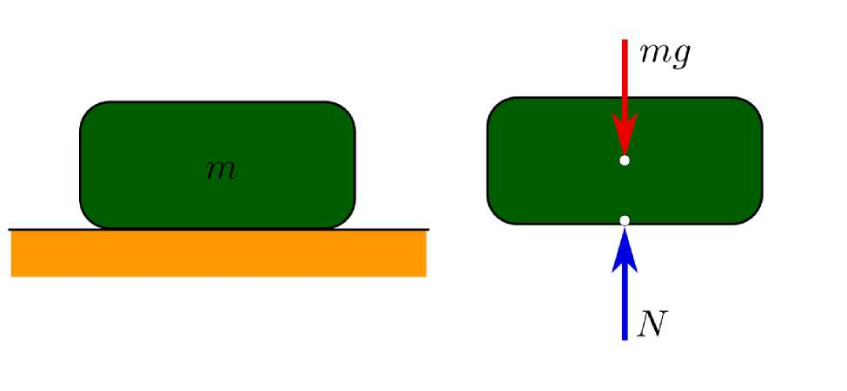
Chapter 6
MECHANICAL LOAD
Dead loads are static forces that are relatively constant for an extended time. They can be in tension or compression. The term can refer to a laboratory test method or to the normal usage of a material or structure.
Live loads are usually variable or moving loads. These can have a significant dynamic element and may involve considerations such as impact, momentum, vibration, slosh dynamics of fluids, etc.
An impact load is one whose time of application on a material is less than one-third of the natural period of vibration of that material.
Cyclic loads on a structure can lead to fatigue damage, cumulative damage, or failure. These loads can be repeated loadings on a structure or can be due to vibration.
18

Slide 19
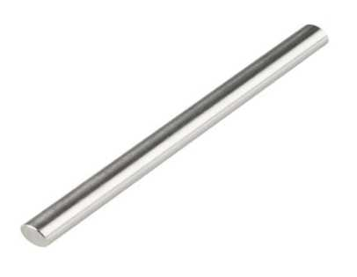
Structural loads are an important consideration in the design of buildings. Building codes require that structures be designed and built to safely resist all actions that they are likely to face during their service life, while remaining fit for use.^{[4]} Minimum loads or actions are specified in these building codes for types of structures, geographic locations, usage and materials of construction.
6.1 SHAFT
Specifications
Shaft diameter: 12mm Material: mild steel Length:26 inch
19

Slide 20
Shaft is a common and important machine element. It is a rotating member, in general, has a circular cross-section and is used to transmit power. The shaft may be hollow or solid. The shaft is supported on bearings and it rotates a set of gears or pulleys for the purpose of power transmission. The shaft is generally acted upon by bending moment, torsion and axial force. Design of shaft primarily involves in determining stresses at critical point in the shaft that is arising due to aforementioned loading. Other two similar forms of a shaft are axle and spindle. Axle is a non-rotating member used for supporting rotating wheels etc. and do not transmit any torque. Spindle is simply defined as a short shaft. However, design method remains the same for axle and spindle as that for a shaft. 8.1.2 Standard sizes of Shafts Typical sizes of solid shaft that are available in the market are, Up to 25 mm 0.5 mm increments 25 to 50 mm 1.0 mm increments 50 to 100 mm 2.0 mm increments 100 to 200 mm 5.0 mm increments 8.1.3 Material for Shafts The ferrous, non-ferrous materials and non metals are used as shaft material depending on the application. Some of the common ferrous materials used for shaft are discussed below. Hot-rolled plain carbon steel. These materials are least expensive. Since it is hot rolled, scaling is always present on the surface and machining is required to make the surface smooth.
Since it is cold drawn it has got its inherent characteristics of smooth bright finish. Amount of machining therefore is minimal. Better yield strength is also obtained. This is widely used for general purpose transmission shaft.
20

Slide 21
6.2 BALL BEARING
A ball bearing is a type of rolling-element bearing that uses balls to maintain the separation between the bearing races.
The purpose of a ball bearing is to reduce rotational friction and support radial and axial loads. It achieves this by using at least three races to contain the balls and transmit the loads through the balls. In most applications, one race is stationary and the other is attached to the rotating assembly (e.g., a hub or shaft).
21

Slide 22
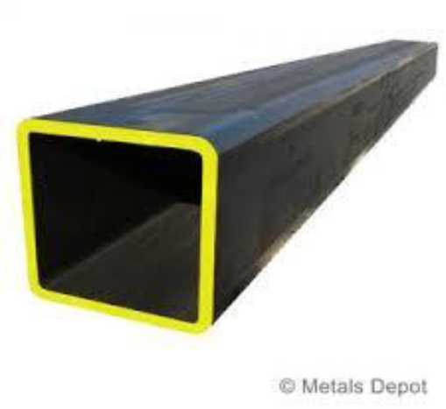
CHAPTER-7
METAL FRAME
The metal frame is generally made of mild steel bars for machining, suitable for lightly stressed components including studs, bolts, gears and shafts. It can be case-hardened to improve wear resistance. They are available in bright rounds, squares and flats, and hot rolled rounds
Suitable machining allowances should therefore be added when ordering. It does not contain any additions for enhancing mechanical or machining properties. Bright drawn mild steel is an improved quality material, free of scale, and has been cold worked (drawn or rolled) to size. It is produced to close dimensional tolerances.
22

Slide 23
CHAPTER-8
MATERIAL USED
S.No | DESCIRPTION | QTY | MATERIAL
1 | SPUR GEAR | 2 | MILD STEEL
2 | LOAD WEIGHT | 1 | MILD STEEL
3 | BEARING | 3 | STAINLESS STEEL
4 | FRAME | AS PER REWUIRMENT | MILD STEEL
5 | SHAFT | AS PER REWUIRMENT | MILD STEEL
6 | METAL STRIP | AS PER REWUIRMENT | MILD STEEL
23

Slide 24
CHAPTER-9
COST ESTIMATION
DISCRIPTION
SPUR GEAR LOAD WEIGHT BEARING FRAME SHAFT
METAL STRIP
500
1000
200
1000
300
300
3500
TOTAL

Slide 25
CHAPTER-10
CONCLUSION
In conclusion, the fabrication of spur gears utilizing a load mechanism proves to be a crucial and efficient process in various mechanical applications. This method ensures precise gear tooth formation, enhancing overall gear functionality. The incorporation of a load mechanism contributes to the durability and reliability of spur gears, crucial in transmitting motion smoothly. This fabrication approach aligns with industry standards, emphasizing precision engineering. As a result, spur gears produced through this method exhibit superior performance under varying loads, making them integral components in diverse machinery and mechanical systems.
25

Slide 26
CHAPTER-11
REFERENCE
1. Vivek Karaveer, Ashish Mogrekar and T. Preman Reynold Joseph (2013): Modeling and Finite Element Analysis of spur gear, International Journal of Current Engineering and Technology ISSN 2277- 4106.
2. Sandeep, R.K.Suresh, B. jayachandraiah, Department of Mechanical Engg. Kalahasteeswara institute of technology Srikala hasti chittor AP. Hyderabad, India. DeForabie body dynamic analysis of of planetary gear with thin rims journal of sound and vibration 262 (2003) 752768.
3. B Venkatesh, V. kamala, A.M.K. Prasad Assoc. Professor. MED Vardhaman college of Engg. Hyderabad India Professor. MED MJCET Hyderabad, DGM (Retd), BHEL R&D, Hyderabad India.Professor & Head MED Osmania Csollage at Engg. University Hyderabad, India. Design Modeling and Manufacturing Helical Gears.
4. F. R. M. Romlay (2008): Modeling of surface contact stress for spur gear mechanism using static and transient finite element method, Journal of Structural Durability & Health Monitoring (SDHM),
26

Slide 27
27

Slide 28
28

