Slide 1
HPML Final Project · Spring 2026
Extending AssetOpsBench: Smart Grid Transformer Integration and Automated Scenario Generation
Integrated Smart Grid Transformer into AssetOpsBench with IEC-grounded diagnostic tools and built a Scenario Generator Agent that automates scenario creation for any new asset class, applying optimizations to achieve 8x speedup over baseline with no loss in scenario quality.
Team 8
Rohith Kanathur · rk3443
Sagar Chethan Kumar · sc5758
Ananya Kapoor · ak5447
Dev Bahl · db3791
GitHub: https://github.com/Rohith-Kanathur/AssetOpsBench
Tracking: https://wandb.ai/rk3443-columbia-university/assetopsbench
Dr. Kaoutar El Maghraoui · Columbia University · Week of May 4, 2026
Notes:
Ananya

Slide 2
Motivation & Problem
Why this matters
Problem statement
Industrial asset operations depend on continuous monitoring across heterogeneous data: IoT telemetry, failure-mode libraries, oil chemistry readings, and maintenance logs.
Evaluating LLM-based agents on these tasks requires realistic, standards-compliant scenarios across diverse asset classes and lifecycle phases.
Manual scenario authoring by subject-matter experts (SMEs) is slow, inconsistent, and cannot scale to new asset classes.
Extending AssetOpsBench to new industrial assets requires manually authoring physically plausible, standards-compliant, tool-reachable evaluation scenarios, a bottleneck that blocks benchmark coverage and delays agent evaluation.
Goal: Automate high-fidelity scenario generation for any new asset class, while applying optimization techniques such as caching, thread pool offloading and parallel scenario generation to achieve a speedup of 8× over the unoptimized baseline, with no degradation in composite scenario quality.
HPML · Spring 2026
2 / 14
Notes:
Ananya

Slide 3









(1) Profile
(2) Budget
(3) Generate
IoT/FMSR/TSFM/WO/Vibration
Composer
Arxiv/Semantic Scholar
(Optional)
Coverage-aware Quotas
(+ negative)
Single-domain Generation
Multi-domain Generation
Asset Class + Budget + Flags
Asset Profile
Budget Allocator
Negative Generation
Scenarios
Digest Synthesizer
Validate & Repair Agent
Grounding Discovery
(IoT, FMSR, Vibration)
Notes:
Ananya

Slide 4
Technical Approach - Model & Data
Model
Dataset
Hardware
watsonx/meta-llama/llama-3-3-70b-instruct (IBM WatsonX) is the model used.
This is used as the LLM backbone in the ScenarioGeneratorAgent: stages: asset profiling, budgeted allocation, domain wise generation, validation and repair
This also serves as the LLM backbone for the transformer FMSR tools: four MCP tools grounded in IEC 60599 and IEC 60076-7 standards; health index prediction, dissolved gas analysis, load profile analysis and winding temperature analysis.
Existing AssetOpsBench scenarios (chillers, AHUs) as few-shot examples for generation scenario.
ArXiv/SemanticScholar literature retrieval (domain papers fetched per asset class to build AssetProfiles for scenario generation).
Mendeley transformer health dataset (Arias Velasquez & Lara, 2020) for the supporting health index model.
Profiling: PyTorch Profiler chrome traces and Weights & Biases for all scenario generation and evaluation runs.
Software stack: Python, FastMCP (MCP Servers), asyncio, CouchDB, Weights & Biases, Pytorch Profiler
HPML · Spring 2026
3 / 14
Notes:
Ananya

Slide 5
Technical Approach - Optimizations Applied
1.
Caching
Asset profiles, research papers, and few-shot examples are cached at two levels: fast in-memory LRU and persistent disk storage. This avoids re-running expensive LLM calls and academic retrieval for the same asset across repeated runs.
2.
Parallel Per-Domain Scenario Generation
Scenario generation across different domains (IoT, FMSR, Work Order, etc.) runs in parallel rather than sequentially.
3.
Thread Pool Offloading
Blocking LLM HTTP calls are offloaded to a shared thread pool executor, keeping the async event loop free. This ensures multiple pipeline phases can make progress simultaneously without stalling on I/O.
HPML · Spring 2026
4 / 14
Notes:
Ananya

Slide 6
Technical Approach - Optimizations Applied
4.
Batch LLM Calls
Instead of one LLM call per scenario, multiple scenarios are requested in a single prompt. This amortizes the per-call overhead (network, parsing, rate-limiter tokens) across a batch.
5.
Early Rejection Filtering
A pre-screen eliminates clearly malformed or duplicate scenarios before the full validator runs. This avoids wasting time on structural validation for outputs that fail basic length, field presence, or near-duplicate checks.
Default params used (unless specified): --max-concurrent 3 --max-workers 4 --cache-ttl 24h · --retriever arxiv
HPML · Spring 2026
4 / 14
Notes:
Ananya

Slide 7
Profiling Methodology
Tools
Metrics captured (Generation)
PyTorch Profiler / torch.profiler
All “per phase” times are wall-clock seconds measured via timed section spans and were verified against the PyTorch Profiler chrome trace.
Conducted four profiling experiments comparing baseline and optimized scenario generation for the Transformer asset. Each experiment isolates a specific optimization dimension: scalability, caching, parallelism, and overall combined effect.
Weights & Biases for run-level tracking
Logging is done for scenario generation and evaluation stages.
Metrics captured: phase wise timing, llm call metrics, cache hit/miss metrics, valid/invalid scenario count and scenario evaluation scores.
Per-LLM-Call Timeline (llm/*): Wall clock time per LLM call, prompt token count, completion token count, total token count.
Run-Level Summary Scalars:
run/*: top-level metadata: asset name, generation mode (open form / closed form) and total scenarios generated.
tokens/*: aggregate token usage: prompt, completion, and combined tokens across all LLM calls.
timing/*: wall-clock and CPU time for each pipeline phase.
cache/*: cache hit/miss counts, hit/miss rates.
batch summary/*: total scenarios generated, valid, repaired, rejected, attempt count, and overall validation pass rate.
HPML · Spring 2026
5 / 14
Notes:
Sagar

Slide 8
Profiling Methodology
Metrics captured
Metrics captured (Evaluation)
Rich Tables
llm calls table: One row per LLM call with columns: phase, prompt tokens, completion tokens, total tokens, wall sec.
batch results table: One row per batch scenario generation attempt with columns: focus, attempt, generated, valid, repaired, rejected counts and pass rate.
Per-Scenario Timeline (eval/*)
eval/scenario_id: Scenario identifier
eval/type: Scenario type (e.g. iot, tsfm)
eval/static_score: Static score for the scenario (/20)
eval/llm score: LLM judge score for the scenario (/30)
eval/dry_run_score: Dry-run execution score for a scenario(/50)
eval/quality_score: Composite quality score for scenario(/100)
Run-Level Summary Scalars (wandb.summary)
summary/static/*: mean static score across all scenarios
summary/llm/*: mean LLM as a judge score across all scenarios
summary/dry_run/*: mean dry-run score across all scenarios
summary/quality/*: mean, min, and max composite quality score across all scenarios.
Rich Tables
eval_report_table: one row per scenario with columns: id, type, category, evaluation scores, issues
llm_calls_table: one row per LLM call with columns: phase, prompt tokens, completion tokens, total tokens, wall sec.
HPML · Spring 2026
5 / 14
Notes:
Sagar

Slide 9
Results — Headline Numbers
8x
4.6x
1.85x
Speedup from all optimizations
Speedup from Caching
Speedup from Parallel Scenario Generation
[baseline → optimized, 408 sec→ 50 sec]
[Cold Cache → Warm Cache, 302.4 sec → 65.09 sec]
[C = 1 → C = 5, 87.3 sec → 47.3 sec]
All measurements are averaged over 3 runs.
C controls how many of the 5 domain {iot, fmsr, tsfm, wo, vibration} scenarios are generated in parallel.
Times listed in this slide refer to the total pipeline time for the scenario generation: transformer asset class, 50 scenarios
HPML · Spring 2026
6 / 14
Notes:
Sagar

Slide 10
Results — Before vs. After (varying N = scenarios)
Baseline (Unoptimized) (Time in seconds)
Optimized (with warm cache) (Time in seconds)
Phase | N=10 | N=25 | N=50
Phase 0: Get Tool Desc | 2.4 | 2.5 | 2.2
Phase 1: Build Asset Profile | 448.2 | 338.9 | 325.7
Phase 2: Allocate Budget | 2.05 | 3.3 | 2.3
Phase 3: Single Agent Gen | 11.4 | 34.7 | 38.8
Phase 4: Multi Agent Gen | 4.05 | 20.6 | 29.3
Total (in seconds) | 468.2 | 400.3 | 408.4
Phase | N=10 | N=25 | N=50
Phase 0: Get Tool Desc | 1.5 | 2.4 | 2.1
Phase 1: Build Asset Profile | 0 | 0 | 0
Phase 2: Allocate Budget | 0 | 0 | 0
Phase 3: Single Agent Gen | 8.2 | 14.8 | 15.9
Phase 4: Multi Agent Gen | 10.7 | 17.2 | 18.1
Total (in seconds) | 13.6 | 19.8 | 50.8
Tables report per-phase and total pipeline times for the baseline and the optimized variants.
Caching optimization contributes the most improvement. Phase 1 dominates baseline which is 80-96% of total (almost 6 to 8 mins). Caching eliminates it entirely on warm runs as shown in the table on the right.
HPML · Spring 2026
7 / 14
Notes:
Sagar

Slide 11
Results — Before vs. After (varying C = parallel domains)
Pipeline Time vs. Number of Domains (Time in seconds)
Cold vs Warm Cache (Optimized Variant) (Time in seconds)
Phase | C=1 | C=2 | C=3 | C=5
Phase 0: Get Tool Desc | 2.18 | 2.15 | 2.18 | 2.45
Phase 1: Build Asset Profile | 0 | 0 | 0 | 0
Phase 2: Allocate Budget | 0 | 0 | 0 | 0
Phase 3: Single Agent Gen | 43.88 | 22.29 | 17.66 | 17.62
Phase 4: Multi Agent Gen | 46.07 | 54.51 | 44.44 | 27.22
Total (in seconds) | 87.39 | 78.95 | 64.29 | 47.30
Phase | Cold | Warm
Phase 0: Get Tool Desc | 2.4 | 2.2
Phase 1: Build Asset Profile | 247.4 | 0
Phase 2: Allocate Budget | 0 | 0
Phase 3: Single Agent Gen | 17.30 | 17.23
Phase 4: Multi Agent Gen | 35.34 | 45.57
Total (in seconds) | 302.47 | 65.09
C controls how many of the 5 domains {iot, fmsr, tsfm, wo, vibration} scenarios are generated in parallel.
Total speedup: 1.85X from C = 1→ C = 5.
Phase 3 speedup: 43.88 sec (C=1) to 17.62 sec (C=5)
We compare two runs of the optimized variant with identical parameters (N=50, C=3) differing only in cache state.
The cold run forces a full asset profile rebuild, the warm run reads the profile in the cache.
The disk cache eliminates Phase 1 entirely on warm runs (247.4 s to 0 s), saving over four minutes per run. The full pipeline drops from 302.5 s to 65.1 s: a 4.6X speedup
HPML · Spring 2026
7 / 14
Notes:
Sagar

Slide 12
Results — Before vs. After
Pipeline time (seconds): Baseline vs. Optimized, Both Cold Cache.
Phase | Baseline | Optimized
Phase 0: Get Tool Desc | 2.20 | 2.42
Phase 1: Build Asset Profile | 325.70 | 216.85
Phase 2: Allocate Budget | 2.34 | 2.56
Phase 3: Single Agent Gen | 38.83 | 14.65
Phase 4: Multi Agent Gen | 39.92 | 32.46
Total | 408.43 | 268.96
Phase 1
I/O concurrency (thread pool) → 33% faster even without cache
Phase 3
Phase 3 shows the largest relative gain: a 2.65× speedup from parallel focus execution
Phase 1 improves by 33% (325.7 s → 216.9 s) through I/O concurrency.
The baseline executes PDF downloads, database queries, and literature searches sequentially.
The optimized module offloads each blocking call to a background thread pool, filling CPU-idle network-wait time with concurrent requests.
HPML · Spring 2026
7 / 14
Notes:
Rohith

Slide 13
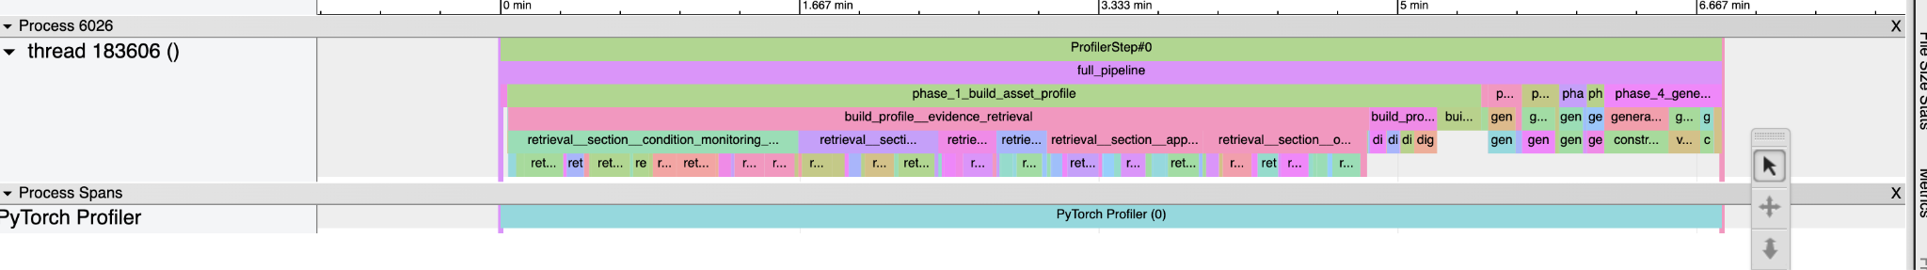
Profiler Evidence (Baseline)
The total pipeline time for generating 50 scenarios for transformer asset using the baseline variant is over 6.5 minutes.
Phase 1 dominates the most taking over 5 minutes. This is due to uncached academic retrieval, PDF fetching, and expensive LLM calls on every run.
HPML · Spring 2026
8 / 14
Notes:
Rohith

Slide 14
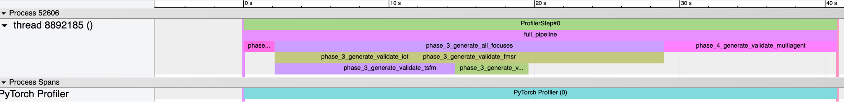
Profiler Evidence (Optimized)
The total pipeline time is reduced to just 40 sec after applying optimizations such as parallel scenario generation, caching and thread pool offloading.
The phase 1 time which was the bottleneck in the baseline is now reduced to 0 sec.
HPML · Spring 2026
8 / 14
Notes:
Rohith

Slide 15

Demo / Visualization
HPML · Spring 2026
9 / 14
Notes:
Rohith

Slide 16
Lessons Learned
What worked
What didn't work
Insight 1 (Caching Impact): Implementing a two-level caching system (L1 in-memory LRU and L2 persistent disk storage) was the most significant optimization, eliminating Phase 1 entirely on warm runs and yielding a 4.6x speedup on its own.
Insight 2 (Concurrency Sweet Spot): Parallelizing the scenario generation across different focus groups via asyncio.gather yielded a 2.65x speedup for Phase 3, with a concurrency limit of 3 proving to be the optimal sweet spot. Offloading blocking I/O calls to a background thread pool also successfully filled CPU-idle network-wait time with concurrent requests.
Insight 3 (Preserved Quality): Achieving a 8x end-to-end speedup did not come at the cost of evaluation fidelity, as the optimized pipeline maintained a composite quality score of 74.2, which is statistically indistinguishable from the baseline which has a quality score of 73.8.
Optimization that regressed performance: Phase 3 (single agent scenario generation) did not show improvements beyond 3 parallel tasks.
Tool / approach we abandoned: We initially relied on a single LLM call to generate scenarios directly from a prompt. While the outputs were linguistically fluent, they frequently violated physical constraints, referenced unavailable tools making them unusable. This led us to introduce the validate-and-repair loop, where a second LLM pass checks each scenario and fixes issues before it is accepted.
Misconception we corrected mid-project: We initially assumed that academic literature and general domain knowledge about transformers would be sufficient context for the LLM to generate valid scenarios. In practice, the generated scenarios frequently referenced sensors, asset IDs, and operating ranges that did not match the actual data in CouchDB, making them unexecutable by the agent. Grounding generation directly in live CouchDB data with real asset IDs, real sensor names, and real historical readings produced scenarios the agent could actually execute, which was reflected higher dry-run scores.
HPML · Spring 2026
10 / 14
Notes:
Dev

Slide 17
Next Steps
Apply the scenario generation pipeline to additional Industry 4.0 asset classes, such as wind turbines, motors, pumps, and process equipment, to test its generality and surface domain-specific validator requirements.
Broaden Asset-Class Coverage
Dedicated Evaluation for Negative Tracks
Generator Fine Tuning
Explore preference-based or reinforcement-style fine-tuning of the generator itself using the validate-and-repair loop as a natural substrate. This could further reduce repair iterations and improve the first-pass yield.
Develop a dedicated evaluation protocol, distinct from the positive track, for the negative-track scenarios to better probe agent refusal and insufficiency behavior under deliberate non-answerability.
HPML · Spring 2026
11 / 14
Notes:
Dev

Slide 18
Bonus Opportunities
Open source Pull Request Submitted to AssetOpsBench: https://github.com/IBM/AssetOpsBench/pull/288
The scenarios generated from our pipeline are available on Huggingface: https://huggingface.co/datasets/rohithkanathur/assetopsbench-transformer-scenarios-dataset
HPML · Spring 2026
10 / 14
Notes:
Dev

Slide 19
Teamwork & Contributions
Member | Primary contributions | Tools / artifacts
Rohith Kanathur | Transformer Asset Class Integration, Profiling, Optimization, Wandb Logging, Evaluation, Documentation and Report Writing. | https://github.com/Rohith-Kanathur/AssetOpsBench/tree/feat/scenario-generator-profiling src/scenarios_{profiling, optimization, wandb}/*
Sagar Chethan Kumar | Scenario generation pipeline implementation (research & digest agent, validate & repair agent, and domain generation). | https://github.com/Rohith-Kanathur/AssetOpsBench/tree/feat/scenario-generator src/scenarios/*, docs/report.tex
Ananya Kapoor | Scenario schema validation, eval unit tests, category alignment fix, --static-only mode, literature survey and report writing. | src/scenarios_evaluation/scenario.schema.json, scripts/validate_scenarios.py, src/scenarios_evaluation/tests/ (local)
Dev Bahl | Eval tests and report rendering, baseline vs optimized comparison, CI pipeline, experiment reproduction. | src/scenarios_evaluation/tests/, scripts/render_eval_report.py, scripts/compare_eval_reports.py, .github/workflows/, scripts/reproduce_experiments.py (local)
Collaboration: Weekly team meetings via Gmeet, communications over Whatsapp. Updated mentor: Dr. Dhaval Patel weekly over email chain and overleaf documents.
HPML · Spring 2026
12 / 14
Notes:
Dev

Slide 20
Thank you
Questions?
GitHub: https://github.com/Rohith-Kanathur/AssetOpsBench
Tracking: https://wandb.ai/rk3443-columbia-university/assetopsbench
HPML · Spring 2026
13 / 14
Notes:
Dev

Slide 21
Backup — Evaluation Methodology
Stage 1
20 pts
Stage 2
30 pts
Stage 3
50 Pts
Static Checks
LLM Judge
Dry-Run Execution
Schema completeness
Type diversity (<=50% per type)
Category alignment
Text length (15–400 chars)
Dedup detection
Answerability (10 pts)
Tool usability (8 pts)
Difficulty (6 pts)
Characteristic quality (4 pts)
Clarity (2 pts)
Plausible response (20 pts)
Correct tools used (15 pts)
No obvious errors (15 pts)
Run by PlanExecuteRunner
Highest weight: real-world signal
Quality Score = Static + LLM + Dry Run Scores ∈ [0, 100]
>= 70: high quality
< 50: low quality
HPML · Spring 2026
14 / 14

Slide 22
Backup — Evaluation Results (N=50, 3 Runs)
Scenario quality evaluation: baseline vs. optimised (mean ± std, n = 3 runs)
Metric | Baseline | Optimized
Static Score (/20) | 18.4 ± 0.6 | 19.1 ± 0.3
LLM Judge Score (/30) | 22.2 ± 3.6 | 22.4 ± 1.8
Dry-Run Score (/50) | 33.1 ± 1.3 | 32.7 ± 2.5
Quality Score (/100) | 73.8 ± 3.0 | 74.2 ± 1.9
Quality preserved
0.4 point gap between baseline & optimised is within run-to-run variance
Static scores high
>= 18.4/20 in both schema validity unaffected by optimisations
Dry-run comparable
33.1 vs 32.7: agent executable quality fully preserved
Both pipelines exceed the 70-pt high-quality threshold, optimised pipeline is faster without any quality trade-off.
HPML · Spring 2026
14 / 14

Slide 23
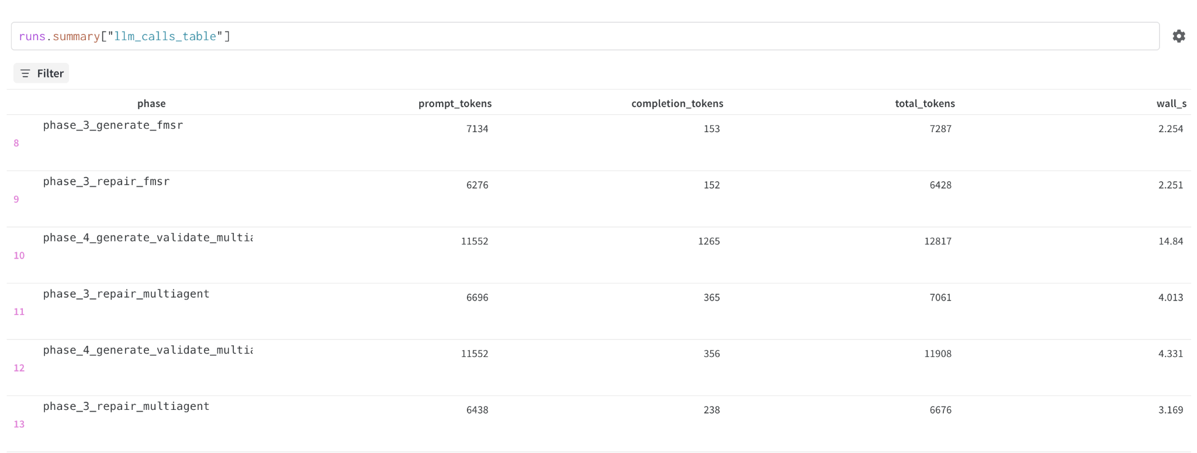
Backup — Wandb Screenshots
HPML · Spring 2026
14 / 14

Slide 24
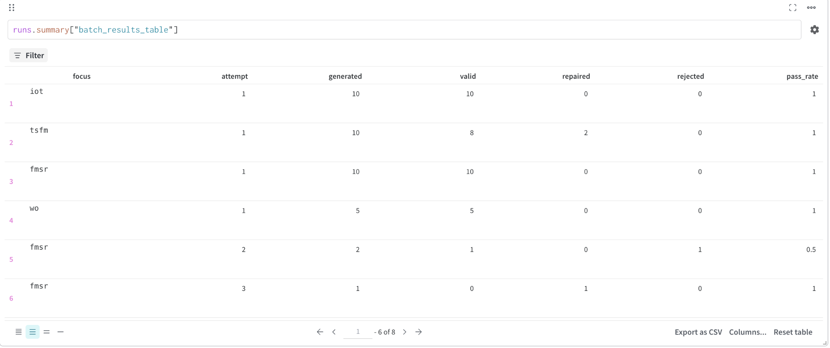
Backup — Wandb Screenshots
HPML · Spring 2026
14 / 14

Slide 25
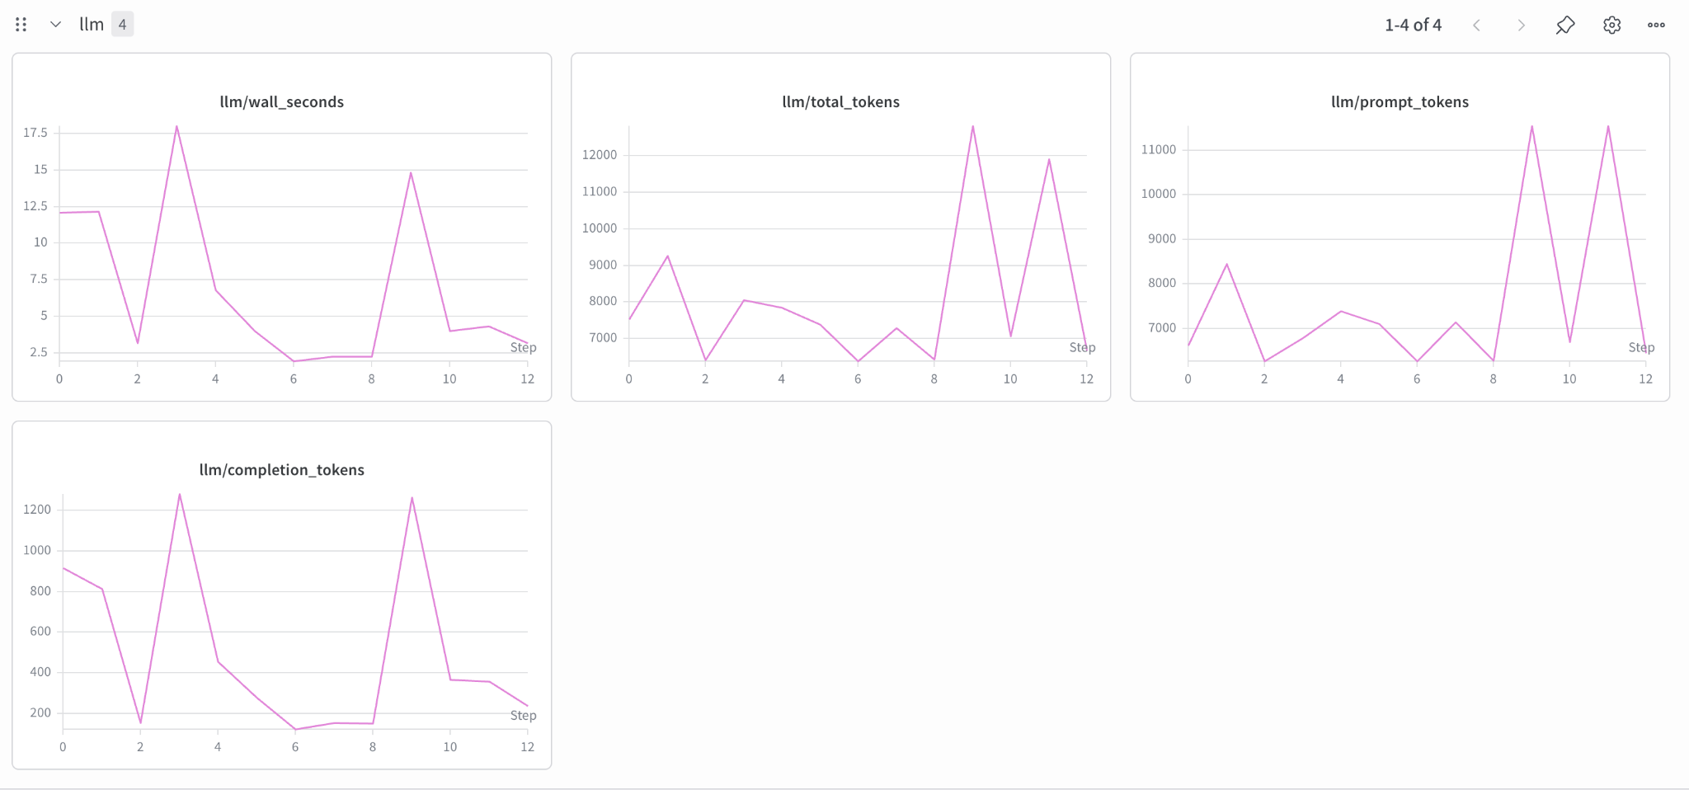
Backup — Wandb Screenshots
HPML · Spring 2026
14 / 14

Slide 26
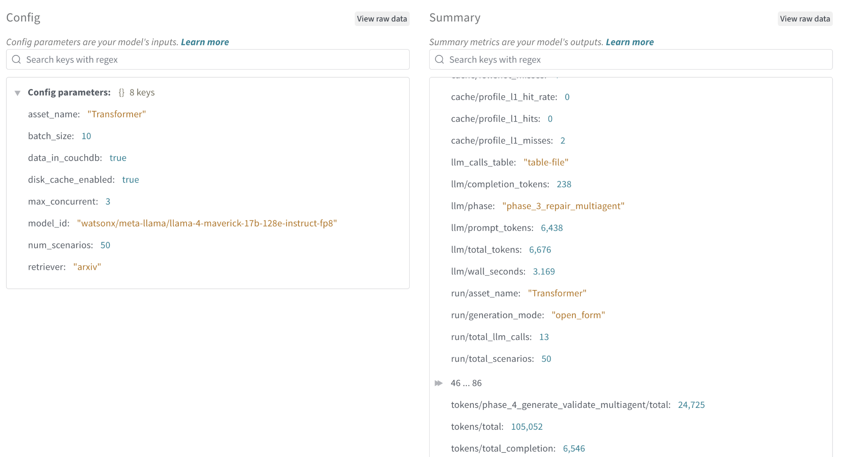
Backup — Wandb Screenshots
HPML · Spring 2026
14 / 14

Slide 27
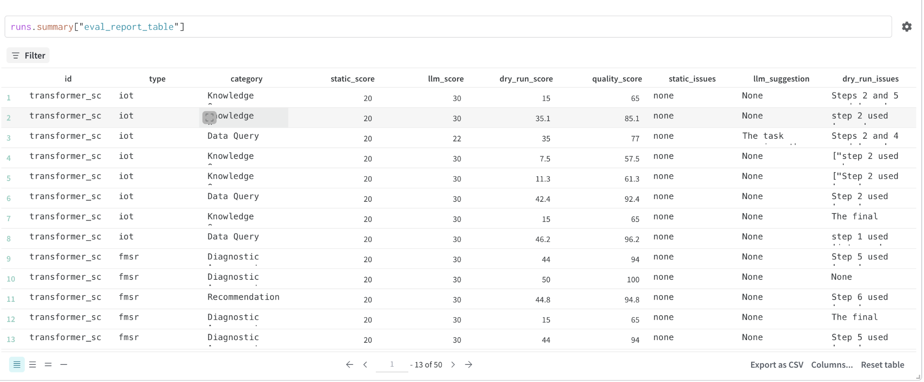
Backup — Wandb Screenshots
HPML · Spring 2026
14 / 14

Slide 28
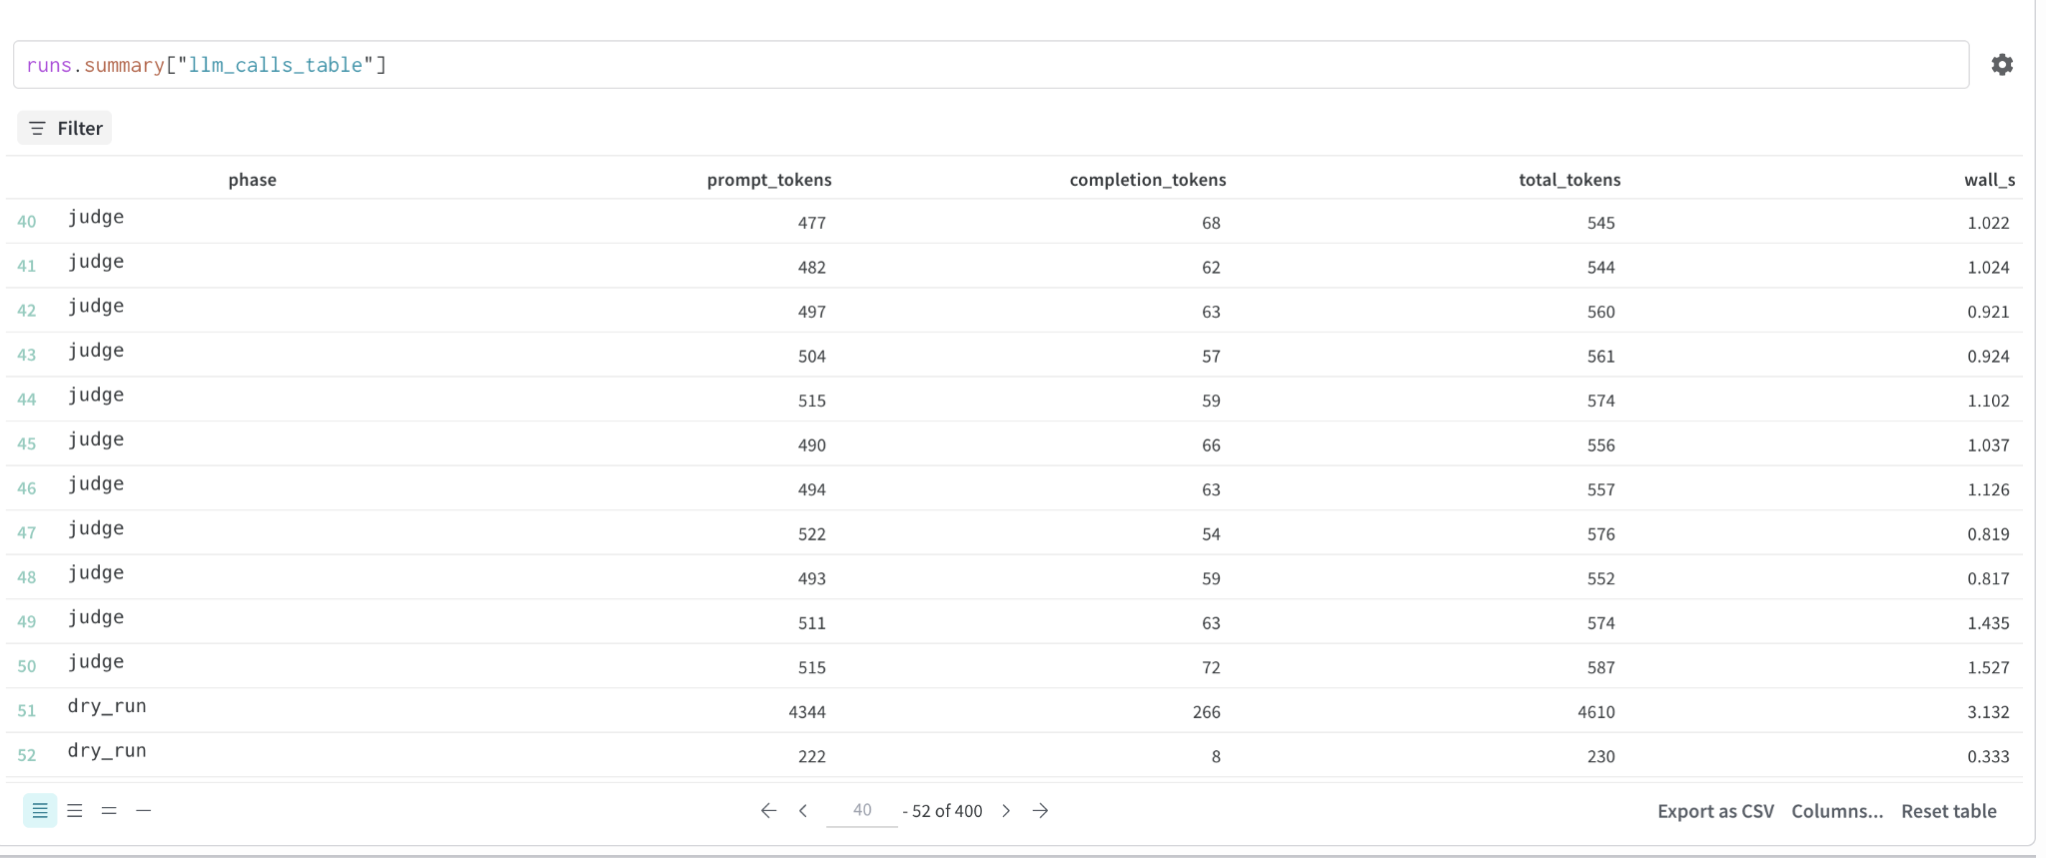
Backup — Wandb Screenshots
HPML · Spring 2026
14 / 14

Slide 29
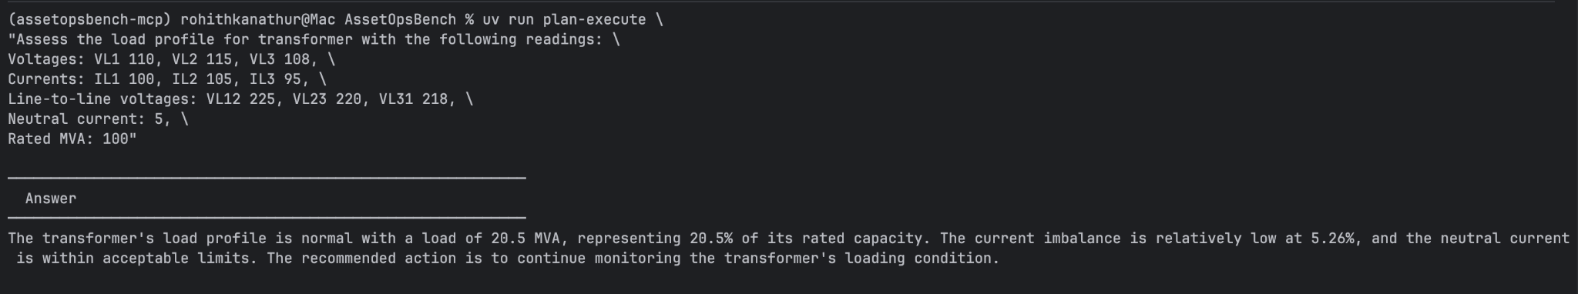
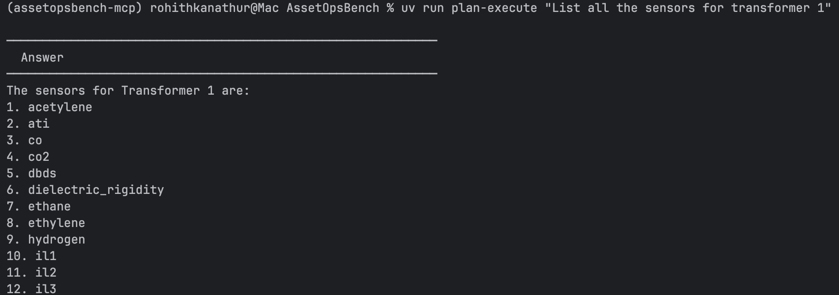
Backup — Transformer Asset Class Integration
HPML · Spring 2026
14 / 14

Slide 30
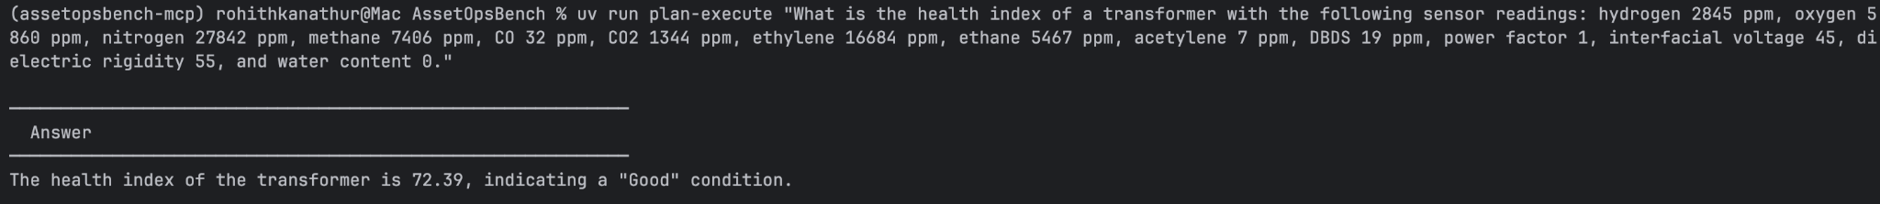
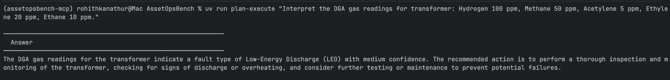
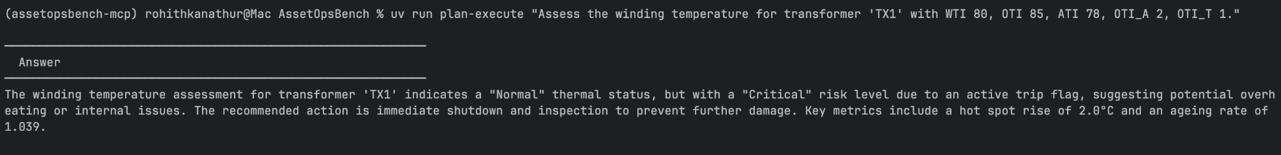
Backup — Transformer Asset Class Integration
HPML · Spring 2026
14 / 14

