Slide 1




Big O No
AI/ML for Networking
AI-Powered Real-Time Threat Detection using Machine Learning
Team Name: Big O No
Team Members:
Problem Statement Number : 01
Rohith Reddy Y
Manish Siva
Vishnupriya T
Detect Smarter. Defend Faster.

Slide 2

Big O No
Problem Statement
Modern networks handle huge amounts of encrypted data, making them vulnerable to sophisticated cyber threats. Traditional rule-based systems and Deep Packet Inspection (DPI) are:
Ineffective in detecting threats in encrypted traffic
Dependent on manual intervention
Slow and prone to errors
Need : An intelligent, scalable solution for real-time threat classification and defense.

Slide 3
Big O No
How does our system work ?
We built an AI-powered system to detect:
- SQL Injection (SQLi)
- Cross-Site Scripting (XSS)
Key Features:
- Two ML models trained separately for SQLi & XSS
- Real-time HTTP request analysis
- Automatic threat detection and logging
- Chatbot support for threat explanation

Slide 4
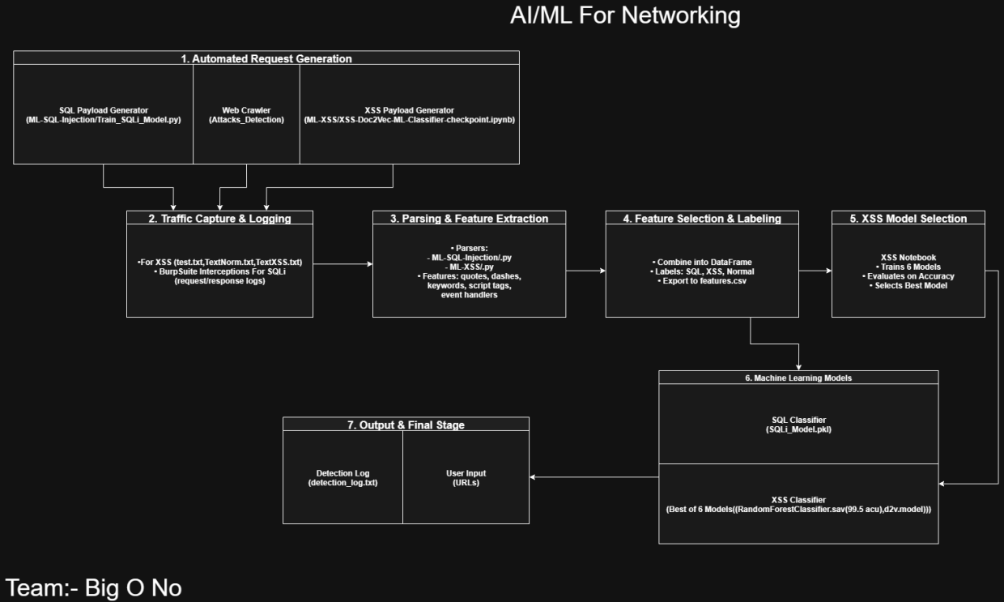
Big O No
Detection pipeline overview

Slide 5
Big O No
Datasets & Preprocessing
Preprocessing Techniques
Datasets from open-source and simulated attacks
SQLi: Logs of normal vs malicious HTTP requests
XSS: Clean text vs known payloads
Text normalization
Tokenization
TF-IDF vectorization
Output: Structured CSVs for model training

Slide 6
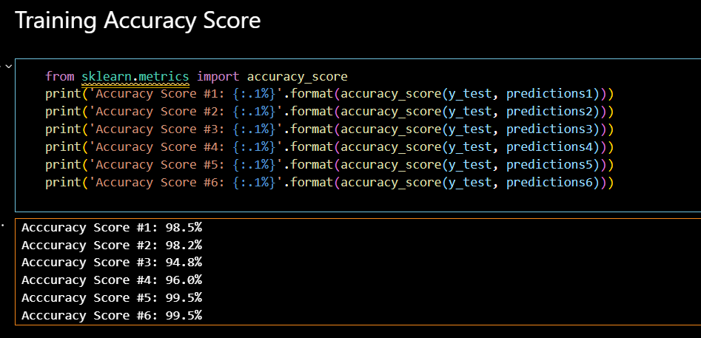
Big O No
Model Accuracy & Results
We trained multiple machine learning models to detect SQLi and XSS attacks with high precision.
For SQLi, Random Forest achieved the highest accuracy at 99.5%, outperforming SVM and Logistic Regression.
For XSS detection, MLPClassifier delivered exceptional performance among Decision Tree, SVC, and GaussianNB models.

Slide 7
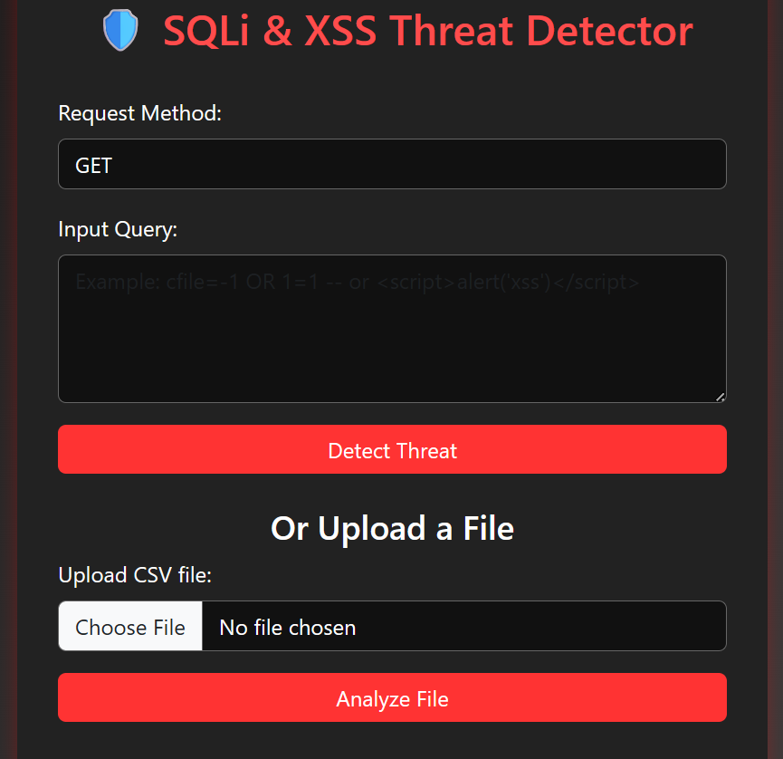
Big O No
Code Workflow
SQLi Workflow:
Logs (good & bad) are processed using Good_and_Bad_requests.py
Model trained via Train_SQLi_Model.py → saved as SQLi_Model.pkl
XSS Workflow:
Classifiers stored in /lib/ folder
Inputs tested using ML-XSS_Model_Testing.py
Logging:
All results (Safe, SQLi, XSS) are recorded in detection_log.txt
This tool empowers users to classify input data as SQLi, XSS, or Safe using our pre-trained machine learning models.

Slide 8
Big O No
Our system is designed to analyze user-submitted HTTP payloads and URLs through a streamlined, AI-driven workflow. Once a request is entered, it is:
Automatically cleaned and preprocessed
Evaluated by trained machine learning models
Classified as Safe, SQL Injection, or XSS attack
User-Guided Detection with Automated Classification
The results are then logged and displayed on a web-based dashboard built using Flask. Users can also interact with an integrated chatbot that provides explanations about the threat type, enhancing user understanding without needing manual intervention.

Slide 9


Big O No
Refined Conclusion & Resources
The AI-powered threat detection system developed by Team Big O No offers:
The future of cybersecurity is being transformed by advancements in artificial intelligence and machine learning. As network threats grow more complex, intelligent models offer faster, more accurate detection of vulnerabilities such as SQL Injection and XSS. This shift from manual defense to automated, real-time protection enables security systems to scale efficiently and adapt quickly to new threats — paving the way for smarter, self-learning defense mechanisms across digital infrastructure.
Real-time protection against SQL Injection (SQLi) and Cross-Site Scripting (XSS) attacks
Automatic threat recognition without manual oversight
Integrated chatbot that explains each detected threat clearly
Big o No
Project Resources
Link
Demo
Architecture

Slide 10
Big O No
Thank You
-

