Slide 1
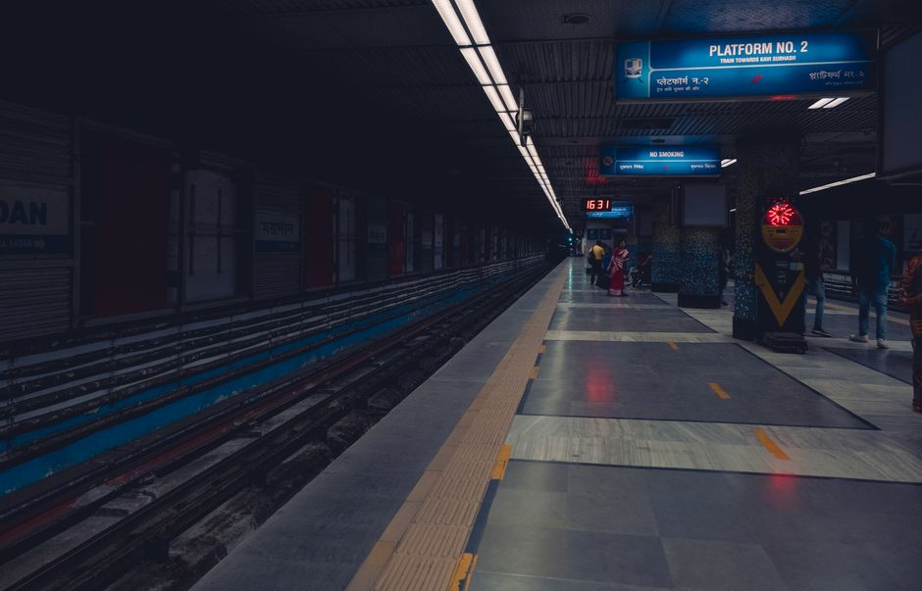
Hyderabad Metro
Journey Planner & Route Optimizer
Graph Algorithms | Multi-Objective Routing | Door-to-Door Planning
Red Line
Blue Line
Green Line

Slide 2
Team Members
Project Contributors
V
R
A
RS
Vanisha
Rachna
Akriti
Rohith Sai Gowd
25BAI70118
25BAI70288
25BAI
25BAI70780
Hyderabad Metro Journey Planner
2

Slide 3
Problem Statement
Hyderabad Metro Rail operates 3 lines with 59 stations across the city. Commuters struggle to find the optimal route — fastest, cheapest, or with fewest transfers — especially when interchange stations connect multiple lines.
!
?
~
Multiple Lines
Competing Goals
First/Last Mile
Red, Blue, and Green lines with complex interchange points
Speed vs cost vs comfort — no single "best" route
Walking to and from stations adds hidden time and cost
Hyderabad Metro Journey Planner
3

Slide 4
Project Objectives
01
02
03
Graph-Based Network Model
Multi-Objective Route Search
Real Graph Algorithms
Represent all 59 stations and 3 metro lines as a weighted directed graph with typed edges (adjacent, interchange, walking).
Implement 6 routing objectives: fastest, cheapest, fewest interchanges, least walking, shortest distance, and balanced.
Use Dijkstra's shortest path, Yen's k-shortest paths, and transfer-aware BFS — no hardcoded routes.
04
05
06
Door-to-Door Itinerary
Fare Estimation
Interactive Visualization
Generate complete travel timelines with access walking, timetable-based waiting, and exit walking.
Estimate metro fares using HMRL's published distance-based slab structure (Rs. 10–60).
Provide a DSA Lab screen that visualizes algorithm execution step-by-step for educational value.
Hyderabad Metro Journey Planner
4

Slide 5
Hyderabad Metro Network
Red Line
Blue Line
Green Line
Miyapur to LB Nagar
Raidurg to Nagole
JBS Parade Ground to MGBS
27
23
9
Stations
Stations
Stations
29.21 km
27.00 km
11.00 km
Length
Length
Length
Total: 3 Lines | 59 Stations | 67.21 km | Key Interchanges: Ameerpet (Red-Blue), Parade Ground (Blue-Green), MGBS (Red-Green)
Hyderabad Metro Journey Planner
5

Slide 6
Graph Data Model
How the metro network is represented as a weighted graph
Vertices (Nodes)
Edges (Connections)
Each station on a line = 1 vertex
Adjacent
A station serving N lines = N vertices
Vertex ID format: stationId:lineId
Interchange
Example: ameerpet:red, ameerpet:blue
Allows precise line-change tracking
Walking
Interchange stations are explicitly modeled
Edge Weights:
distanceKm | timeMin | type | line
Hyderabad Metro Journey Planner
6

Slide 7
Dijkstra's Shortest Path Algorithm
Core Algorithm
Data Structures Used
1
Initialize all distances to infinity
> Adjacency-list graph representation
> Min-priority queue (binary heap)
2
Set source distance to 0
> Distance array (Map<vertexId, number>)
3
Insert source into min-priority queue
> Predecessor array (Map<vertexId, string>)
> Settled set (Set<vertexId>)
4
Extract minimum vertex, mark as settled
5
Relax all unsettled neighbors
Complexity Analysis
6
Update distance if shorter path found
Time:
O((V + E) log V)
7
Repeat until all vertices settled
Space:
O(V + E)
8
Reconstruct path from destination to source
Weight modes:
time, distance
Hyderabad Metro Journey Planner
7

Slide 8
Yen's K-Shortest Paths Algorithm
Finding multiple alternative routes for user choice
How It Works
Why Multiple Paths?
> Find shortest path using Dijkstra
User Choice
> For each node on the best path:
Spur from that node (deviate)
Balanced Objective
Remove used edges and root vertices
Run Dijkstra on modified graph
Trade-off Visibility
Collect candidate paths
> Pick lowest-cost candidate as next path
Robustness
> Repeat until K paths found
Reference: Yen, J.Y. (1971). Management Science.
Hyderabad Metro Journey Planner
8

Slide 9
Six Route Optimization Objectives
G
Fastest
W
Cheapest
S
Fewest Changes
Minimize total travel time
Minimize estimated fare
Minimize line transfers
Dijkstra (time weight)
Dijkstra (fare slab)
Lexicographic BFS
F
Least Walking
R
Shortest
=
Balanced
Minimize walking distance
Minimize track distance
Weighted multi-criteria
Dijkstra (walk weight)
Dijkstra (distance)
K-shortest + scoring
Weights: Time 35% | Cost 25% | Transfers 25% | Walking 15%
Hyderabad Metro Journey Planner
9

Slide 10
Fare Estimation Model
Based on HMRL published distance-based slab structure
Fare Slab Structure
Key Properties
Distance Range
Fare
Distance-based, not line-based
0 – 2 km
Rs. 10
Same fare regardless of route taken
2 – 4 km
Rs. 15
4 – 6 km
Rs. 20
Fare depends only on total km traveled
6 – 8 km
Rs. 25
8 – 10 km
Rs. 30
Slab boundaries from HMRL published data
10 – 14 km
Rs. 35
14 – 18 km
Rs. 40
Minimum: Rs. 10 (up to 2 km)
18 – 22 km
Rs. 45
Maximum: Rs. 60 (30+ km)
22 – 26 km
Rs. 50
26 – 30 km
Rs. 55
Cheapest objective meaningful with first/last mile costs
30+ km
Rs. 60
Hyderabad Metro Journey Planner
10

Slide 11
Door-to-Door Itinerary Planning
W
C
B
R
T
W
Access Walk
Wait
Board
Ride
Interchange
Exit Walk
Walk from start address to boarding station
Wait for next train based on timetable
Board the first metro line
Travel along the metro line
Transfer between lines at interchange station
Walk from exit station to final destination
Outputs: Leave Time | Board Time | Arrival Time | Total Duration | Walking Distance | Total Cost (Metro + First/Last Mile)
Hyderabad Metro Journey Planner
11

Slide 12
Timetable & Walking Estimation
Simulated Timetable
Walking Estimation
Operating Hours: 06:30 – 22:00
Average walking speed
5 km/h
Red Line
Headway: 3–5 min
Walking distance
speed x time
Blue Line
Headway: 4–6 min
Interchange penalty
5 minutes
Green Line
Headway: 5–8 min
Access walk
User input or estimated
Note: HMRL GTFS data requires request form access. Timetable is simulated with realistic headways for demonstration.
Exit walk
User input or estimated
No GPS or map API used. All walking estimates are simulated for demonstration.
Hyderabad Metro Journey Planner
12

Slide 13
Application Features
Plan Journey
Route Results
Network Map
DSA Lab
Select source, destination, departure time, and routing objective with a clean, intuitive interface.
View multiple route options with metrics: time, distance, fare, transfers, and walking distance.
Explore the full Hyderabad Metro network map with all 3 lines and 59 stations.
Step-by-step visualization of Dijkstra, priority queue, and k-shortest paths algorithm execution.
Graph Inspector
Route Comparison
Door-to-Door
Itinerary Timeline
Inspect vertices, edges, and adjacency lists of the metro graph data model.
Side-by-side comparison report of all candidate routes across every metric.
Optional first/last mile walking and cost inputs for complete journey planning.
Detailed timeline with timestamps for each step: walk, wait, board, ride, transfer.
Hyderabad Metro Journey Planner
13

Slide 14
Technology Stack
Frontend Framework
Language
Build Tool
React 18
TypeScript 5
Vite 7
Component-based UI with hooks for state management
Type-safe code with interfaces for all graph and routing types
Fast development server and optimized production builds
Styling
Icons
Backend
Tailwind CSS 3
Lucide React
Supabase
Utility-first CSS framework for responsive, consistent design
Clean, modern SVG icon set for UI elements
PostgreSQL database with Row Level Security for data persistence
Hyderabad Metro Journey Planner
14

Slide 15
System Architecture & Data Flow
User Input
Graph Builder
Route Engine
Fare & Timetable
Itinerary
UI Display
Source, destination,
time, objective
Build adjacency list
from station data
Dijkstra / Yen's /
Transfer BFS
Fare slabs +
simulated schedule
Door-to-door
timeline + metrics
Route cards, maps,
comparison report
1
2
3
4
5
6
Key Design Principles
Type-safe graph model separated from UI | Deterministic algorithms with execution traces | No hardcoded routes — everything computed from edge weights | Data provenance clearly labeled (verified vs simulated)
Hyderabad Metro Journey Planner
15

Slide 16
Thank You
Hyderabad Metro Journey Planner
Questions & Discussion
Red Line
Blue Line
Green Line
Vanisha | Rachna | Akriti | Rohith Sai Gowd

