Slide 1
IT Ticket Analysis
Prepared by: Rohith

Slide 2
Problem Statement
The IT support team manages 97,000+ tickets over 5 years, creating high workload pressure.
Average resolution time is 4.5 days, but delays are frequent during seasonal peaks (Aug–Dec).
Employee satisfaction remains flat at 4.1/5, showing no improvement despite system upgrades.
Inefficiencies observed in priority vs severity mapping, causing urgent tickets to be delayed.
Management needs clear insights to decide on hiring, firing, training, and software investments.

Slide 3
Data Overview
Scope: Dataset covers IT tickets from 2016–2020, across multiple categories (Hardware, Software, Login, System).
Attributes: Ticket ID, Agent, Age, Category, Priority, Severity, Resolution Time, Satisfaction.
Data Cleaning:
1.Fixed spelling inconsistencies in Severity column.
2.Standardized Agent names (removed dots, duplicates).
3.Checked for missing/blank values — none found.
Data Volume:
1.~97,500 total tickets.
2.50+ agents.
3.Covers 5 years of operational data.
Dataset is clean and ready for analysis, enabling reliable insights on performance, efficiency, and satisfaction.

Slide 4
Monthly Trends – Avg Resolution Time
• Resolution stable (~4.5 days) across months.
• Spikes in June and Q4 reflect seasonal stress.
• Delays affect employee satisfaction during peak workload.

Slide 5
Monthly Trends – Avg Satisfaction
• Satisfaction flat (avg ~4.1).
• Dips during high workload months.
• Employees perceive slower service in peak periods.

Slide 6
Monthly Ticket Count
• Ticket volumes steadily increase over the year.
• Peaks Aug–Dec (8,500+ tickets monthly).
• Seasonal workload drives delays and lower satisfaction.

Slide 7
Tickets by Category
• System = 40% of tickets, Login = 30%, Software = 20%, Hardware = 10%.
• System and Hardware are the most complex issues.
• Login tickets resolve quickly despite high volume.

Slide 8
Avg Resolution Time by Category
• Hardware tickets take longest (~7.6 days).
• System tickets also high (~6.6 days).
• Login tickets are resolved in <1 day.

Slide 9
Distribution of Tickets by Resolution Time
• Most tickets resolved within 1–2 days.
• A long tail of delayed tickets extends to 20+ days.
• Delays impact overall employee satisfaction.

Slide 10
Count Of Ticket IDs By Time
Ticket volume grew steadily from 13K (2016) to 29K (2020).
2020 shows the largest surge in tickets.
Rising workload calls for scalable resources and tools.

Slide 11
Tickets by Satisfaction Rate
• Majority (52%) rated service 4/5.
• 28% rated 3/5, highlighting dissatisfaction.
• Improvement needed in communication and speed.

Slide 12
Age Group by Satisfaction
• Best: Ages 28–32 (avg 4.21).
• Lowest: Ages 33–37 (avg 3.96).
• Mid-career agents may require targeted training.

Slide 13
Tickets by Severity
• 91% of tickets classified as Major.
• Only 3% marked Urgent despite business impact.
• Priority–Severity mismatches reveal tool inefficiency.

Slide 14
Summary of Insights
Resolution times have remained stable (~4.5 days) but not improving year-over-year, showing the current system has plateaued.
Employee satisfaction has stagnated at ~4.1, with dips during peak workloads, meaning employees notice performance slowdowns.
System and Hardware tickets are the main bottlenecks, averaging the longest resolution times.
Ticket volumes spike between Aug–Dec, overwhelming the team and stretching resolution times.
Significant variation among agents: six underperformers have low CSAT and slower resolution, pulling down team averages.

Slide 15
Recommendations
Agent Training & Performance
Provide targeted coaching for underperformers.
Pair low performers with top performers for mentorship.
Software & Process
Configure ticketing tool to align Severity ↔ Priority automatically.
Use AI-based triaging to route urgent tickets faster.
Resource Optimization
Deploy seasonal/contract staff during Aug–Dec peaks.
Automate repetitive tasks (login resets, system checks) to free agents for complex tickets.

Slide 16
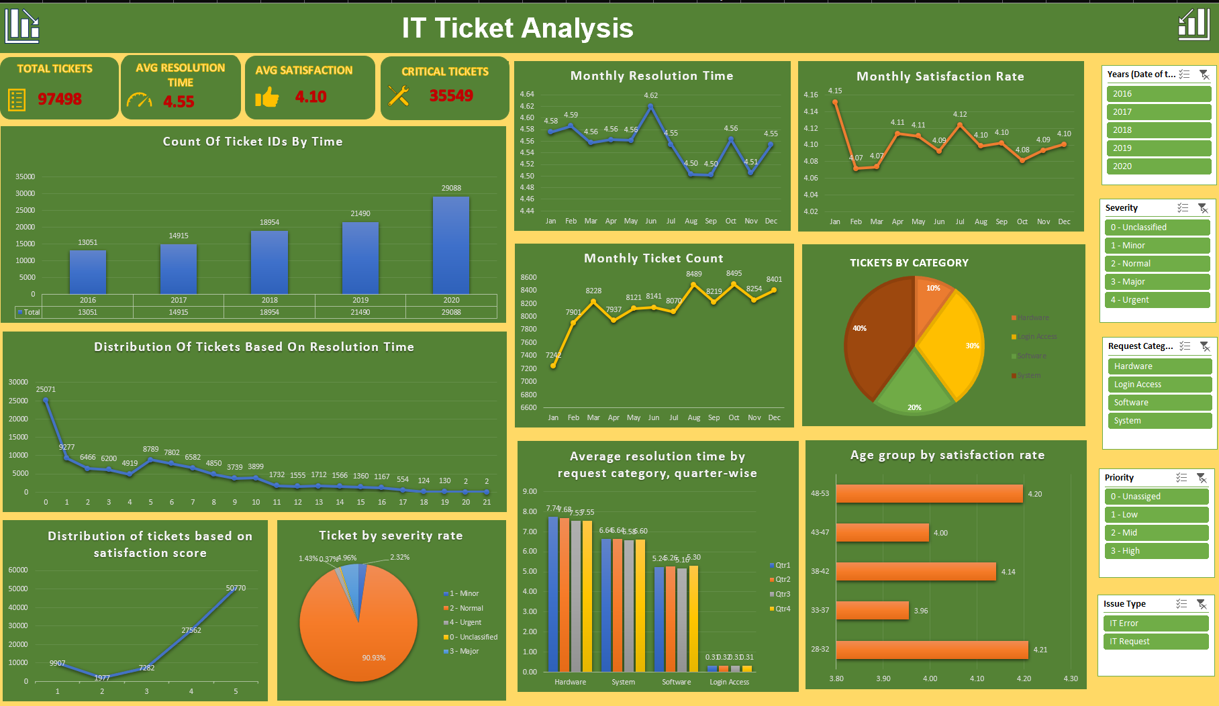
Dashboard Overview

Slide 17
Conclusion
The IT support team shows consistent but stagnant performance with resolution times (~4.5 days) and satisfaction (~4.1).
System and Hardware tickets remain the key bottlenecks, while Login issues are resolved quickly.
Seasonal peaks (Aug–Dec) increase workload, slowing performance and lowering satisfaction.
Significant variation among agents highlights the need for training, performance management, and workload balancing.
With targeted improvements in training, software, and staffing, service quality and employee satisfaction can improve sustainably.

