Slide 1
REInstruct: Building Instruction Data from Unlabeled Corpus
Rohith Kumar
Rithwik Vamshi
Notes:
Good morning everyone,
My name is Rohith, and I’m here with my team Rithwik. This paper tackles a critical challenge in NLP by automating the creation of instruction-tuning datasets directly from unlabeled data, reducing dependency on human annotation or pre-trained instruction-tuned models.

Slide 2
Introduction
Instruction-Tuned Models
Models fine-tuned on input-output task pairs, e.g., ChatGPT.
Instruction datasets
Enable precise task understanding for models like GPT and ChatGPT
Challenge
Expensive, human-annotated datasets.
Dependency on pre-existing instruction-tuned models
Notes:
Instruction-tuned models like ChatGPT and GPT-4 have revolutionized natural language processing by enabling models to generalize across diverse tasks. These models rely heavily on instruction-response datasets to learn how to follow user instructions. However, creating such datasets is challenging—manual annotation is time-consuming and costly, while relying on proprietary models is limiting due to accessibility and scalability issues. These challenges have created a need for scalable, cost-effective alternatives, which this paper addresses.

Slide 3
Problem Statement
Issue Addressed
Scarcity of instruction datasets for open-source use.
High costs and low scalability of manual annotation.
Dependency on proprietary models limits accessibility.
Underutilization of vast unlabeled corpora.
Goal
Democratize dataset creation by making it scalable, cost-effective, and accessible.
Notes:
Instruction datasets are the backbone of instruction-tuned models, but existing methods have significant bottlenecks. Manual annotation is expensive and not scalable for the large datasets required. Additionally, proprietary instruction-tuned models, though useful for generating synthetic datasets, are inaccessible to many due to cost and licensing restrictions. Meanwhile, vast amounts of unlabeled text data remain untapped. The goal is to develop a system that leverages this untapped resource to create instruction datasets efficiently and cost-effectively.

Slide 4
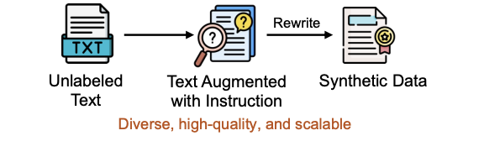
REInstruct
REInstruct:
Automated pipeline for generating instruction-response datasets.
Leverages unlabeled corpora to bypass manual annotation.
Produces diverse, scalable, and high-quality datasets..
Notes:
REInstruct introduces a groundbreaking approach to instruction dataset generation. It is an automated pipeline that transforms raw, unlabeled corpora into instruction-response pairs without relying on manual annotation or external proprietary models. This makes the process scalable, affordable, and accessible for researchers and organizations of all sizes. With REInstruct, we can unlock the full potential of unlabeled data, making high-quality datasets available for training instruction-tuned models.
Why REInstruct?
Fully automated and cost-efficient.
Independent of proprietary instruction-tuned models.
Democratizes access to advanced NLP capabilities.

Slide 5
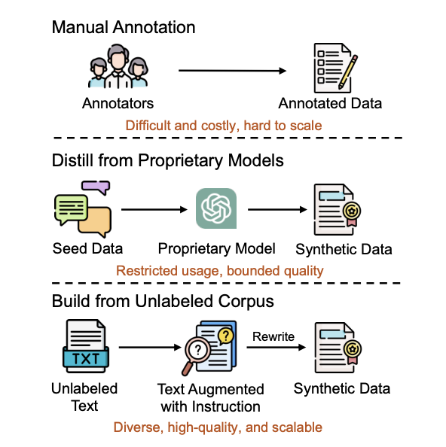
Existing Methods vs REInstruct
Manual Annotation
Relies on human experts.
Accurate but time-consuming, expensive, and hard to scale.
Distillation from Proprietary Models
Generates synthetic data using pre-trained models.
Limited by restricted access and variable quality.
Building from Unlabeled Corpus (REInstruct)
Automates task generation from raw text.
Cost-effective, scalable, and diverse data creation.
Comparison of our automatic instruction data annotation method and previous methods.
Notes:
This slide highlights the differences between existing methods and REInstruct. Manual annotation, while accurate, is prohibitively expensive and not scalable. Synthetic data distillation from proprietary models faces challenges of restricted access and variable data quality. In contrast, REInstruct leverages unlabeled corpora and an automated pipeline to produce diverse, high-quality datasets that are scalable and cost-effective. It represents a significant step forward in democratizing NLP advancements.

Slide 6
Framework
Step 1: Extract unlabeled corpora as input.
Step 2: Identify task-relevant text segments.
Step 3: Rewrite text into instruction-response pairs.
Step 4: Evaluate for quality and consistency.

Slide 7
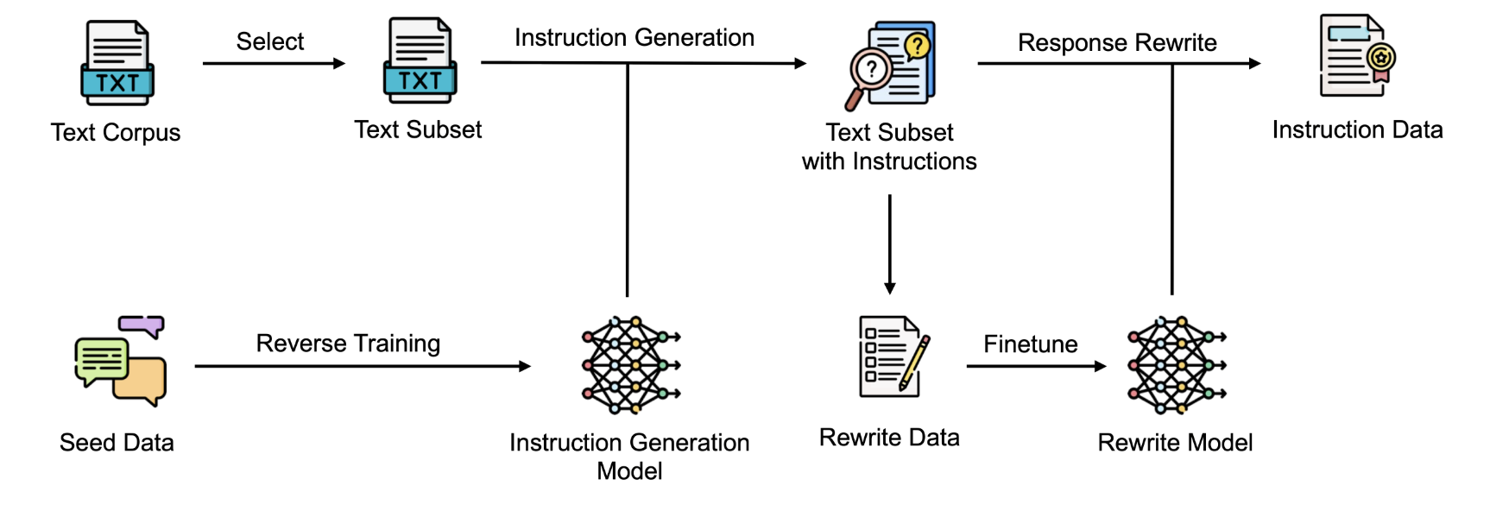
Framework
Notes:
The image illustrates the REInstruct framework for creating instruction-following datasets. It starts by extracting unlabeled corpora (like C4), then identifies task-relevant text segments. These segments are transformed into instruction-response pairs for training. Finally, the system evaluates these pairs for quality and consistency. This end-to-end automation minimizes human input and allows large-scale, cost-effective generation of high-quality datasets. The framework ensures scalability and flexibility, enabling instruction-tuning for a wide range of tasks with minimal reliance on proprietary data.

Slide 8
Dataset
Datasets Used:
C4 Corpus
400M text segments from the Common Crawl project
Widely used for pre-training LLMs
Seed Instruction Data
3k high-quality instruction data from the first round of OpenAssistant conversations (Köpf et al., 2023)
Rewriting Data
4k data from GPT-3.5-turbo for training the rewriting model
Baselines for Comparison:
OASST3K (Köpf et al., 2023)
Llama model tuned with 3k seed instruction data
Guanaco (Dettmers et al., 2023)
Llama model tuned with 9k instruction data from OpenAssistant
Dromedaryours (Sun et al., 2023)
Llama model trained with 40k random instructions from Dromedary dataset
Humpbackours (Li et al., 2023a)
Re-implementation using C4 and Llama7b
Notes:
For the dataset used in REInstruct, the authors relied on C4—a popular corpus derived from Common Crawl, containing over 400 million text segments. This corpus is commonly used for pre-training large language models (LLMs). For the seed instruction data, they used 3k high-quality instruction data collected from the OpenAssistant dataset. Additionally, 4k rewriting data were collected using GPT-3.5-turbo to train the model. The paper also compares the proposed REInstruct framework against several baselines, including OASST3K (which uses the Llama model tuned with 3k seed instructions), Guanaco, Dromedaryours, and a re-implementation of Humpbackours using C4 and the Llama7b model.

Slide 9
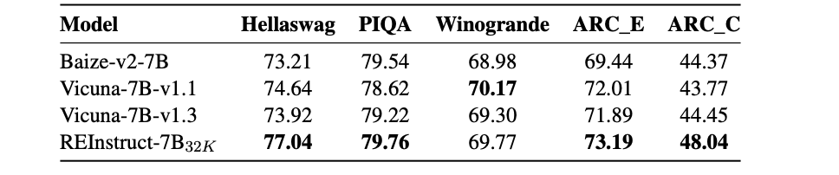
Results
Notes:
The table above compares the performance of REInstruct-7B32K against other instruction-tuned models such as Baize-v2-7B, Vicuna-7B-v1.1, and Vicuna-7B-v1.3 on various benchmarks like Hellaswag, PIQA, Winogrande, and ARC (both easy and challenge versions).
REInstruct-7B32K consistently outperforms the other models across all evaluation metrics. For example, it achieves a score of 77.04 on Hellaswag, which is higher than Baize-v2-7B’s score of 73.21, and 79.76 on PIQA, surpassing Vicuna-7B-v1.1’s score of 78.62.
The Winogrande and ARC results show similar trends, with REInstruct scoring 69.77 and 73.19 on these tasks, respectively, demonstrating its strong performance in a wide range of reasoning tasks. This indicates that REInstruct-7B32K not only improves over previous models but also maintains robustness across multiple tasks, showing its generalization capabilities.
Strength of REInstruct: The results underline REInstruct's ability to leverage synthetic instruction data for superior model performance, particularly in tasks requiring complex reasoning. These improvements highlight the potential of REInstruct for democratizing instruction-tuning and providing an efficient, scalable alternative to models relying on more resource-intensive fine-tuning techniques.
This comparison highlights the effectiveness of REInstruct in enhancing model performance while reducing reliance on proprietary data, making it a strong candidate for wide adoption in the field of instruction-tuned language models.

Slide 10
Strengths of REInstruct
Automation
Fully automated data generation process.
No need for human annotators or proprietary models.
Scalability:
Easily scalable to any domain with large unlabeled corpora.
Generate data quickly and at a low cost.
Independence from Proprietary Models
Eno reliance on expensive, closed-source models.
Accessible to the broader research community.
Notes:
One of REInstruct's greatest strengths is its automation—there is no need for human annotators or proprietary models, which significantly reduces both the time and cost of dataset creation. It can be scaled easily across various domains by using large volumes of unlabeled corpora. This makes it highly adaptable and efficient. Additionally, it eliminates the need for costly proprietary models, making REInstruct a valuable resource for the broader research community and enabling a democratization of instruction-tuned models.

Slide 11
Limitations & Future work
Current Limitations:
REInstruct is limited by the quality of the raw corpora used for instruction generation.
Some domains may require additional fine-tuning for higher specificity.
Quality control in diverse, niche areas may still need further improvement.
Future Directions:
Expand the diversity of corpora to enhance domain coverage.
Integrate domain-specific expertise to improve data quality in specialized areas.
Explore advanced evaluation metrics for dataset quality.
Notes:
While REInstruct is a breakthrough in scalable dataset generation, it does have some limitations. For instance, the quality of the generated datasets depends heavily on the underlying raw corpora. Some specialized domains may need further fine-tuning to achieve optimal performance. In terms of future work, expanding the diversity of corpora and incorporating domain-specific expertise will help improve data quality for specialized fields like healthcare or law. Furthermore, developing more advanced evaluation metrics will ensure the highest quality datasets for training instruction-tuned models.

Slide 12
THANK YOU!!

