Slide 1
Quantum Bit
Chapter 2 of Introduction to Quantum Computing
M Rohith

Slide 2
What is qubit
A qubit or quantum bit is similar to classical bit in some ways and different in some ways.
A qubit take two values 0 and 1, like a classical bit. But the notations of these qubits are different in quantum physics.
Their notations are : |0 >, |1 >
The laws of quantum mechanics allow a qubit to be a combination of |0> and |1>, called a superposition of |0> and |1>
For example : 1/√ 2 ( |0> + |1> )

Slide 3
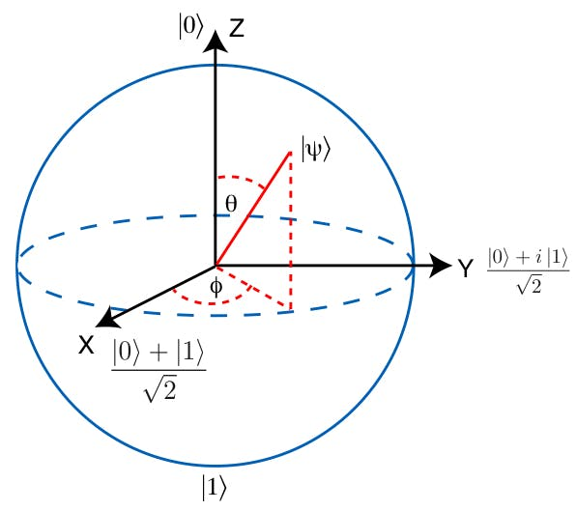
Superposition
One example of superposition of 0 and 1 is :
1/√ 2 ( |0> + |1> )
Since this state is half |0> and half |1>, it should be on the equator of the Bloch sphere, which is halfway between the north and south poles.
This state is at the (x, y,z) point (1,0,0), where the Bloch sphere intersects the X-axis.
One more example: 1 √ 2 (|0> + i|1>)
Similarly this is the state at (x,y,z)point (0,0,1) where the bloch sphere intersects the Y-axis.

Slide 4
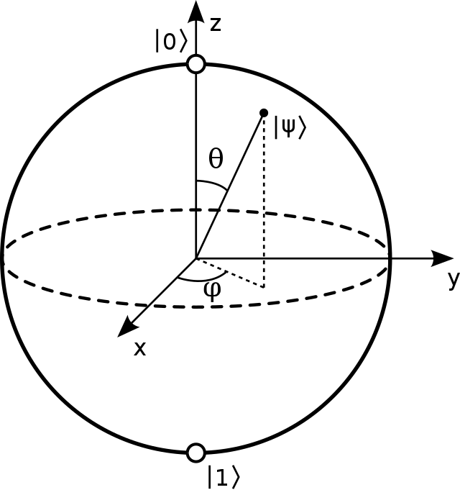
In this bloch sphere |0> is called as north pole and |1> is called south pole .Which are end points of Z -axis lying on bloch sphere.
Similarly |+> and |-> are endpoints of X-axis lying on bloch sphere and |i>and |-i> are endpoints of Y-axis lying on bloch sphere.
|+> = 1 √ 2 (|0> + |1>)
|−> = 1 √ 2 (|0> − |1>)
|i> = 1 √ 2 (|0> + i|1>)
|−i> = 1 √ 2 (|0> − i|1>)
Bloch sphere

Slide 5
Measurement
Although the laws of quantum mechanics permit this superposition of |0i and |1i, it also demands that if we measure the qubit, such as at the end of a computation in order to read the result, we get a single, definite value.
let's take a qubit 1 /√ 2 ( |0> + e ^{iπ/6} |1> )
If you measure this qubit you would either get the result as |0> or |1> but not superposition of both . The result depends on the probability of occurrence of |0> or |1>.
The probability can be calculated as the norm-square of the amplitude .

Slide 6
Therefore the probability of getting |0> is
|1 /√ 2|² = 1 /2
And e probability of getting |0> is
|e ^(iπ/6) / √ 2 |² = 1/ 2 [After final evaluation]
This measurement is said to be done in Z-basis [As values are calculated with coefficients of 0 and 1]
Suppose if you take a qubit superposition of 0 and 1 and when you measure it lets say it has resulted in 0 . Then the previous state of qubit is collapsed and now if you measure again you will get 0 with probability of 1.
Therefore measurement collapses the qubit.

Slide 7
Measurement in other bases
In Bloch sphere any two opposite points can be taken as north and south poles.
A set of distinct measurement outcomes is called a basis . Therefore measurement can be done with respect to different basis , that is :
{|0>,|1>} which is called Z-basis because they lie on the Z-axis of the Bloch sphere
{|+>,|−>} which is called X-basis because they lie on the X-axis of the Bloch sphere
{|i>,|−i>} which is called Y-basis because they lie on the Y-axis of the Bloch sphere
While measuring the qubit , global phases can be neglected as they are physically irrelevant.

Slide 8
Normalization
A quantum state is normalized if its total probability is 1.
It is one in most cases but sometimes we must find an overall normalization constant to make this true.
For example take this qubit √ 2|0>+i|1> its total probability is |√ 2 |² +|i|² which is 3 .
There needs to be a constant such that A( √ 2|0>+i|1> ) satisfies sum of probabilities condition.
Here A is 1/√ 3

Slide 9
Bloch Sphere
A generic quantum state is typically called ψ and since it is quantum, we write it as a ket |ψ>. Now say we have a generic qubit |ψ. with some amplitudes α and β:
|ψ> = α|0>+β|1> , where |α| 2 +|β| 2 = 1 for normalization.
To determine the location of this qubit on the Bloch sphere, we first parameterize, or write in terms of other parameters, α and β in terms of two angles θ and φ:
α = cos (θ /2) , β = e ^{iφ} sin (θ /2)
With 0 ≤ θ ≤ π and 0 ≤ φ < 2π, this captures all the properties we need: α is real and positive, β is complex, and the state is normalized. The quantum state can be rewritten as:
|ψ>= cos (θ /2) |0>+e ^{iφ} sin (θ /2) |1>

Slide 10
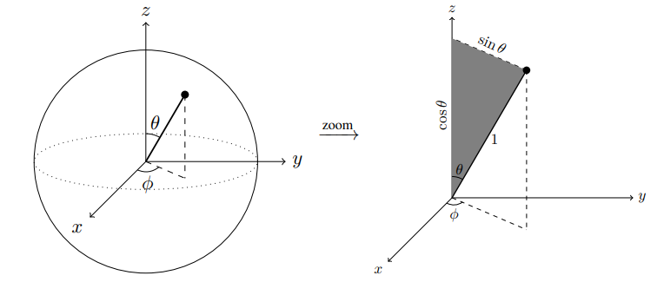
θ measures the angle down from the north pole, called the polar angle, and φ measures the angle across from the x-axis in the xy plane, called the azimuthal angle.

Slide 11
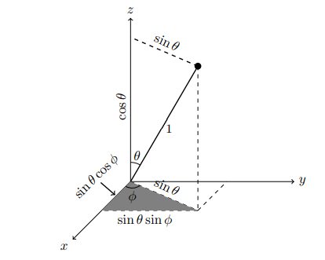
From the mathematical derivations we can conclude that:
x = sinθ cosφ , y = sinθ sinφ , z = cosθ

Slide 12
Physical Qubits
Physically, any quantum system with two distinct states can be used as a qubit.
For example:
• Photons, or quantum particles of light, have a property called polarization. A photon’s polarization can be vertical or horizontal, or a superposition of both, and we can use this as a qubit.
• Trapped ions. An ion is an atom that has an overall charge (instead of being neutral) because it has gained or lost one or more electrons. Individual ions can be trapped in space using electric fields. Two energy levels of an ion can be used as a qubit.

Slide 13
Quantum Gates
A quantum gate transforms the state of a qubit into other states. A quantum gate must be linear, meaning it can distributed across superpositions.
Linear Maps :
Quantum gates are linear maps that keep the total probability equal to 1.
Classical Reversible Gates:
Classical reversible logic gates are valid quantum gates.

Slide 14
3. Common One-Qubit Quantum Gates
The identity gate (I) turns |0> into |0> and |1> into |1>, hence doing nothing: I|0> = |0>, I|1> = |1>.
Pauli X-Gate, or NOT gate, turns |0> into |1>, and |1> into |0>: X|0> = |1>, X|1> = |0>. On the Bloch sphere, it can be shown that X is a rotation of 180◦ about the x-axis.
The Pauli Y-Gate turns |0> into i|1>, and |1> into −i|0>: Y|0> = i|1>, Y|1> = −i|0>. On the Bloch sphere, it can be shown that Y is a rotation of 180◦ about the y-axis

Slide 15
The Pauli Z-Gate keeps |0> as |0> and turns |1> into −|1>: Z|0> = |0> , Z|1> = −|1> . On the Bloch sphere, it can be shown that Z is a rotation of 180◦ about the z-axis.
Phase gate, which is the square root of the Z-gate (i.e., S² = Z). S|0> = |0>, S|1> = i|1>. On the Bloch sphere, it can be shown that S is a rotation of 90◦ about the z-axis
T gate (also called π/8 gate), which is the square root the S gate (i.e., T 2 = S), or fourth root of the Z gate. T|0> = |0>, T|1> = e ^{iπ/4} |1>. On the Bloch sphere, T is a rotation of 45◦ about the z-axis.

Slide 16
The Hadamard gate turns |0> into |+>, and |1> into |−>:
H|0> = 1 /√ 2 (|0>+|1>) = |+>, H|1> = 1 /√ 2 (|0i−|1i) = |−>.
On the Bloch sphere, it can be shown that H is a rotation of 180◦ about the
x+z-axis.
4. General One-Qubit Gates
One-qubit quantum gates are rotations on the Bloch sphere.
we can denote the axis of rotation by ˆn, and n^ = n_{x}x^+n_{y}yˆ+n_{z}z^ . where n^ is a unit
Vector.
U = e ^{iγ} [ cos (θ /2) I −isin (θ/2) (n_{x}X +n_{y}Y +n_{z}Z)] where θ is angle of rotation about some
axis.

