Slide 1
Predicting Air Quality Index
Ritheesha Rajannagari
U00917163
Rohith Boddu
U00927888
Group 11

Slide 2
Introduction
Air quality is a crucial environmental issue with significant impacts on health and ecosystem integrity.
Predictive modeling of AQI is essential for timely warnings and effective intervention strategies.
This study aims to leverage machine learning techniques to enhance the prediction accuracy of AQI based on environmental data.
The focus is on comparing the efficacy of multiple regression models (KNN, Ridge, Lasso) to predict AQI and determine the key influencing factors.

Slide 3
Motivation
Public Health
Understanding and predicting AQI is crucial for protecting public health from the adverse effects of air pollution.
Environmental Impact
Accurate predictions help monitor and control air quality, contributing to environmental conservation efforts.
Policy Formulation
Data-driven insights aid policymakers in creating effective regulations to reduce pollution sources.
Technological Advancement
Applying advanced machine learning techniques to environmental data opens new avenues for innovation in pollution management.
Community Awareness
Increased accuracy in AQI predictions can enhance community awareness and encourage proactive behaviors regarding air quality.

Slide 4
Problem Description
What Are We Trying to Do?
To analyze environmental data to predict the Air Quality Index (AQI) using regression, Ridge, and Lasso models.
Objectives
Not only forecast AQI levels but also identify the key pollutants and environmental factors influencing air quality.
To build robust predictive models that can effectively handle diverse and complex environmental data.
To understand the influence of meteorological conditions and urban activities on AQI.
Type of Problem. Why?
This is a regression problem because we aim to predict a continuous outcome—the AQI—based on multiple input features.
To establish the relationship between various factors (like pollutant concentrations, weather conditions) and the overall air quality index.

Slide 5
Dataset
Overview
Daily air quality measurements from multiple cities, capturing trends over time.
Missing Values
Present, notably in key pollutants like PM2.5 and NH3.
Outliers
Retained to reflect natural variability in extreme pollution events.
Size
29,531 rows and 16 variables.
Key Measurements
Includes pollutants such as PM2.5, PM10, NOx, CO, SO2, and O3.
Target Variable
AQI, with values indicating a range of air quality from clean to hazardous.

Slide 6
Dataset - Clean Up
Initial Assessment:
Identified missing values and outliers in the dataset.
Reviewed the consistency and accuracy of data entries.
Handling Missing Data:
Employed imputation techniques to address missing values, using the median value for numerical columns.
Removed columns with excessive missing data that could not be reliably imputed.
Feature Removal:
Dropped non-relevant features such as 'City', 'Date', and 'Xylene' to focus on variables directly impacting AQI.
Removed the 'AQI_Bucket' as it was redundant with the continuous AQI value.
Data Transformation:
Standardized numerical features to have zero mean and unit variance, ensuring model stability and performance.
Converted date strings to datetime objects to facilitate time-series analysis (if applicable).

Slide 7
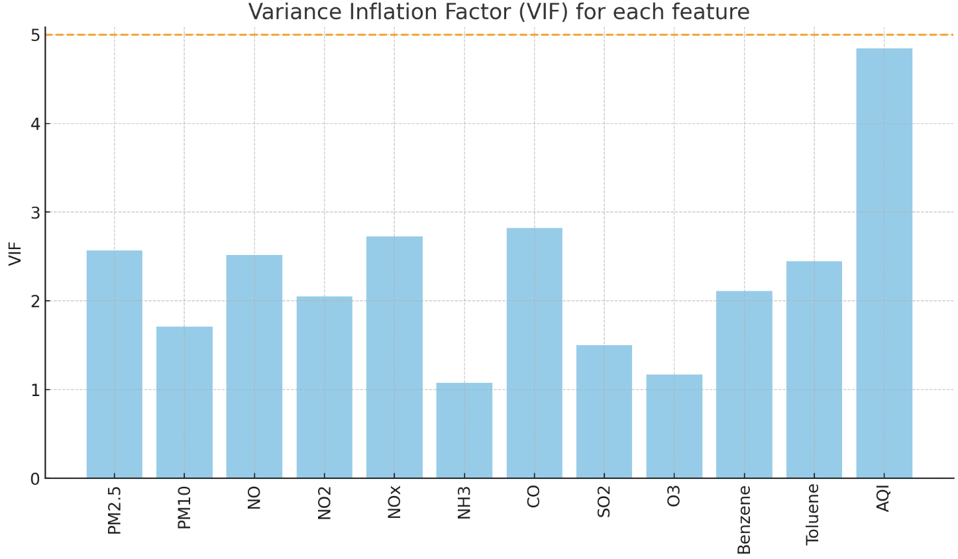
Variables
Predictors
PM2.5
PM10
NO
NO2
NOx
NH3
CO
SO2
O3
Benzene
Toluene
All predictors are quantitative
Toluene and AQI have the highest VIFs, suggesting they might be key predictors, but multicollinearity is a concern.
None of the variables exceeds the common threshold of 5
It suggests that multicollinearity is not a major concern in this dataset.

Slide 8
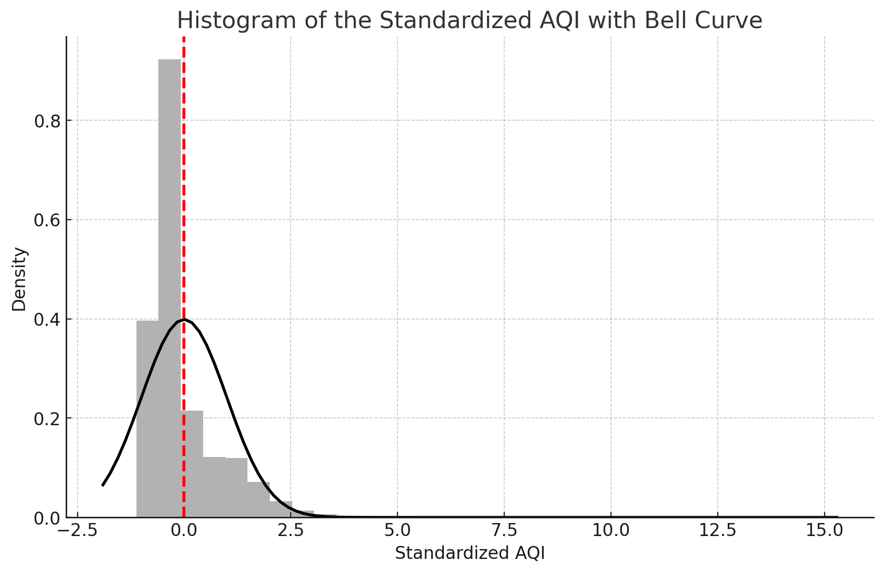
Target Variable
Count | Mean | Standard Deviation | Minimum | 25th Percentile | Median | 75th Percentile | Maximum
24,850 (Non-Null) | 166.46 | 140.70 | 13 | 81 | 118 | 208 | 2,049
The shape of the histogram suggests that the data may not follow a normal distribution.
There is a skew towards the lower end of the standardized AQI scale.
The presence of outliers is evident, with some values extending far beyond the typical range.
The peak of the histogram indicates a concentration of values around the mean, which is expected after standardization, but the long tail suggests a non-normal distribution.

Slide 9
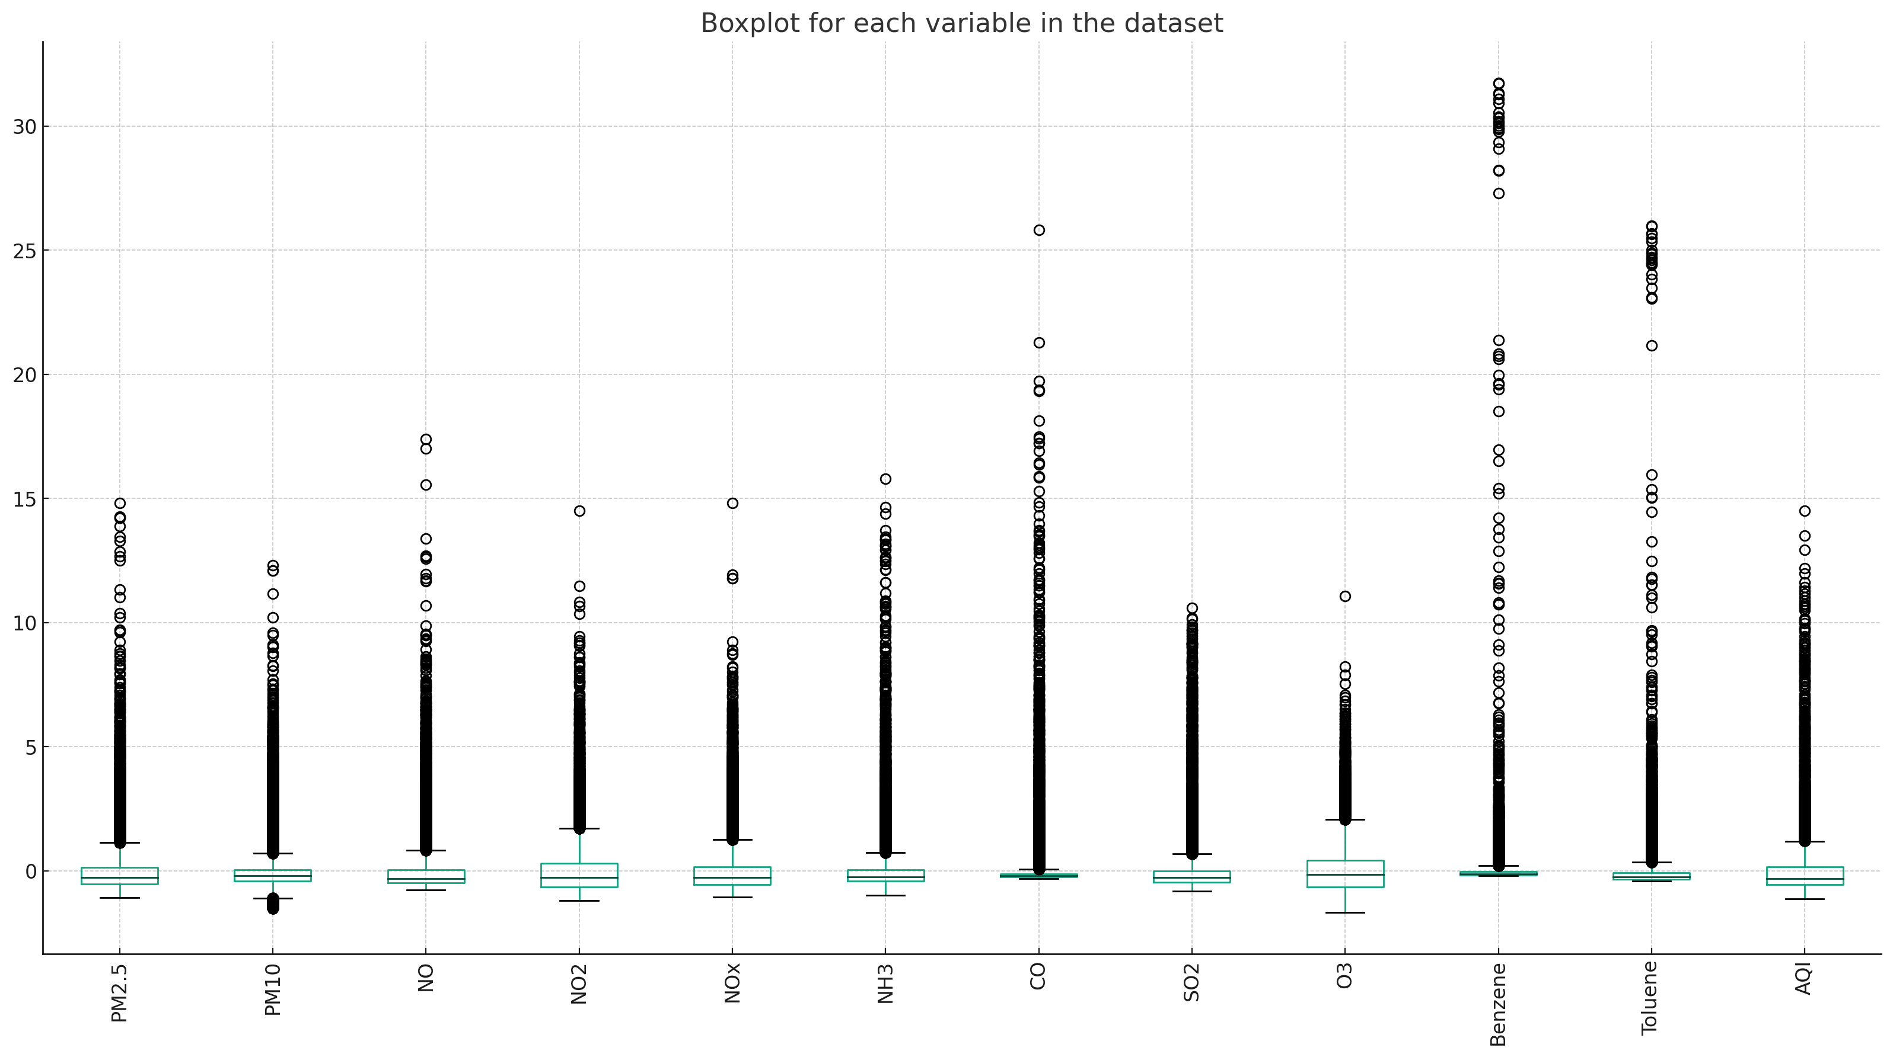
Diagnosis Boxplots
The box plots reveal a significant presence of outliers across almost all variables, indicating that the data contains extreme values.
Many variables have a median near the lower quartile, suggesting a positive skew in these distributions.

Slide 10
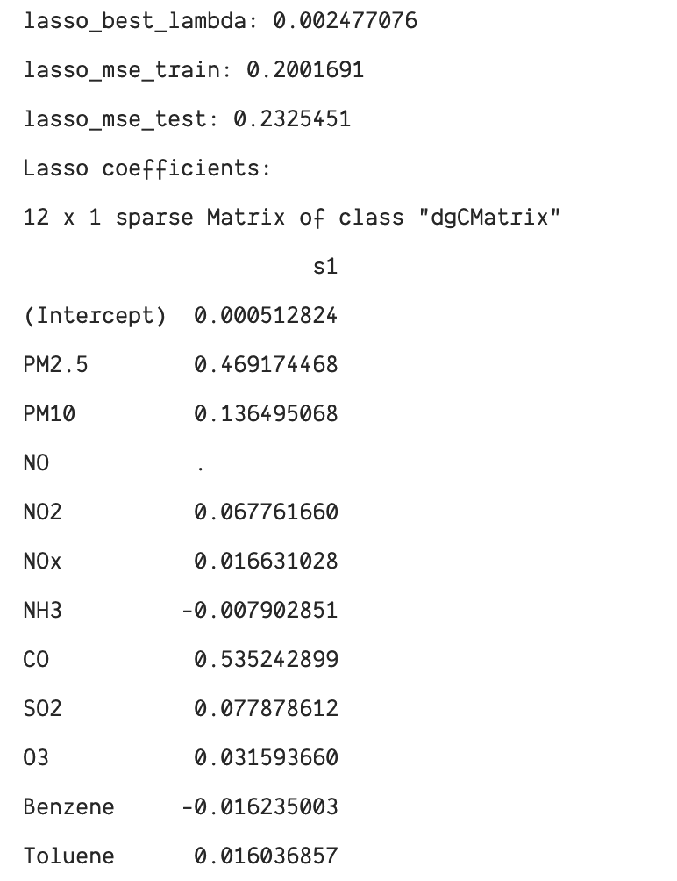
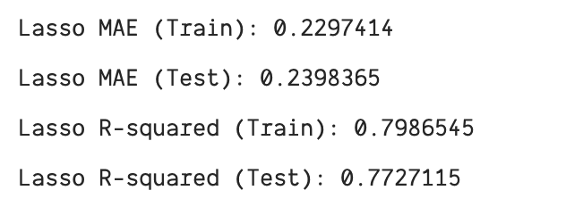
Model – Lasso Regression
The coefficients seem to be penalized the most for NO and Toluene.
MSE (Train): 0.20
MSE (Test): 0.23
R-Squared (Train): 0.79
R-Squared (Test): 0.77
Optimum λ (using 5 CV): 0.002
Training Set: 80% of the dataset
Testing Set: Remaining 20% of the dataset

Slide 11
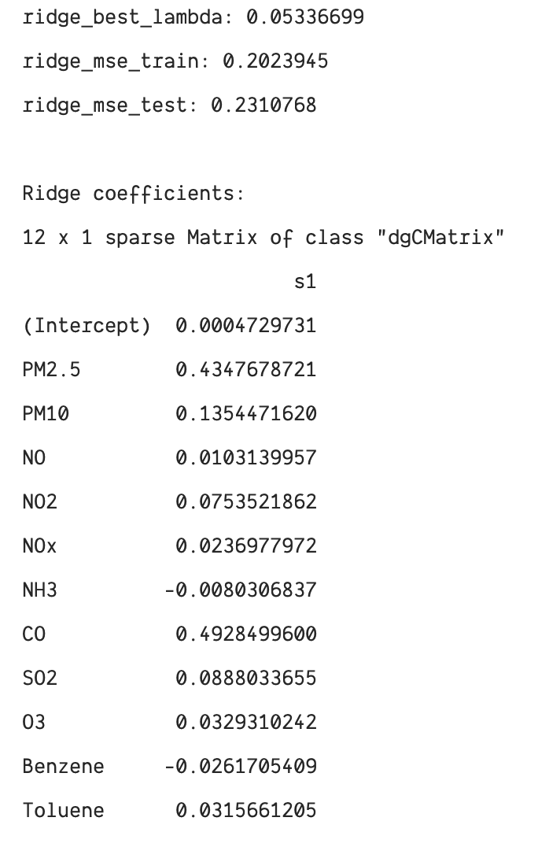
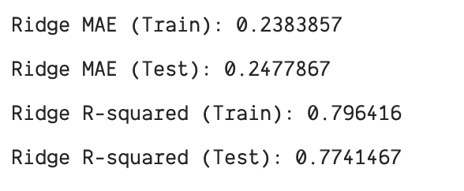
Model – Rigde Regression
The coefficients seem to be penalized the most for NO, NH3, and Benzene.
MSE (Train): 0.20
MSE (Test): 0.23
R-Squared (Train): 0.79
R-Squared (Test): 0.77
Optimum λ (using 5 CV): 0.05
Training Set: 80% of the dataset
Testing Set: Remaining 20% of the dataset

Slide 12
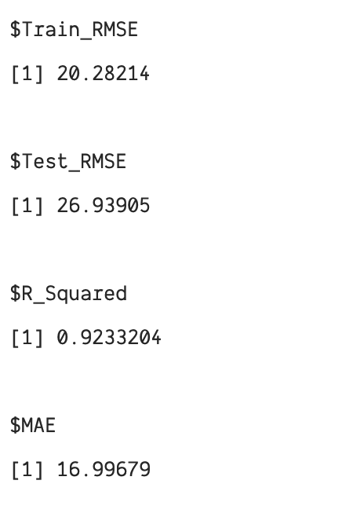
Model – KNN Regression
The coefficients seem to be penalized the most for NO, NH3, and Benzene.
Optimal K (CV = 10): 5
RMSE (Train): 20.28
RMSE (Test): 26.93
R Squared: 0.923
Mean Absolute Error: 16.9
Training Set: 80% of the dataset
Testing Set: Remaining 20% of the dataset

Slide 13
Evaluation & Results
KNN Regression shows the highest R-Squared value (0.923), indicating the strongest fit among the models.
Both Ridge and Lasso Regression have identical R-Squared values for train and test datasets, showing consistency and good generalization but a weaker fit compared to KNN.
Success Metrics:
Mean Squared Error (MSE): Utilized to assess regression model performance, with lower values indicating better model accuracy.
R-Squared: Adopted to measure the proportion of variance in the dependent variable that is predictable from the independent variables.
Mean Absolute Error (MAE): Included to provide an additional layer of accuracy assessment, with lower values indicating more precise predictions.
Interpreting Results:
A high R-Squared value indicates a model that effectively fits and predicts the data.
Lasso Regression's ability to produce sparse coefficients helps identify the most influential predictors, enhancing interpretability.
Ridge Regression uses regularization to adjust coefficients, effectively reducing overfitting and maintaining robustness across various datasets.

Slide 14
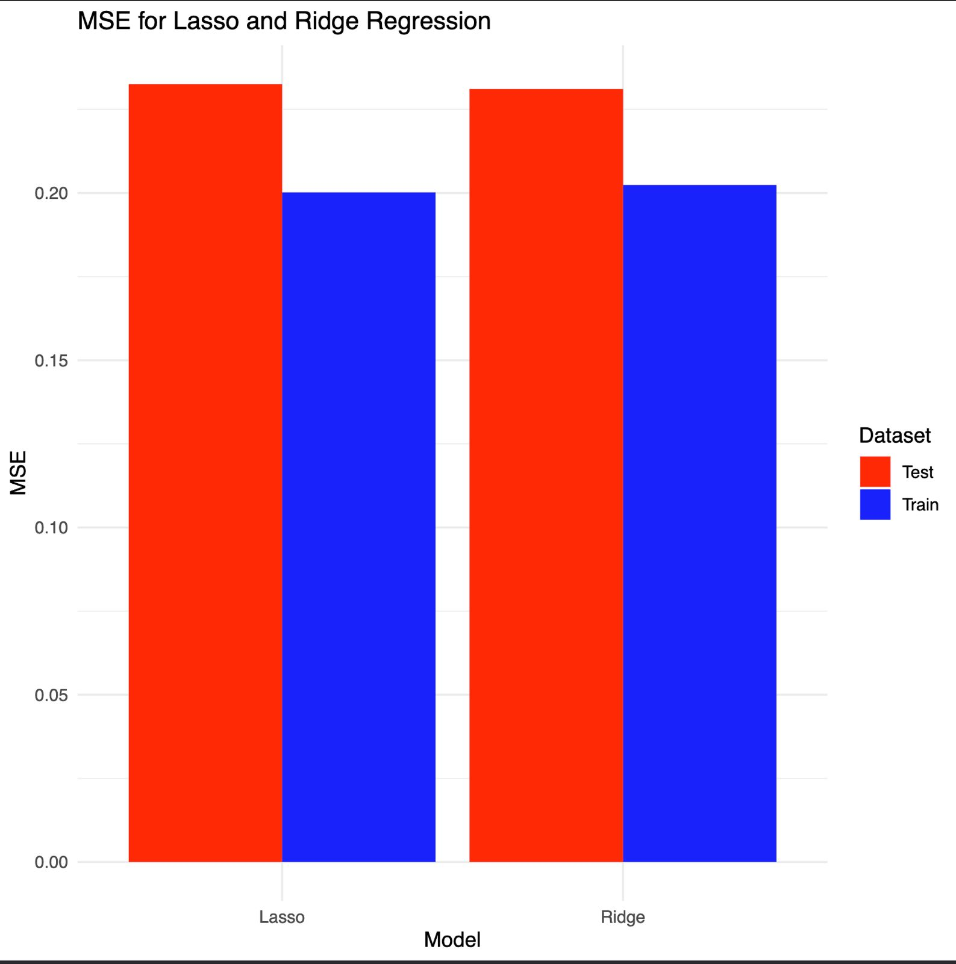
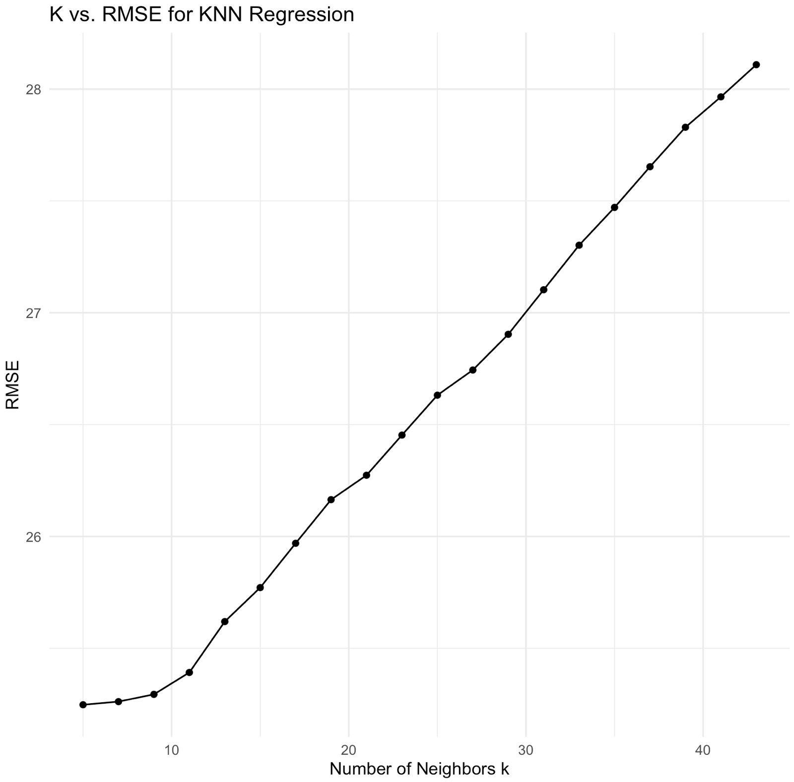
Results

Slide 15
Discussion and Future Work
Conclusions
KNN Regression: Achieved high predictive accuracy with an R-Squared of 0.923, indicating a strong fit to the data.
Ridge Regression: Showed consistent performance with a slightly higher test MSE (0.231) compared to the train MSE (0.203), suggesting good generalization.
Lasso Regression: Yielded a comparable test MSE (0.232) to Ridge, with the potential benefit of feature selection, as reflected in the sparse coefficient matrix.
Justification
The choice of Lasso over Ridge was informed by empirical test outcomes, sparse coefficients in lasso, emphasizing a harmonious trade-off among model simplicity, understandability, and forecast precision.
Future Directions
Investigate the impact of additional data or alternative regularization techniques on model performance.
Explore model explainability tools to provide deeper insights into feature influence and student success predictors.

Slide 16
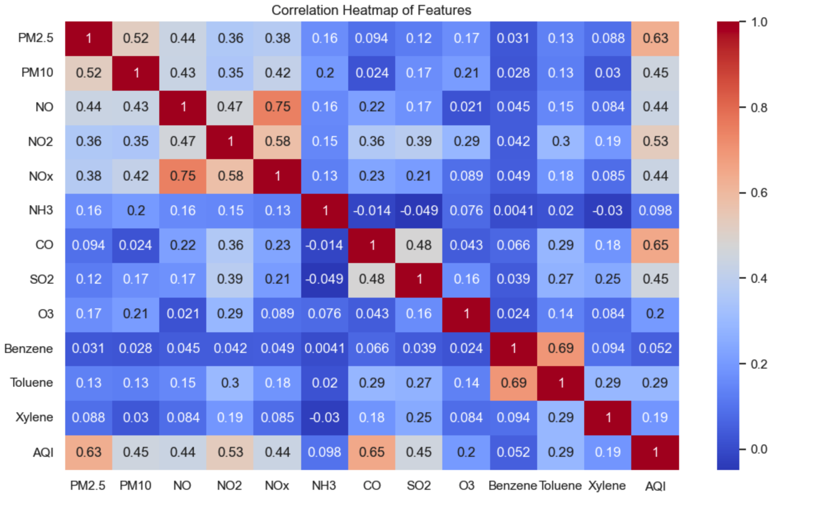
Dataset – Exploratory Analysis

Slide 17
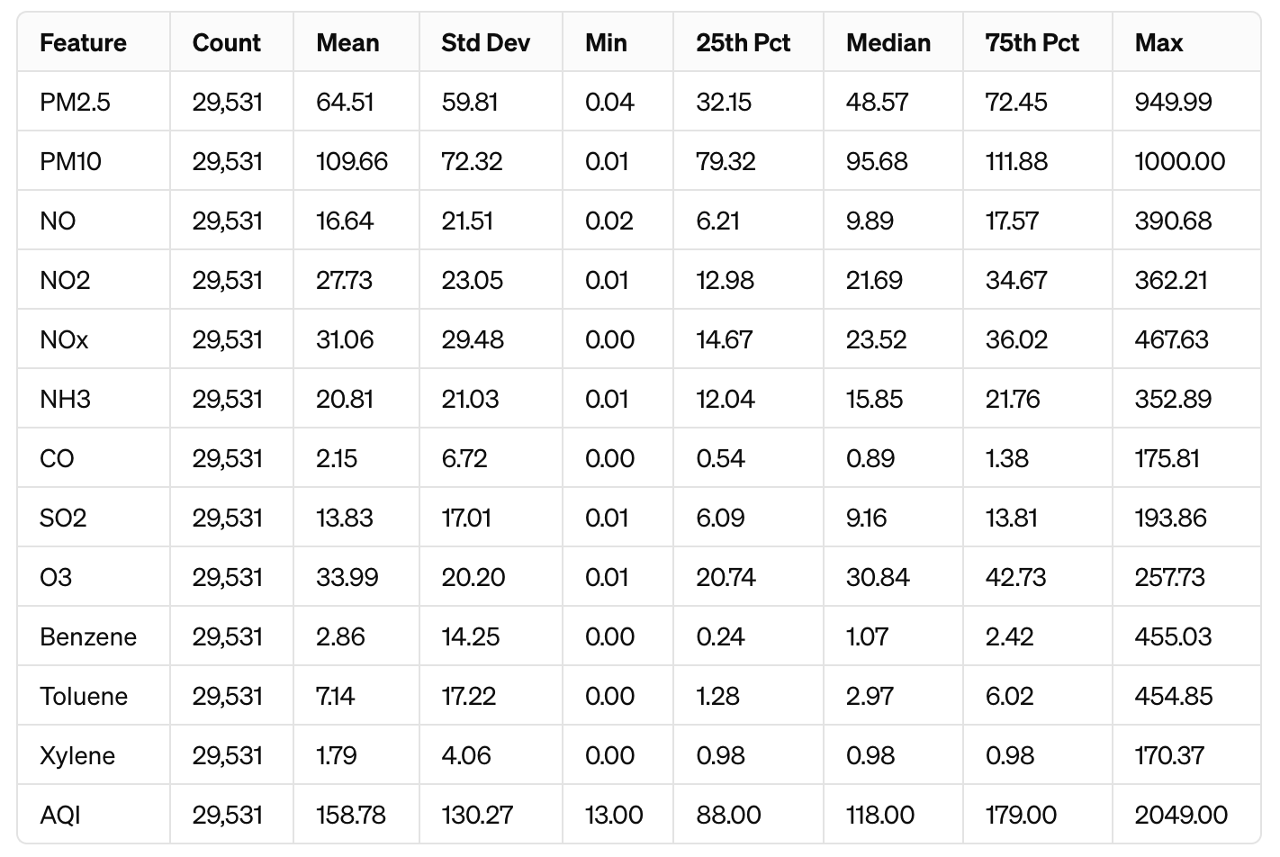
Dataset – Exploratory Analysis

Slide 18
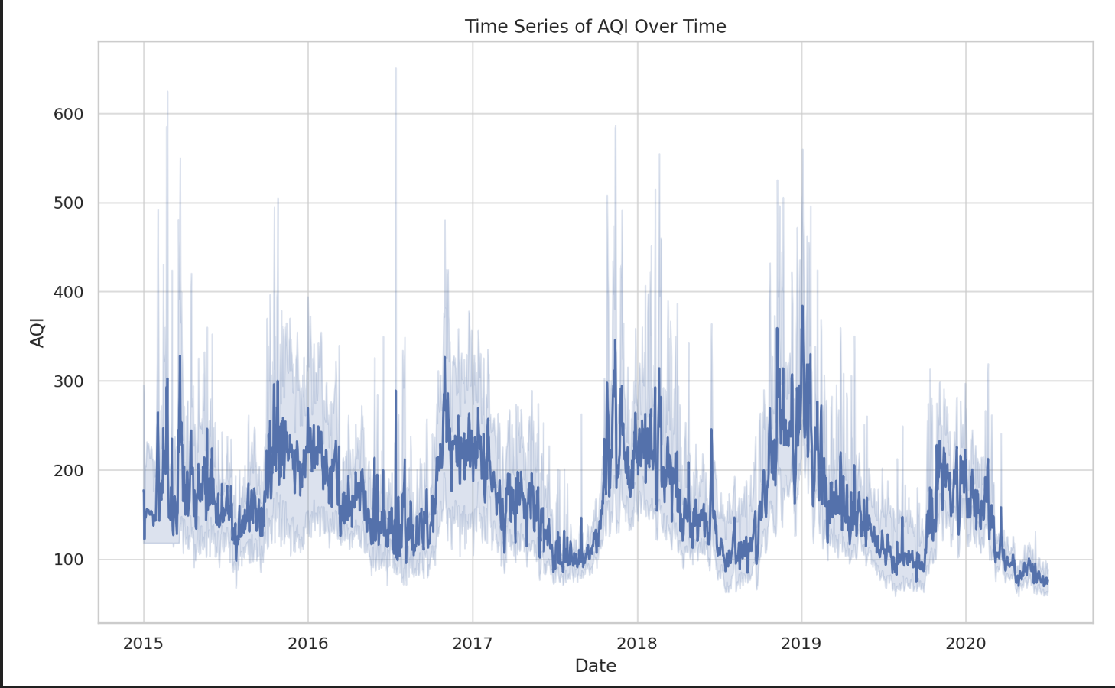
Dataset – Exploratory Analysis

Slide 19
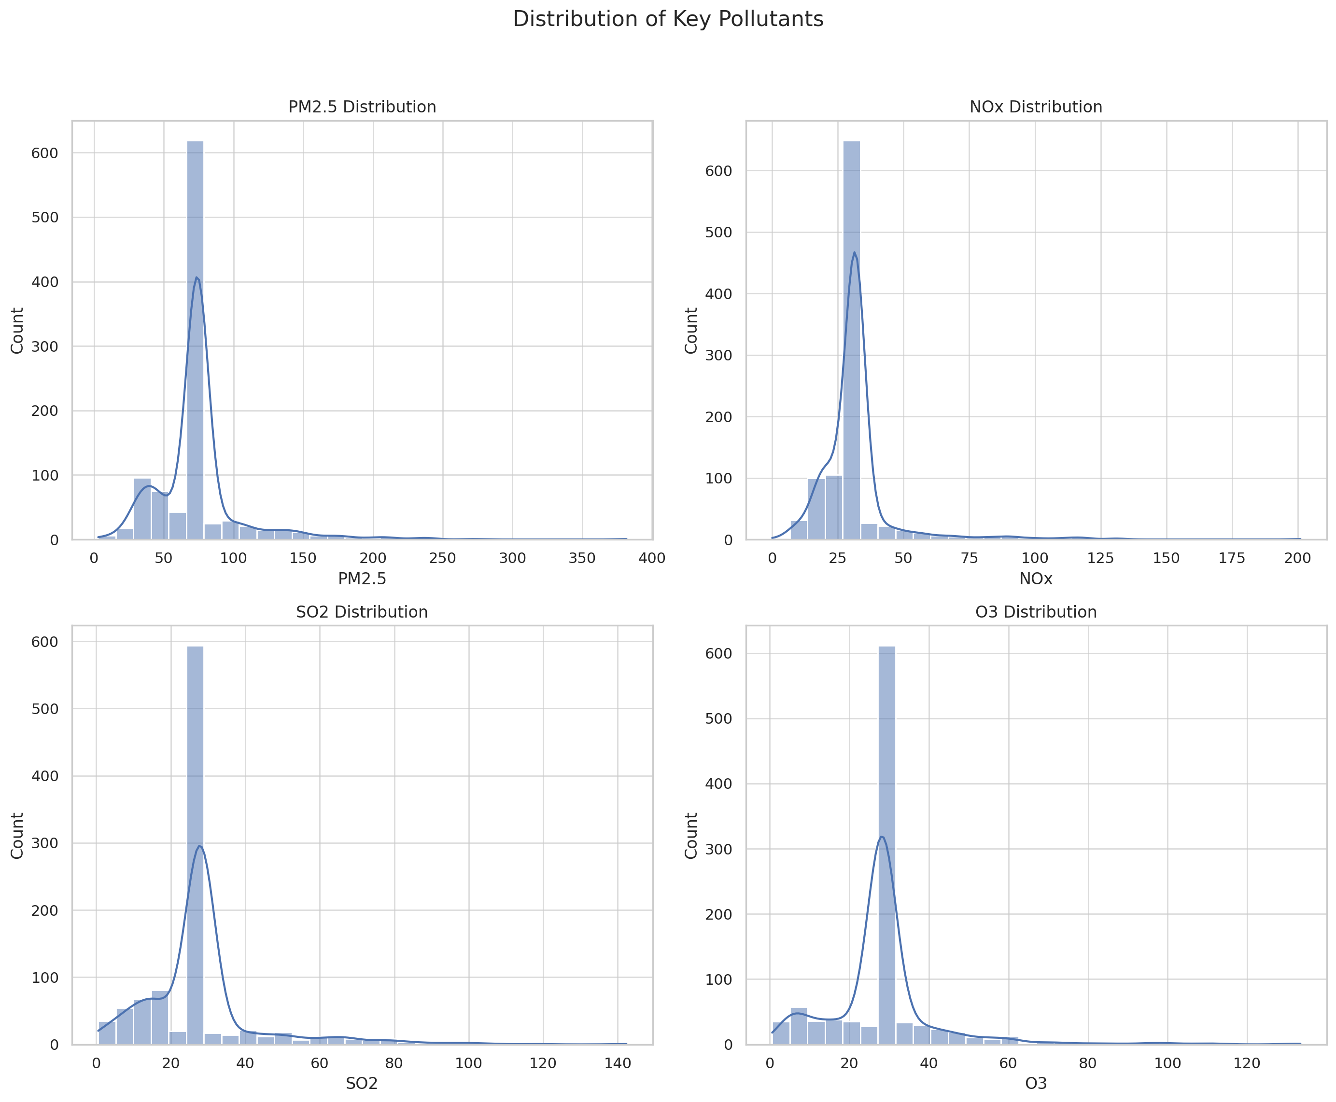
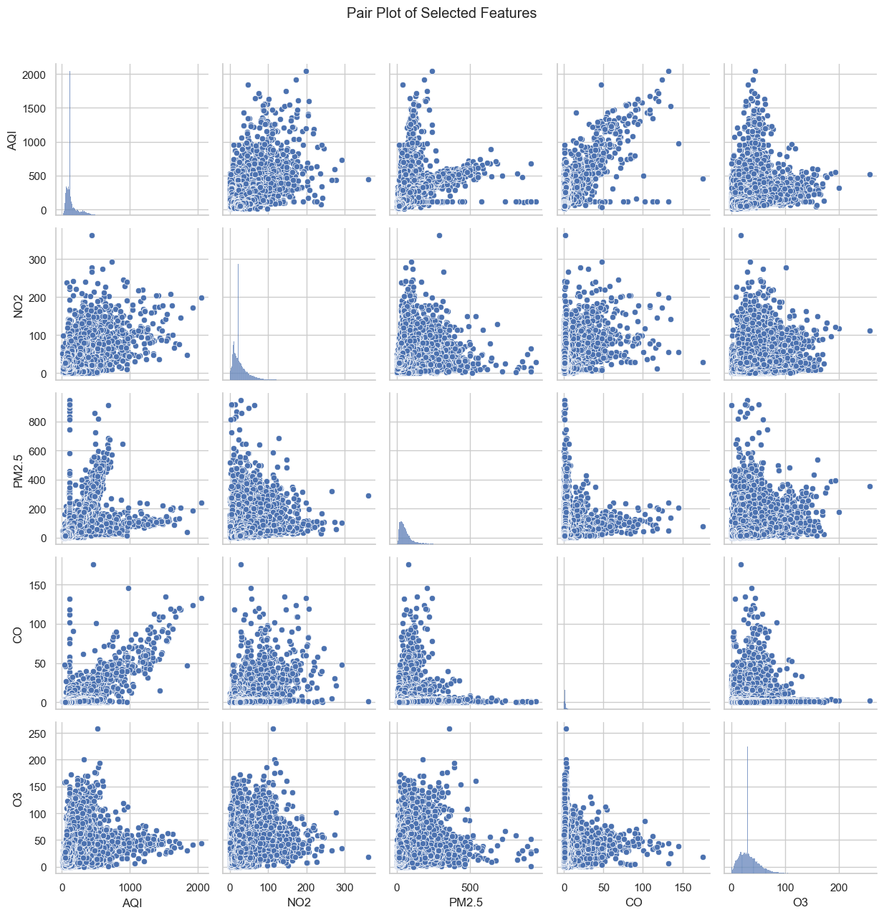
Dataset – Exploratory Analysis

Slide 20
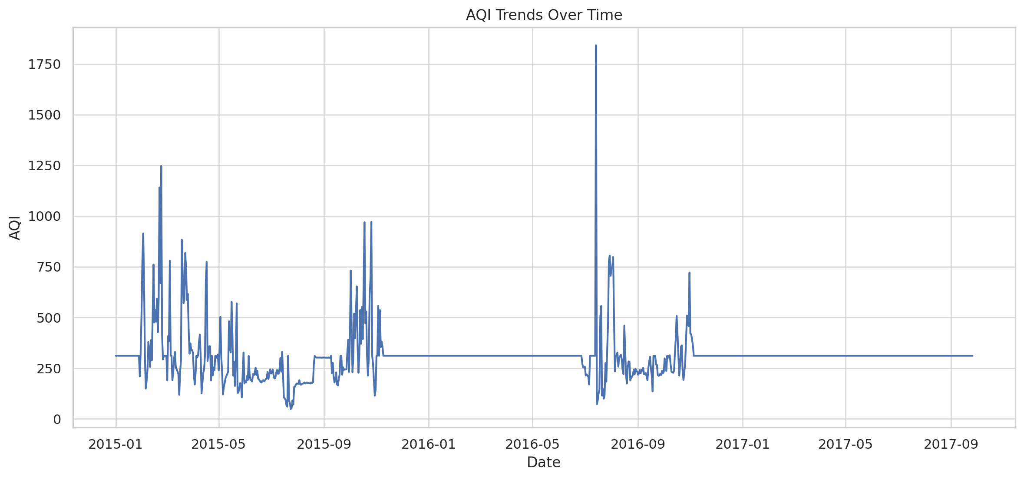
Dataset – Exploratory Analysis

Slide 21
References
https://www.kaggle.com/datasets/rohanrao/air-quality-data-in-india

