Slide 1

Inventory Management & Billing System
A Python Console Application for Small Business Efficiency

Slide 2

Project Objective
What We're Building
A comprehensive system to manage product inventory, process customer orders, and generate professional bills—all through a simple console interface.
This solution handles data storage, searching, updating, and reporting without relying on external frameworks or libraries.

Slide 3

Product Management Features
Add Products
Update Details
Register new items with ID, name, price, and stock quantity
Modify product information including prices and stock levels
Search System
Delete Products
Find products quickly by ID or name
Remove discontinued items from inventory
All product data is stored persistently in CSV files, ensuring your inventory information is always saved and accessible across sessions.

Slide 4
Order Processing Features
01
Add to Cart
Select products with automatic stock availability verification
02
Stock Updates
Inventory automatically adjusts after each successful purchase
03
Apply Discounts
Optional discount codes or percentage reductions at checkout
04
Finalize Order
Confirm and complete the transaction with bill generation

Slide 5
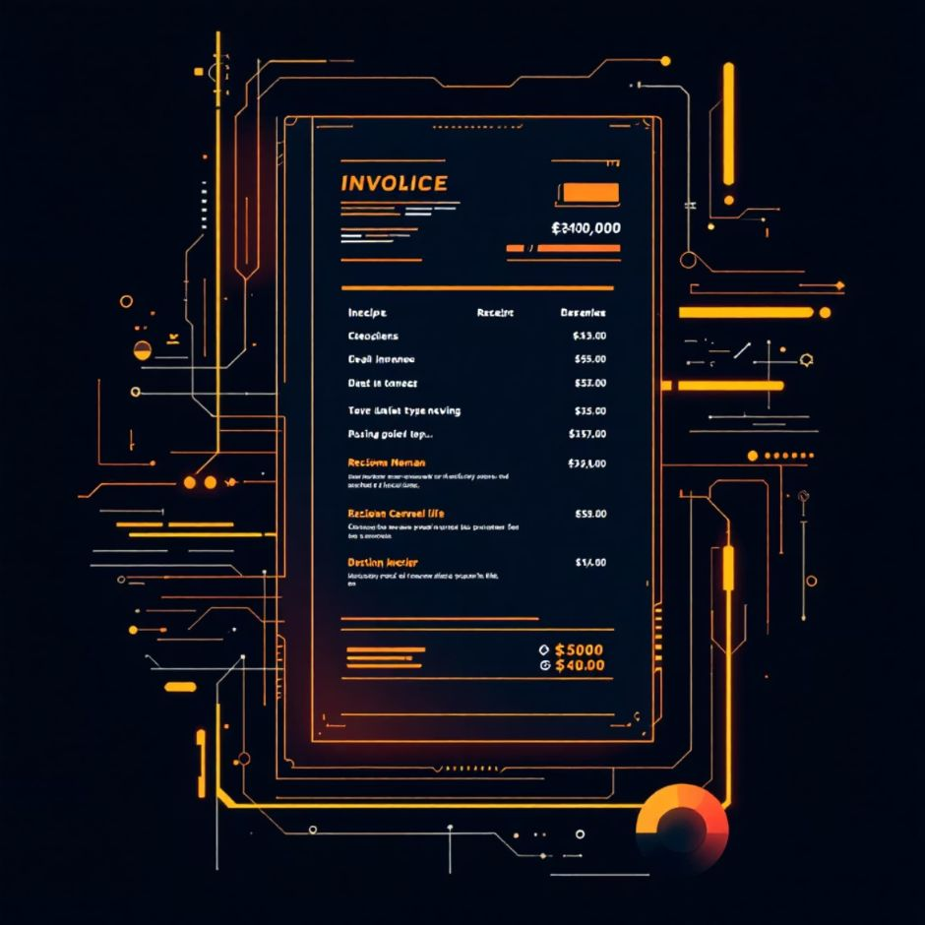
Billing System
Professional Bill Generation
Create detailed, text-based bills that include:
Complete item details with quantities and individual prices
Subtotal calculations and applied discount amounts
Final total with date and time stamping
Customer-ready formatting for easy readability
Bills can be saved as .txt or .csv files for record-keeping and easy sharing with customers.

Slide 6

Reporting & Analytics
Daily Sales Report
Track total revenue for any selected date. View comprehensive sales summaries to understand your business performance and identify peak sales periods.
Low Stock Alerts
Automatically monitor inventory levels and receive alerts when products fall below defined thresholds. Stay ahead of stockouts and ensure product availability.

Slide 7

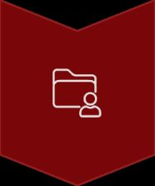
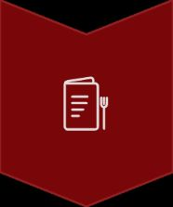


System Workflow
Launch Application
Start the console program and access the main menu
Load Data
System reads product inventory from CSV storage
Select Operation
Choose from product management, orders, billing, or reports
Process Transaction
Execute selected operation with real-time validation
Save Changes
All updates persist to CSV files automatically

Slide 8
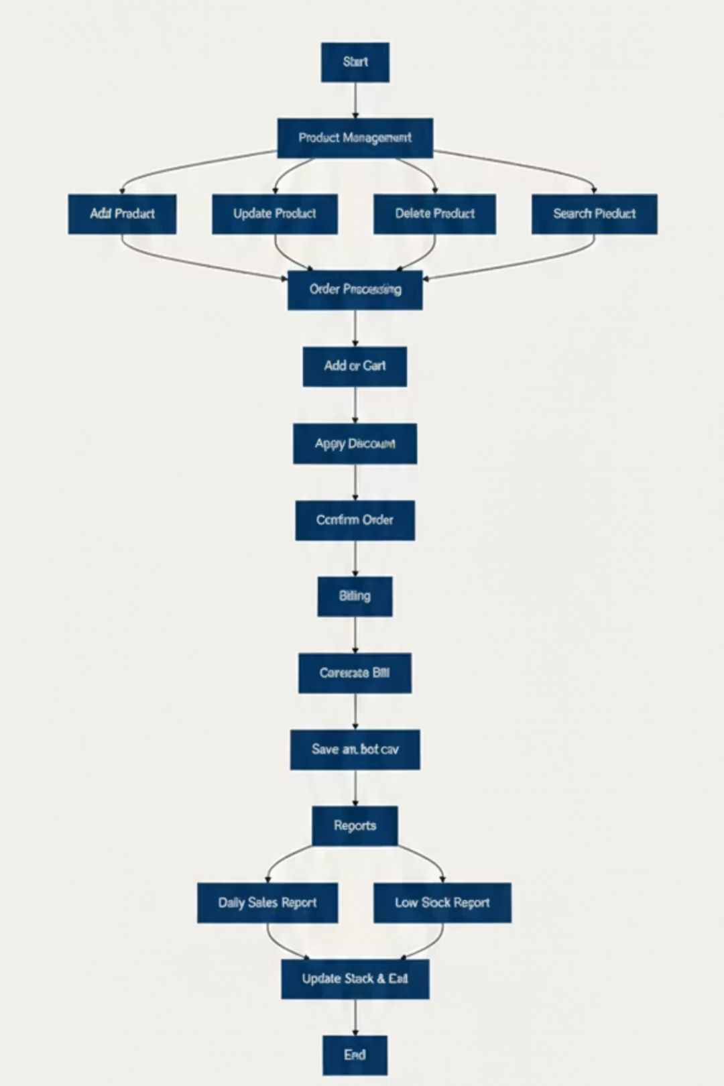
flow chart of whole work flow
A flow chart of the whole work flow, showing the sequence of steps and decisions involved.

Slide 9

Testing Your Application
Verification Steps
Run the program via your console or terminal
Test product operations: Add, update, search, and delete sample products
Process test orders: Add items to cart, apply discounts, and complete purchases
Generate bills: Save and review bill files in both text and CSV formats
Check reports: Generate daily sales summaries and low-stock alerts

Slide 10

Key Benefits
0
100%
24/7
External Dependencies
Console-Based
Data Persistence
Simple interface that works anywhere Python runs
All information safely stored in CSV files
Built entirely with Python's standard library

Slide 11
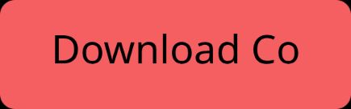
Ready to Get Started?
Perfect For
Small retail businesses
Learning Python data management
Quick deployment without complex setup
Tracking stock and sales efficiently
You now have a fully functional inventory and billing system that helps small businesses track stock levels, process orders, and maintain accurate sales records—all through an intuitive console interface with persistent data storage.

