Slide 1


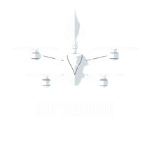


CERTIFICATE OF INTERNSHIP
DATE: 08.07.2026
TO WHOM IT MAY CONCERN
Candidate Name: GHAANDHAMADHAN V
Institute Name: KONGU ENGINEERING COLLEGE
This is to notify GHAANDHAMADHAN V, 3rd Year, COMPUTER SCIENCE AND ENGINEERING, has successfully completed an Internship and Live Project under the Research & Development area "FULL-STACK Development & Software Development" in COPTERCODE
INTERNSHIP & LIVE PROJECT AREA: FULL-STACK DEVELOPMENT & SOFTWARE DEVELOPMENT - ERP SOLUTION & SITES
at COPTERCODE. The INTERNSHIP happened for 1 MONTH - JAN (regular) at Coptercode, Venue: IIT Madras Research Park, Kanagam, Taramani, Chennai.
BEST REGARDS,
KARTHIKEYAN SUNDHARESAN, COPTER CODE, hr@coptercode.co.in
+91 96554 51382 www.Coptercode.co.in
<<QR>>
+91 8072193600
www.Coptercode.co.in
hr@coptercode.co.in

