Slide 1
QUADRANTS DYNAMIC HISTOGRAM EQUALIZATION for CONTRAST ENHANCEMENT
Presented by :
M. Rohith Kumar(Y20IT072)
M. Ganesh Kumar(Y20IT076)
N. Arun Babu(L21IT137)
Guided by:
Smt. K. Chandana
Assistant Professor

Slide 2
CONTENTS:
ABSTRACT
KEYWORDS
EXISTING METHODS
PROPESED METHOD
BLOCK DIAGRAM
RESULTS & DISCUSSION
CONCLUSIONS
REFERENCES

Slide 3
ABSTRACT :
Enhancing digital images from consumer electronic devices remains a significant challenge due to inherent limitations in existing methods. This study proposes a novel approach, Quadrant Dynamic Histogram Equalization (QDHE), to address these limitations effectively. QDHE strategically divides the image histogram into quadrants and utilizes median-based sub-histograms, along with intensity clipping based on occurrence mean. By dynamically assigning a new dynamic range and performing individual sub-histogram equalization, QDHE aims to outperform current techniques. Notably, QDHE addresses issues such as intensity saturation and noise amplification while preserving intricate details. The study highlights the efficacy of QDHE, particularly in enhancing images captured in low-light conditions, which are common challenges in devices like smartphone cameras. Overall, QDHE offers a promising solution for improving image quality and enhancing user experience in consumer electronic devices.

Slide 4
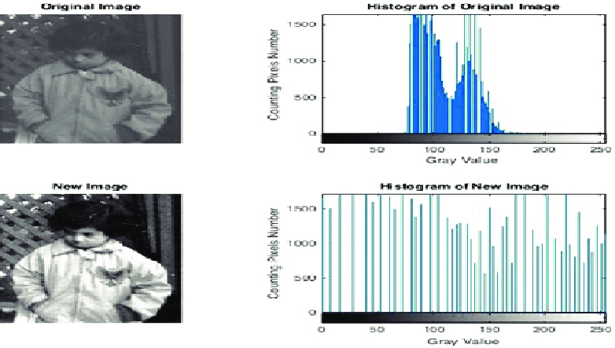
KEYWORDS :
Histogram Equalization : Histogram equalization is a technique used in image processing to enhance the contrast of an image by redistributing the pixel intensities.

Slide 5
Dynamic Histogram Equalization: Dynamic Histogram Equalization is a technique that adjusts the contrast and brightness of an image by dividing it into smaller regions and applying Histogram Equalization separately to each of these regions.
Contrast Enhancement : Contrast enhancement is a technique that increases the visual difference between light and dark areas of an image, improving clarity and detail without changing the overall image balance or appearance.
Partitioned Histogram : Partitioned histogram is a technique of dividing an image histogram into smaller sub-histograms based on specific criteria, allowing for more precise adjustments to specific regions of the image.

Slide 6
EXISTING METHODS:
1.Histogram Equalization:
Histogram equalization (HE) is a technique used to enhance the contrast of an image by adjusting the intensity distribution of the image's pixels. The HE method then redistributes the pixel intensities in the image such that the resulting histogram is as flat as possible, which means that all intensity levels are equally represented in the image.
This equalization process results in an image with improved contrast and visibility of details. However, the method can lead to over-enhancement and loss of some image details, especially in regions with low contrast. There are several variations of HE, including adaptive HE and contrast-limited HE, that aim to address these limitations and produce better results for specific types of images.

Slide 7
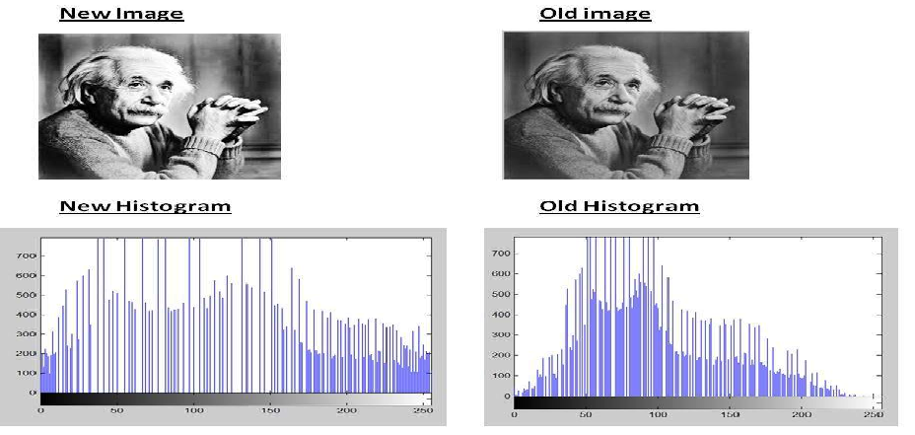
Algorithm :
Compute the histogram of the input image by counting the number of pixels for each intensity level.
Compute the cumulative distribution function (CDF) of the histogram by summing the counts of all intensity levels up to the current level.
Normalize the CDF to obtain a new mapping function that spreads out the intensities across the entire range.
Apply the mapping function to each pixel in the input image to create a new image with improved contrast.

Slide 8
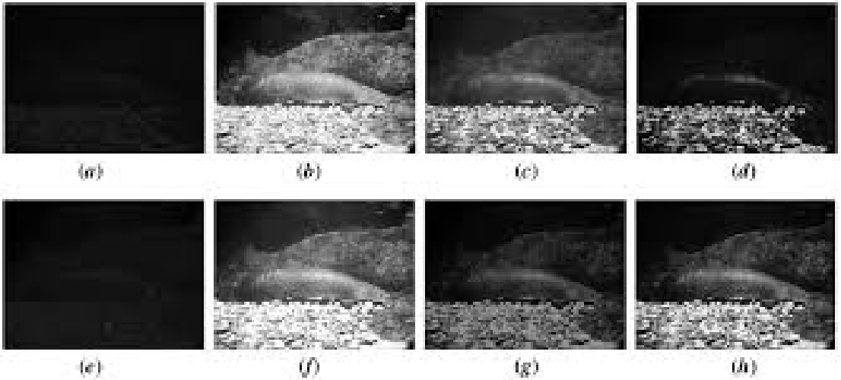
2.Dynamic Histogram Equalization :
Dynamic Histogram Equalization (DHE) is a variation of histogram equalization that is used to enhance the contrast of images. Unlike traditional histogram equalization, which uses a fixed mapping function to redistribute the intensity values, DHE computes a mapping function for each image patch based on its local histogram. This allows for better preservation of local contrast and details in the image.

Slide 9
The idea behind the dynamic histogram equalization is to perform histogram equalization on local image patches, rather than the entire image at once, to account for variations in local contrast. The resulting enhanced image has improved contrast and details, making it visually more appealing.
Algorithm:
1. Divide the input image into non-overlapping patches of size NxN.
2. For each patch, compute the histogram H(i) of intensity values i=0,...,L-1, where L is the maximum intensity level.
3. Compute the cumulative distribution function (CDF) F(i) of the histogram H(i) for each patch.
4. Compute the transformation function T(i) for each patch by scaling and shifting the CDF to the range [0,L-1], such that T(i) = round((L-1) * (F(i) - F(0)) / (N*N - H(0))).
5. Apply the transformation function T(i) to each pixel in the corresponding patch to obtain the enhanced patch.
6. Combine the enhanced patches to form the output image.

Slide 10
PROPOSED METHOD :
Quadrants Dynamic Histogram Equalization : It is a novel technique proposed in a research paper for enhancing digital images captured from consumer electronic devices. The method involves dividing the image histogram into four sub-histograms based on the median of the input image, clipping them according to the mean of intensity occurrence, assigning a new dynamic range to each sub-histogram, and finally equalizing each sub-histogram.
The evaluation of QDHE against existing state-of-the-art methods demonstrates its superior performance in producing clearer enhanced images without issues such as intensity saturation, noise amplification, or over-enhancement, while also preserving intricate image details. The technique is particularly noted for its suitability in enhancing images captured in low-light environments, which is a common scenario in consumer electronic devices like smartphone cameras.

Slide 11
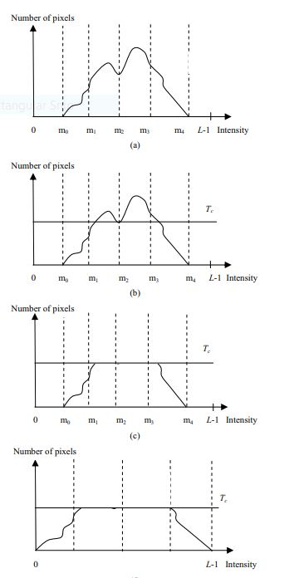
STEPS IN THE PROPOSED METHOD:
Histogram Partitioning
Clipping process
New Gray Level Allocation
Histogram Equalization

Slide 12
Algorithm for Quadrants Dynamic Histogram Equalization (QDHE):
Input: Grayscale image (WAAD_img)
1. Preprocess Image:
- Read the input image (cameraman.tif).
- Convert the image to grayscale.
2. Compute Histogram and Set Thresholds:
- Compute the histogram of the grayscale image.
- Define thresholds to determine significant intensity levels in the histogram.
3. Find Key Intensity Levels:
- Initialize an array m of size 1x5 to store key intensity levels.
- Determine the minimum and maximum intensity levels based on the histogram and defined thresholds.
4. Compute Cumulative Distribution Function (CDF):
- Calculate the cumulative distribution function (CDF) of the image histogram.
5. Adjust Histogram:
- Compute the average frequency of pixel intensity levels in the image.
- Modify the histogram to adjust frequencies that are significantly higher than the average frequency.
.

Slide 13
6. Determine Mapping Ranges:
- Calculate the range of intensity levels for each key interval.
- Determine the separation positions based on the computed ranges.
7. Compute New Cumulative Distribution Function (CDF):
- Compute the new cumulative distribution function (CDF) for each key interval.
8. Map Intensity Levels:
- Map the intensity levels of the original image to the adjusted levels based on the computed mapping ranges and cumulative distribution functions.
9. Generate Enhanced Image:
- Create a new image QDHE_img of the same size as the original image.
- Iterate over each pixel (i, j) in the original image.
- Map the intensity of the pixel to the corresponding adjusted intensity level using the mapping function.
10. Display Enhanced Image:
- Display the enhanced image using the `imshow` function.
Output: Enhanced image (QDHE_img) with improved contrast.

Slide 14
PROPOSED ALGORITHM MODULES:
The QDHE consists of four modules:
Histogram Partitioning
Clipping process
New Gray Level Allocation
Histogram Equalization

Slide 15
1.HISTOGRAM PARTITIONING :
QDHE utilizes the median intensity value of the input image histogram in partitioning the histogram. Initially, the histogram of the original image is divided into two sub-histograms.
Similarly, the medians from the two partitioned sub-histograms are used as separating points to further divide the two sub-histograms into two smaller sub-histograms each. Thus, there are a total of four sub-histograms obtained.
Then, the minimum and maximum intensity values of the input histogram are set as the separating points.

Slide 16
Histogram partitioning

Slide 17
2:CLIPPING PROCESS:
The reason behind the clipping process is to control the enhancement rate of HE in order to overcome unnatural and over-enhancement of the processed image to occur.
An automatic clipping process, the self-adaptive plateau histogram equalization (SAPHE) initially introduced by Wang et. al. for the infrared image contrast enhancement.
However, the algorithm may fail to implement in the natural image due to unsuccessful local peak detection.
Thus, a modified-SAPHE is introduced to locate median value of the non-empty bins as the clipping threshold, Tc.
However, in order to reduce the computational complexity, Tc is replaced by the average of the number of intensity in the proposed QDHE.
The clipping process is illustrated in below figs.

Slide 18
T_{c}
T_{c}
Before clipping
After clipping

Slide 19
3:NEW GRAY LEVEL ALLOCATION:
PHE-based methods only perform the enhancement process in each sub-histogram between two separating points. Thus, the sub-histograms may not ensure the balance space in each sub-histogram for sufficient contrast enhancement.
This is because contrast enhancement obtained in a narrow stretching space is less significant and wide stretching space introduces redundant contrast enhancement. This phenomenon particularly occurs when the side of the sub-histogram is narrow. Consequently, the processed image tends to suffer from loss of image details and intensity saturation artifact.
In order to balance the enhancement space for each sub histogram, the proposed QDHE allocates a new gray level dynamic range based on the ratio of gray level spans and total number of pixels for each sub-histogram.

Slide 20
T_{c}
New Gray level allocation

Slide 21
4:HISTOGRAM EQUALIZATION:
After the new dynamic ranges have been determined for all the quadrant sub-histograms, the final step in the QDHE is to equalize each sub-histogram independently. If the I - th histogram is allocated at gray level from [I start I end], then the output of histogram equalization, y(x) of this partition can be determined by using the transfer mapping function in
y( x) = ( I start - i end ) ´ cdf ( X k ) + I start
where cdf(X k) is the cumulative density function in that sub- histogram. In (10) a general HE equation is used but I start and I end are used instead of the minimum and maximum intensities in the output dynamic range.

Slide 22
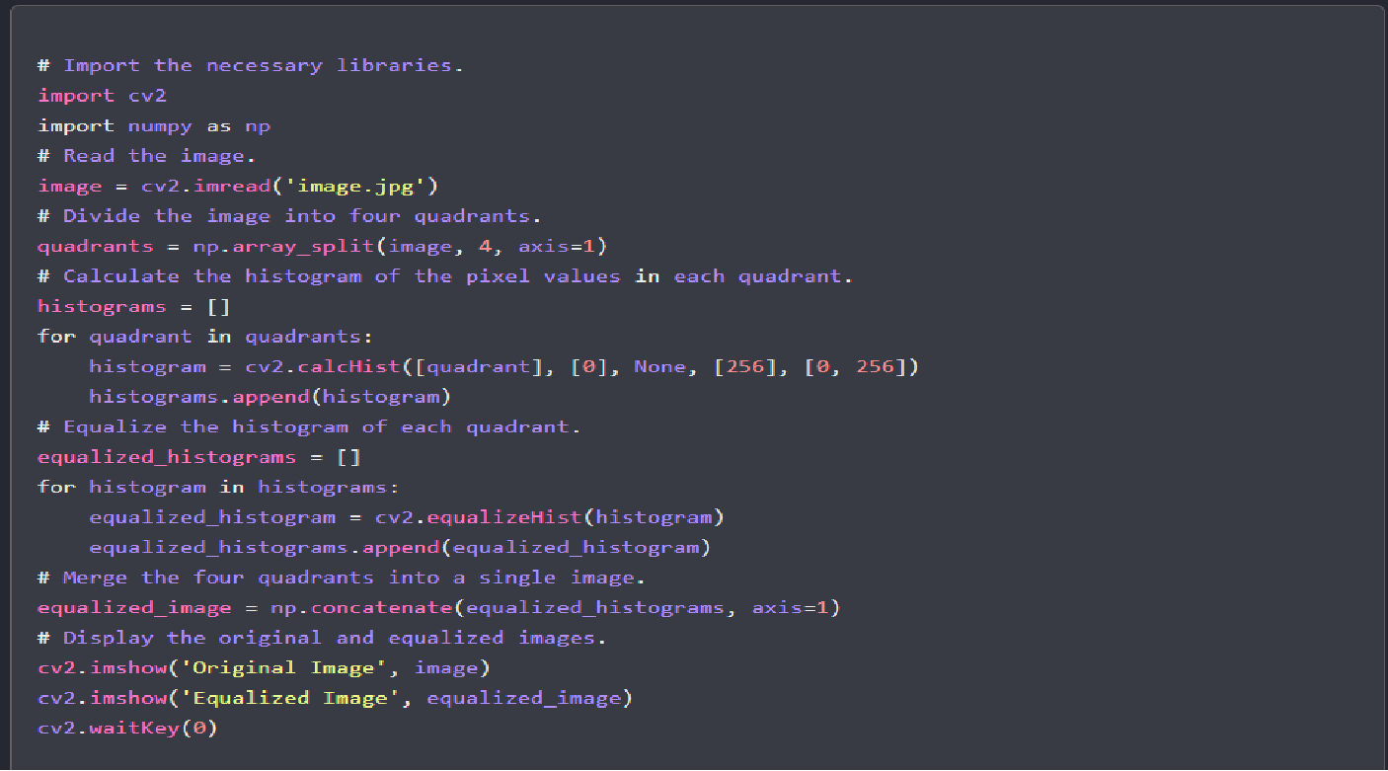

Slide 23
BLOCK DIAGRAM:
INPUT IMAGE - Taken in Low light
HISTOGRAM DIVISION - Four Parts
INTENSITY CLIPPING - Based on mean
DYNAMIC RANGE ASSIGNMENT - Particular ranges
HISTOGRAM EQUALIZATION - Equalized Individually
ENHANCED IMAGE - Equalized Total Image
RESULTS - Evaluate & Compare

Slide 24
RESULTS & DISCUSSION:
Here, we demonstrate the performance of the proposed QDHE method by comparing with other seven existing HE-based methods: the conventional
HE (Histogram Equalization) –
Histogram equalization (HE) is an image processing technique that enhances contrast by redistributing intensity values across the histogram. By spreading out intensity levels, it improves visual quality and detail, especially in images with low contrast or uneven lighting. However, it may amplify existing noise or artifacts.
QDHE (Quadrants Dynamic Histogram Equalization ) –
Quadrants Dynamic Histogram Equalization (QDHE) is an image processing method that, like HE, enhances contrast by redistributing intensity values across the histogram. It's particularly useful for improving detail and visual quality in images with low contrast or uneven lighting. However, it may also amplify existing noise or artifacts.

Slide 25
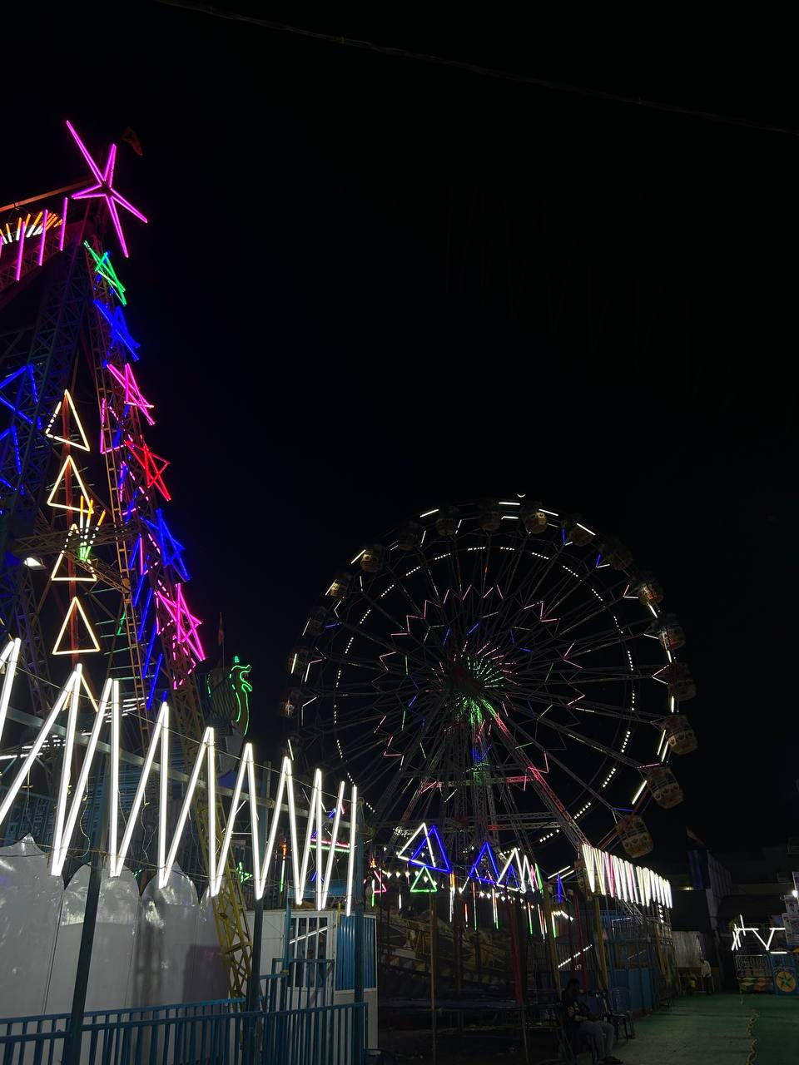
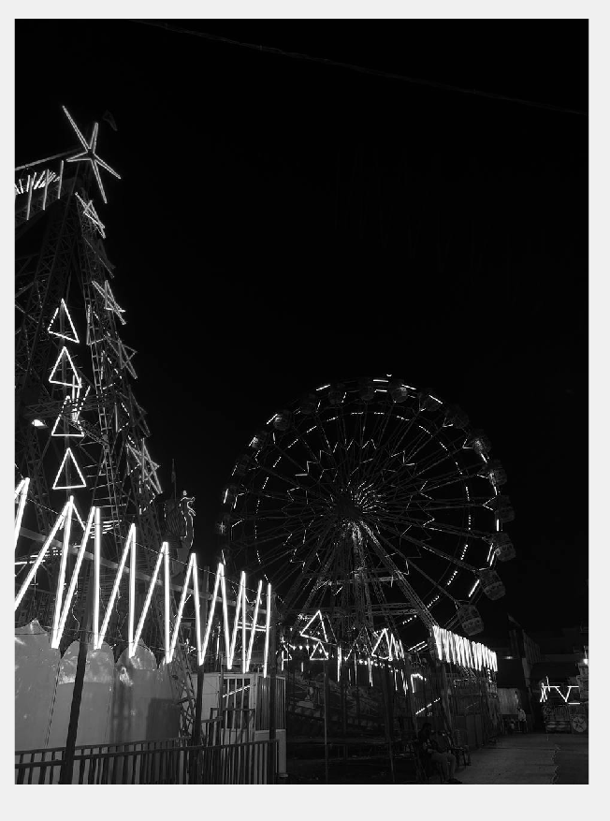
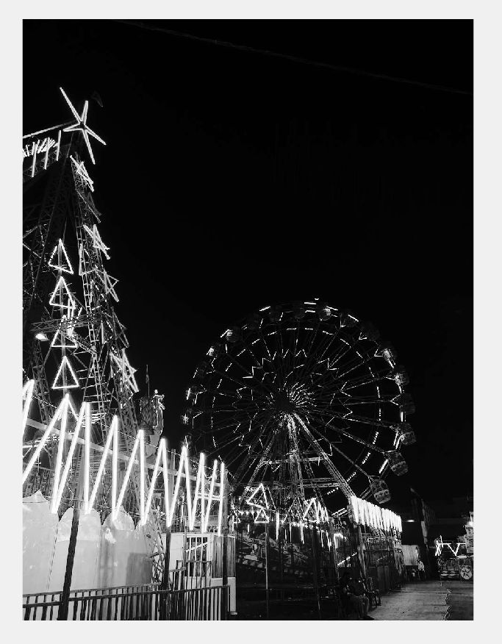
Fig 1: Original image
Fig 2 :HE
Fig 3 : QDHE

Slide 26
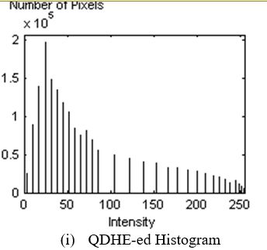
PROPOSED “QDHE” PERFORMANCE:
On the other hand, the proposed QDHE method yields the best performance as compared to others. The contrast for all tested images is successfully enhanced; thus, producing better and clearer images. Furthermore, the QDHE method has successfully preserved image details .
The concrete proof could be seen, for examples, at the faces of the people in fig.3i, the background, and the fish body of the fig.(5i). The problems of intensity saturation ,noise amplification, and over enhancement are avoided.
Furthermore, the QDHE-ed histogram in Fig. 6i shows that the histogram is distributed more evenly than other conventional methods.
All ranges of intensity level are evenly stretched and, thus, the details in all intensity level are successfully preserved and clearly highlighted.

Slide 27

QUANTITATIVE EVALUATION (DISCRETE ENTROPY):
To further demonstrate the capability of proposed method in extracting the details from the images, the discrete entropy is performed as the quantitative evaluation . The discrete entropy E(x) is defined as:
where pX_{k} is the normalized probability of the k - th gray level. Higher value of the entropy indicates that more information is brought out from the images. The discrete entropy computed for the methods implemented are tabulated in Table 1.
According to Table I, the QDHE produces the highest entropy, thus becomes the best method to bring out the details of the images. Overall, both qualitative and quantitative analyses favor the proposed QDHE algorithm as the best contrast enhancement technique for low contrast images.
Images | DISCRETE ENTROPY | SSIM-Structural Similarity Index | PSNR-Peak Signal-to-Noise Ratio
Original_image | 5.0142155 | — | —
HE | 5.3386846 | 7.951348686125634 | 0.4405146156329332
QDHE | 5.4497023 | 9.358995615242337 | 0.4940024729331975

Slide 28
- **High Entropy**: Indicates greater randomness or uncertainty in the image.
- Implies better preservation of information.
- May result in more detailed and nuanced representations.
- **High PSNR (Peak Signal-to-Noise Ratio)**:
- Signifies better image quality.
- Indicates closer resemblance to the original image with minimal distortion.
- Reflects reduced noise and improved signal fidelity.
- **High SSIM (Structural Similarity Index)**:
- Reflects a higher degree of similarity between the processed and original images.
- Considers structure, luminance, and contrast.
- Indicates better preservation of image structure and texture.
- **Balancing Factors**:
- When comparing image processing techniques, a balance between these factors is crucial.
- Optimal results aim for information preservation, high image quality, and similarity to the original image.

Slide 29
CONCLUSION:
To summarize QDHE, The HE is a simple and effective method. However, it leads to over-enhancement and intensity saturation problems. For the ill-illumination images, HE-based brightness preserving methods fail to extract the detail information of the images. Although the DHE is a powerful method for enhancing the low contrast images, it leads to noise amplifying and intensity saturation problems in some cases. From the experiment results, the proposed QDHE is the most robust method to extract the details of the low contrast images. Observing from the simulation results obtained, the QDHE has produced the best performance for both qualitative and quantitative evaluations.

Slide 30
REFERENCES:
1.H. Siddiqui and C.A. Bouman, "Hierarchical Color Correction for Camera
Cell Phone Images,"IEEE Trans. Image Processing, vol.17, no.11, pp.2138-
2155, Nov. 2008
2. M. Gamadia, N. Kehtarnavaz, and K. R. Hoffman, "Low-Light Auto-Focus
Enhancement for Digital and Cell-Phone Camera Image Pipelines," IEEE
Trans. Consumer Electronics, vol.53, no.2, pp.249-257, May 2007
3. T. Kim, and J. Paik, “Adaptive contrast enhancement using gain-controllable
clipped histogram equalization”, IEEE Trans. Consumer Electronics, vol. 54,
no. 4, pp. 1803-1810, Nov. 2008

