Slide 1

Diabetes Prediction using Machine Learning & Deep Learning methods.
Student name: Rohith Chityala
Supervisor name: Dr. Rochelle sassman

Slide 2

Contents
Introduction
Broad Subject area
Narrow Topic area
Relevant Existing Studies
Methodology
Research Results
Conclusion
Future work

Slide 3
Introduction
Diabetes is a chronical illness that is caused due to increase in blood glucose levels in human body.
It is triggered when the body fails to generate required amount of insulin in blood.
Many health factors contribute for a person to be diagnosed with diabetes.
If left untreated, it can cause serious health complications.

Slide 4

Data:
Data is a collection of various kinds of information that is stored in different forms.
How is data being used?
Data is helping researchers and analysts to understand the trends and make decisions effectively.
Data Science:
It is the concept of generating useful insights from data by performing preprocessing tasks and implementing machine learning algorithms.
How is Data Science changing the world?
From predicting diseases to tackling climate change, data science is being used in broad spectrum of areas.

Slide 5


Broad Subject Area
How are data science and machine learning being applied in healthcare sector?
Image analysis - Cancers and Tumors detection
Mental Health – Depression and sleep disorders
Disease surveillance & prediction
Administering Treatment
Health monitoring through smart devices

Slide 6
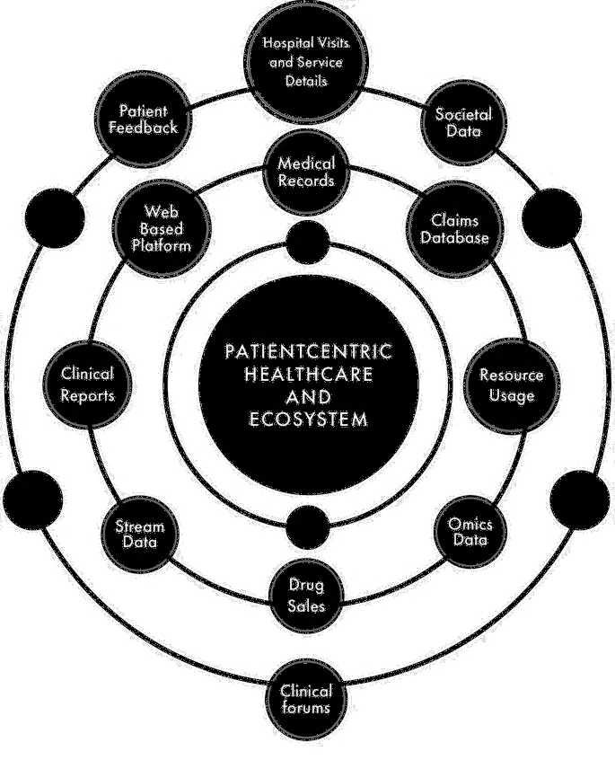
Sources of data
How is data being generated in healthcare?
Primary data - Data that has been collected by an individual via conducting surveys, research or interviews.
Secondary data – Data that has been collected by public health organizations, government institutions, hospitals etc.

Slide 7
Narrow Topic Area
The problem:
Diabetes and its effects on humans
Possible solutions:
Early diagnosis and treatment.
The aim:
Implementing Machine Learning and Deep Learning algorithms to predict diabetes.

Slide 8
Project Objectives
To understand the causes and effects of diabetes on human body
To analyze the dataset by performing exploratory data analysis
To build machine learning and deep learning algorithms and fit them on the dataset
To analyze the performance of models used based on accuracy metrics

Slide 9
Relevant Existing Studies
Diabetes Prediction using Machine Learning algorithms – (Mujumdar & Vaidehi, 2019)
This study used two different datasets – Diabetes and PIMA Indian diabetes
Implemented different machine learning algorithms.
Best model - Logistic Regression
For diabetes dataset – 96%, For PIMA Indian diabetes dataset – 76%
Summary – Accuracy scores of ML algorithms can be varied by varying the data.

Slide 10
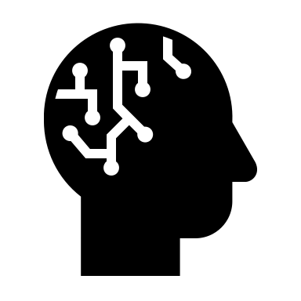
A deep learning approach based on convolutional LSTM for detecting diabetes - Rahman, M., Islam, D., Mukti, R., & Saha
Different Deep Learning techniques used – CNN, LSTM, Conv-LSTM, and CNN-LSTM.
Performed hyperparameter optimization using Grid Search algorithm to find the optimal parameters. (Glucose, Age, BMI, Insulin, and Blood pressure)
Best model – Conv-LSTM with accuracy of 91.38%
This accuracy is further improved to 97.26% by performing cross-validation technique.

Slide 11
A Comparative Analysis of Early-stage Diabetes Prediction using Machine Learning and Deep Learning Approach - Refat, M., Amin, M., Kaushal, C., Yeasmin, M., & Islam, M.
Dataset used is a collection of 17 different health factors of 520 patients in Bangladesh.
Both Machine learning and Deep learning algorithms are used.
XGBoost showed state-of-the-art performance among ML models with 100% accuracy.
LSTM scored an accuracy of 92% among DL models used.

Slide 12
Methodology
The different stages in implementing this project include:
Importing libraries
Exploratory data analysis
Filling missing values
Outlier analysis
Splitting the dataset
Model building
Model Evaluation
Comparing ML and DL algorithms

Slide 13

Models used
Machine Learning methods:
Decision Tree
Random Forest
Logistic Regression
Support Vector Machine
K Nearest Neighbour
XGBoost algorithm
Deep Learning Methods:
Artificial Neural Network (ANN)
Convolutional Neural Network (CNN)
Long Short-Term Memory (LSTM)

Slide 14

Requirements
Programming Language used – Python
Tools used – Jupyter Notebook
Libraries used –
Numpy, Pandas (for data preprocessing)
Seaborn, Matplotlib (for visualizations)
Scikit-learn (for machine learning algorithms)
Tensorflow & Keras (for deep learning algorithms)

Slide 15
The Dataset
S.No | Name of the Variable
1 | Pregnancies
2 | Glucose
3 | BloodPressure
4 | SkinThickness
5 | Insulin
6 | BMI
7 | DiabetesPedigreeFunction
8 | Age
9 | Outcome
The PIMA Indian Diabetes dataset
It is a publicly available dataset taken from Kaggle.
The data available is of women aged 21 or above.
It consists of 768 rows and 9 columns.
There are 8 predictor variables and 1 target variable.

Slide 16
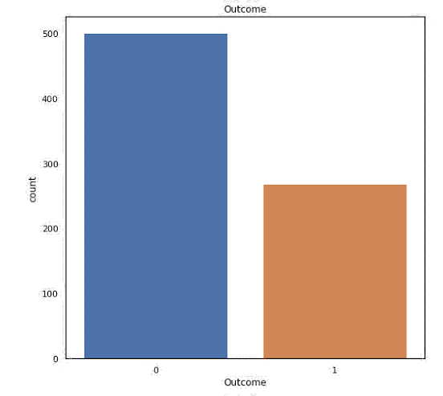
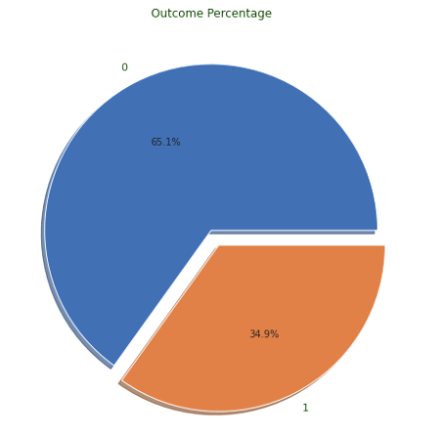
Exploratory data analysis
Target Variable: Outcome (0 or 1)
0 indicates not diabetic
1 indicates diabetic

Slide 17
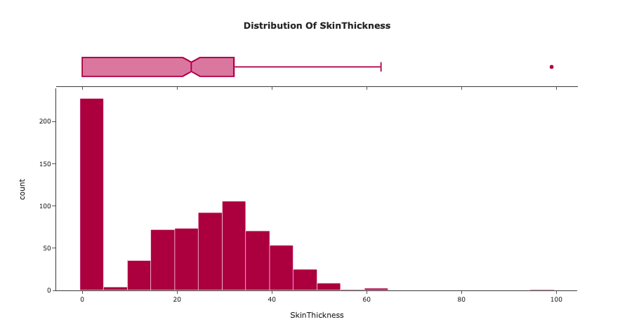
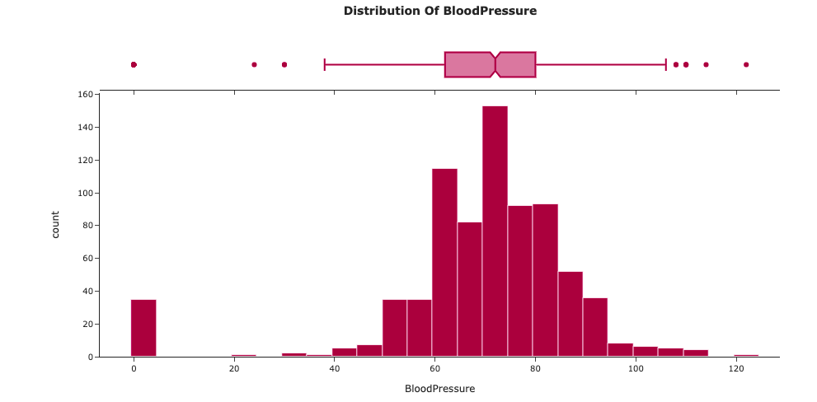
Univariate Analysis
It is the process of analyzing and understanding the trends of each variable in a dataset.
Graphical representations such as histograms and boxplots are used.

Slide 18
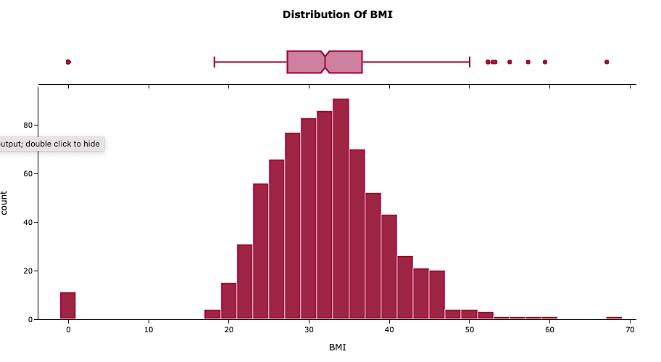
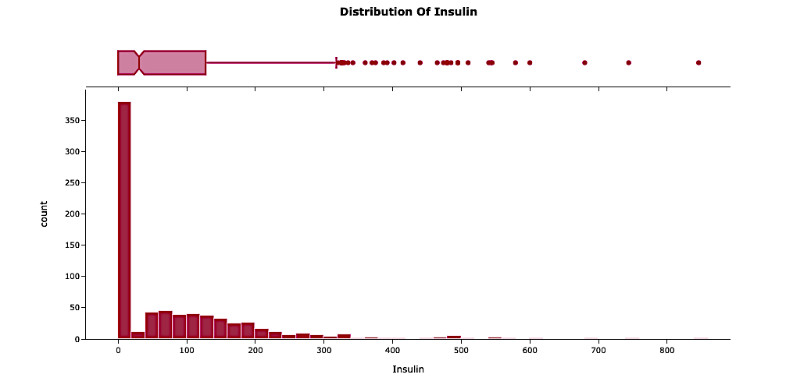
Univariate analysis of BMI and Insulin

Slide 19
Removing Outliers & Filling missing values
Name of Variable | Number of missing values
Pregnancies | 0
Glucose | 0
BloodPressure | 34
SkinThickness | 224
Insulin | 366
BMI | 11
DiabetesPedigreeFunction | 0
Age | 0
Outcome | 0
Before outlier removal the size of the dataset is
(768, 9)
After removing the outliers, the size of the dataset is
(748, 9)
Missing values:
Count of NaN values as shown in the table.
The missing values were filled with mean and median values

Slide 20
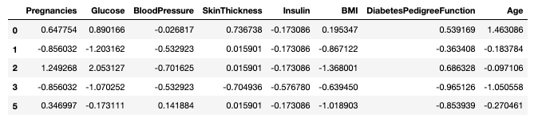
Standardization of the data :
The goal of standardizing the data is to convert it into a single scale values.
The mean and variance of every attribute is made 0 and 1 by performing standardization.
It is implemented by importing StandardScaler library
Train-Test split:
The dataset is divided into train and test sets in the ratio 70:30
Shape of X_train | (523, 8)
Shape of X_test | (225, 8)
Shape of y_train | (523, 1)
Shape of y_test | (225, 1)

Slide 21
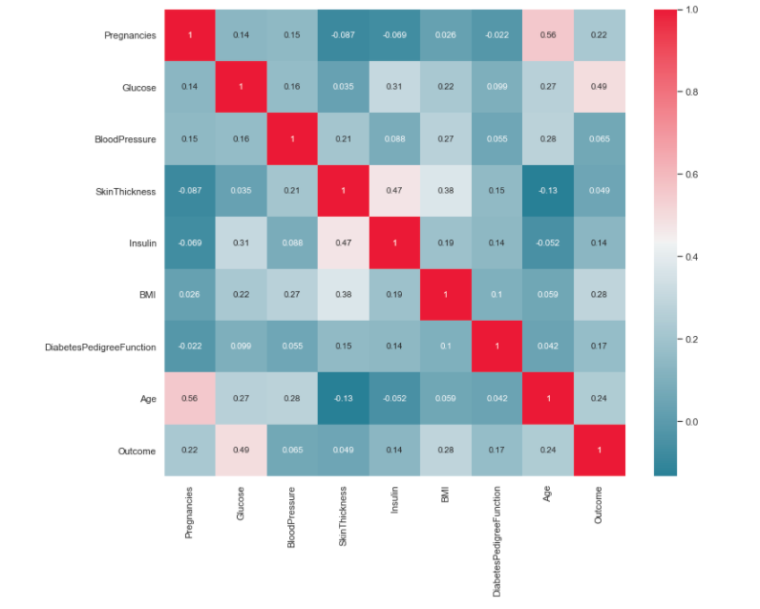
Correlation Analysis
Top three variables with high correlation coefficient values are:
Glucose – 0.49
BMI – 0.28
Age – 0.24

Slide 22

Evaluation metrics
Confusion matrix – True Positive, False Positive, True Negative, and False Negative
Classification Report - Accuracy, Precision, Recall, F1-score.
AUC-ROC Score and curve

Slide 23
Research Results
S.no | Model | Test accuracy | Train accuracy
1 | SVC | 79.55 | 76.2
2 | Random Forest | 78.22 | 100
3 | Logistic Regression | 78.22 | 81.64
4 | CNN | 77.3 | 74.7
5 | Gradient Boost or XGBoost | 76 | 100
6 | KNN | 75.11 | 81.64
7 | ANN | 74.2 | 80.6
8 | LSTM | 73.3 | 73.2
9 | Decision Tree | 71.11 | 100

Slide 24
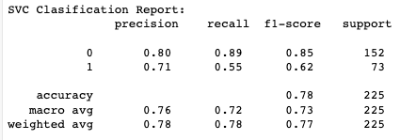
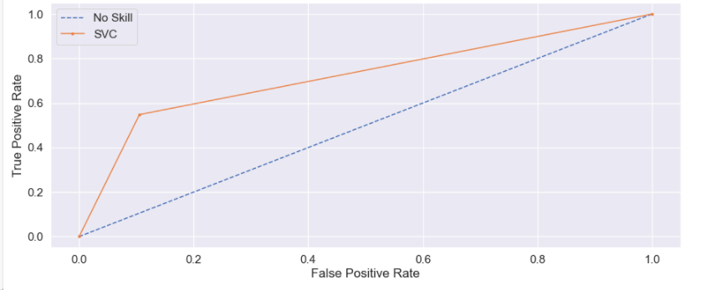
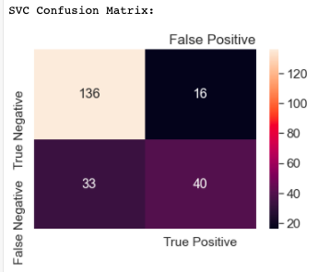
Best Model – SVC

Slide 25
Conclusion
In this project, the causes and effects of diabetes are understood.
By predicting diabetes using ML and DL algorithms, its serious effects on humans can be prevented.
The dataset has been analyzed by performing EDA.
Among all the algorithms used, Support Vector Classifier has shown highest accuracy of 79.5%.
Compared to deep learning models, machine learning models have shown a better accuracy.

Slide 26
Future Work
With the usage of large and variety kind of data, better accuracies can be achieved.
Methods such as hyperparameter optimization can be performed to improve the accuracies.
Instead of splitting the dataset, cross-validation technique can be applied.
Research can be conducted on how the model’s performance change, by adding new data.

