Slide 1
🌱 StorySprout
Intergenerational Knowledge Transfer Through AI Storytelling — Turned Into a Book for Every Child
"Sowing Yesterday's Wisdom, Growing Tomorrow's Minds."

Slide 2
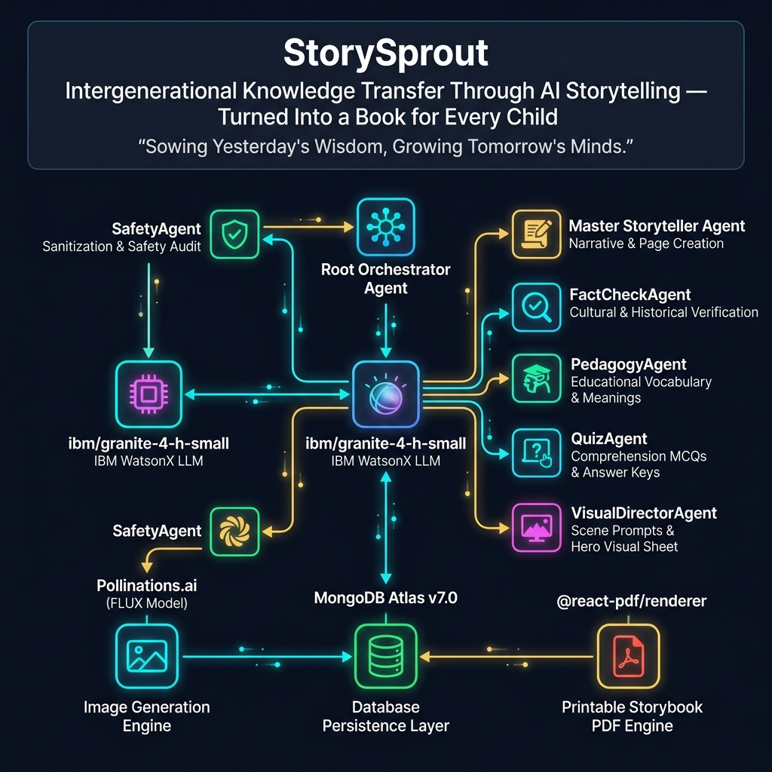
Multi-Agent System Architecture & Model Flow

Slide 3
Verified AI Models & Engine Specifications
Component / Sub-Agent | Verified Model / Engine | System Function
👑 Root Orchestrator | Python ThreadPoolExecutor | Coordinates sub-agent pipeline execution & thread concurrency
🛡️ Safety Agent | ibm/granite-4-h-small + Guardrails | Sanitizes input prompts & page safety auditing
✍️ Master Storyteller Agent | ibm/granite-4-h-small | Generates native narrative pages & title per age & language
🔍 Fact Check Agent | ibm/granite-4-h-small | Validates historical dates, people & cultural traditions
📖 Pedagogy Agent | ibm/granite-4-h-small | Extracts 4 age-tailored vocabulary words & meanings
🧩 Quiz Agent | ibm/granite-4-h-small | Builds 3 comprehension multiple-choice questions & key
🎨 Visual Director Agent | ibm/granite-4-h-small | Crafts scene illustration prompts & hero character sheet

