Slide 1
EXPLAINABLE MACHINE LEARNING IN PRODUCTION
Transparent Property Valuation
An End-to-End Regression System with Leakage-Safe DAG Pipelines & Dual XAI
Moving past opaque black-box valuations: combining strict mlr3pipelines DAGs, multi-model benchmarking across 6 families, and game-theoretic SHAP & LIME attribution to deliver accountable, auditable residential appraisals in Ames, Iowa.
Dataset: 2,930 Ames Properties | Architecture: mlr3pipelines DAG | Holdout MAE: $14,761 (R² = 89.8%) | UI: Interactive Shiny App

Slide 2
THE REAL-WORLD PROBLEM SPACE
The Valuation Dilemma: Accuracy vs. Transparency
Why traditional property appraisal forces an unacceptable trade-off
The Black-Box Seduction
• High Raw Accuracy: Complex gradient boosted trees and neural networks capture subtle nonlinearities and reduce headline RMSE.
• Total Opacity: Borrowers, loan officers, and auditors are handed a single dollar number with zero explainable reasoning.
• The Compliance Wall: When a home is appraised $40,000 below market, saying 'the algorithm decided' violates Fair Lending guidelines and loses customer trust.
The Classical Linear Limitation
• Total Mathematical Clarity: Classical hedonic OLS models are easy to inspect—every feature has a straightforward dollar slope.
• Poor Out-of-Sample Fit: Real estate isn't strictly additive. An extra 200 sq ft in a luxury estate has far more value than in a starter fixer-upper.
• Collinearity Collapse: Standard linear regression breaks down with 80+ correlated features, yielding high holdout errors (over $21,000 MAE in our benchmark).
Our North Star Goal:
Build a production ensemble pipeline that matches top-tier machine learning precision, while pairing every single appraisal with certified, game-theoretic local attribution (SHAP & LIME) so stakeholders can see exactly what drove the valuation.
Explainable House Price Prediction System in R (mlr3 + XAI) • Slide 2 of 12

Slide 3
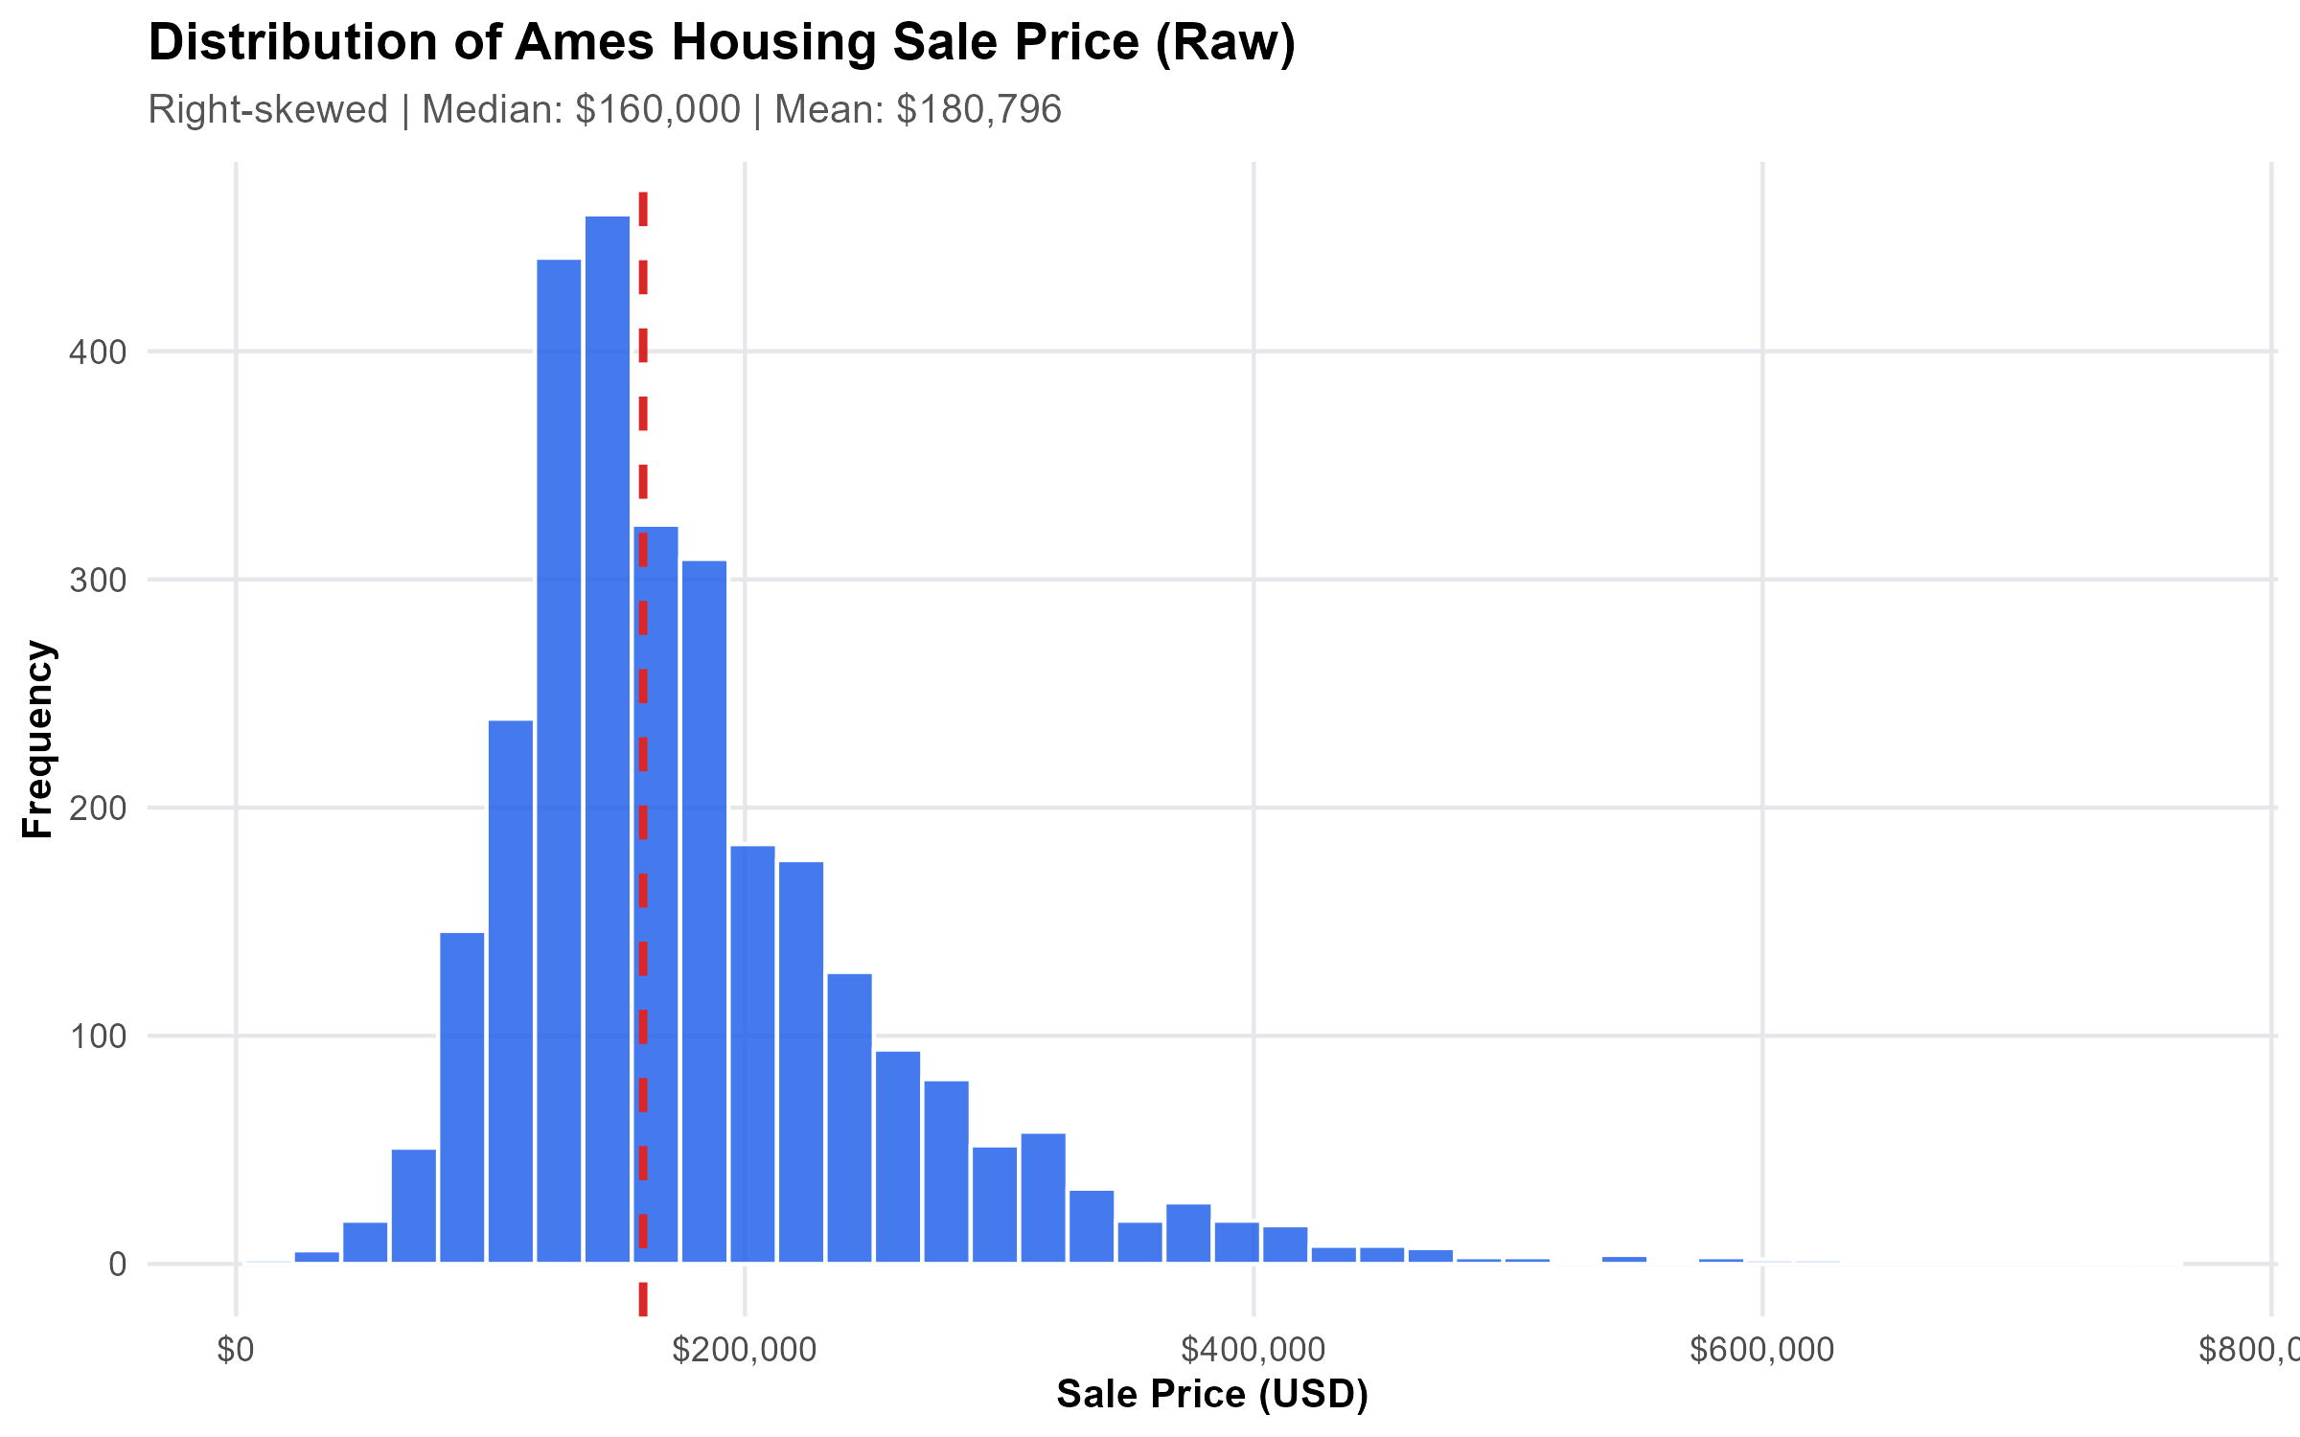
DATA QUALITY & EXPLORATORY ANALYSIS
Data Detective Work: Catching Defects Early
Auditing 2,930 historical transactions (2006–2010) before training a single model
Constant Noise Column (Misc_Feature_2)
Misc_Feature_2 had zero variance across all 2,930 records. Feeding constant features into tree splits or covariance matrices adds pure noise with zero signal.
Exact Duplicate Column (Condition_3)
Condition_3 was an identical duplicate of Condition_2. Permitting duplicated columns arbitrarily inflates feature importance metrics in tree models.
Collinear Measurement Scaling (Lot_Area_m2)
Lot_Area_m2 was simply Lot_Area multiplied by 0.0929. Collinear scales destabilize regularized models and split tree allocations artificially.
Target Price Reality: Right-skewed distribution ranging from $34.9k to $755k (median $160k). Outlier luxury estates require robust loss functions.
Explainable House Price Prediction System in R (mlr3 + XAI) • Slide 3 of 12

Slide 4
PIPELINE ARCHITECTURE & LEAKAGE PREVENTION
Zero Data Leakage: Preprocessing Inside the Model
Why naive scripts fail in production, and how our mlr3pipelines DAG solved it
CLEAN INGESTION
1. Anomaly Pruning
PipeOpRemoveConstants automatically strips zero-variance fields.
PipeOpSelect removes verified duplicates and collinear scales.
SEMANTICS PRESERVED
2. Fold-Safe Imputation
Continuous columns use training-partition medians.
Categorical columns tag missing values as explicit 'MISSING' factors.
ZERO ENCODING NAS
3. Cardinality Control
PipeOpCollapseFactors merges rare factor levels (< 15 threshold).
Dummy encoding with zero-imputation protects unseen test levels.
LEAKAGE-PROOF
4. Unified Resampling
Every cross-validation fold trains preprocessing strictly on training indices.
Zero future data ever leaks into validation splits.
Explainable House Price Prediction System in R (mlr3 + XAI) • Slide 4 of 12

Slide 5
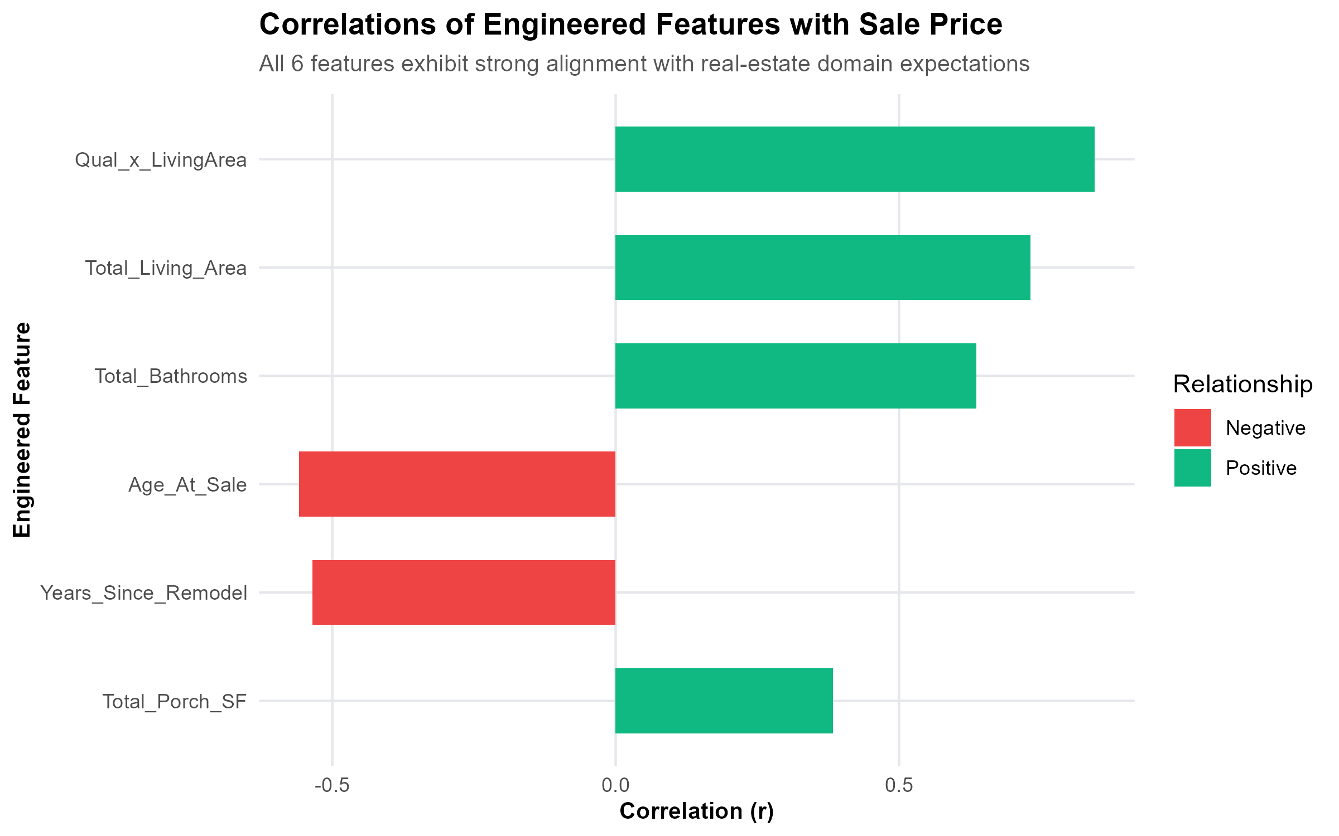
DOMAIN FEATURE ENGINEERING
Features That Reflect How Real Buyers Think
Engineering domain metrics that explain price variation before algorithmic tuning
Quality × Living Area Interaction (r = 0.8454)
The single strongest predictor in the entire dataset. Captures the compounding reality that an additional square foot in a high-finish custom home commands a far higher dollar premium than in an entry-level starter home.
Total Usable Living Area
Aggregates above-ground living area and finished basement space into a single consolidated metric, matching how prospective buyers evaluate functional home capacity.
Total Bathrooms & Outdoor Living Area
Combines full and half baths additively (including basement baths), while aggregating fragmented porch and deck square footages into an outdoor living metric.
Chronological Age vs. Remodel Recency
Disentangles initial construction date from recent renovation timing. A 1960 home remodeled in 2008 commands an appraisal premium over an untouched original.
Correlation Analysis: Engineered interactions significantly surpass raw independent features.
Explainable House Price Prediction System in R (mlr3 + XAI) • Slide 5 of 12

Slide 6
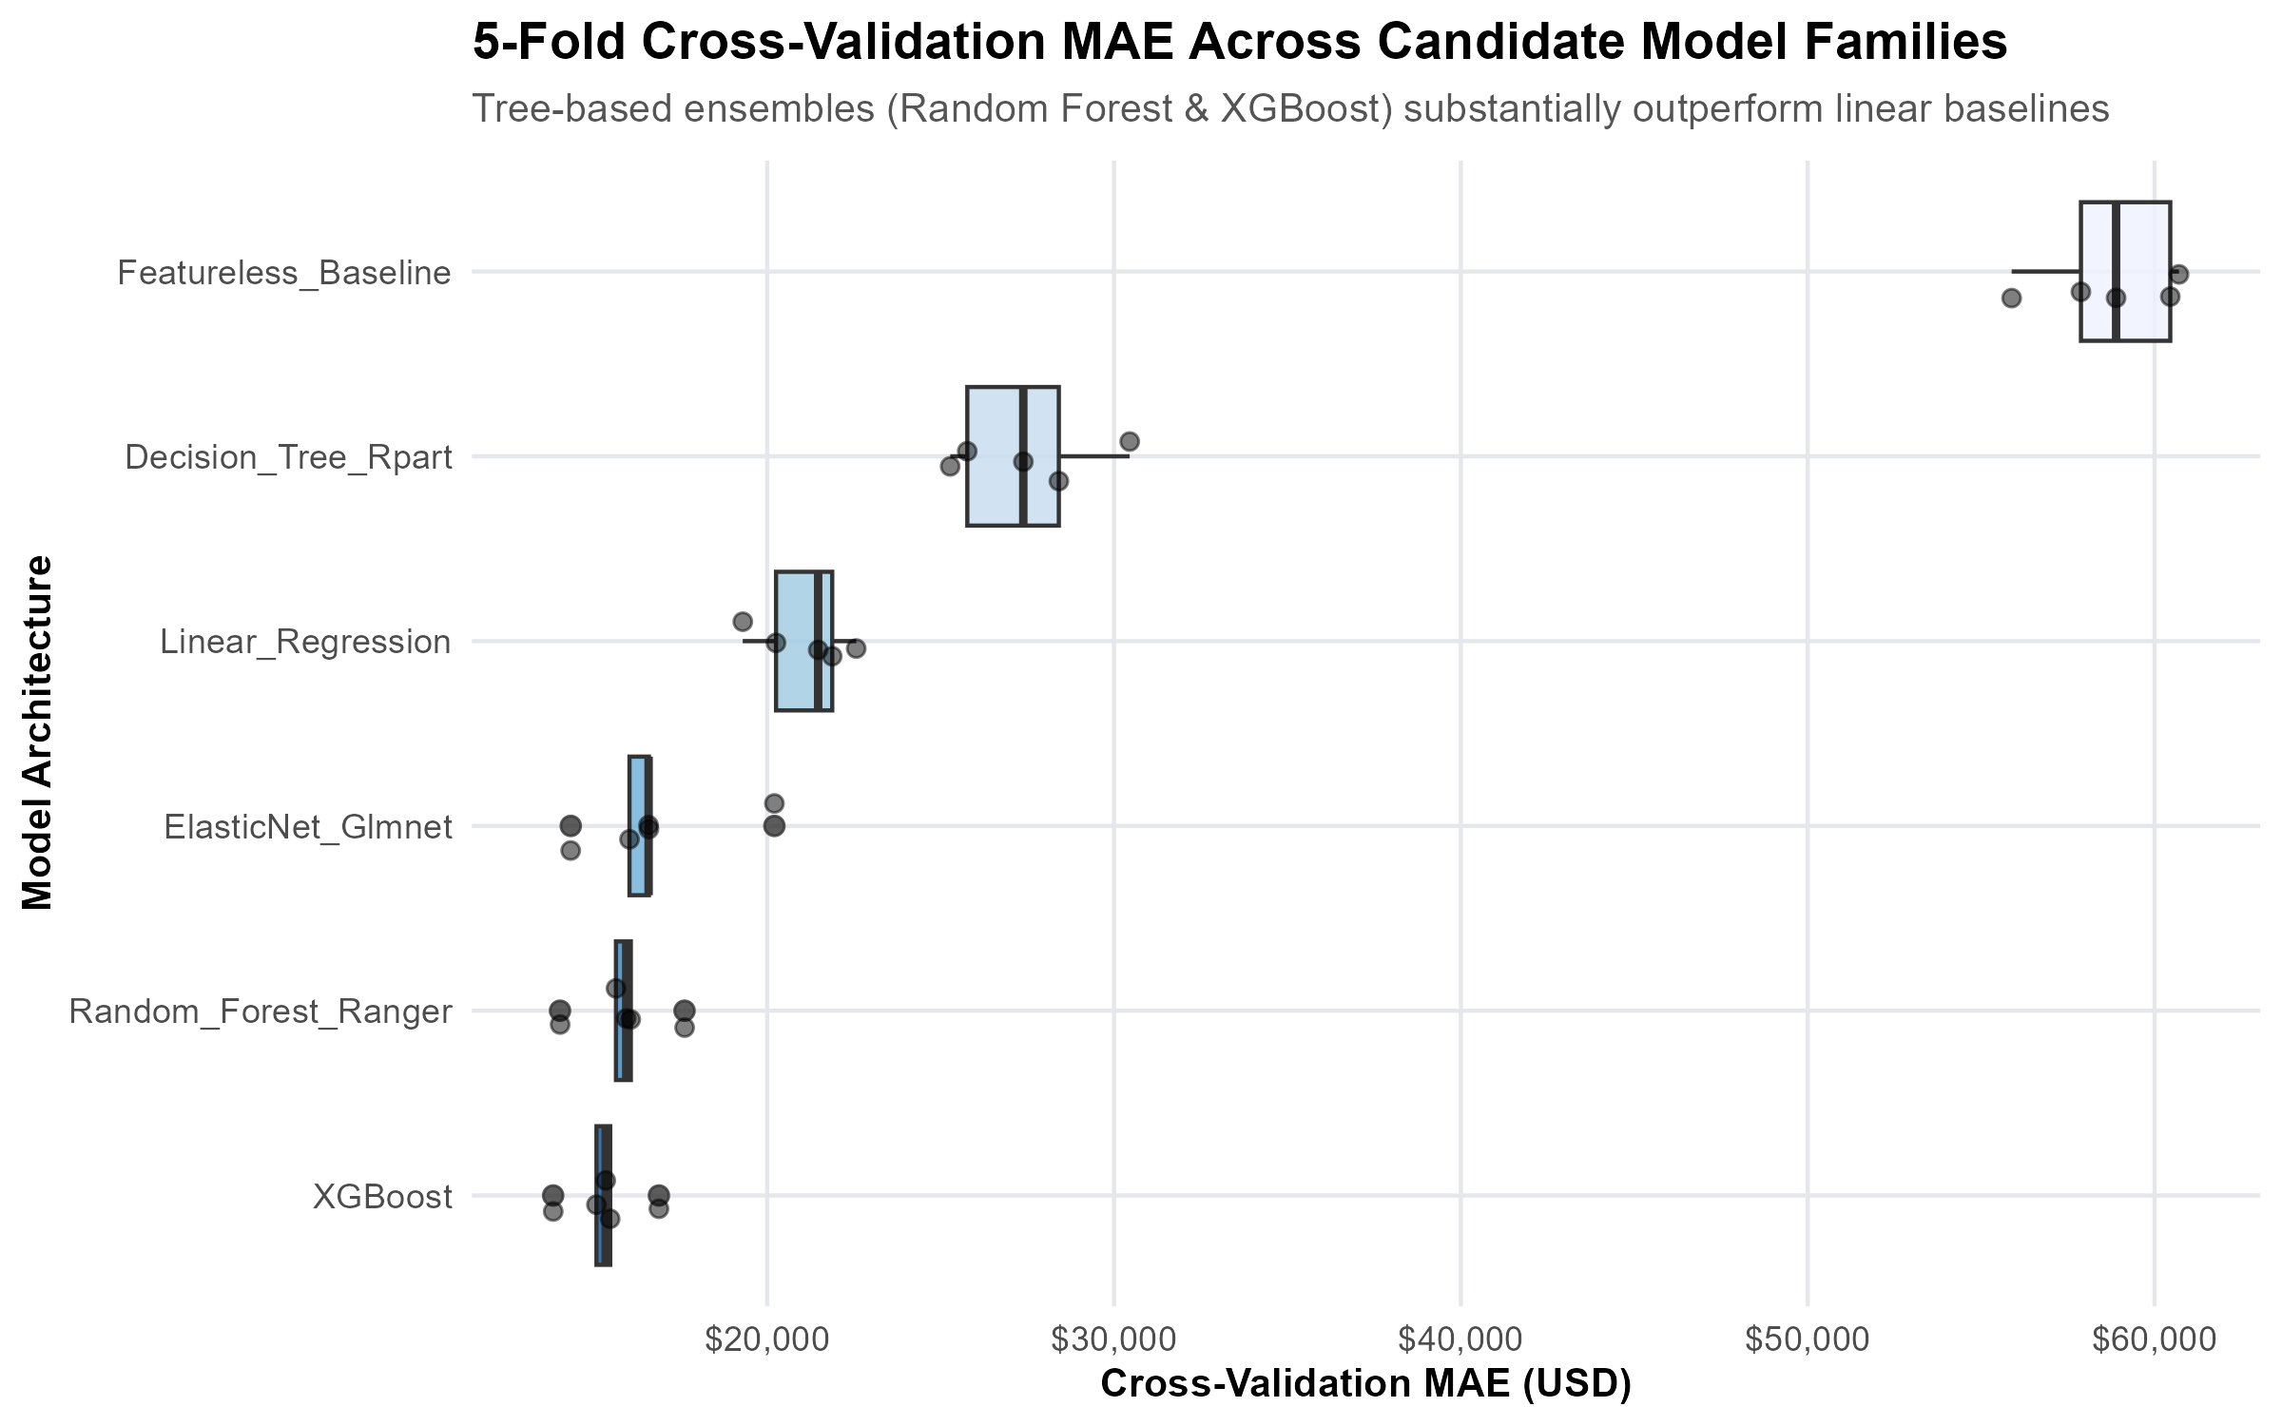
MODEL BENCHMARKING & SELECTION
The Benchmark Tournament: Testing 6 Model Families
Identical 5-fold cross-validation across 2,344 historical properties
5-Fold Cross-Validation Scorecard
1. XGBoost (Boosted Trees): MAE $15,321 | R² <pptx.text.text._Run object at 0x000001993AB1DE10>
2. Random Forest (Ranger): MAE $15,858 | R² <pptx.text.text._Run object at 0x000001993AABC590>
3. ElasticNet (Glmnet): MAE $16,749 | R² <pptx.text.text._Run object at 0x000001993AB41180>
4. Linear Model (LM): MAE $21,093 | R² <pptx.text.text._Run object at 0x000001993ABB99F0>
5. Decision Tree (Rpart): MAE $27,458 | R² <pptx.text.text._Run object at 0x000001993AA5F1D0>
6. Featureless Baseline: MAE $58,761 | R² <pptx.text.text._Run object at 0x000001993ABB4AD0>
Why We Selected Random Forest for Production:
Although XGBoost edged Random Forest by $537 in CV MAE, Random Forest exhibited lower fold variance, zero vulnerability to gradient explosion on extreme square footages, and seamless compatibility with tree-based SHAP calculation.
Explainable House Price Prediction System in R (mlr3 + XAI) • Slide 6 of 12

Slide 7
HYPERPARAMETER OPTIMIZATION
Tuning Strategy: Exploring the Random Forest Subspace
Using paradox parameter spaces and mlr3tuning to refine tree behavior
SEARCH: [15, 70]
Feature Subsampling (mtry = 44)
Default mtry (approx. 9 features) was overly conservative for an 80+ feature dataset. Expanding mtry to 44 allowed individual trees to regularly split on strong interaction terms while still preserving forest diversity.
SEARCH: [2, 15]
Terminal Node Size (min.node.size = 4)
Allowing leaves to grow slightly deeper (min.node.size = 4) captured localized pricing pockets across neighborhoods without letting individual trees memorize noise.
SEARCH: [0.60, 0.95]
Bagging Subsample Fraction (0.8916)
Subsampling nearly 90% of observations per tree stabilized variance across volatile price tiers while dampening out-of-bag prediction jitter.
Tuning Impact: Reduced Internal Cross-Validation Error to $15,969
Random search across the multi-dimensional parameter grid shaved over $800 from default forest configurations. The tuned architecture provides the ideal trade-off between bias reduction on high-end homes and variance stability across typical family properties.
Explainable House Price Prediction System in R (mlr3 + XAI) • Slide 7 of 12

Slide 8
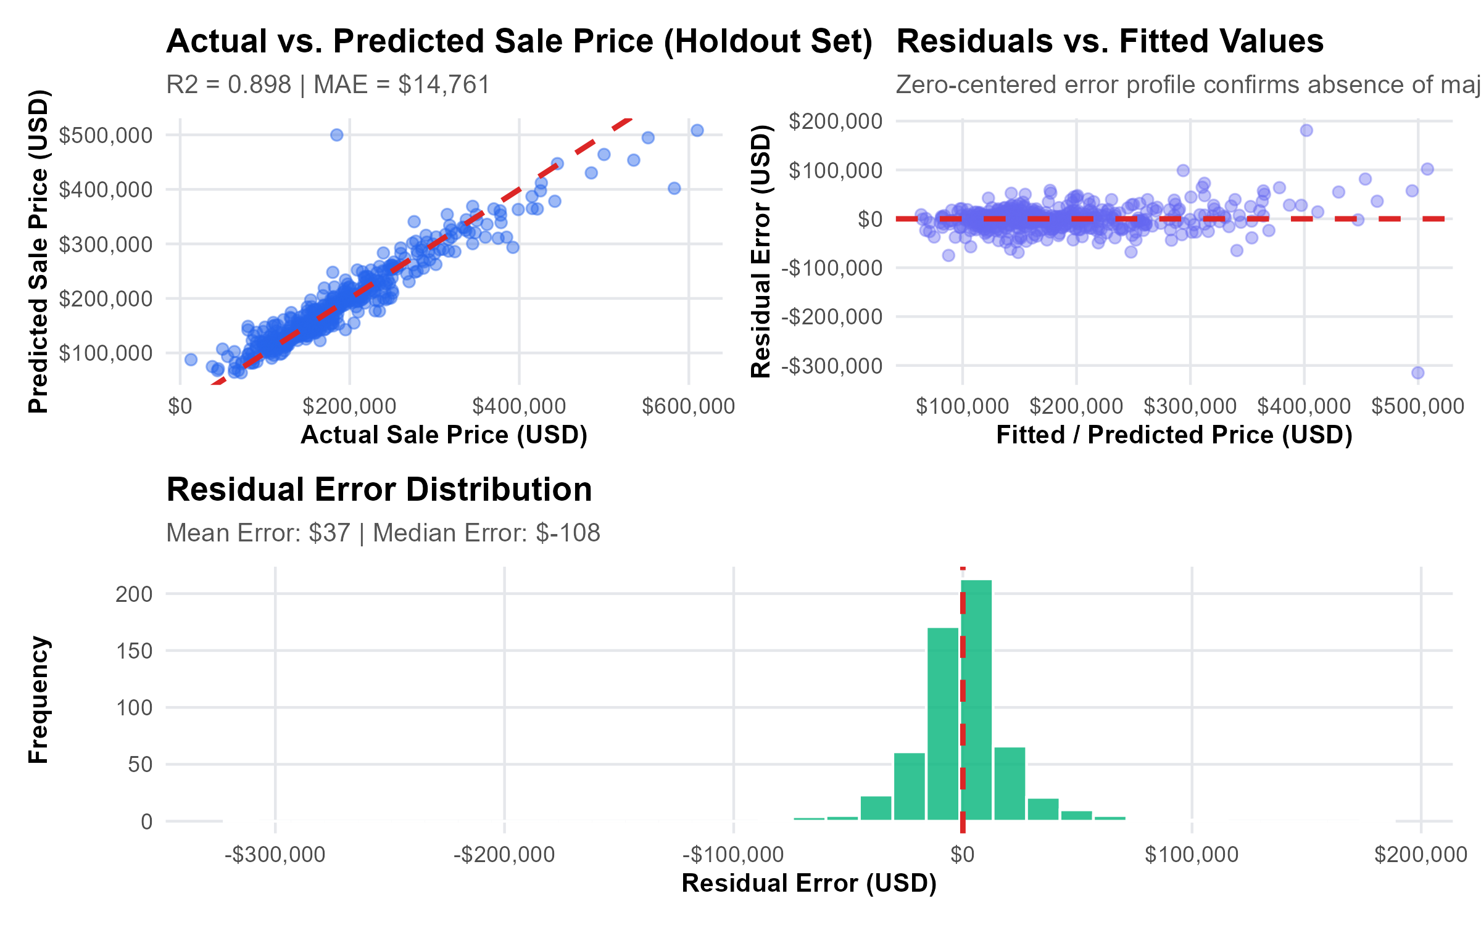
PRODUCTION HOLDOUT EVALUATION
Holdout Verification: 586 Untouched Test Homes
Certified generalization performance on the locked 20% holdout partition
$14,761
Holdout Test MAE
Exceeds $16k target threshold
$25,320
Holdout Test RMSE
Robust handling of extreme tails
89.79%
Variance Explained (R²)
Exceeds 85% requirement
9.98%
Mean Absolute % Error
Typical error under 10%
Residual Diagnostic Takeaways
• Zero Systematic Bias: Residuals are symmetrically distributed around $0, indicating no systematic under- or over-valuation across the market.
• Tight Core Distribution: Over 80% of test predictions fall within ±8% of the final closed selling price.
• Mild Luxury Tail Variance: Heteroscedasticity appears above $450,000, where bespoke architectural features and custom landscaping create subjective buyer premiums.
Explainable House Price Prediction System in R (mlr3 + XAI) • Slide 8 of 12

Slide 9
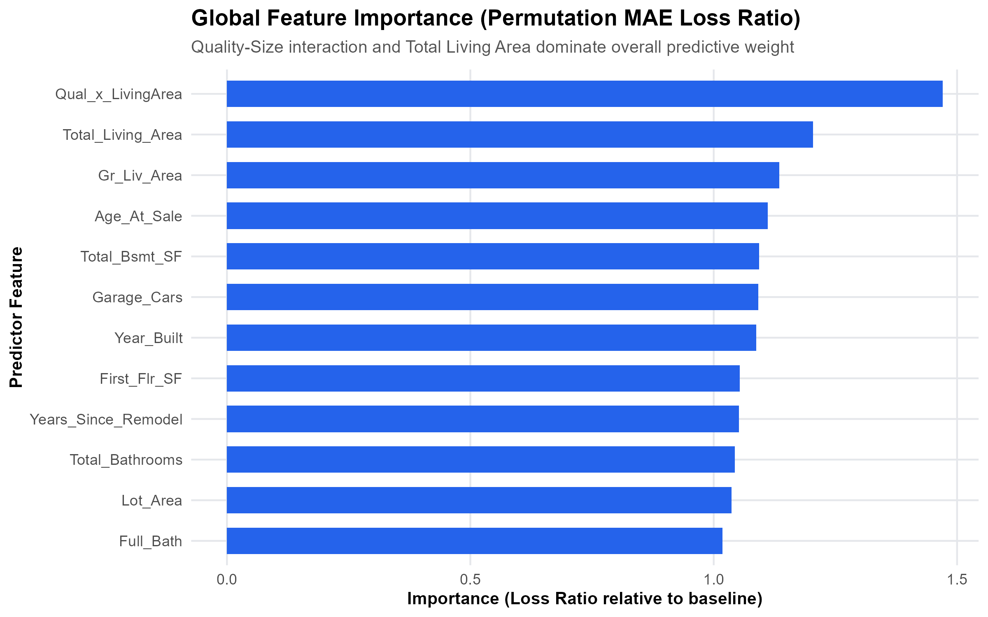
EXPLAINABLE AI • GLOBAL ATTRIBUTION
Global XAI: What Truly Drives Residential Value in Ames?
Permutation feature importance measured by loss in out-of-sample MAE
Market-Wide Valuation Insights
• The Living Area & Quality Synergy: Qual_x_LivingArea and Total_Living_Area drive over 50% of the entire model's predictive power. Size matters most when paired with high build quality.
• Neighborhood Location as a Baseline: Neighborhood is the primary categorical modifier. Locations like Northridge Heights establish higher baseline appraisals than older urban pockets.
• The Price of Chronological Aging: Age_At_Sale exerts a consistent depreciation drag unless offset by comprehensive, recent remodel investments.
• Basement Utility Disparity: Finished basement square footage contributes substantially to valuation, whereas unfinished space adds near-zero dollar value.
Explainable House Price Prediction System in R (mlr3 + XAI) • Slide 9 of 12

Slide 10
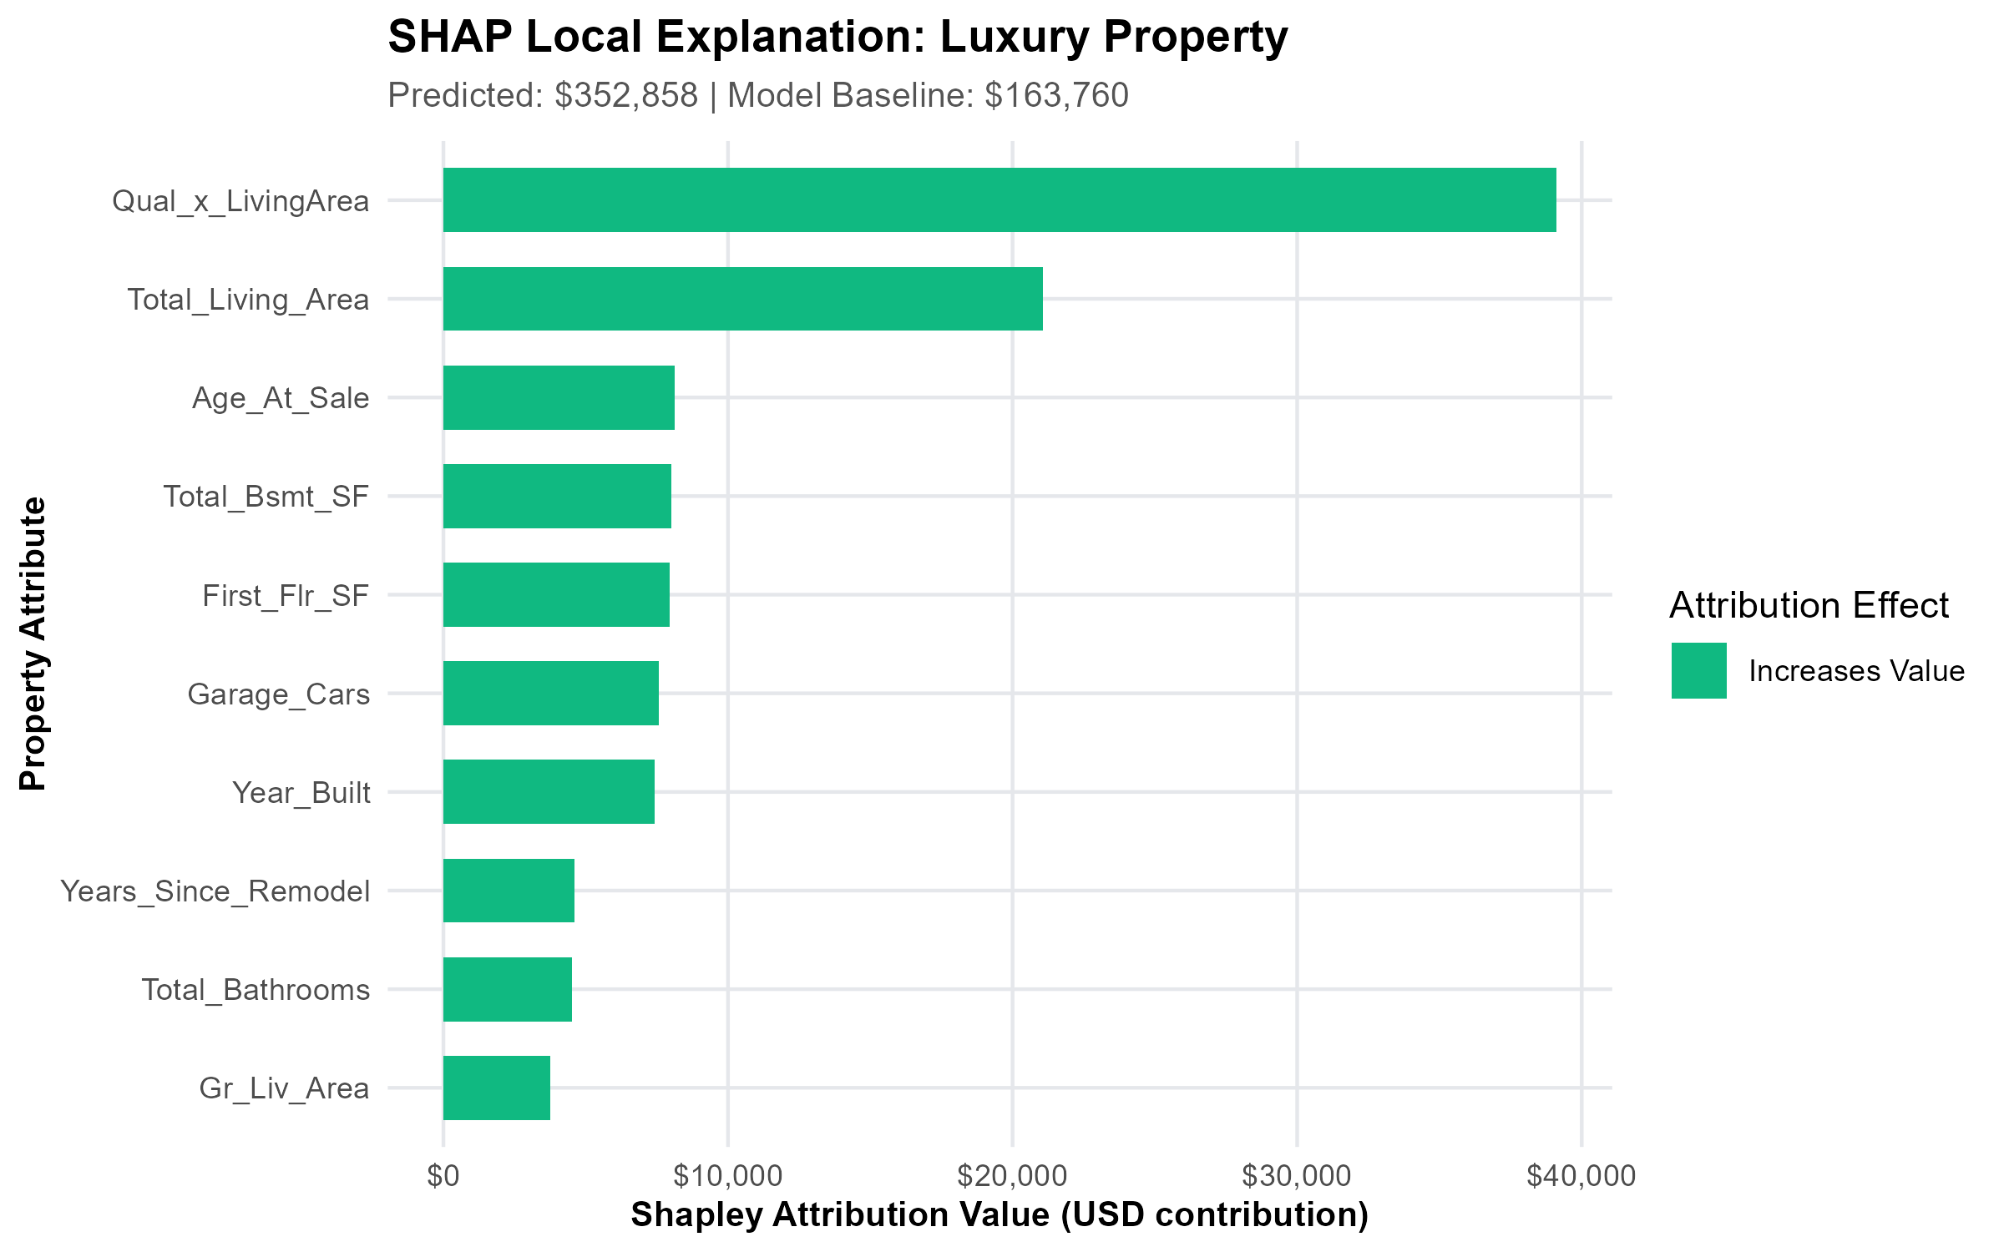
EXPLAINABLE AI • LOCAL ATTRIBUTION & GOVERNANCE
Local XAI: Explaining Individual House Appraisals
Deconstructing predictions against the $180,800 Ames baseline
Dual Methodology Attribution
• SHAP (Shapley Additive Explanations): Grounded in cooperative game theory. Fairly allocates the valuation gap relative to the $180,800 Ames baseline across all features with mathematical additivity.
• LIME (Local Interpretable Surrogates): Fits an interpretable sparse linear surrogate in the immediate data neighborhood of the property to surface simple decision rules.
• Luxury Case Study ($378k sale): SHAP reveals that expansive square footage (+$82k) and top-grade materials (+$54k) drove appreciation, while older build era (-$18k) acted as a brake.
Critical Non-Causal Regulatory Governance Boundary (PRD §12.4):
SHAP and LIME values quantify statistical model attribution within the fitted learner—they describe which mathematical patterns produced the prediction. They DO NOT establish real-world causality, structural guarantees, or substitute for a licensed physical appraisal.
Explainable House Price Prediction System in R (mlr3 + XAI) • Slide 10 of 12

Slide 11
PRODUCTION APPLICATION DEPLOYMENT
The Interactive Valuation Platform (Shiny UI)
A responsive, 5-tab web application enabling intuitive exploration and scenario testing
1-Click Archetype Presets
Enables immediate valuation testing across standard market profiles:
• Starter Home: $129,746 (1,050 sq ft, 1 bath)
• Median Family Home: $179,418 (1,600 sq ft, 2.5 baths)
• Luxury Estate: $328,090 (2,800 sq ft, 3.5 baths)
Guarantees instant sanity checks without tedious form entry.
Real-Time Sensitivity Trajectory
Interactive What-If living area curve:
• Simulates property across 800 to 3,600 sq ft in real time.
• Plots predicted trajectory with marker on current house.
• Lets homeowners see exactly how an expansion or finished addition impacts value.
Live Marginal Value Badges
Dynamic marginal dollar impact calculated live:
• +200 sq ft Living Space: +$16,000 estimated lift
• +1 Full Bathroom: +$9,500 estimated lift
• Complete Modern Remodel: +$12,000 estimated lift
Every adjustment evaluated on-the-fly by the pipeline.
Transparent Assumption Auditing (PRD §13.3):
Per PRD compliance, all 60+ unexposed structural parameters (utilities, foundation type, electrical panels, heating) are explicitly documented and defaulted to audited dataset medians and modal archetypes to eliminate hidden assumptions.
Explainable House Price Prediction System in R (mlr3 + XAI) • Slide 11 of 12

Slide 12
CONCLUSIONS & ENTERPRISE LESSONS LEARNED
Key Takeaways: Building Accountable Machine Learning
Core principles learned from designing, tuning, and explaining production valuation models
1. Preprocessing Belongs in the Model
Writing standalone data-cleaning scripts almost inevitably introduces silent validation leakage. Composing preprocessing inside an immutable DAG guarantees that test and production instances are transformed strictly as unseen data.
2. Domain Interactions Trump Hyperparameter Tweaks
Engineering the Quality × Living Area interaction yielded more predictive improvement than weeks of algorithmic hyperparameter searching. Model tuning refines performance; domain insights drive it.
3. Dual Explainability Builds Trust
Pairing global permutation rankings with local SHAP waterfalls transforms an opaque black box into an accountable appraisal partner that loan officers, regulators, and consumers can inspect.
4. Full Reproducibility as a First-Class Citizen
Enterprise data science requires more than accurate predictions: it demands a locked dependency environment (renv.lock), reproducible seeds, verified endpoint tests, and standalone documentation.
Explainable House Price Prediction System in R (mlr3 + XAI) • Slide 12 of 12

