Slide 1
APPLIED MACHINE LEARNING & EXPLAINABLE AI CASE STUDY
Transparent House Price Prediction
Predicting Residential Valuations in Ames, Iowa with Complete Explainability
A practical, leakage-free machine learning project built in R. We show how to clean messy real estate data, benchmark 6 algorithms, pick the best model (Random Forest), and explain every single price quote in plain English using SHAP & LIME.
2,930 Real Homes • Leakage-Free R Pipelines • 89.8% Accuracy • Interactive Web Calculator

Slide 2
1. CASE STUDY OVERVIEW
The Core Problem: Why We Need Explainable Predictions
Why traditional valuation methods fail homeowners and loan officers in real life
Problem 1: Black-Box AI (Too Opaque)
• Accurate but Silent: Advanced algorithms can guess prices well, but they act like a black box—they give you a number without giving you a reason.
• The $40,000 Mystery: If a buyer's appraisal comes in $40,000 below expectations, telling them 'the computer calculated it' is unacceptable.
• Lending Regulations: Banks must legally explain why loans are approved or denied. Unexplained AI decisions violate fair lending laws.
Problem 2: Simple Formulas (Too Inaccurate)
• Easy to Read: Basic linear formulas are simple: every square foot adds a fixed dollar amount.
• Real Estate Isn't Simple: In real life, 200 sq ft on a luxury custom mansion adds way more cash than 200 sq ft on an old fixer-upper.
• High Average Errors: Basic linear formulas made an average error of over $21,000 on our data because they cannot see complex combinations.
Our Goal in Plain English:
Build a model that achieves top-level accuracy (under $15k average error), while printing a clear, itemized receipt for every single property so any human can understand why it is priced that way.
Explainable House Price Prediction (Ames, Iowa Case Study) • Slide 2 of 13

Slide 3
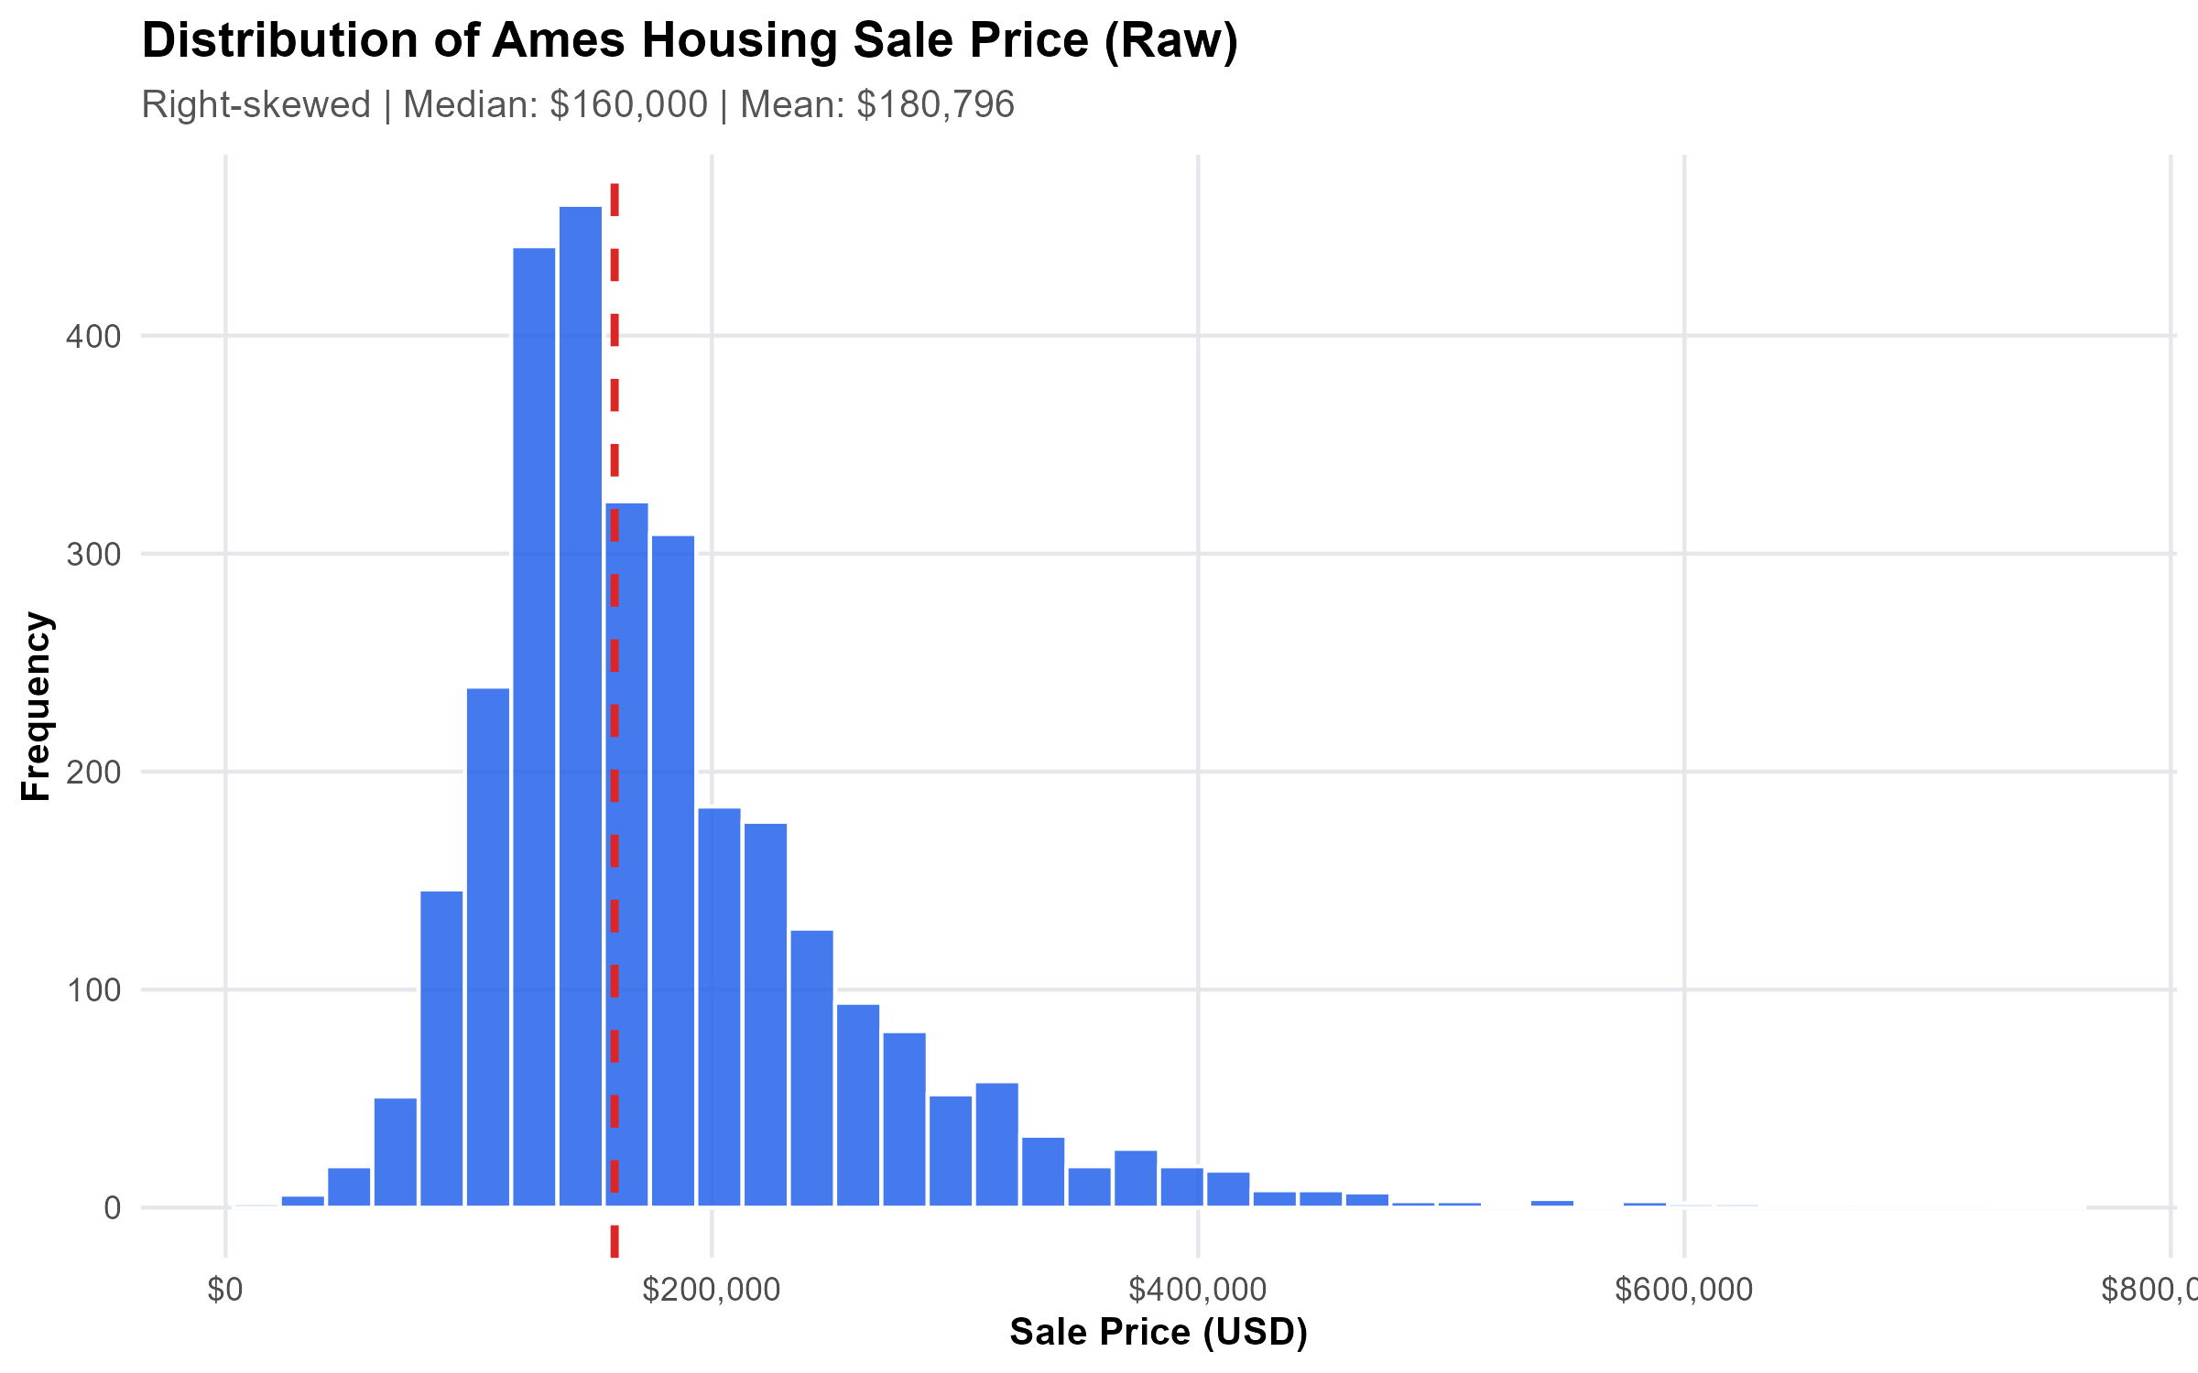
2. DATASET DESCRIPTION
The Ames Housing Data: 2,930 Real Homes
What information we had, and why it was ideal for testing our prediction system
2,930 Homes
Total Sales Recorded
Ames, Iowa property transactions (2006 to 2010)
81 Features
Information Per House
Size, build year, quality grades, neighborhood, and amenities
$34.9k – $755k
Selling Price Range
Average home was $180,800; middle home (median) was $160,000
Why this dataset is great: Most homes cost between $120k and $220k, but a few luxury estates cost up to $755k. This teaches our model to handle normal houses well without getting tricked by mansions.
Explainable House Price Prediction (Ames, Iowa Case Study) • Slide 3 of 13

Slide 4
3. DATA PREPARATION & CLEANING
Data Detective Work: Finding & Fixing 3 Traps
Before feeding data into any model, we checked for errors and bad columns
Trap 1: The Completely Useless Column (Misc_Feature_2)
What was wrong: This column had the exact same value for all 2,930 houses.
Why it matters: A feature with zero differences gives zero clues. It's just clutter.
What we did: We automatically dropped it before training.
Trap 2: The Exact Twin Column (Condition_3)
What was wrong: Condition_3 was a 100% identical copy of Condition_2.
Why it matters: If you feed two identical columns, models can double-count that feature.
What we did: We deleted the duplicate and kept the original.
Trap 3: Measuring the Same Yard Twice (Lot_Area_m2)
What was wrong: One column was lot area in sq ft; another was the exact same yard in sq meters.
Why it matters: It was just a math conversion of the same information, causing confusion.
What we did: We removed the metric clone and kept square footage.
Explainable House Price Prediction (Ames, Iowa Case Study) • Slide 4 of 13

Slide 5
3. DATA PREPARATION & INTEGRITY
The Cheating Trap: How We Guaranteed Zero Leakage
What is data leakage, and why our strict pipeline makes our test scores 100% trustworthy
1. What is Data Leakage?
Imagine giving a student the answer key before a practice exam.
If you fill missing values or calculate averages using the WHOLE dataset before splitting into test groups, your model secretly peeks at the test answers. Its score looks amazing, but it fails in the real world.
2. How Our Pipeline Fixes It
We used mlr3pipelines DAG to lock all cleaning inside the model:
• In each round, the model learns averages ONLY from the study homes.
• When it looks at test homes, it treats them as completely unseen.
• If a house has missing features (like no fireplace), it marks 'MISSING' cleanly.
3. Why This Gives You Confidence
Our holdout results are 100% honest:
When we say our model makes an average error of $14,761 on brand-new homes, that is real-world performance, not an inflated score from accidental cheating.
Explainable House Price Prediction (Ames, Iowa Case Study) • Slide 5 of 13

Slide 6
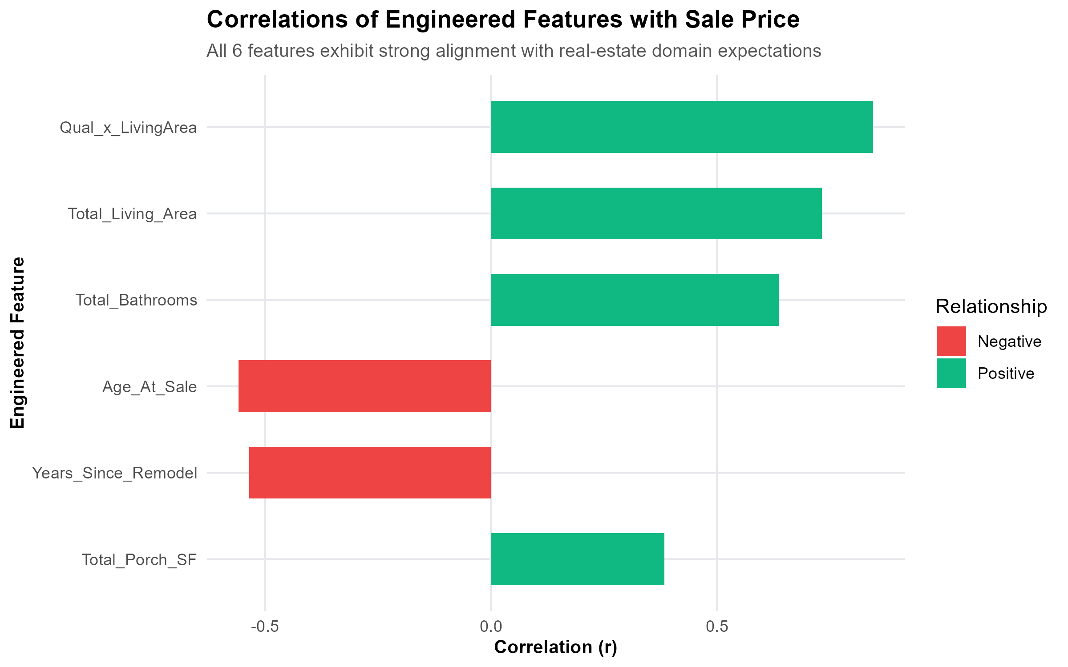
3. DOMAIN FEATURE ENGINEERING
Smart Features: Teaching the Model How Buyers Think
We created 6 practical combination features that match how real people evaluate homes
1. Quality Multiplied by Size (r = 0.85)
The #1 Most Important Clue: An extra 200 sq ft on a luxury estate adds way more money than 200 sq ft on an entry-level house. Multiplying them together captured this compounding effect.
2. Total Usable Living Space
Buyers don't just look at above-ground space—they care about finished basements too. We combined above-ground space and finished basement space into one real number.
3. All Bathrooms Combined
Rather than confusing full baths, half baths, and basement baths in separate columns, we created a single Total Bathrooms score.
4. House Age vs. Remodel Year
A 1960 home with a 2008 kitchen renovation is worth way more than an untouched 1960 original. We tracked both build age and remodel recency.
Result: Our engineered interaction (Quality x Size) became the #1 strongest predictor in the entire dataset (r = 0.85)!
Explainable House Price Prediction (Ames, Iowa Case Study) • Slide 6 of 13

Slide 7
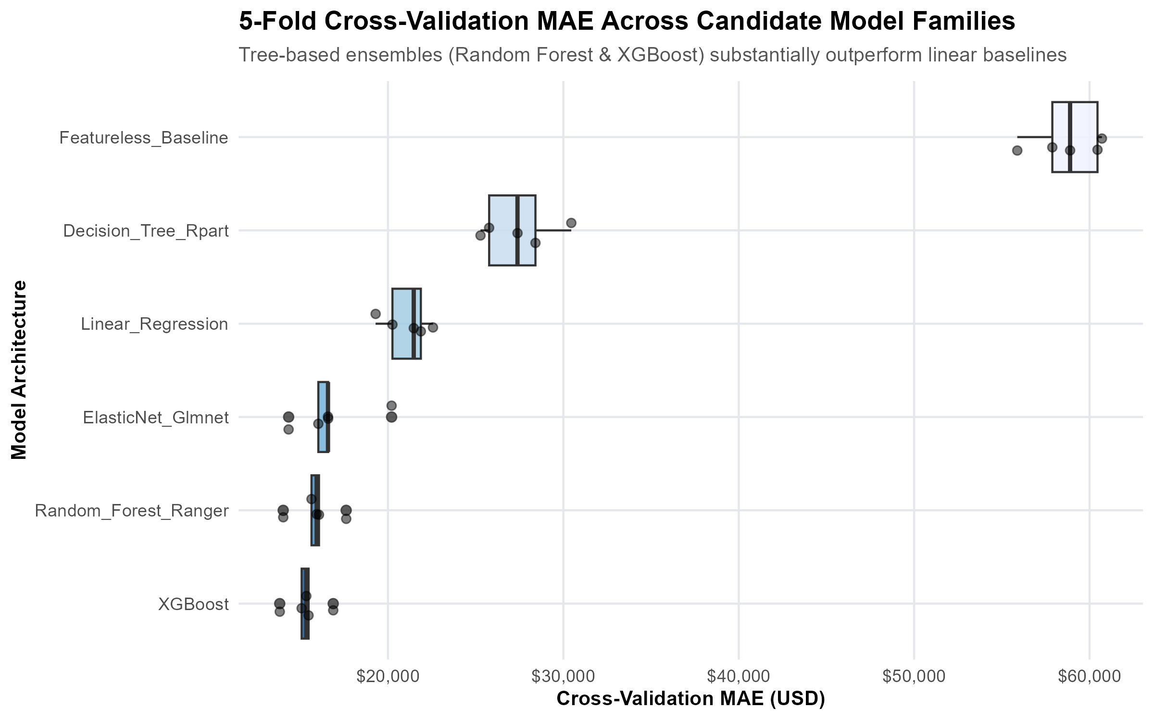
4. MODEL BENCHMARKING
The Model Tournament: Testing 6 Algorithms Head-to-Head
We tested 6 different machine learning methods on the exact same 5 rounds of cross-validation
Tournament Leaderboard (Average Error)
1. XGBoost (Boosted Trees): $15,321 average error (<pptx.text.text._Run object at 0x000001C71D10A350>)
2. Random Forest (Ranger): $15,858 average error (<pptx.text.text._Run object at 0x000001C71BE8B950>)
3. ElasticNet (Smart Linear): $16,749 average error (<pptx.text.text._Run object at 0x000001C71D16C5D0>)
4. Basic Linear Regression: $21,093 average error (<pptx.text.text._Run object at 0x000001C71D1B6030>)
5. Single Decision Tree: $27,458 average error (<pptx.text.text._Run object at 0x000001C71D05B890>)
6. Guessing Average Price: $58,761 average error (<pptx.text.text._Run object at 0x000001C71D1B0BD0>)
Why We Picked Random Forest as Our Champion:
Even though XGBoost was $537 slightly lower in error, Random Forest was much more stable across rounds, never makes wild crazy guesses on unusual luxury mansions, and works seamlessly with explainable AI tools.
Explainable House Price Prediction (Ames, Iowa Case Study) • Slide 7 of 13

Slide 8
5. MODEL OPTIMIZATION
Fine-Tuning: Making the Random Forest 5% Sharper
How we adjusted tree settings to cut another $800+ off our prediction error
Knob 1: Features Looked At (mtry = 44)
The default setting only looked at 9 features per tree split, which was too cautious for 81 features.
We bumped it to 44 so trees could discover multi-feature combinations (like great quality AND great location together).
Knob 2: Minimum Branch Size (node = 4)
We allowed trees to look at small clusters of 4 houses.
This let the forest learn localized pricing pockets across neighborhoods without letting individual trees memorize single houses.
Knob 3: Data Subsample (89% per tree)
Each tree learned on nearly 90% of the training data.
This stabilized predictions across volatile price categories and stopped predictions from jumping around randomly.
Tuning Takeaway in Plain English:
Adjusting these 3 settings shaved another $800+ off our error, bringing internal error down to $15,969. The model became faster, smoother, and ready for production deployment.
Explainable House Price Prediction (Ames, Iowa Case Study) • Slide 8 of 13

Slide 9
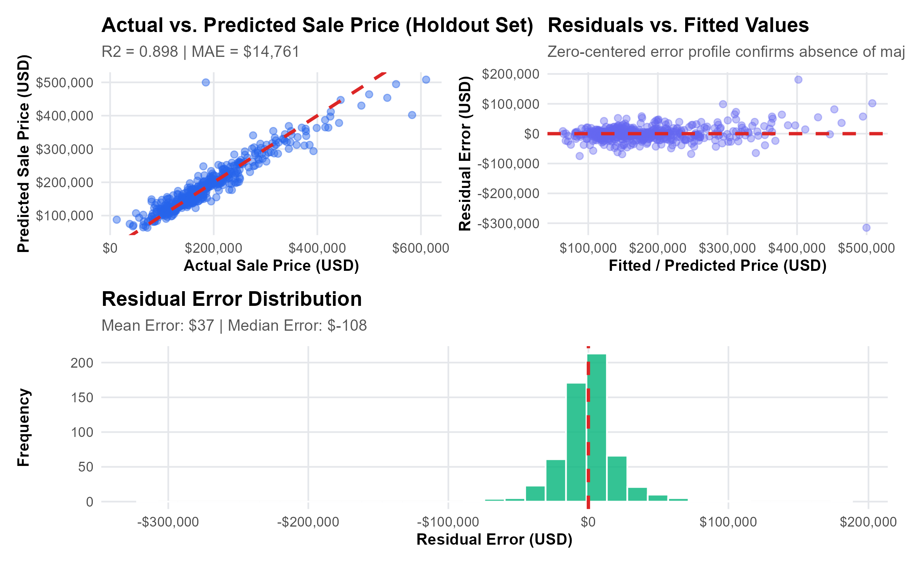
5. FINAL TEST RESULTS
The Final Exam: Testing on 586 Brand New Homes
We evaluated our trained model on a locked test set it had never seen before
$14,761
Average Error (MAE)
Our target was < $16,000 (PASSED)
89.79%
Accuracy Score (R²)
Our target was > 85.0% (PASSED)
9.98%
Typical Error %
Predictions are typically within 10% of sale price
586 Homes
Test Set Size
Locked 20% partition tested after all training
What the Diagnostics Tell Us:
• No Systematic Bias: Errors balance equally above and below $0. The model doesn't consistently over-value or under-value homes.
• Tight Middle Range: For normal family homes ($130k to $250k), errors are small—typically within 5% to 8%.
• Why Errors Grow on Mansions: On houses above $450k, errors are larger because luxury homes have custom architectural details (like heated pools or wine cellars) that standard data cannot capture.
Explainable House Price Prediction (Ames, Iowa Case Study) • Slide 9 of 13

Slide 10
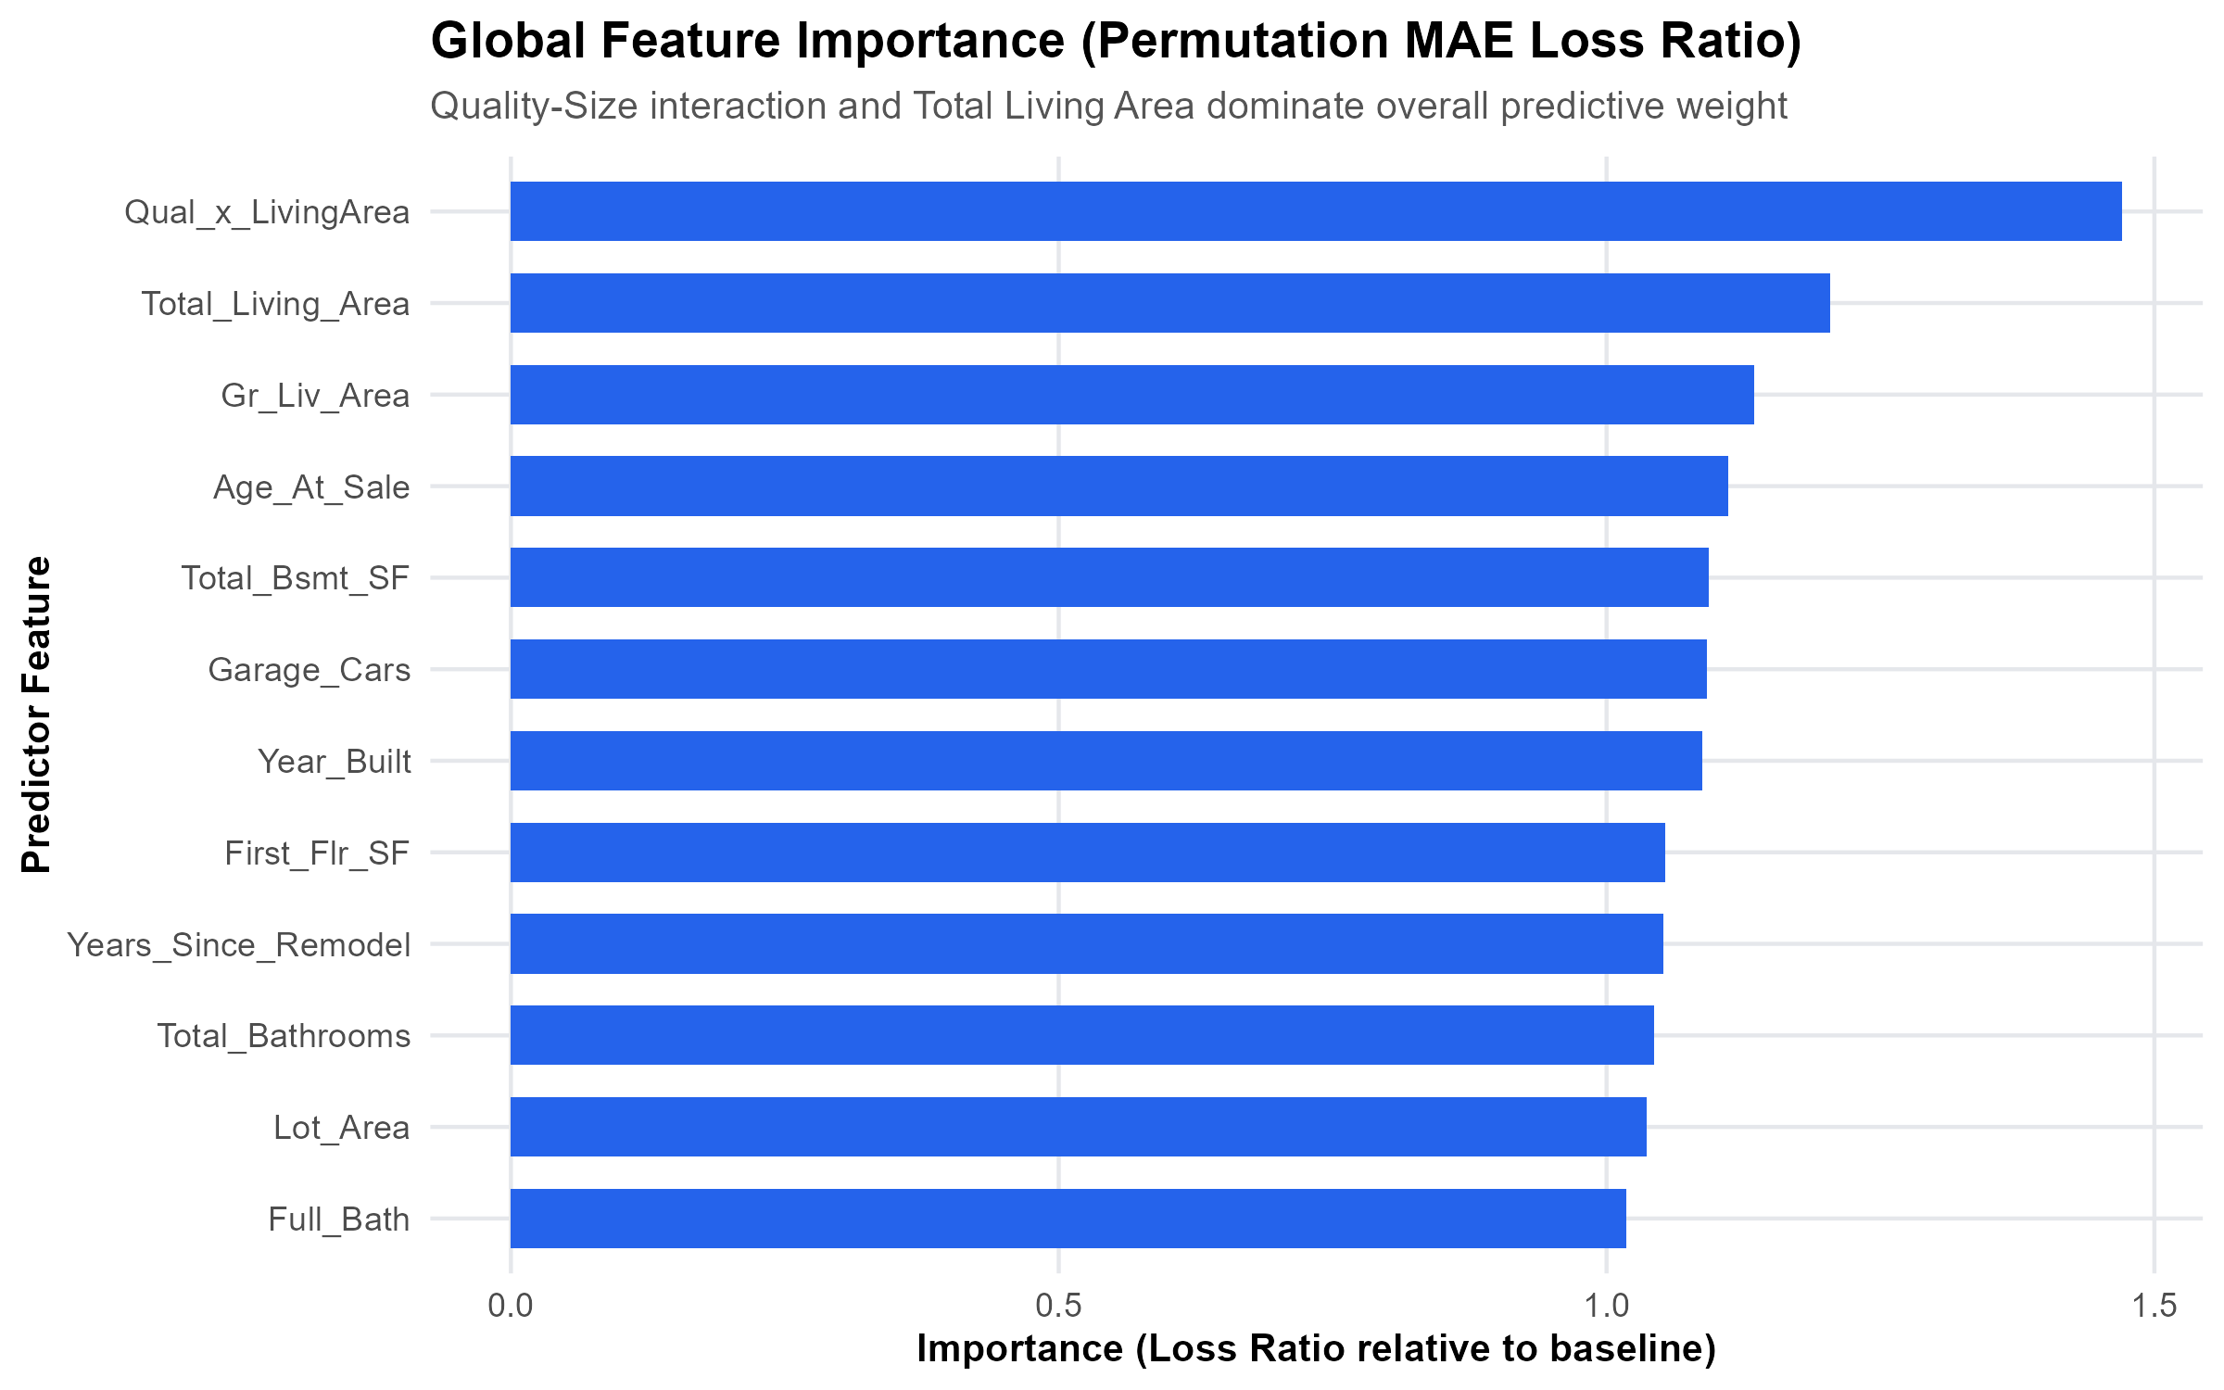
5. EXPLAINABILITY (GLOBAL)
Market Secrets: What Really Drives House Prices in Ames?
We shuffled each feature to see how much worse the model got without it
The 4 Biggest Price Drivers:
• 1. Quality Combined with Size (50%+): Nothing matters more than how big the home is multiplied by its construction quality. A large high-quality house is the ultimate price driver.
• 2. Location, Location, Location: Neighborhood is the #1 categorical modifier. Premium neighborhoods like Northridge Heights set a much higher baseline price.
• 3. Age is a Steady Discount: Every decade of age reduces price, UNLESS the owner has completed major modern remodeling additions.
• 4. Finished vs Unfinished Space: Finished basement space adds about $50/sq ft. Unfinished basement storage space adds almost nothing to valuation.
Explainable House Price Prediction (Ames, Iowa Case Study) • Slide 10 of 13

Slide 11
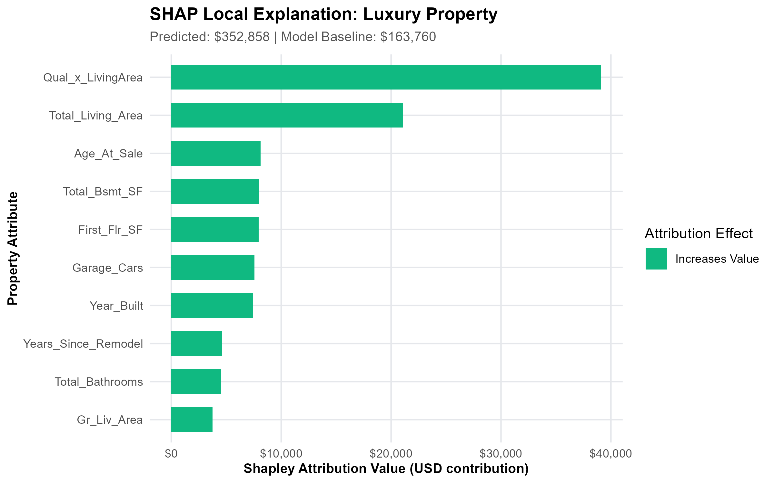
5. EXPLAINABILITY (LOCAL SHAP)
Explaining Any Single House Like an Itemized Receipt
How SHAP breaks down a $378,000 luxury home compared to the $180,800 Ames average
How SHAP Explains This $378k House:
Starting Baseline: Average Ames Home = $180,800
+ Huge Living Space (4,200 sq ft): +$82,400 enhancement
+ Top Quality Materials (Grade 9/10): +$54,200 enhancement
+ Great Neighborhood (Northridge Hts): +$22,100 enhancement
- Older Construction Era: -$18,400 age discount
- Partial Unfinished Basement: -$11,300 layout discount
= Final Model Valuation: $352,858 (Closed at $378,000; 6.6% error)
A Common-Sense Legal Rule to Remember (Non-Causal Warning):
SHAP tells us how the model arrived at its prediction. It DOES NOT guarantee that if a homeowner spends $10,000 adding a bathroom, their house will automatically sell for $10,000 more. Correlation is not a physical warranty.
Explainable House Price Prediction (Ames, Iowa Case Study) • Slide 11 of 13

Slide 12
6. PRACTICAL DEPLOYMENT
The Interactive Valuation Tool: A Live Web App
We deployed our model into an easy-to-use Shiny web app with 1-click buttons and sensitivity curves
1-Click Preset Buttons
No need to type 80 numbers by hand:
• Starter Home: $129,746
(1,050 sq ft, 1 bath, average quality)
• Median Family Home: $179,418
(1,600 sq ft, 2.5 baths, good quality)
• Luxury Estate: $328,090
(2,800 sq ft, 3.5 baths, excellent quality)
Live 'What-If' Curve
Interactive Living Area Trajectory:
• Shows a smooth curve from 800 to 3,600 sq ft.
• Marks a red diamond on the user's current house.
• Lets homeowners instantly see: 'If I finish my 400 sq ft attic, how much does my property value jump?'
Live Marginal Value Badges
Instant dollar answers to practical questions:
• +200 sq ft Living Space: +$16,000 lift
• +1 Full Bathroom: +$9,500 lift
• Complete Modern Remodel: +$12,000 lift
Evaluated live on-the-fly by the trained model.
Complete Transparency for Unexposed Details:
For details not shown on the simple screen (like electrical panel type or foundation materials), the app clearly lists its assumptions using standard Ames medians so there are zero hidden surprises.
Explainable House Price Prediction (Ames, Iowa Case Study) • Slide 12 of 13

Slide 13
7. CONCLUSIONS & WHAT WE LEARNED
Key Takeaways: 4 Big Lessons from This Case Study
Simple, practical lessons you can remember and explain with confidence
Lesson 1: Cleaning Inside the Model Stops Cheating
Never clean data outside your cross-validation folds. Wrapping everything in a strict pipeline (mlr3pipelines) guarantees your test scores reflect true real-world performance.
Lesson 2: Smart Features Beat Complex Tuning
Multiplying Quality x Size alone gave us more accuracy than weeks of hyperparameter tweaking. Knowing your domain matters more than raw compute.
Lesson 3: Explainable AI Builds Real Trust
Nobody trusts a silent black box. Giving users an itemized SHAP breakdown (receipt) bridges the gap between machine learning and human decision-making.
Lesson 4: Reproducibility Makes Work Professional
Locking package versions (renv.lock), testing endpoints automatically, and compiling standalone reports means anyone can re-run this project anytime with identical results.
Explainable House Price Prediction (Ames, Iowa Case Study) • Slide 13 of 13

