Slide 1
ECE6043 J Component Smart Home Controller 20MES0027 Avinash 20MES0038 Rohith

Slide 2
Objectives
Design and build a Smart Home Controller
Focus on voice control
Near real time words inference using AIML and NLP
Works offline to control home
Modular and extensible interfaces
Learn the following
CMSIS HAL and CMSIS NN
Audio Processing
Audio device Interfaces

Slide 3
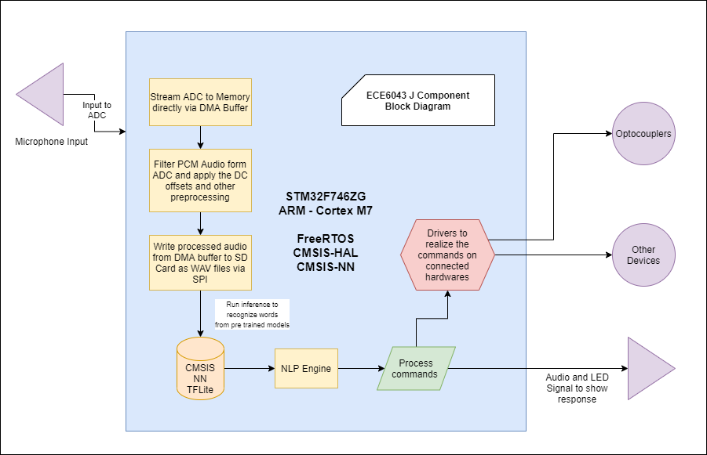
Block Diagram

Slide 4
Components
Hardware
STM32F746ZG^{[1]}, based on ARM Cortex M7, STM32 NUCLEO 144 Series Board.
STLinkv2 over USB for Debugging
Electret Microphone with MAX4466^{[4]} Micropower Pre-amplifier
Generic SD Card Module over SPI
MAX98357A Class D amp for driving a speaker. Communicates with board via I2S^{[5]}
4 Ohms 3 W Speaker for audio output
Software
ARM Cross Compiler Toolchain for Linux^{[2]}
OpenOCD/GDB for Breakpoint/Watchpoint Monitoring and Debugging^{[3]}
STM32CubeMX for configuring board
GNU Make for Compile and Build Task automation
VSCode for Editing

Slide 5
Methodology
Use FreeRTOS^{[6]} for running tasks and synchronization between them
Get Analog audio feed from Electret Microphone into ADC
Convert to PCM in ADC and move to memory via DMA^{[7]}
Filter and process the audio and write it to the SD Card as WAV file. Then prepend the file with the meta data.
Train a TFLite model with colloquial language voice data.
Load the model from SD Card and run inference with the audio recorded.^{[8]}
Process the commands and actuate the home devices.
Send feedback via LED and Speaker.

Slide 6
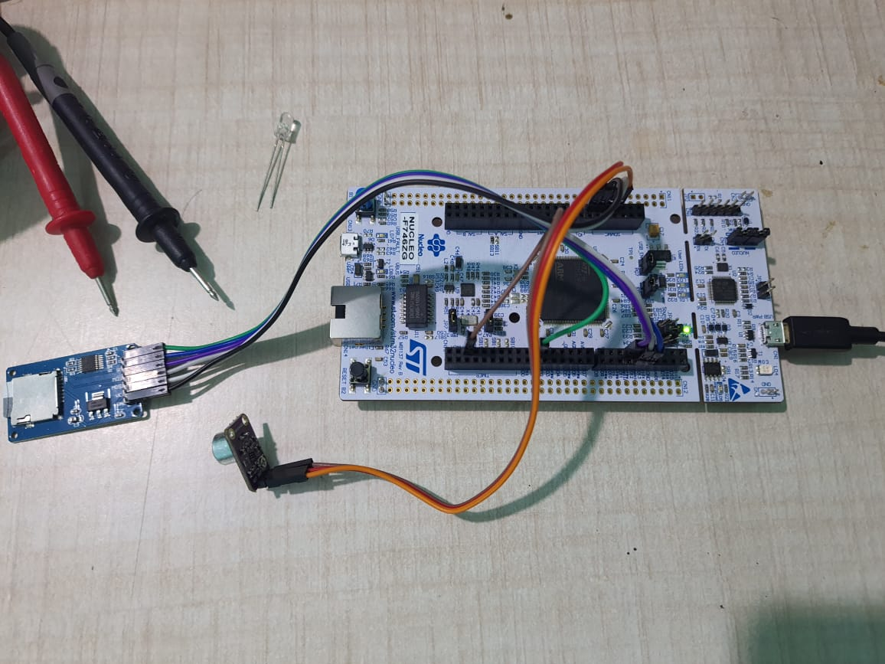

Slide 7
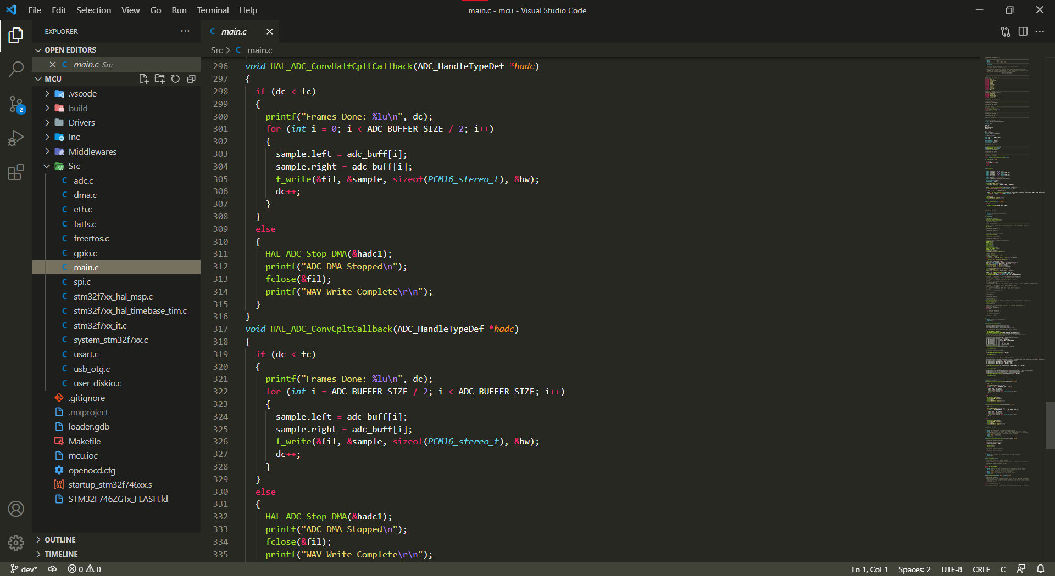

Slide 8
Progress
Audio Input @ 16kHz with 12bit resolution scaled upto 16bit via ADC - DMA Channel
Th audio is filtered using a FIR filter from the CMSIS-DSP library configured to be a band pass filter using proper FIR coefficients.
Audio is written to disk as WAV file for ML inference later on
I2S-DMA connections setup for audio response playback
Machine Learning model for speech recognition built but it needs to be optimised

Slide 9
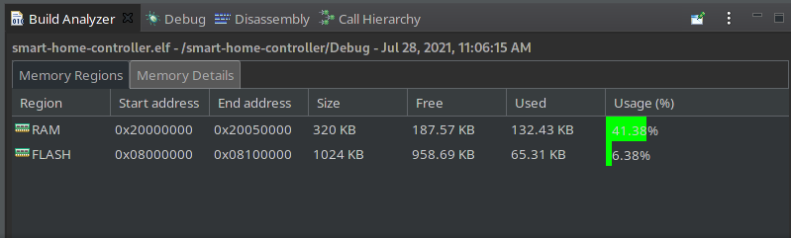
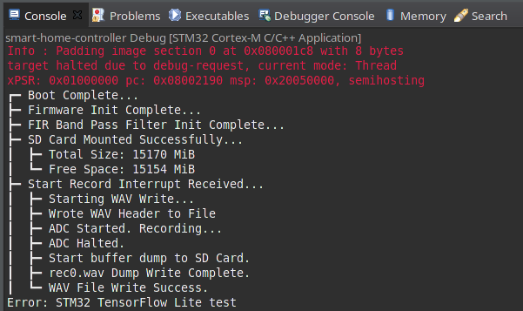

Slide 10
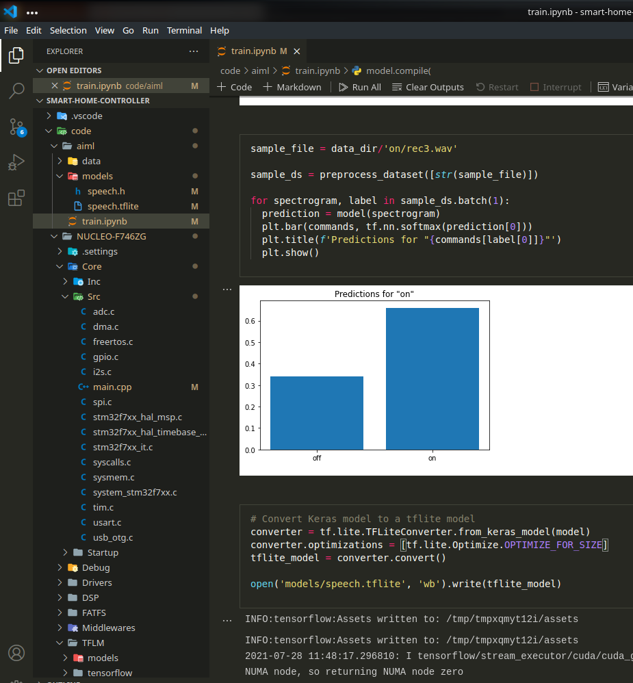
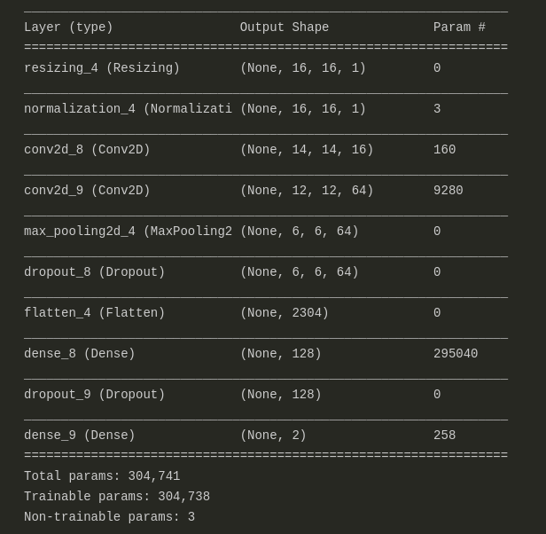

Slide 11
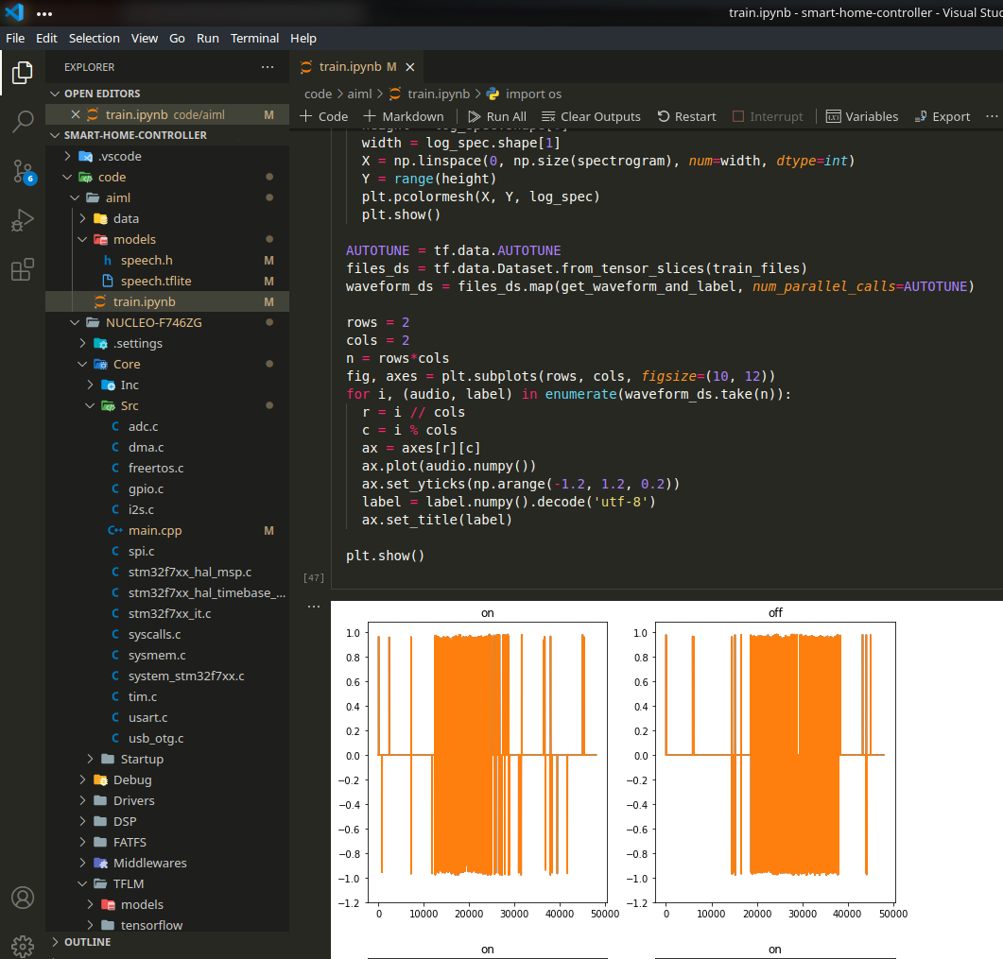
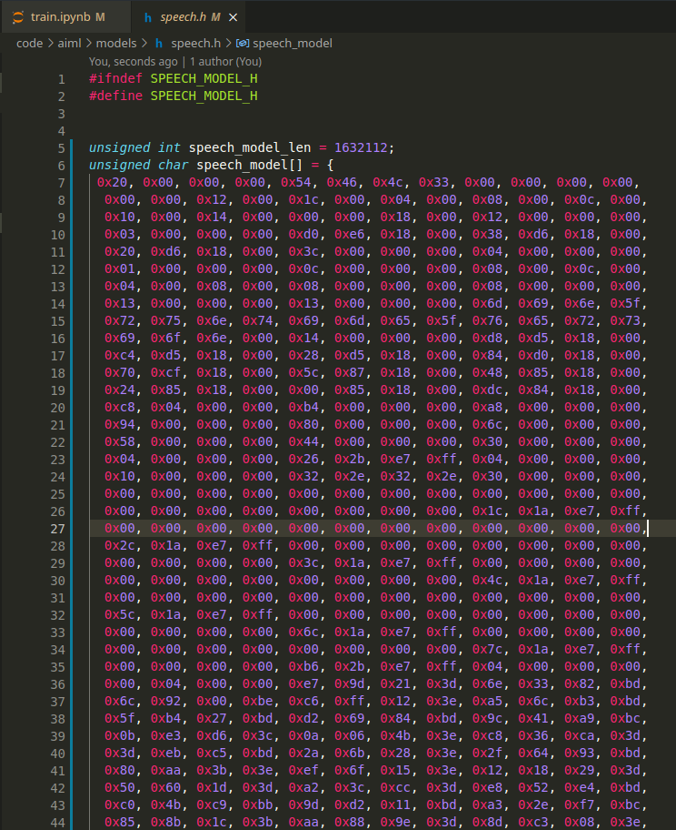

Slide 12
Challenges
Originally we wanted CD quality audio @44.1kHz. Although the DMA could handle it, We could not write it at that speed to SD Card over SPI
44.1k*2bytes/channel = 176k bytes / second. The onboard memory itself is just 320kb. So we cannot buffer CD quality audio.
Filtering next. The band pass filter params were hard to arrive at. We first did a rough check on audacity to find the cut-off frequencies. Then we found the online site at http://t-filter.engineerjs.com/ that spit out the coeffs if given the cut-off frequencies. And it worked.

Slide 13
Challenges
Timer Configuration. The Main clock SYSCLK is 216 MHz. Our Timers are at APB2 and receive the 216 MHz Directly. So @16kHz, we need 0.0625 uS period. So we configured TIM7 used by ADC-DMA to Count Up, Auto-Reload Mode. It fires a Global Interrupt via NVIC whenever it rolls over.
Porting to C++. So until this point everything was in C. Unfortunately, Tensorflow Supports only C++. We could easily port the Third Party Libraries. But run into trouble with the core HAL and FreeRTOS functions. The CubeMX generator does not have the capability to auto convert to C++. So we ditched everything and started a new C++ project using STM32CubeIDE instead of the VSCode-Makefile flow. The IDE automatically included the extern “C” to all core libs.

Slide 14
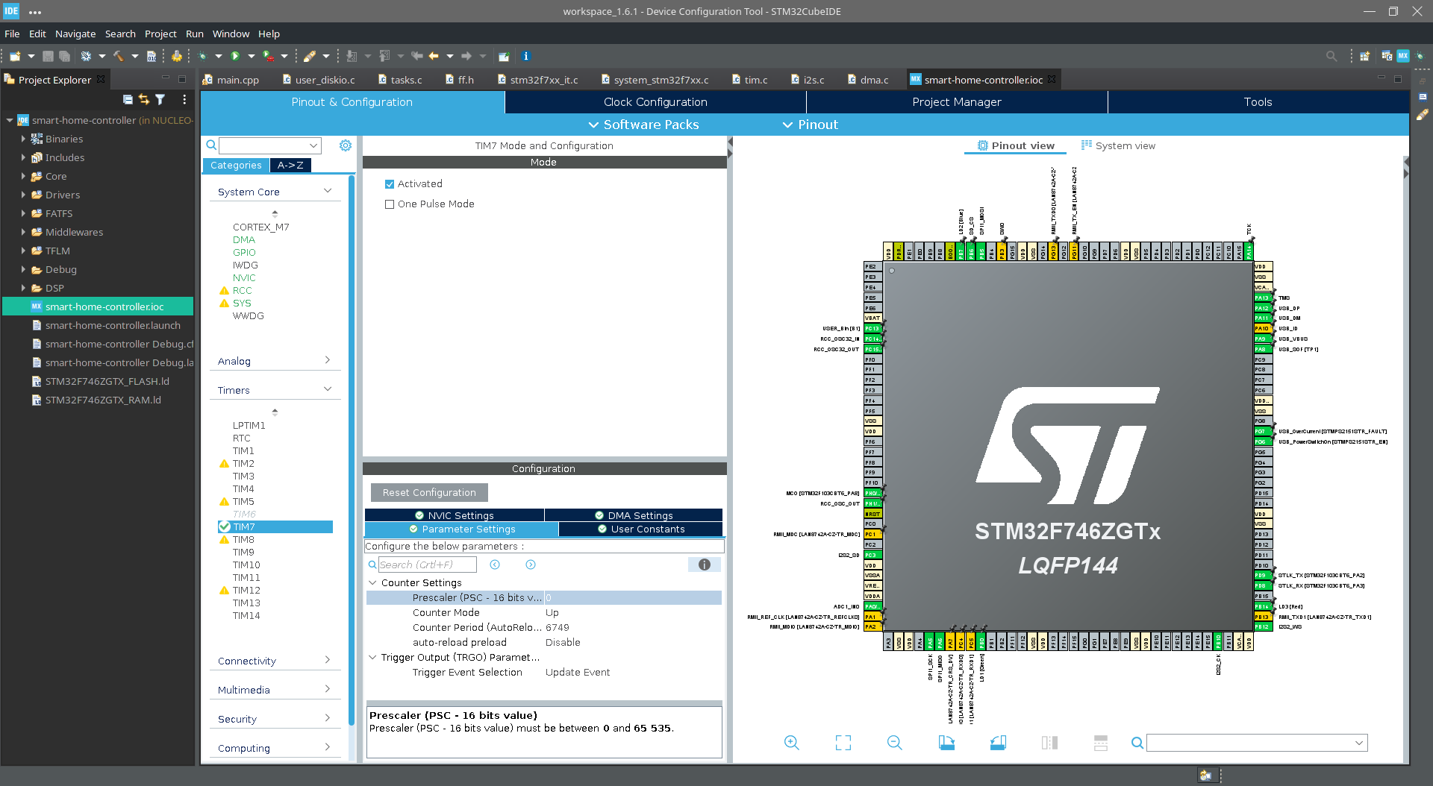

Slide 15
Challenges
Then we copied all the old implementations to the new project and made changes where necessary to get it working in C++
The Speech Model Training. We collected a lot of data and trained a ML model with tensorflow keras. We did a FFT of the audio and trained with the spectrogram. The tflite model was just 1.6Mb. But when exported to a .h file, it became 9 Mb. The uC flash is 1Mb. So we thought we can load the .tflite directly from the SDCard. But 1.6Mb is still too much for a device with 320kB SRAM.
So we’re working on reducing the model size.

Slide 16
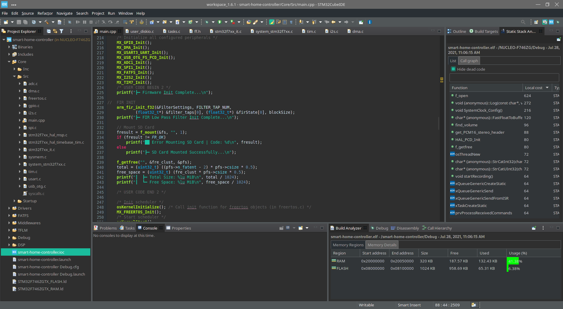

Slide 17
Results
We reduced the number of layers in the ML model to decrease the required TF Arena Size on RAM.
The new model is just 33.6 kB compared to Older 1.6 MB
The CMSIS DSP Library does not implement STFT functions, only FFTs are available. So we had to come up with another method to preserve time data as well as frequency data.
With usual STFT, the input spectrogram dimensions for the model was 320*270 which when used in a microcontroller, as float values, with 4bytes each becomes ~345kB which is not affordable.

Slide 18
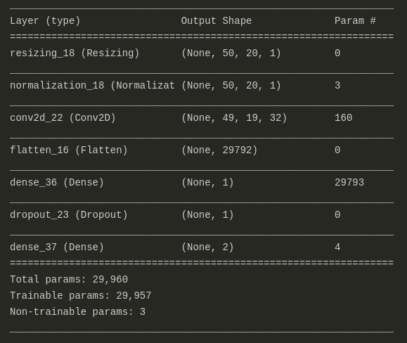
New Model (Left) vs Old Model (Right)

Slide 19
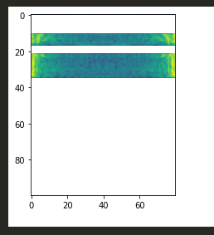
Results
We split the audio signals in steps of 480 points, with 10ms overlap on evey step. Then did FFT on each of these steps and took the mean of every 6 steps. This brought down the spectrogram’s dimensions to 100*80 which is just 8000 * 4 = 32 kB, while preserving both time and frequency data.
Then with full integer quantization, 4 byte float32_t becomes 1 byte int8_t. This brings the input size to just 8 kB. So now we have sufficient space for the TF Arena on RAM and the model also fits in the flash with enough room in the RAM for runtime.
The new spectrogram
for the off command

Slide 20
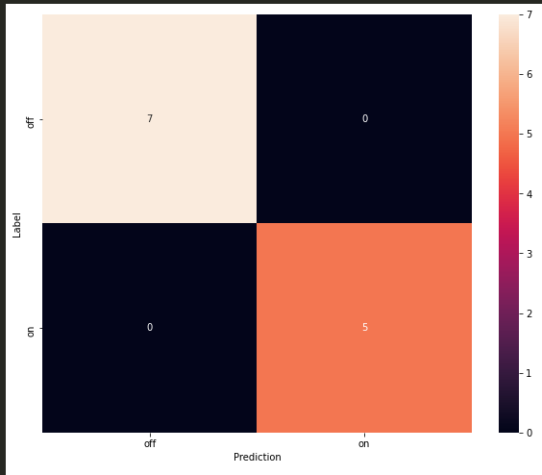
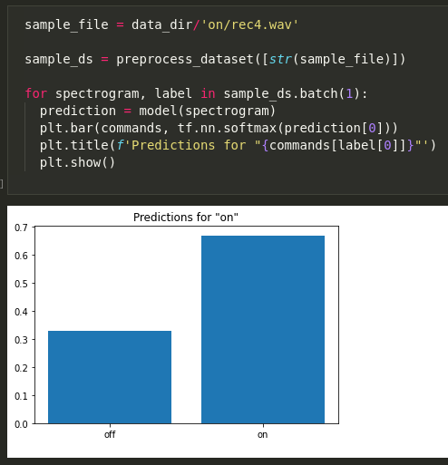
Results
With properly planned layers and training data, we were also able to achive better model accuracy than before.
The test set gave a 100% accuracy. However in actual controller while running, it mis-predicted off as on some times, although on was always predicted perfectly.
With more voice data from multiple people, this model can be further improvised, but for a concept project, this works really well.
Confusion Matrix (Top)
Test Prediction (Bottom)

Slide 21
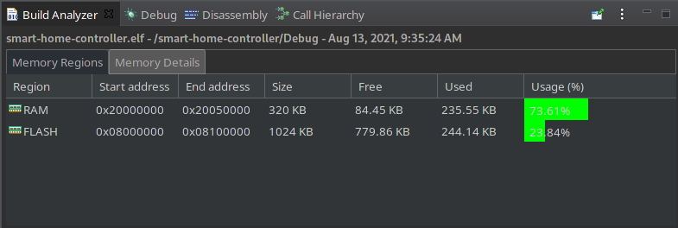
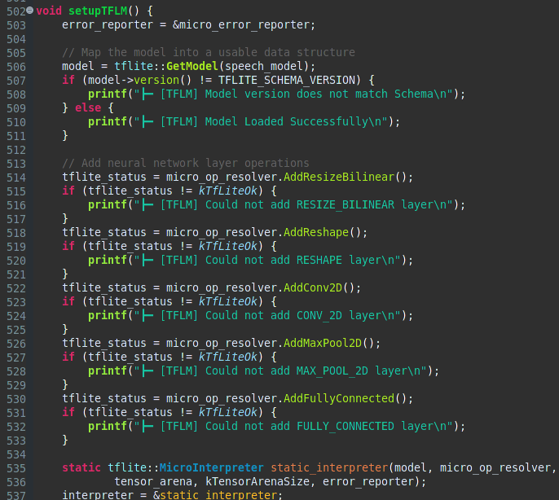
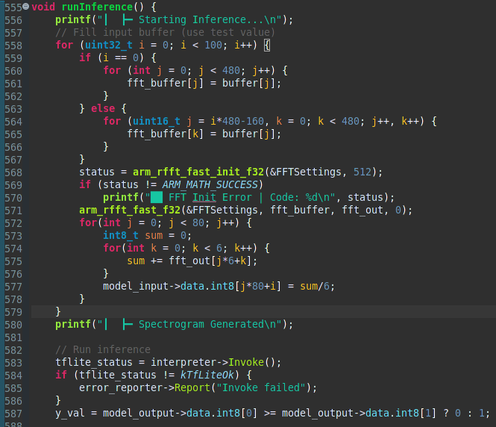
Flash and Memory Usage (Top), TF Layers Setup in uC (Left) and Spectrogram Generation and Model Invokation (Right)

Slide 22
Results
The model is resonably accurate and fits on the microcontroller
The model works as expected and Light is turned on and off
The custom spectrogram implementation preserves all important data from the audio signal
The device is able to recognise commands without internet
All of the project is available publicly on GitHub

Slide 23
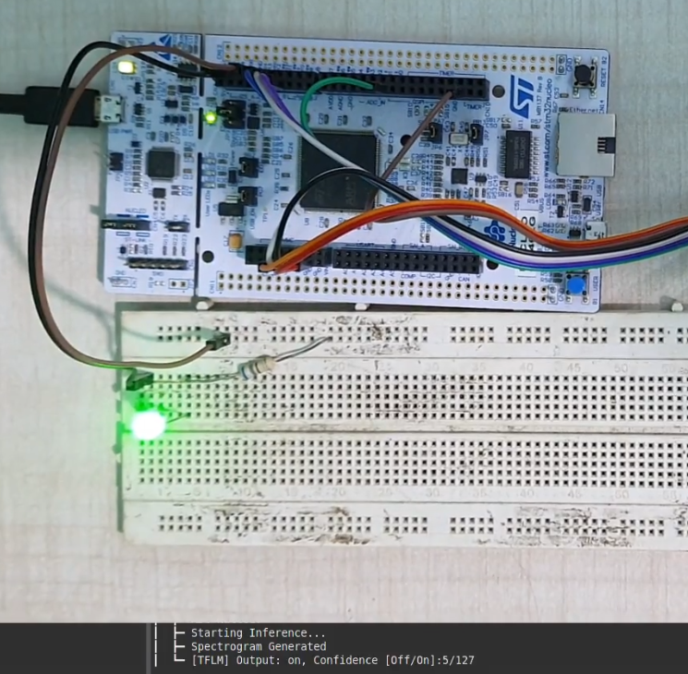
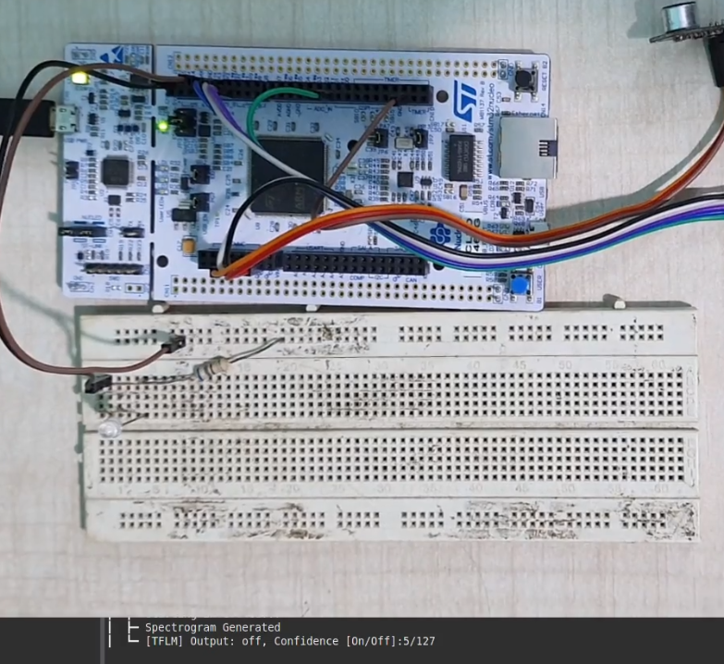
On Prediction (Left) vs Off Prediction (Right)

Slide 24
REFERENCES
[1] STM32 Nucleo-144 boards (MB1137) – User Manual p.32
[2] GNU Arm Embedded Toolchain - https://developer.arm.com/tools-and-software/open-source-software/developer-tools/gnu-toolchain/gnu-rm/downloads
[3] OpenOCD Documentation - http://openocd.org/documentation/ , GDB Documentation - https://www.gnu.org/software/gdb/documentation/
[4] Electret Microphone Amplifier - MAX4466 with Adjustable Gain - https://www.adafruit.com/product/1063
[5] Tiny, Low-Cost, PCM Class D Amplifier with Class AB Performance - https://datasheets.maximintegrated.com/en/ds/MAX98357A-MAX98357B.pdf
[6] FreeRTOS Documentation - https://www.freertos.org/Documentation/RTOS_book.html
[7] Getting Started with STM32 - Working with ADC and DMA - https://www.digikey.in/en/maker/projects/getting-started-with-stm32-working-with-adc-and-dma/f5009db3a3ed4370acaf545a3370c30c
[8] Simple audio recognition: Recognizing keywords - https://www.tensorflow.org/tutorials/audio/simple_audio

Slide 25
Thank You

