Slide 1
ECE6043 J Component Smart Home Controller 20MES0027 Avinash 20MES0038 Rohith

Slide 2
Objectives
Design and build a Smart Home Controller
Focus on voice control
Near real time words inference using AIML and NLP
Works offline to control home
Modular and extensible interfaces
Learn the following
CMSIS HAL and CMSIS NN
Audio Processing
Audio device Interfaces

Slide 3
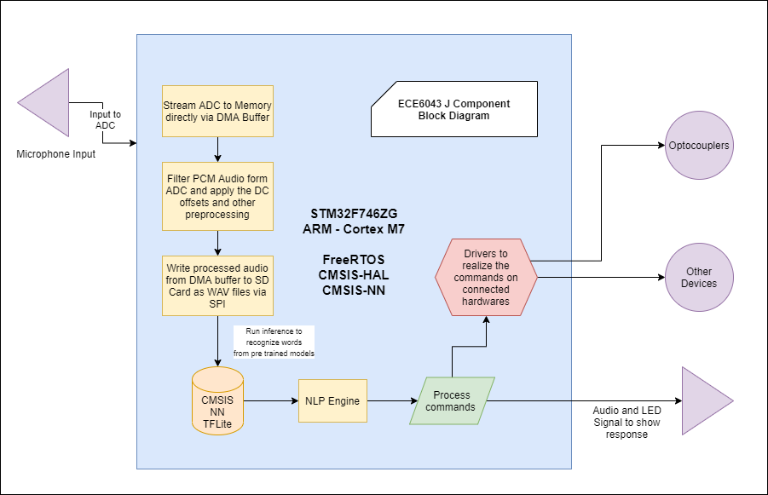
Block Diagram

Slide 4
Components
Hardware
STM32F746ZG^{[1]}, based on ARM Cortex M7, STM32 NUCLEO 144 Series Board.
STLinkv2 over USB for Debugging
Electret Microphone with MAX4466^{[4]} Micropower Pre-amplifier
Generic SD Card Module over SPI
MAX98357A Class D amp for driving a speaker. Communicates with board via I2S^{[5]}
4 Ohms 3 W Speaker for audio output
Software
ARM Cross Compiler Toolchain for Linux^{[2]}
OpenOCD/GDB for Breakpoint/Watchpoint Monitoring and Debugging^{[3]}
STM32CubeMX for configuring board
GNU Make for Compile and Build Task automation
VSCode for Editing

Slide 5
Methodology
Use FreeRTOS^{[6]} for running tasks and synchronization between them
Get Analog audio feed from Electret Microphone into ADC
Convert to PCM in ADC and move to memory via DMA^{[7]}
Filter and process the audio and write it to the SD Card as WAV file. Then prepend the file with the meta data.
Train a TFLite model with colloquial language voice data.
Load the model from SD Card and run inference with the audio recorded.^{[8]}
Process the commands and actuate the home devices.
Send feedback via LED and Speaker.

Slide 6
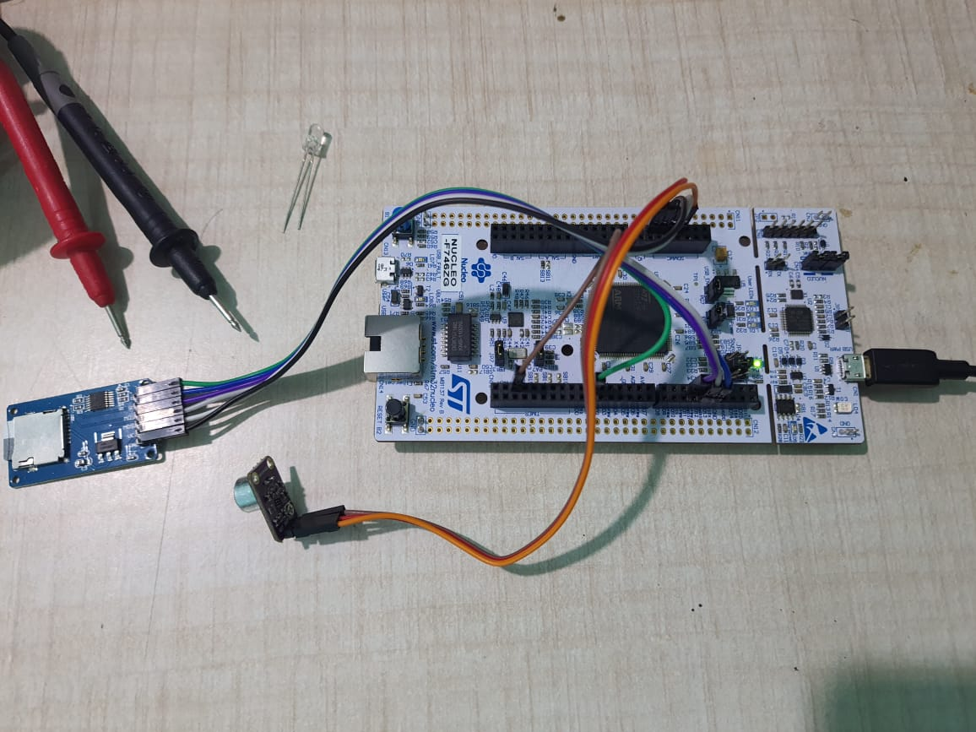

Slide 7
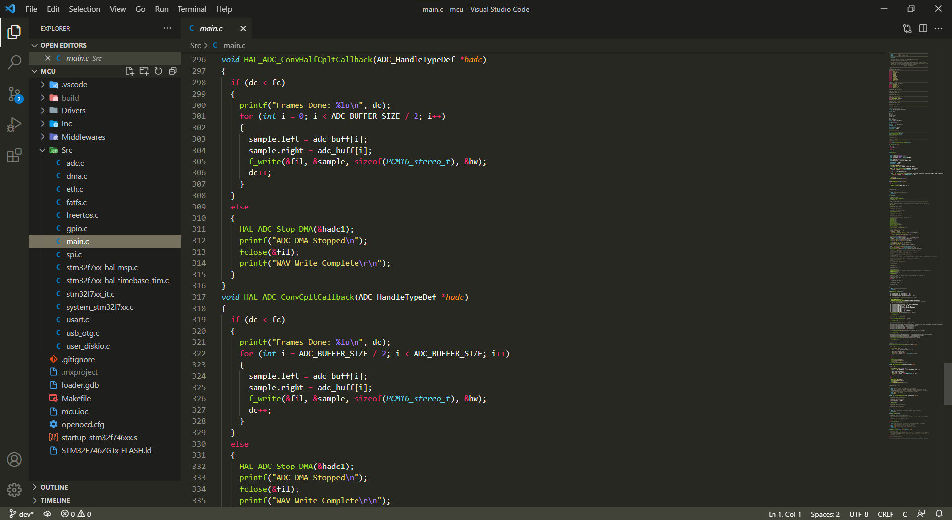

Slide 8
REFERENCES
[1] STM32 Nucleo-144 boards (MB1137) – User Manual p.32
[2] GNU Arm Embedded Toolchain - https://developer.arm.com/tools-and-software/open-source-software/developer-tools/gnu-toolchain/gnu-rm/downloads
[3] OpenOCD Documentation - http://openocd.org/documentation/ , GDB Documentation - https://www.gnu.org/software/gdb/documentation/
[4] Electret Microphone Amplifier - MAX4466 with Adjustable Gain - https://www.adafruit.com/product/1063
[5] Tiny, Low-Cost, PCM Class D Amplifier with Class AB Performance - https://datasheets.maximintegrated.com/en/ds/MAX98357A-MAX98357B.pdf
[6] FreeRTOS Documentation - https://www.freertos.org/Documentation/RTOS_book.html
[7] Getting Started with STM32 - Working with ADC and DMA - https://www.digikey.in/en/maker/projects/getting-started-with-stm32-working-with-adc-and-dma/f5009db3a3ed4370acaf545a3370c30c
[8] Simple audio recognition: Recognizing keywords - https://www.tensorflow.org/tutorials/audio/simple_audio

Slide 9
Thank You

