Slide 1
Statistics Mini Project
Rohith Ganni
Pranthi Cavuturu
Akhil Addepalli

Slide 2

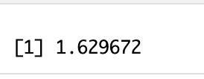

Preprocessing Improvements
Imputing missing values with mean
Imputing missing values with median
Omitting null values

Slide 3

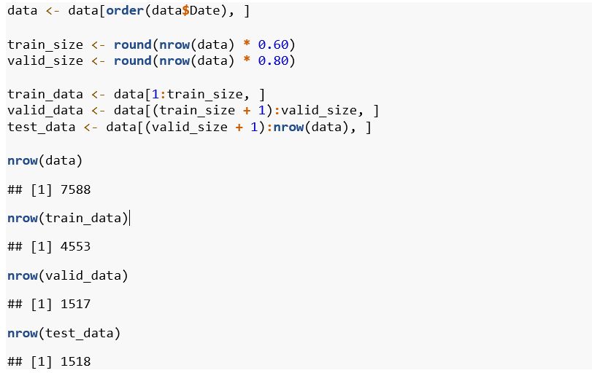
Data Description

Slide 4
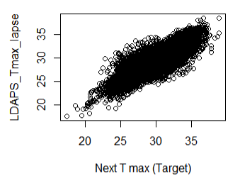
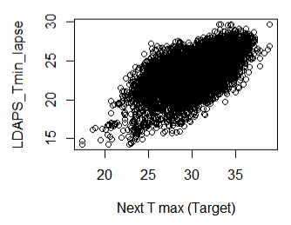

Slide 5
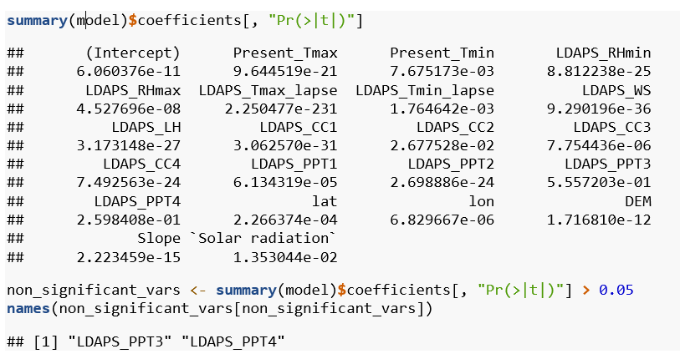

Insignificant Columns
When checking the p_values, we found that the following columns have p_value greater than alpha. Therefore, they are insignificant to next_Tmax:

Slide 6

Insignificant Columns
Also removed Next_Tmin as it is not a predictor
Removed columns that do not contribute much (based on domain knowledge) to Next_Tmax like lat, long, Slope, Elevation (using station column instead)

Slide 7

Transformations on the Columns
Night_Cloud_Cover = (LDAPS_CC1 + LDAPS_CC4) / 2
Day_Cloud_Cover = (LDAPS_CC2 + LDAPS_CC3) / 2
Precipitation = (LDAPS_PPT1 + LDAPS_PPT2) / 2
Removed the columns that were transformed:
LDAPS_CC1 = NULL
LDAPS_CC2 = NULL
LDAPS_CC3 = NULL
LDAPS_CC4 = NULL
LDAPS_PPT1 = NULL
LDAPS_PPT2 = NULL

Slide 8
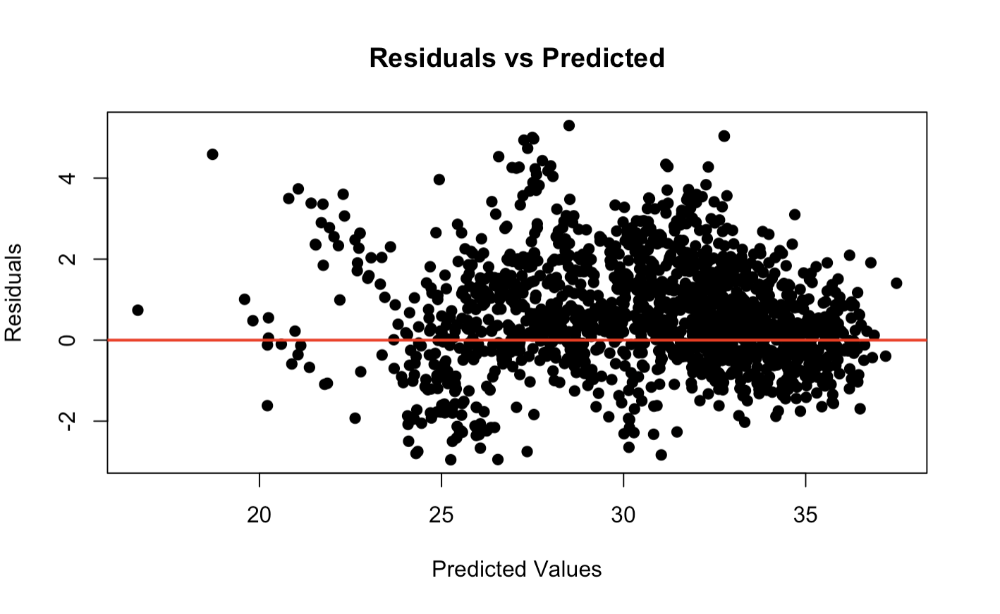

Slide 9

Recalculating p_values
After adding the transformed variables, we recalculated p_values and removed the insignificant variables again [Present_Tmin].

Slide 10
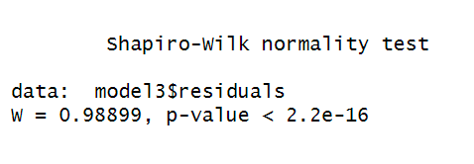
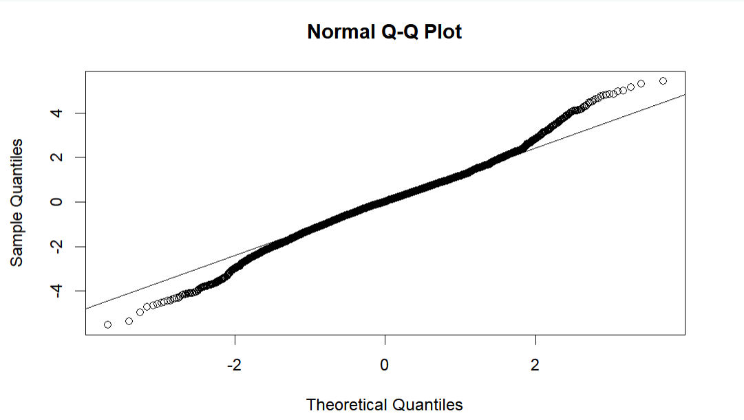
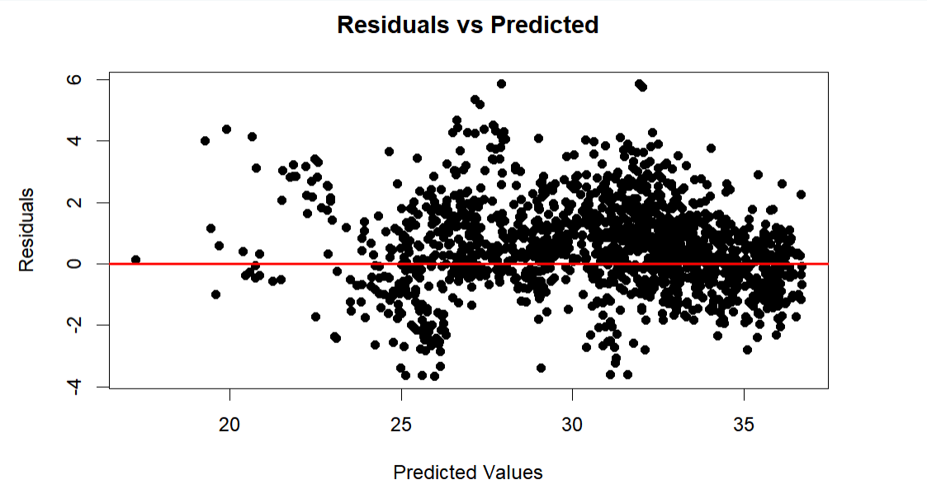

Slide 11


Results
Initial Model
Improved Model

