Slide 1
Cryptography and Network Security
Chapter 18
Fifth Edition
by William Stallings
Lecture slides by Lawrie Brown
Notes:
Lecture slides by Lawrie Brown for “Cryptography and Network Security”, 5/e, by William Stallings, Chapter 18 – “Electronic Mail Security”.

Slide 2
S/MIME (Secure/Multipurpose Internet Mail Extensions)
security enhancement to MIME email
  original Internet RFC822 email was text only
  MIME provided support for varying content types and multi-part messages
  with encoding of binary data to textual form
  S/MIME added security enhancements
have S/MIME support in many mail agents
  eg MS Outlook, Mozilla, Mac Mail etc
Notes:
S/MIME (Secure/Multipurpose Internet Mail Extension) is a security enhancement to the MIME Internet e-mail format standard, which in turn provided support for varying content types and multi-part messages over the text only support in the original Internet RFC822 (now RFC5322) email standard. See text for discussion of these extensions. MIME is specified in RFCs 2045 through 2049. MIME allows encoding of binary data to textual form for transport over traditional RFC822 email systems. S/MIME support is now included in many modern mail agents.

Slide 3
S/MIME Functions
enveloped data
  encrypted content and associated keys
signed data
  encoded message + signed digest
clear-signed data
  cleartext message + encoded signed digest
signed & enveloped data
  nesting of signed & encrypted entities
Notes:
In terms of general functionality, S/MIME is very similar to PGP. Both offer the ability to sign and/or encrypt messages. S/MIME provides the functions shown.

Slide 4
S/MIME Cryptographic Algorithms
digital signatures: DSS & RSA
hash functions: SHA-1 & MD5
session key encryption: ElGamal & RSA
message encryption: AES, Triple-DES, RC2/40 and others
MAC: HMAC with SHA-1
have process to decide which algs to use
Notes:
S/MIME uses a range of cryptographic algorithms, as shown. Support for SHA-1, DSS, RSA and Triple-DES is required, the rest should be provided for backwards compatibility of possible.
The S/MIME specification includes a discussion of the procedure for deciding which content encryption algorithm to use, based on the capabilities of all parties. To support this decision process, a sending agent may announce its decrypting capabilities in order of preference any message that it sends out. A receiving agent may store that information for future use. If a message is to be sent to multiple recipients and a common encryption algorithm cannot be selected for all, then the sending agent will need to send two messages. However, in that case, it is important to note that the security of the message is made vulnerable by the transmission of one copy with lower security.

Slide 5
S/MIME Messages
S/MIME secures a MIME entity with a signature, encryption, or both
forming a MIME wrapped PKCS object
have a range of content-types:
  enveloped data
  signed data
  clear-signed data
  registration request
  certificate only message
Notes:
S/MIME secures a MIME entity with a signature, encryption, or both. A MIME entity may be an entire message or one or more of the subparts of the message. The MIME entity plus some security related data, such as algorithm identifiers and certificates, are processed by S/MIME to produce a PKCS, which refers to a set of public-key cryptography specifications issued by RSA Laboratories. A PKCS object is then treated as message content and wrapped in MIME. A range of S/MIME content-types are specified, as shown. See text for details of how these are used.

Slide 6
S/MIME Certificate Processing
S/MIME uses X.509 v3 certificates
managed using a hybrid of a strict X.509 CA hierarchy & PGP’s web of trust
each client has a list of trusted CA’s certs
and own public/private key pairs & certs
certificates must be signed by trusted CA’s
Notes:
S/MIME uses public-key certificates that conform to version 3 of X.509 (see Chapter 14). The key-management scheme used by S/MIME is in some ways a hybrid between a strict X.509 certification hierarchy and PGP’s web of trust. S/MIME managers and/or users must configure each client with a list of trusted keys and with certificate revocation lists, needed to verify incoming signatures and to encrypt outgoing messages. But certificates are signed by trusted certification authorities.

Slide 7
Certificate Authorities
have several well-known CA’s
Verisign one of most widely used
Verisign issues several types of Digital IDs
increasing levels of checks & hence trust
  Class Identity Checks Usage
  1 name/email check web browsing/email
  2 + enroll/addr check email, subs, s/w validate
  3 + ID documents e-banking/service access
Notes:
There are several companies that provide X.509 certification authority (CA) services. Of these, the most widely used is the VeriSign CA service. VeriSign issues X.509 certificates known as Digital IDs. As of early 1998, over 35,000 commercial Web sites were using VeriSign Server Digital IDs, and over a million consumer Digital IDs had been issued to users of Netscape and Microsoft browsers. VeriSign provides three levels, or classes, of security for public-key certificates, with increasing levels of checks & hence trust, as shown above, and with additional details in Stallings Table 18.8. Class 1 and Class 2 requests are processed on line, and in most cases take only a few seconds to approve. For Class 3 Digital IDs, VeriSign requires a higher level of identity assurance. An individual must prove his or her identity by providing notarized credentials or applying in person.

Slide 8
S/MIME Enhanced Security Services
3 proposed enhanced security services:
  signed receipts
  security labels
  secure mailing lists
Notes:
As of this writing, three enhanced security services have been proposed in an Internet draft, and may change or be extended. The three services are:
• Signed receipts: may be requested in a SignedData object to provide proof of delivery to the originator of a message and allows the originator to demonstrate to a third party that the recipient received the message.
• Security labels: may be included in the authenticated attributes of a SignedData object, and is a set of security information regarding the sensitivity of the content that is protected by S/MIME encapsulation. They may be used for access control, indicating which users are permitted access to an object
• Secure mailing lists: When a user sends a message to multiple recipients, a certain amount of per-recipient processing is required, including the use of each recipient's public key. The user can be relieved of this work by employing the services of an S/MIME Mail List Agent (MLA). An MLA can take a single incoming message, perform recipient-specific encryption for each recipient, and forward the message. The originator of a message need only send the message to the MLA, with encryption performed using the MLA's public key.

Slide 9
Domain Keys Identified Mail
a specification for cryptographically signing email messages
so signing domain claims responsibility
recipients / agents can verify signature
proposed Internet Standard RFC 4871
been widely adopted
Notes:
Domain Keys Identified Mail (DKIM) is a specification for cryptographically signing email messages, permitting a signing domain to claim responsibility for a message in the mail stream. Message recipients (or agents acting in their behalf) can verify the signature by querying the signer's domain directly to retrieve the appropriate public key, and thereby confirm that the message was attested to by a party in possession of the private key for the signing domain. DKIM is a proposed Internet Standard (RFC 4871: DomainKeys Identified Mail (DKIM) Signatures). DKIM has been widely adopted by a range of email providers, including corporations, government agencies, gmail, yahoo, and many Internet Service Providers (ISPs).

Slide 10
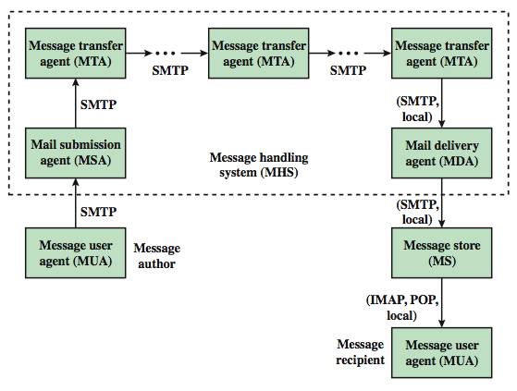
Internet Mail Architecture
Notes:
To understand to operation of DKIM, it is useful to have a basic grasp of the Internet mail architecture, as illustrated in Stallings Figure 18.9. At its most fundamental level, the Internet mail architecture consists of a user world in the form of Message User Agents (MUA), and the transfer world, in the form of the Message Handling Service (MHS), which is composed of Message Transfer Agents (MTA). A MUA is usually housed in the user's computer, and referred to as a client email program, or on a local network email server. The MHS accepts a message from one User and delivers it to one or more other users, creating a virtual MUA-to-MUA exchange environment. The MSA accepts the message submitted by an MUA and enforces the policies of the hosting domain and the requirements of Internet standards. This function may be co-located with the MUA or be a separate functional model. In the latter case, the Simple Mail Transfer Protocol (SMTP) is used between the MUA and the MSA. The MTA relays mail for one application-level hop. Relaying is performed by a sequence of MTAs, until the message reaches a destination MDA. The MDA is responsible for transferring the message from the MHS to the MS. An MS can be located on a remote server or on the same machine as the MUA. Typically, an MUA retrieves messages from a remote server using POP (Post Office Protocol) or IMAP (Internet Message Access Protocol). Also an administrative management domain (ADMD) is an Internet email provider. The Domain Name System (DNS) is a directory lookup service that provides a mapping between the name of a host on the Internet and its numerical address.

Slide 11
Email Threats
see RFC 4684- Analysis of Threats Motivating DomainKeys Identified Mail
describes the problem space in terms of:
  range: low end, spammers, fraudsters
  capabilities in terms of where submitted, signed, volume, routing naming etc
  outside located attackers
Notes:
RFC 4684 (Analysis of Threats Motivating DomainKeys Identified Mail) describes the problem space being addressed by DKIM in terms of the characteristics, capabilities, and location of potential attackers. It characterizes the range of attackers on a spectrum of three levels of threat: low end attackers who simply want to send email that a recipient does not want to receive, often with falsified sender addresses. At the next level are professional senders of bulk spam mail. The most sophisticated and financially motivated senders of messages are those who stand to receive substantial financial benefit, such as from an email-based fraud scheme. The RFC then lists a range of capabilities that an attacker might have in terms of where submitted, signed, volume, routing naming etc (see text). DKIM focuses primarily on attackers located outside of the administrative units of the claimed originator and the recipient.

Slide 12
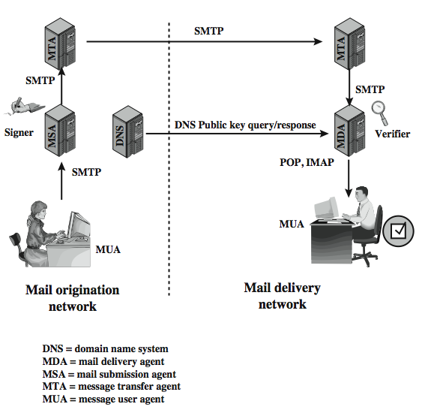
DKIM Strategy
transparent to user
  MSA sign
  MDA verify
for pragmatic reasons
Notes:
DKIM is designed to provide an email authentication technique transparent to the end user. In essence, a user's email message is signed by a private key of the administrative domain from which the email originates. The signature covers all of the content of the message and some of the RFC 5322 message headers. At the receiving end, the MDA can access the corresponding public key via a DNS and verify the signature, thus authenticating that the message comes from the claimed administrative domain. Thus, mail that originates from somewhere else but claims to come from a given domain will not pass the authentication test and can be rejected. This approach differs from that of S/MIME and PGP, which use the originator's private key to sign the content of the message, for various pragmatic reasons (see text).
Stallings Figure 18.10 shows a simple example of the operation of DKIM. An email message is generated by an email client program. The content of the message, plus selected RFC 5322 headers, is signed by the email provider using the provider's private key. The signer is associated with a domain, which could be a corporate local network, an ISP, or a public email facility such as gmail. The signed message then passes through the Internet via a sequence of MTAs. At the destination, the MDA retrieves the public key for the incoming signature and verifies the signature before passing the message on to the destination email client. The default signing algorithm is RSA with SHA-256. RSA with SHA-1 may also be used.

