Slide 1
EVALUATING THE PERFORMANCE OF COMPLEX HYPERDIMENSIONAL COMPUTING ON RASPBERRY PI AND GOOGLE COLAB-GPU USING THE MNIST DATASET
ECE 618: Hardware Accelerators for Machine Learning
Raja Kumar Janga - G01411489
Rohith Kumar Kalisetti – G01410445

Slide 2
CONTENTS
Introduction
What is HDC?
Methodology
Experimental Setup – Baseline
Workflow
Code Analysis
Experimental Setup – Raspberry pi
Code Analysis
Optimization
Result Overview
Baseline Result
Edge Device Results
Analysis
Future Work
Conclusion

Slide 3
Introduction
Hyperdimensional Computing (HDC) offers an alternative to traditional ML by leveraging high-dimensional vectors for robust and efficient computation.
This project compares HDC performance on:
Raspberry Pi (low-cost, resource-limited)
Google Colab (GPU-enabled environment)
Objective: Evaluate Training Time, Testing Time, Memory Usage, and Accuracy.

Slide 4
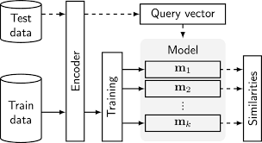
What is Hyperdimensional Computing (HDC)?
Hyperdimensional Computing (HDC) is an alternative computational model inspired by the way the human brain processes information. It operates on high-dimensional vectors, which represent data overall.
Key Features:
- Robustness to noise and errors.
- Efficient and lightweight compared to traditional machine learning algorithms.
- Suitable for hardware-constrained environments like Raspberry Pi.
Applications:
- Cognitive computing.
- Pattern recognition and classification.
- Low-power, embedded systems.

Slide 5
Methodology
Dataset: MNIST (handwritten digit classification)
Model: HDC (Hyperdimensional Computing)
Platforms:
- Raspberry Pi (D=5000, CPU)
- Google Colab (D=10000, GPU)
Metrics Evaluated:
- Training Time
- Testing Time
- Memory Usage
- Accuracy

Slide 6
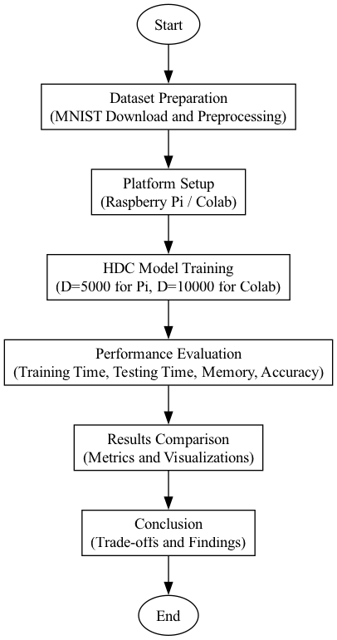
Methodology

Slide 7

Experimental Setup - Baseline
Focus: Leveraging GPU for faster computation.
Preprocess MNIST dataset.
GPU: NVIDIA Tesla T4
Memory: 16 GB
Use DIMENSIONS = 10000 to utilize GPU capabilities.
Set optimized batch size for parallel processing.
Train the HDC model using GPU.

Slide 8
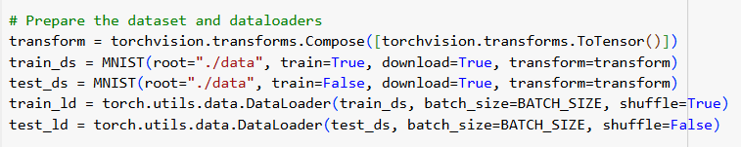
Experimental Setup - Baseline
Pre-Process Data Set: MNIST
70,000 hand-written images of the digits, 0-9
Stored as 28x28 byte grayscale images with their associated labels

Slide 9
Workflow
Encoding Hypervectors:
Position Embedding:
Assigns unique position hypervectors to each pixel using embeddings.Random.
Generates random hypervectors for the 28x28 grid.
Value Embedding:
Quantizes pixel intensities into discrete levels (e.g., NUM_LEVELS =1000).
Maps these levels to hypervectors using embeddings.Level.
Binding Operation:
Combines position and value hypervectors using torchhd.bind, creating unique hypervectors that encode both pixel position and intensity.
Multiset Operation:
Aggregates all bound hypervectors into a single high-dimensional hypervector using torchhd.multiset for compact representation.

Slide 10
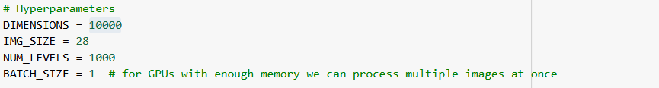

Encoding

Slide 11
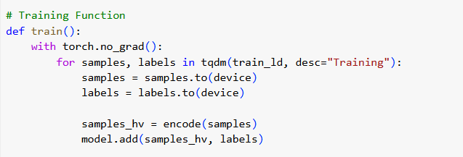
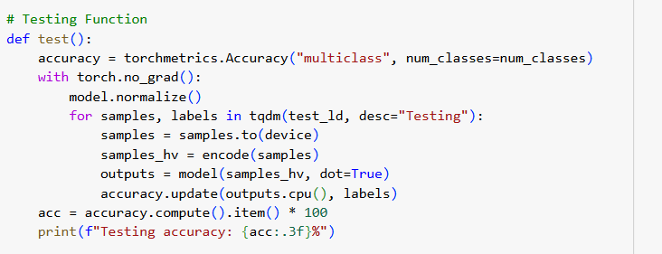
Training

Slide 12
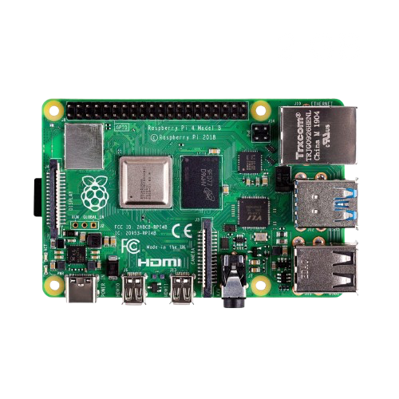
Experimental Setup – Raspberry Pi
Focus: Implementing HDC on a resource-constrained device.
Preprocess MNIST dataset.
CPU: ARM Cortex-A72
Memory: 4 GB
OS: Debian-based Raspberry Pi OS
Use DIMENSIONS = 5000 for memory efficiency.
Set batch size to 1 to fit into limited RAM.
Train the HDC model using CPU.

Slide 13
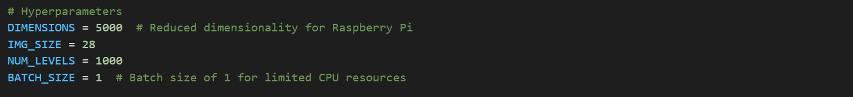
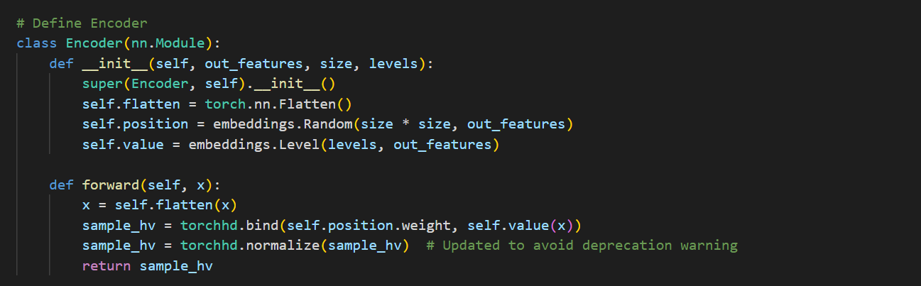
Encoding

Slide 14
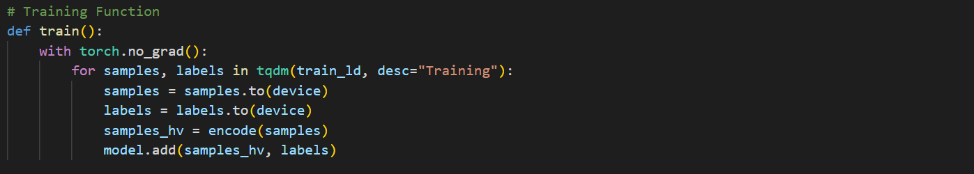
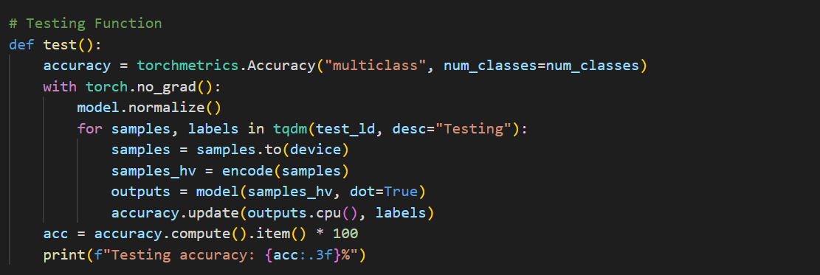
Training

Slide 15
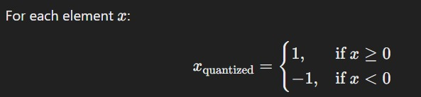
Optimization
Hard Quantization Optimization:
Replaced the deprecated torchhd.hard_quantize with the recommended torchhd.normalize for robust vector processing.
Converts high-dimensional vectors into binary states (+1 or -1), simplifying computation.
Improves model compatibility with the latest libraries and ensures stable performance.

Slide 16
Optimization
Dimensionality Adjustment:
Raspberry Pi: Reduced dimensionality (DIMENSIONS = 5000) to minimize memory usage and computation requirements.
Google Colab: Increased dimensionality (DIMENSIONS = 10000) to fully utilize GPU capabilities and improve accuracy.
Model Efficiency:
Lightwieght centroid-based HDC model avoids the complexity of traditional deep learning architectures.
Encoders effieciently bind and qunatize data into hyperdimensional vectors, ensuring computationally simplicity.

Slide 17
Results Overview
Metrics | Raspberry Pi | Google Colab
Training Time (s) | 1741 | 96.61
Testing Time (s) | 316 | 20.78
Memory Usage (MB) | 496 | 205
Accuracy (%) | 82.75 | 82.99

Slide 18
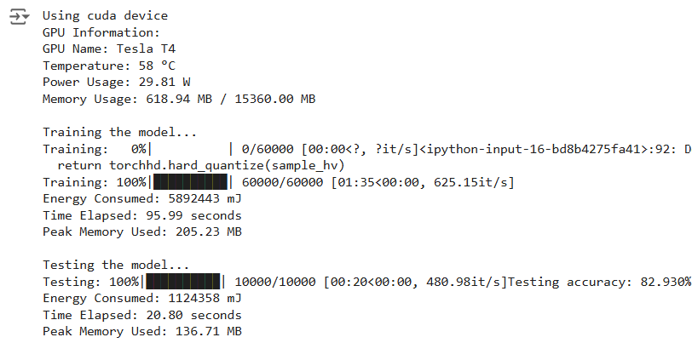
Baseline results

Slide 19
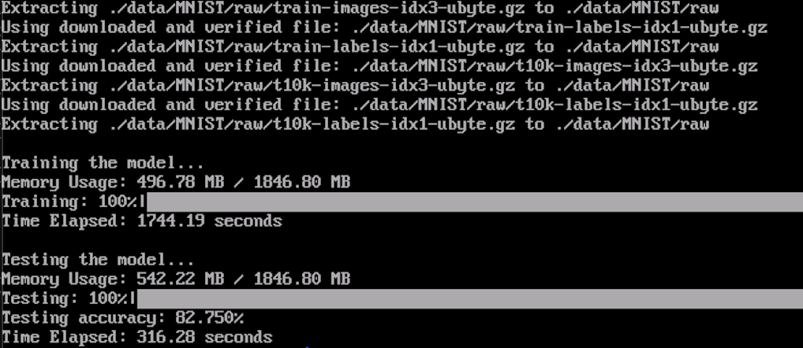
Raspberry pi results

Slide 20
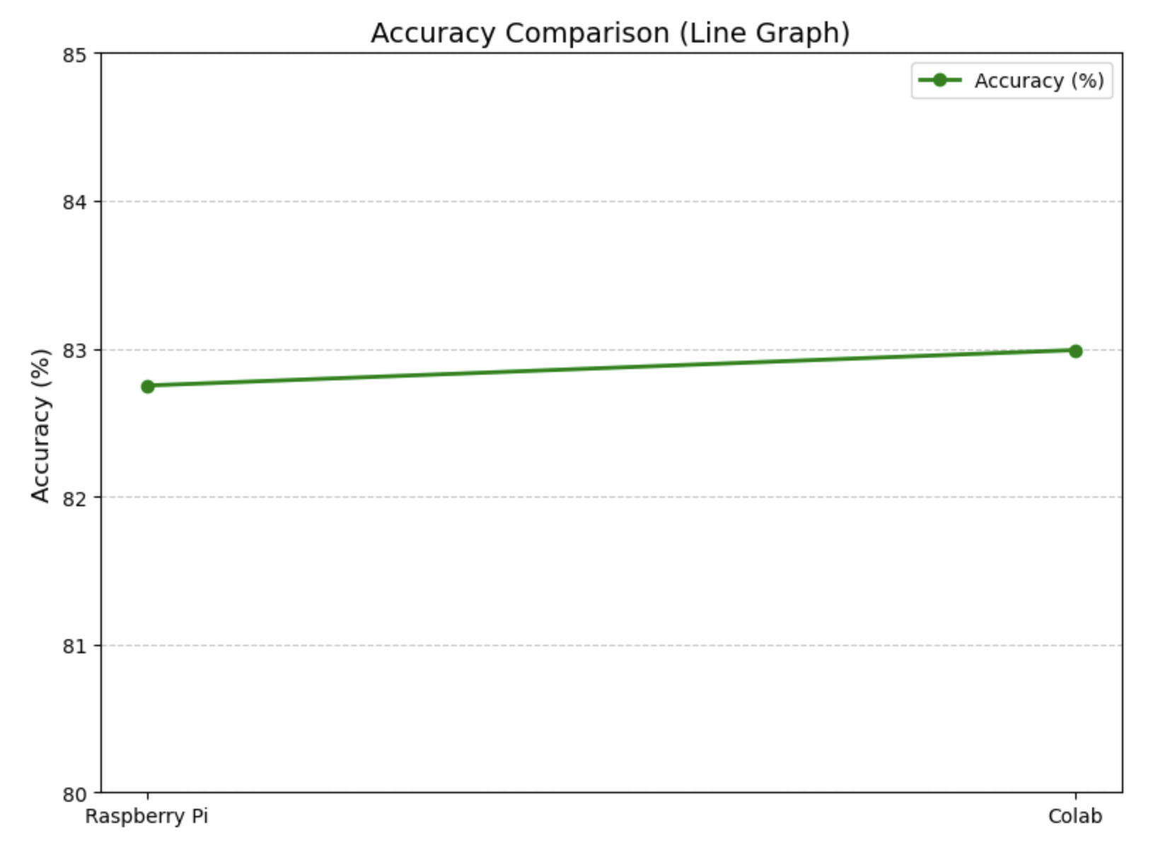
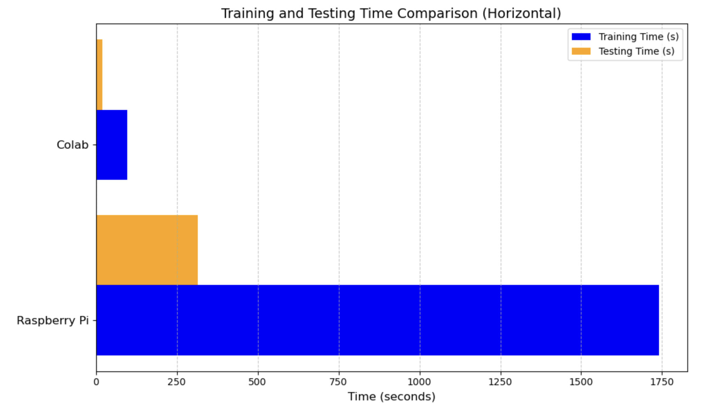
Accuracy and Timing Analysis

Slide 21
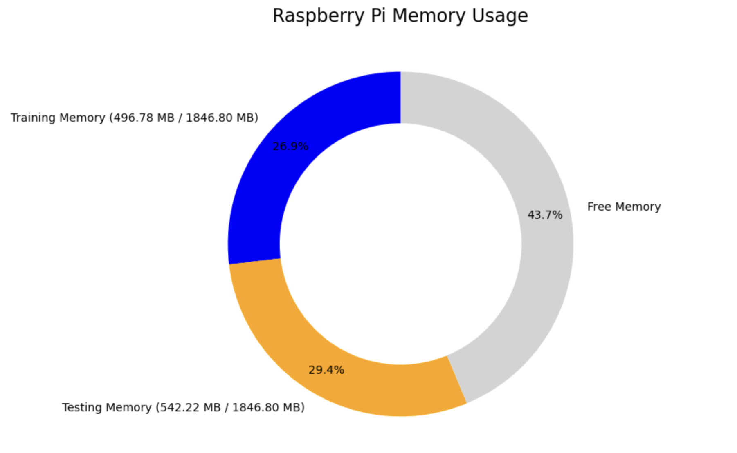
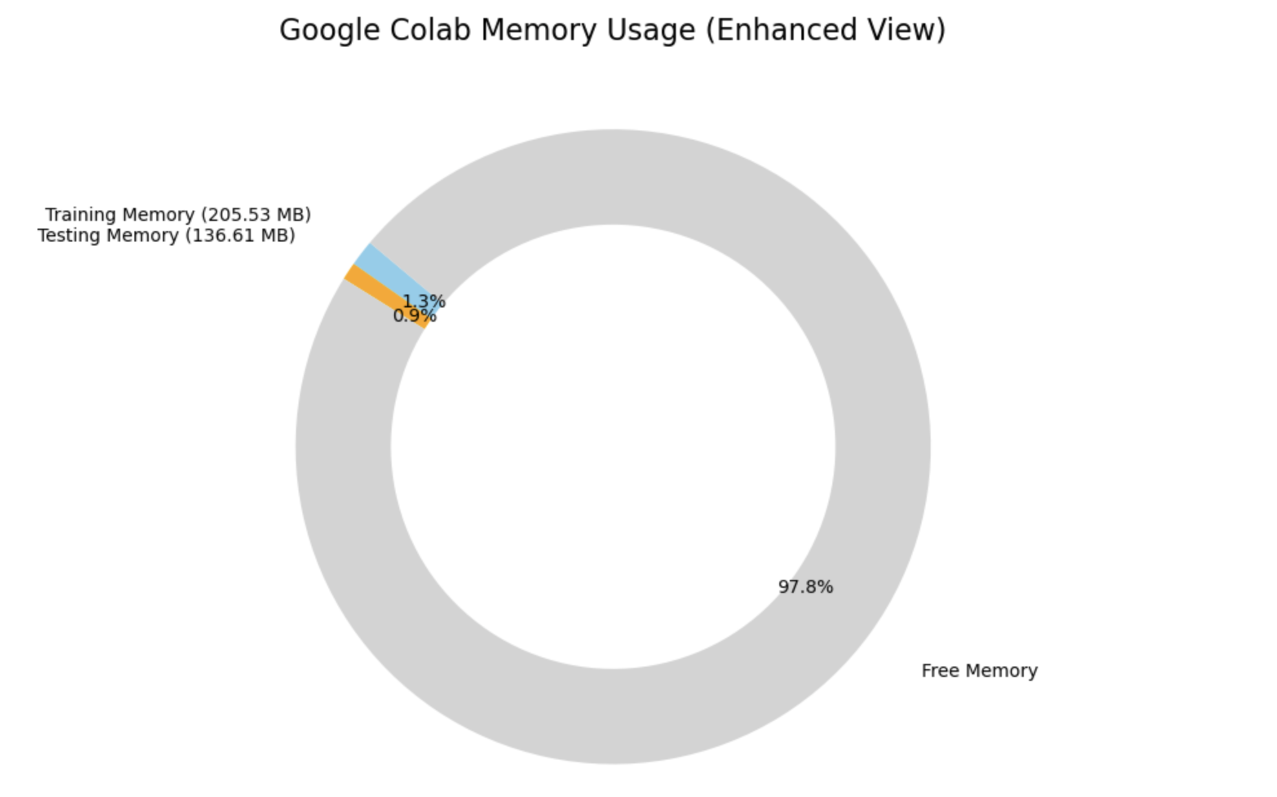
Memory Comparison

Slide 22
Future Work
Dataset Expansion:
Test on more complex datasets to evaluate scalability and accuracy (e.g., CIFAR-10, Tiny ImageNet).
Algorithm Improvements:
Enhance encoding mechanisms for higher precision and lower dimensionality.
Hardware Acceleration:
Develop FPGA/ASIC implementations for faster and more energy-efficient performance.
Hybrid Models:
Combine HDC with neural networks to create hybrid models leveraging the strengths of both paradigms.
Integration in Real-Time Systems:
Apply the method to real-time applications like handwriting recognition, gesture classification, or autonomous navigation.

Slide 23
Conclusion
This project highlights the adaptability of HDC and its potential in both edge and cloud computing environments.
Google Colab is optimal for time-sensitive tasks.
Raspberry Pi is suitable for cost-effective, offline experiments.
Binary representation makes the system ideal for hardware implementations, such as FPGA or ASIC accelerators.

Slide 24
THANK YOU

