Slide 1

Predictive Analytics for Customer Behavior
Customer Churn Prediction using Machine Learning
Rohith Kumar K M · B.E. Electronics & Communication Engineering · Don Bosco Institute of Technology, Bengaluru · July 2026

Slide 2
PROBLEM STATEMENT
Why Predict Churn?
Customer retention is a major challenge for service-based industries. Acquiring a new customer costs significantly more than retaining an existing one. Businesses often lose valuable customers because they fail to recognize early warning signs.
The Challenge
The Solution
The Goal
Customer churn directly impacts company revenue and long-term profitability.
Build a predictive analytics solution to identify at-risk customers before they leave.
Enable organizations to take proactive retention measures using machine learning.

Slide 3

CHAPTER 3
Project Objectives
01
Understand Customer Behavior
Perform exploratory data analysis (EDA) and clean/preprocess customer data.
02
Identify Churn Factors
Perform feature engineering to isolate the most influential variables.
03
Build & Compare ML Models
Train multiple classifiers and select the best-performing model.
04
Drive Business Decisions
Provide data-driven recommendations to improve customer retention.

Slide 4
CHAPTER 4
Dataset at a Glance
7043
33
26.5%
Customer Records
Original Features
Overall Churn Rate
Unique customers in the IBM Telco dataset
Attributes covering demographics, services, and billing
Approximately 1,900 of 7,043 customers churned
Features include customer demographics, service subscriptions, contract information, billing details, Customer Lifetime Value (CLTV), and the target variable — Churn Value.

Slide 5






CHAPTER 5
Tools & Technologies
Python
Jupyter Notebook & VS Code
Core programming language for all data processing and modeling tasks.
Development environments for interactive analysis and coding.
Pandas & NumPy
Matplotlib & Seaborn
Data manipulation and numerical computing libraries.
Statistical visualization for EDA charts, histograms, and heatmaps.
Scikit-Learn
GitHub
Machine learning library for model training and evaluation.
Version control for project code and collaboration.

Slide 6
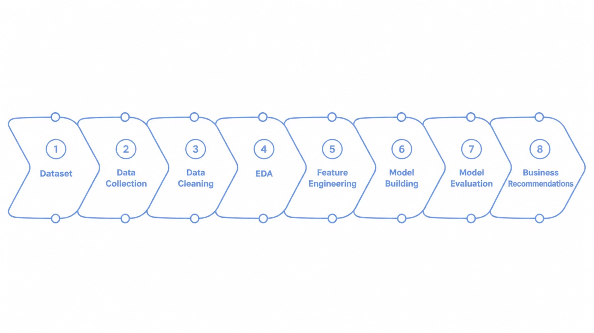
CHAPTER 6
Project Methodology
The end-to-end pipeline moves from raw IBM Telco data through cleaning, exploration, feature engineering, and model training, culminating in actionable business recommendations for customer retention.

Slide 7
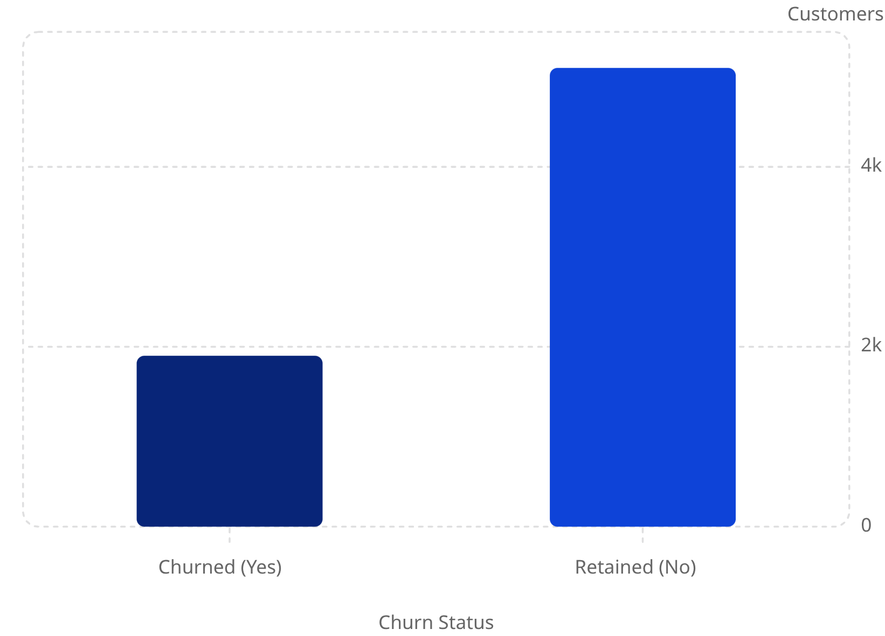


PHASE 1 · EDA
Key EDA Findings
Contract Type
Internet Service
Month-to-month contracts show the highest churn rate.
Fiber optic users churn more frequently than DSL users.
Payment Method
Tenure & CLTV
Electronic check customers have a higher churn rate.
Longer tenure and higher Customer Lifetime Value correlate with lower churn.

Slide 8
PHASE 2 · PREDICTIVE MODELING
Machine Learning Models
Decision Tree
Logistic Regression
Random Forest
Splits data into subsets using decision nodes. Good interpretability but lower accuracy.
Predicts probability of churn. Strong baseline with competitive accuracy.
Ensemble of multiple decision trees. Reduces overfitting via majority voting.
Data split: 80% training (5,625 × 19) and 20% testing (1,407 × 19). Categorical variables encoded; irrelevant columns removed.

Slide 9
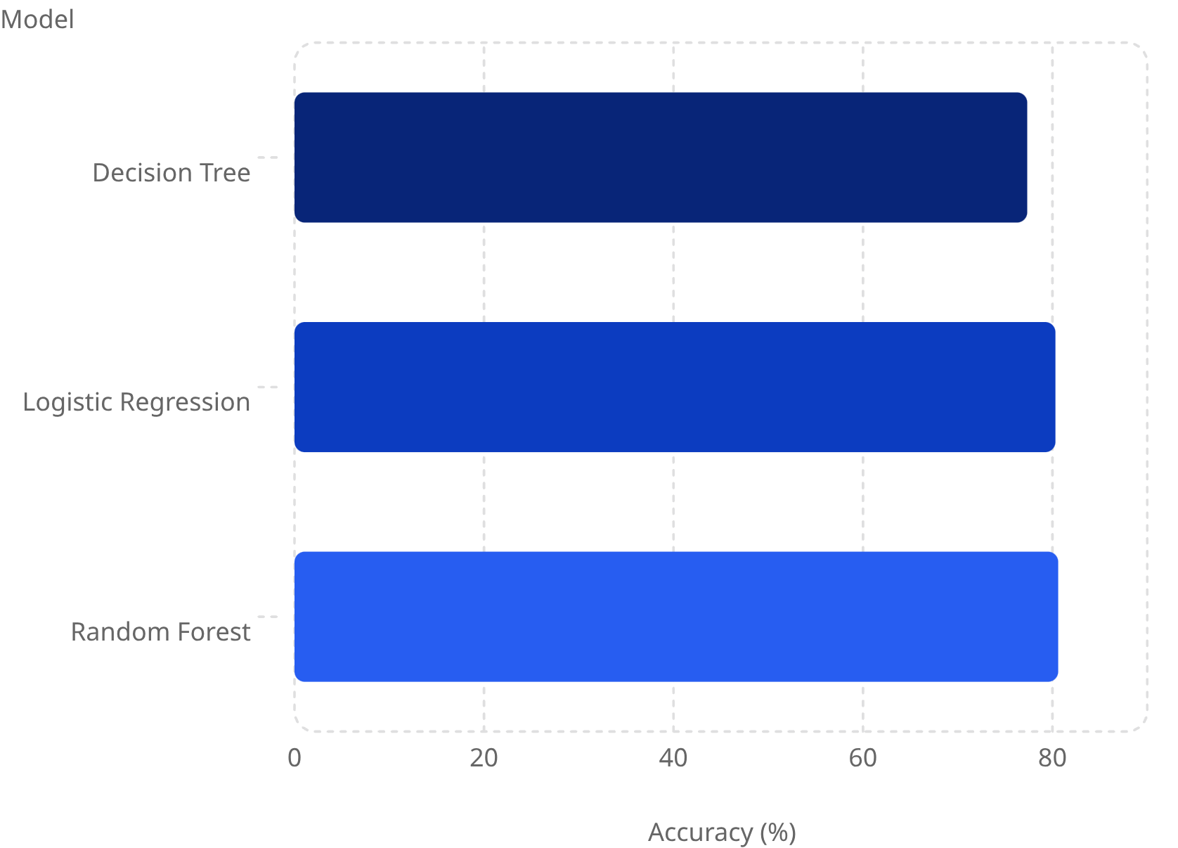
MODEL EVALUATION
Model Performance Comparison
🏆 Random Forest — Best
Logistic Regression
80.60% accuracy with best generalization on unseen data.
80.31% accuracy. Strong baseline with good interpretability.
Decision Tree
77.33% accuracy. Interpretable but lower predictive performance.
Top Feature Importance (Random Forest)
Feature
Importance
Tenure Months
0.1003
Total Charges
0.0945
Monthly Charges
0.0882
Contract Type
0.0728
CLTV
0.0669

Slide 10





CHAPTER 9 & 10
Recommendations & Conclusion
Customer Retention
Personalized Marketing
Target month-to-month customers; encourage long-term contracts; improve support quality.
Special offers for new customers; loyalty rewards for high-value segments.
Customer Engagement
Monitor high-risk customers monthly; improve service quality and interaction.
Random Forest achieved 80.60% accuracy, identifying tenure, monthly charges, contract type, and CLTV as the strongest churn predictors — enabling data-driven retention strategies.

