Slide 1

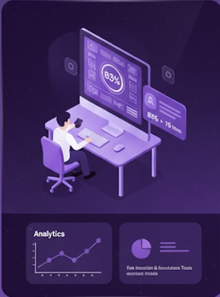
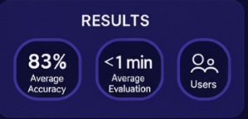
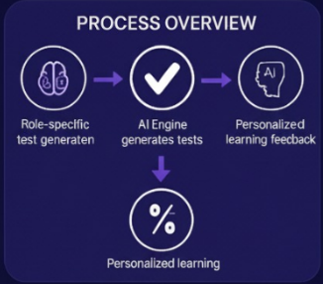
NEXTHIRE AI
2203A52157 Rohith Macharla, 2203A52173 Akhilananda Teja Sanga, 2203A52174 Kailash Satkuri, 2203A52156 Sai Sruthi Kunduru
SR University School of CS&AI, Under the guidance of Dr. B. Sharan, Faculty Mentor
ABSTRACT
CONCLUSIONS
NexHireAI is an AI-driven platform designed to enhance recruitment and career development through adaptive assessments and personalized learning. The system integrates artificial intelligence to generate role-specific skill tests that evaluate candidates objectively. By combining AI-based question generation with hybrid scoring and recruiter analytics, NexHireAI ensures a fair, scalable, and efficient evaluation process. The platform also offers personalized feedback and learning recommendations to help users improve their performance over time. Through ethical and bias-aware algorithms, NexHireAI promotes transparency and equal opportunity in hiring. This project aims to demonstrate how intelligent automation can transform the hiring landscape by making candidate assessment faster, more accurate, and data-driven.
The NexHireAI project successfully demonstrates how artificial intelligence can reshape and modernize the recruitment and skill evaluation process. By integrating adaptive assessments, intelligent scoring mechanisms, and personalized feedback systems, the platform provides a more efficient, data-driven, and transparent approach to candidate evaluation. Unlike traditional recruitment methods that rely heavily on manual screening and subjective judgment, NexHireAI ensures objectivity, accuracy, and fairness through automation and AI analytics.
Throughout the project, the team implemented several AI and machine learning models to dynamically generate assessments, analyze candidate responses, and offer detailed performance insights. The hybrid scoring system helped in maintaining a balanced evaluation by combining human-defined rules with AI decision-making. Additionally, the inclusion of ethical AI ensured that the platform minimized biases and maintained transparency during the entire evaluation process.
The platform’s ability to deliver instant analytics and personalized learning recommendations proves its usefulness not only in hiring but also in skill development and training. The system can be easily integrated into academic institutions, job portals, and corporate recruitment systems to support large-scale evaluations.
In conclusion, NexHireAI represents a step toward transforming recruitment into an intelligent, fair, and scalable ecosystem. It reduces the burden on recruiters, empowers candidates with feedback-driven improvement, and promotes equal opportunities through unbiased assessment. With further enhancements in AI explainability, data privacy, and large-scale deployment, this project has the potential to become a vital tool in the future of hiring and career growth.
OBJECTIVES
The primary objective of the NexHireAI project is to design and develop an intelligent, AI-driven recruitment and skill evaluation system that bridges the gap between candidates’ potential and recruiters’ expectations. The project aims to revolutionize the hiring process by integrating adaptive assessments, performance analytics, and ethical artificial intelligence to ensure fairness, efficiency, and transparency in candidate evaluation.
In today’s fast-paced job market, recruiters face challenges such as manual screening, subjective bias, and limited scalability in evaluating large numbers of applicants. NexHireAI addresses these challenges by leveraging AI algorithms that dynamically generate assessments based on job roles, skill categories, and performance history. The system ensures that every candidate receives a fair and data-driven evaluation while also benefiting from personalized learning recommendations to enhance their skills.
Through this project, the team seeks to create a complete ecosystem where both recruiters and candidates gain measurable benefits — recruiters through faster, data-backed decisions, and candidates through transparent, adaptive feedback.
Specific Objectives
To develop an AI-powered adaptive assessment system capable of automatically generating and evaluating questions according to the candidate’s performance level and job role requirements.
To design a hybrid scoring mechanism that integrates both rule-based logic and machine learning models for balanced, objective evaluations across multiple skill areas.
To enhance the recruitment experience by providing real-time analytics dashboards for recruiters, displaying candidate progress, ranking, and comparative performance metrics.
To support continuous learning and improvement by generating personalized feedback reports and tailored learning resources based on individual weaknesses and strengths.
To ensure fairness and inclusivity in hiring by implementing bias-detection and mitigation algorithms that promote equal opportunities for all candidates.
To reduce evaluation time and human intervention through automation, thereby increasing recruitment efficiency and minimizing errors in candidate screening.
To integrate a secure and scalable architecture that supports large datasets, concurrent user access, and data privacy compliance.
To explore AI ethics in recruitment by studying the implications of algorithmic decisions and ensuring transparency in evaluation results.
To demonstrate the real-world applicability of NexHireAI through prototype testing, performance benchmarking, and validation against traditional hiring methods.
To contribute to future-ready workforce development by aligning AI assessment outcomes with emerging job market trends and industry skill demands.
REFERENCES
Ian Goodfellow, Yoshua Bengio, and Aaron Courville, Deep Learning, MIT Press, 2016.
Andrew Ng, Machine Learning Yearning, deeplearning.ai Publications, 2018.
Stuart Russell and Peter Norvig, Artificial Intelligence: A Modern Approach, Pearson Education, 4th Edition, 2021.
Tom M. Mitchell, Machine Learning, McGraw-Hill Education, 1997.
Pedro Domingos, The Master Algorithm: How the Quest for the Ultimate Learning Machine Will Remake Our World, Basic Books, 2015.
Daniel Kahneman, Olivier Sibony, and Cass R. Sunstein, Noise: A Flaw in Human Judgment, Little, Brown Spark, 2021.
R. K. Pathak, P. Singh, and A. Sharma, “AI in Recruitment: An Overview of Tools and Ethical Considerations,” International Journal of Artificial Intelligence and Applications, vol. 13, no. 2, pp. 45–52, 2023.
S. Verma and T. Dutta, “Artificial Intelligence in Hiring: The Future of Data-Driven Recruitment,” Journal of Human Resource and Sustainability Studies, vol. 9, no. 4, pp. 180–191, 2022.
IBM Research, “Ethical AI and Fairness in Machine Learning Systems,” IBM Developer, 2023. Available at: https://developer.ibm.com
Google AI, “Responsible AI Practices for Model Transparency,” Google Research, 2023. Available at: https://ai.google/responsibility/
LinkedIn Talent Solutions, “How AI is Transforming the Future of Hiring,” LinkedIn Reports, 2024. Available at: https://business.linkedin.com/talent-solutions
OpenAI Research Team, “Applications of Generative AI in Workforce Optimization,” OpenAI Technical Reports, 2024.
ACKNOWLEDGEMENT
We would like to express our sincere gratitude to Dr. Bediga Sharan, our project guide, for his continuous guidance, encouragement, and valuable suggestions throughout the development of NexHireAI. His expertise and support were instrumental in shaping this project into its final form.
Our heartfelt appreciation goes to our faculty members, friends, and classmates for their cooperation, motivation, and valuable feedback during various stages of the project.
- Team NexHireAI
Rohith Macharla — 2203A52157
Akhilananda Teja Sanga — 2203A52173
Kailash Satkuri — 2203A52174
Sai Sruthi Kunduru — 2203A52156

