Slide 1
Social Interaction Simulation: Analyzing Relationships and Communication Patterns in a Social Network
Rohith R
2023246038
M Tech- IT

Slide 2
Abstract
This project simulates a social network environment using RDF (Resource Description Framework) and various Python libraries. It generates synthetic data for individuals and their relationships, categorizes them into friends, relatives, and haters, and conducts analyses on their interactions.
The RDF graph represents individuals with randomly generated names and assigns them relationships based on predefined subsets. Using RDF and namespaces, the project establishes relationships among individuals and categorizes them accordingly.
Furthermore, the project utilizes various functionalities such as generating QR codes for financial transactions, sending emails, and executing SMS bombing for different subsets of individuals within the network.
Through this simulation, we explore social dynamics, communication patterns, and interactions within a virtual social network.

Slide 3
Tools Used
Jupyter Notebook
Pajek Software
RDF online grapher
Twilio Software

Slide 4
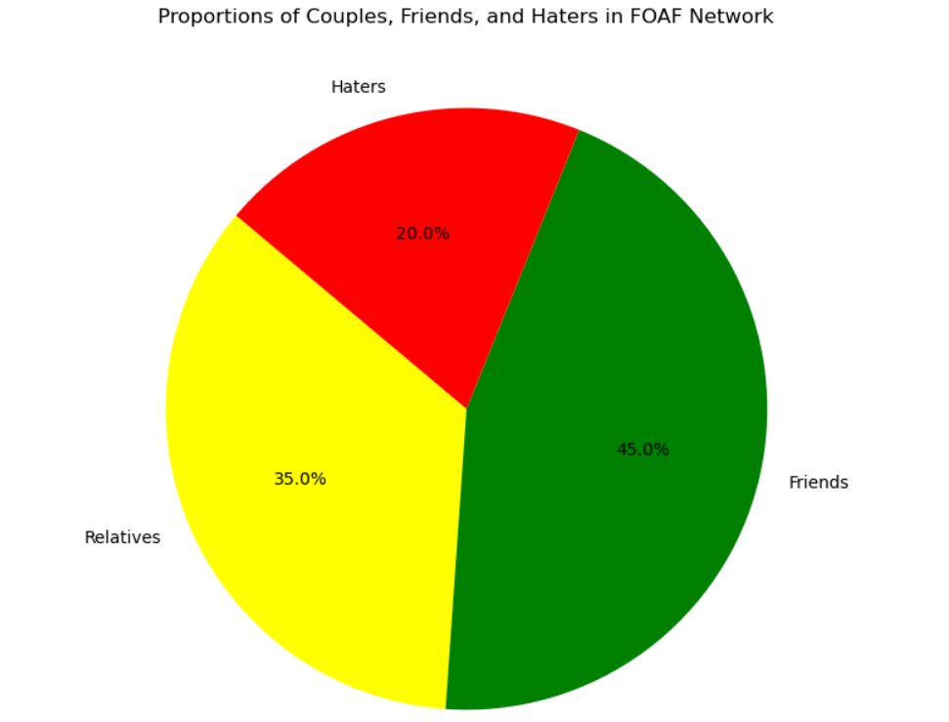
LIST
Friends →QR code | Relatives → Email | Haters →SMS Bomb
http://example.org/person92 | http://example.org/person75 | http://example.org/person22

Slide 5
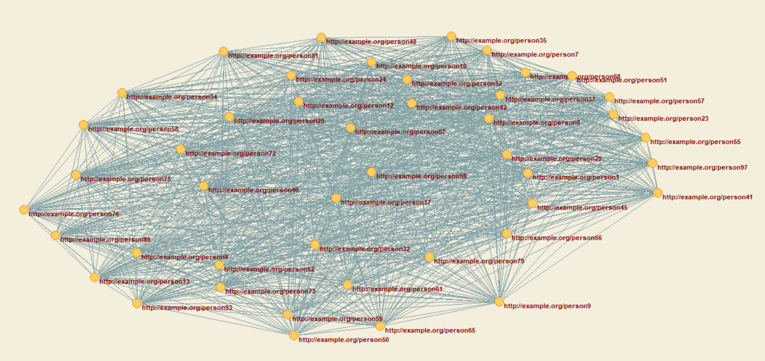
Pajek in Friend List

Slide 6
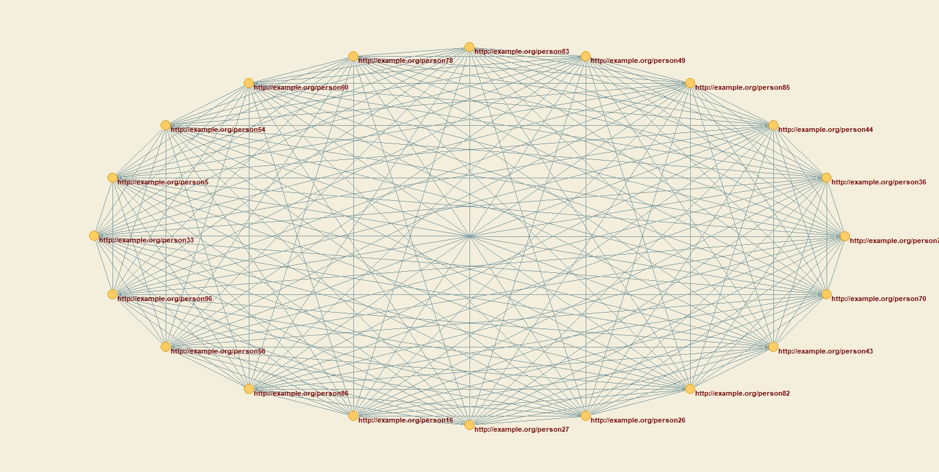
Pajek in Haters List

Slide 7
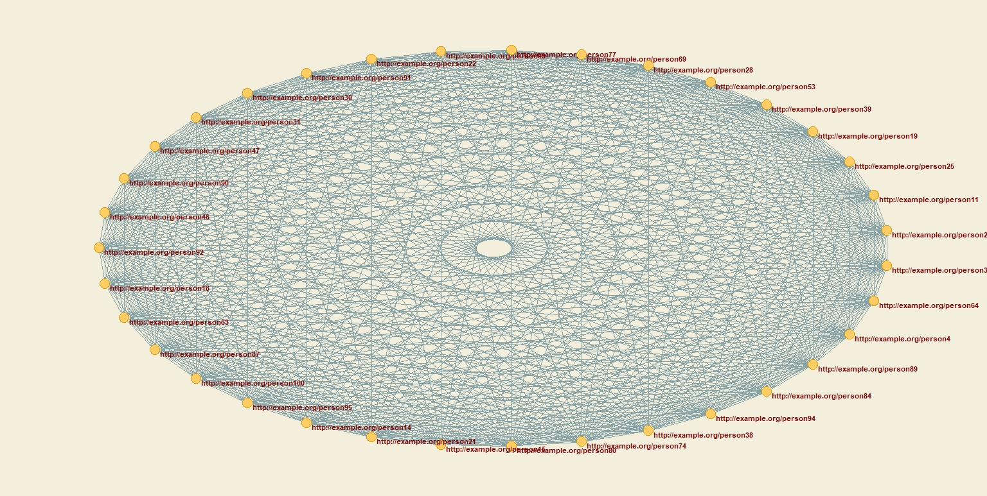
Pajek in Relatives List

Slide 8
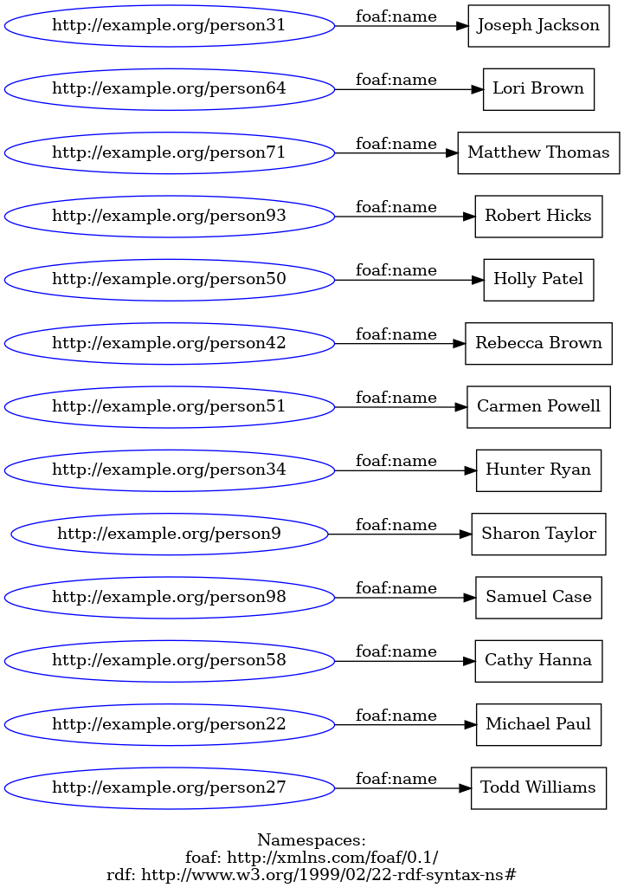
RDF Visualization

Slide 9
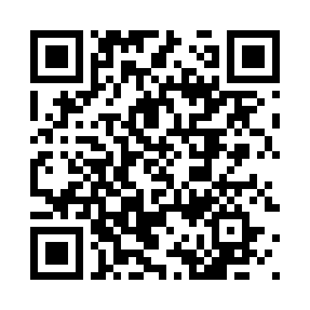
QR Code Generator

Slide 10
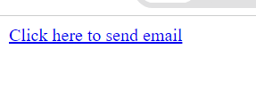
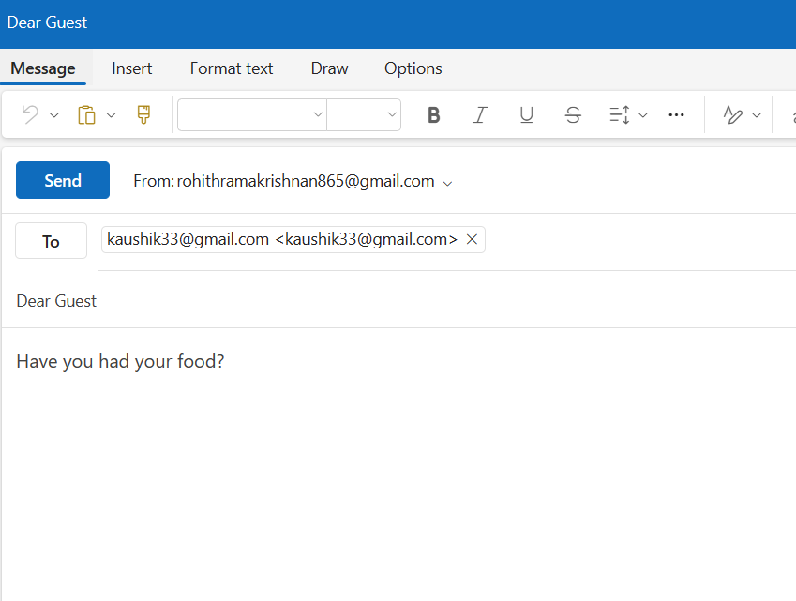
Mail To Tab

Slide 11
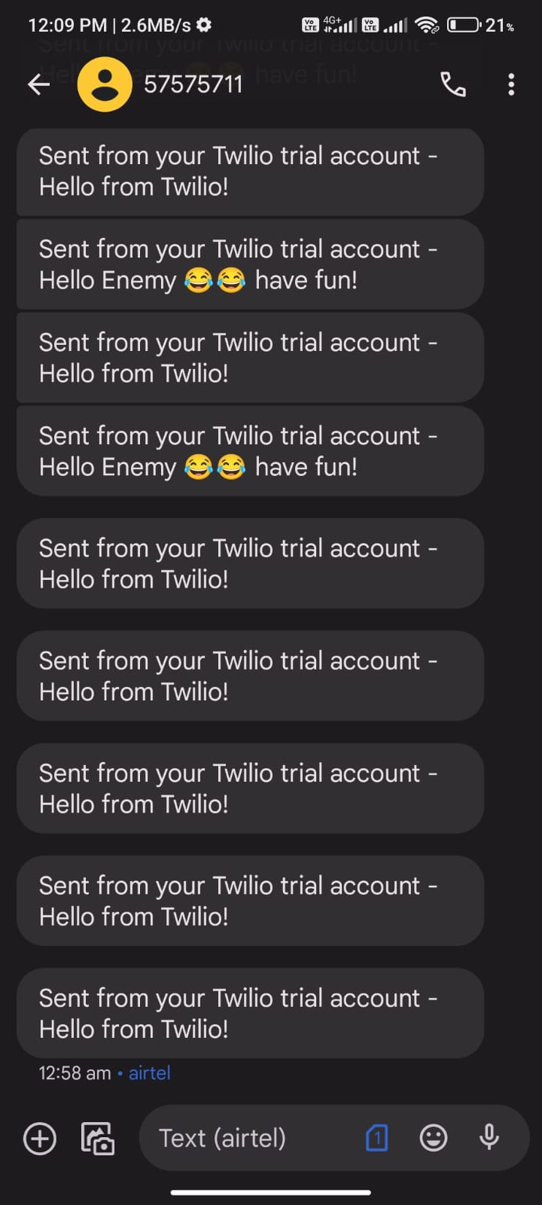
SMS BOBM

