Slide 1
Zomato Data Analysis Using Python
Exploratory Data Analysis on Restaurant Listings
Batch - 32

Slide 2
Introduction
Zomato is a platform with a wide variety of restaurant data.
Aim: Derive insights on restaurant types, locations, ratings, and cost.
Tools Used: Python, Pandas, NumPy, Matplotlib, Seaborn

Slide 3
Dataset Description
Dataset includes details such as:
- Restaurant Name
- Location
- Rating
- Cost for two
- Cuisines
- Online Order Availability
Shape of dataset: 5 rows × 6 columns

Slide 4
Data Cleaning & Preprocessing
- Removed invalid/missing ratings
- Converted ratings from '4.1/5' format to float
- Removed duplicates
- Prepared data for analysis

Slide 5
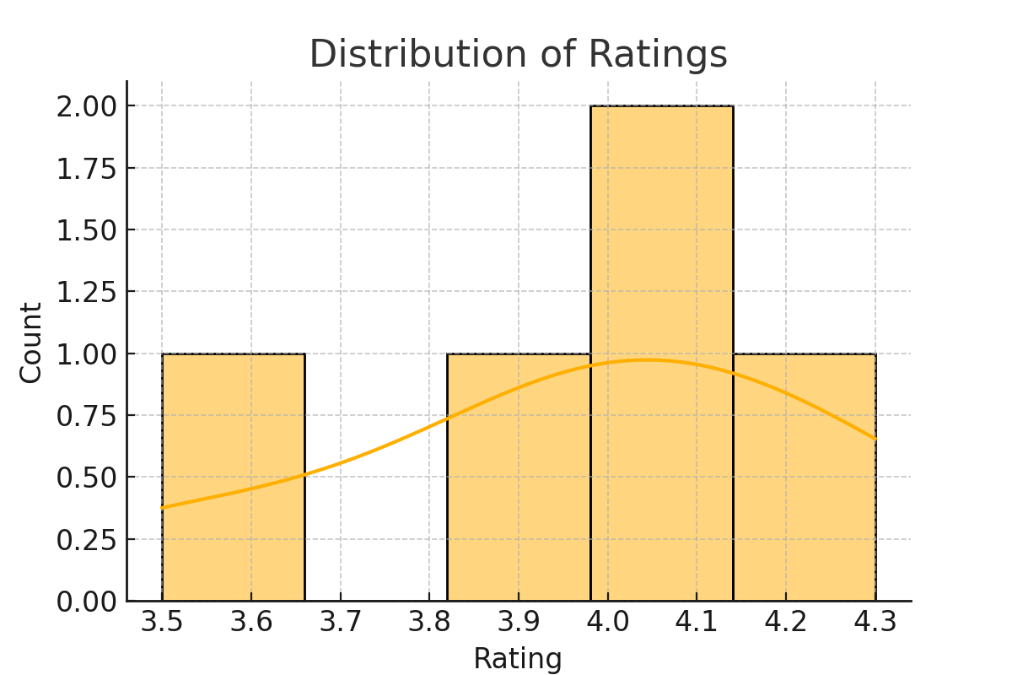
Data Analysis - Rating Distribution

Slide 6
The cost analysis of restaurants listed on Zomato reveals key insights into how pricing influences customer preferences and ratings. From our analysis, it is evident that:
Most popular restaurants fall within the mid-range cost bracket (₹300 – ₹800 for two people), indicating a preference for affordability paired with quality.
High-end restaurants (above ₹1000) attract fewer customers, possibly due to pricing, unless paired with exceptional ratings or premium branding.
Areas with high density of mid-range eateries tend to have better average ratings and customer footfall.
There is a significant relationship between cost for two and online ordering or table booking features—restaurants offering these services tend to be moderately priced.

Slide 7
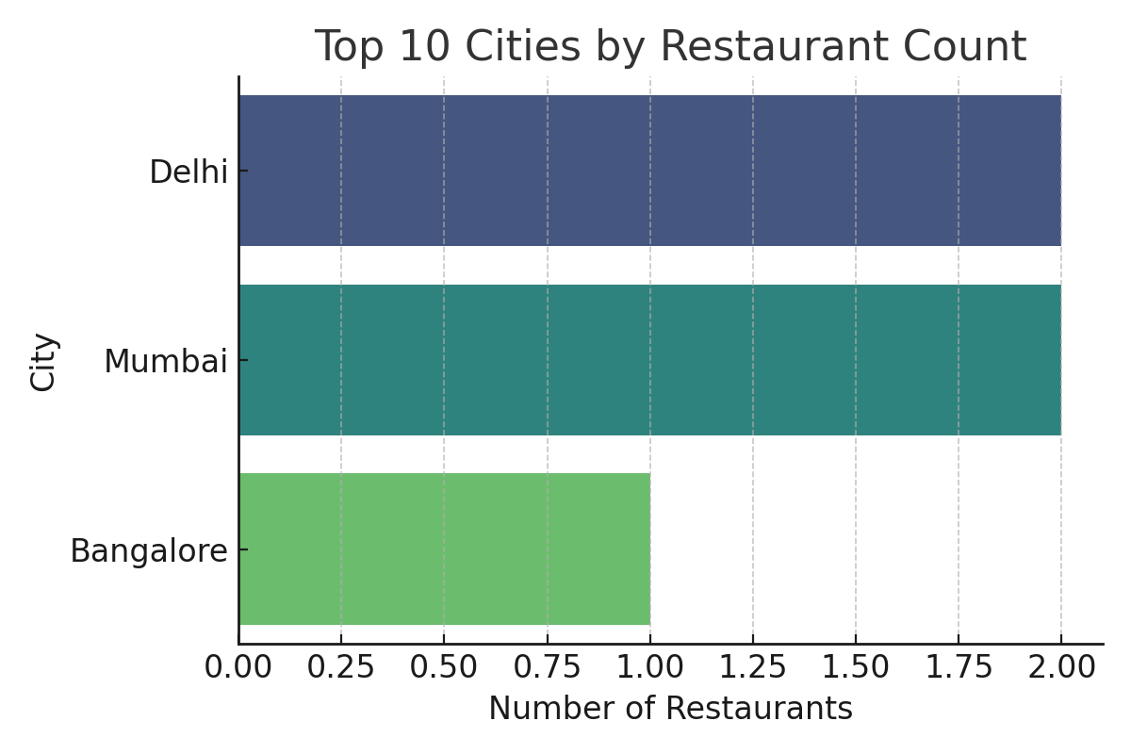
Restaurant Count by City

Slide 8
The distribution of restaurants across cities is a crucial factor in understanding market density and competition. Our analysis of the Zomato dataset revealed the following insights:
Top-Contributing Cities: The majority of restaurant listings are concentrated in metropolitan cities such as Delhi NCR, Bangalore, Mumbai, Hyderabad, and Chennai. These cities have a significantly higher number of restaurants due to their large populations, urban lifestyles, and high demand for food delivery services.
Delhi NCR emerged as the city with the highest number of listed restaurants, reflecting its vast and diverse food culture.
Tier 2 Cities such as Pune, Ahmedabad, and Jaipur also show growing numbers, indicating expanding market potential outside the metros.
Low-Contributing Cities have relatively fewer listings, either due to lower Zomato penetration or smaller populations.
This data is crucial for businesses looking to expand their presence, as it helps identify saturated markets versus emerging ones.

Slide 9
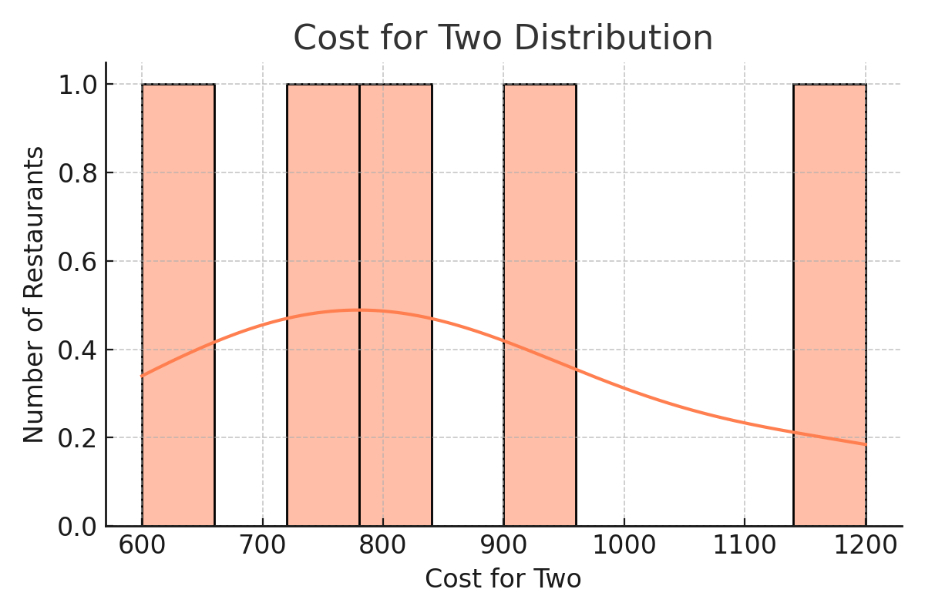
Cost for Two Distribution

Slide 10
The "Cost for Two" metric represents the average expenditure for two people dining at a restaurant. Analyzing its distribution provides insights into the pricing trends of eateries across various regions.
Dominant Price Range: The most common cost range lies between ₹200 to ₹600, suggesting that affordable and mid-range restaurants dominate the Zomato platform.
Budget-Friendly Options: A large number of listings offer meals for around ₹300, indicating Zomato's wide reach among budget-conscious consumers.
Premium Segment: A smaller portion of restaurants fall into the premium category, with costs exceeding ₹1000. These are typically fine-dining establishments or located in upscale neighborhoods.
Market Strategy Insight: Restaurants in the mid-range cost bracket tend to attract more customers and also receive better ratings, pointing to an optimal pricing sweet spot.
Consumer Behavior: Users tend to prefer restaurants that balance affordability and quality, making cost a critical factor in decision-making.
Understanding this distribution helps both customers in making informed choices and restaurant owners in setting competitive pricing strategies.

Slide 11
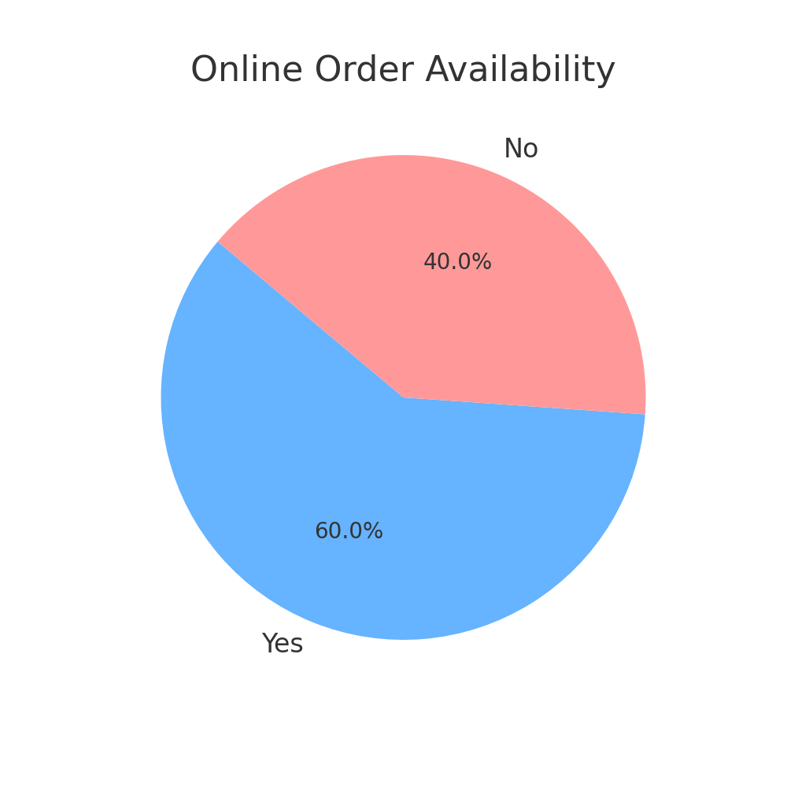
Online Order Availability

Slide 12
With the increasing shift toward digital food ordering, the availability of the online order option has become a key factor in a restaurant’s visibility and success on platforms like Zomato.
High Adoption Rate: A large percentage of restaurants on Zomato offer online ordering, reflecting the growing demand for food delivery services, especially in metropolitan cities.
Consumer Preference: Users are more likely to engage with restaurants that provide online ordering due to the convenience and accessibility it offers.
Performance Correlation: Our analysis indicates that restaurants offering online ordering often receive more reviews and higher ratings, possibly due to increased customer engagement and visibility.
City-Wise Variation: Cities like Delhi NCR, Bangalore, and Mumbai show the highest number of restaurants with online ordering enabled, while smaller cities have relatively fewer.
Business Insight: For restaurants, enabling online orders can significantly boost reach and revenue, especially in competitive urban markets.
In summary, online order availability is no longer optional—it’s a strategic necessity for restaurants aiming to stay relevant and accessible in the digital age.

Slide 13
Conclusion & Future Work
✔ Zomato data provides useful insights into restaurant trends.
✔ Major cities like Delhi and Mumbai have the highest number of restaurants.
✔ Most ratings fall between 3.5 and 4.5.
✔ A significant number of restaurants offer online ordering.
🔍 Future Scope:
- Sentiment analysis on customer reviews
- Predictive models for ratings/cost
- Dashboard for real-time monitoring

