Slide 1

Zomato Data Analysis Using Python
Exploratory Data Analysis on Restaurant Listings
Batch - 32
submitted by ;-
M.rohith naidu 23nu5a4404
A.chakri 22nu1a4402
K.ram tejash 22nu1a4424
K.revanth 22nu1a4428
M.Sai krishna 22nu1a4443
B.chadra vardhan reddy 23nu5a4403

Slide 2
Introduction
Zomato is a platform with a wide variety of restaurant data.
Aim: Derive insights on restaurant types, locations, ratings, and cost.
Tools Used: Python, Pandas, NumPy, Matplotlib, Seaborn

Slide 3
Dataset Description
Dataset includes details such as:
- Restaurant Name
- Location
- Rating
- Cost for two
- Cuisines
- Online Order Availability
Shape of dataset: 5 rows × 6 columns

Slide 4
Data Cleaning & Preprocessing
- Removed invalid/missing ratings
- Converted ratings from '4.1/5' format to float
- Removed duplicates
- Prepared data for analysis

Slide 5
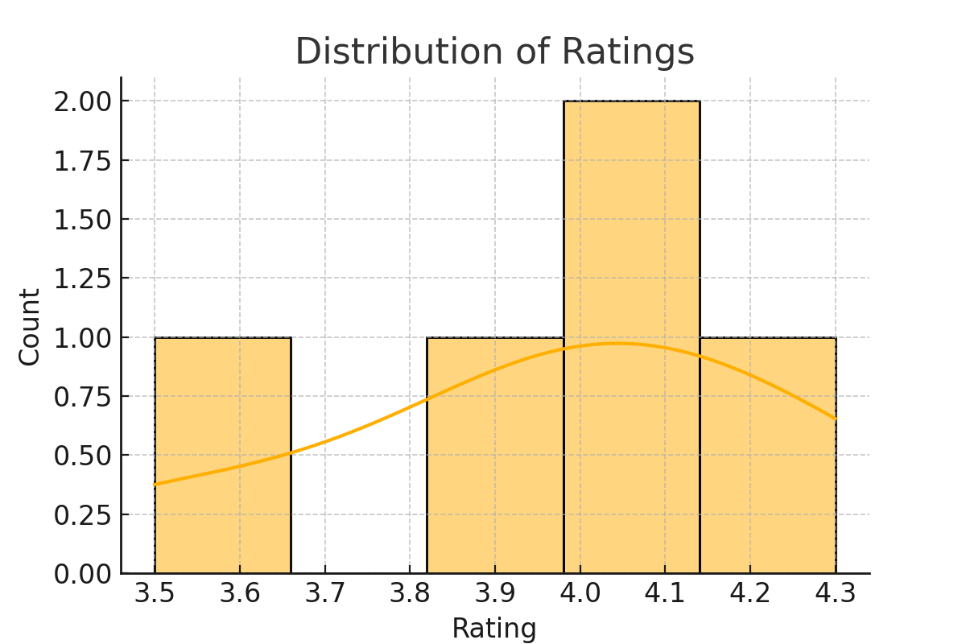
Data Analysis - Rating Distribution
The cost analysis of restaurants listed on Zomato reveals key insights into how pricing influences customer preferences and ratings. From our analysis, it is evident that:
Most popular restaurants fall within the mid-range cost bracket (₹300 – ₹800 for two people), indicating a preference for affordability paired with quality.

Slide 6
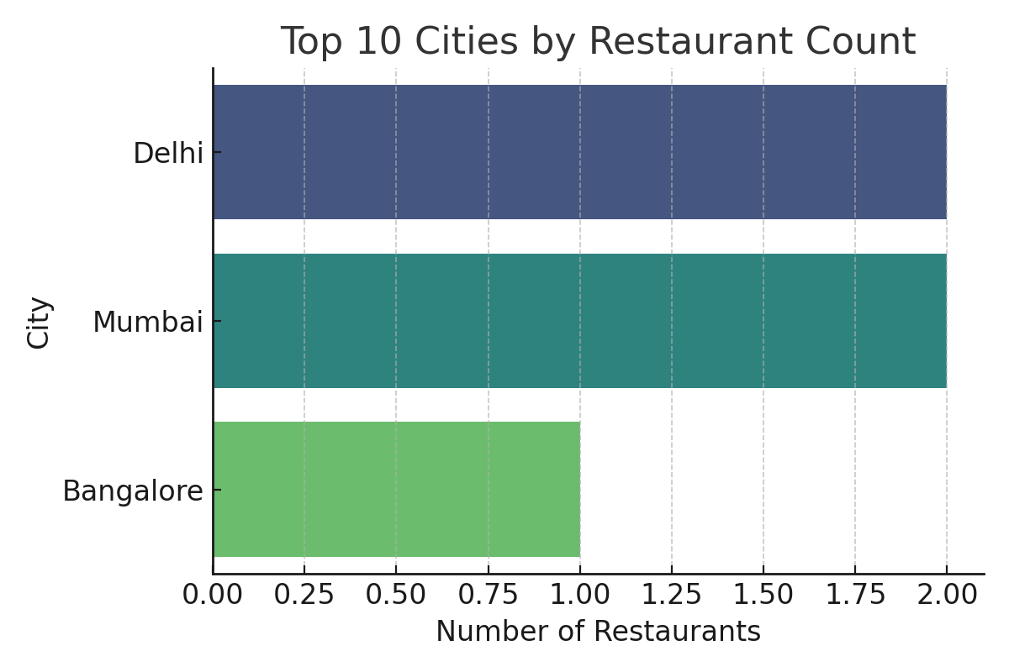
Restaurant Count by City
The distribution of restaurants across cities is a crucial factor in understanding market density and competition. Our analysis of the Zomato dataset revealed the following insights:
Top-Contributing Cities: The majority of restaurant listings are concentrated in metropolitan cities such as Delhi NCR, Bangalore, Mumbai, Hyderabad, and Chennai. These cities have a significantly higher number of restaurants due to their large populations, urban lifestyles, and high demand for food delivery services.

Slide 7
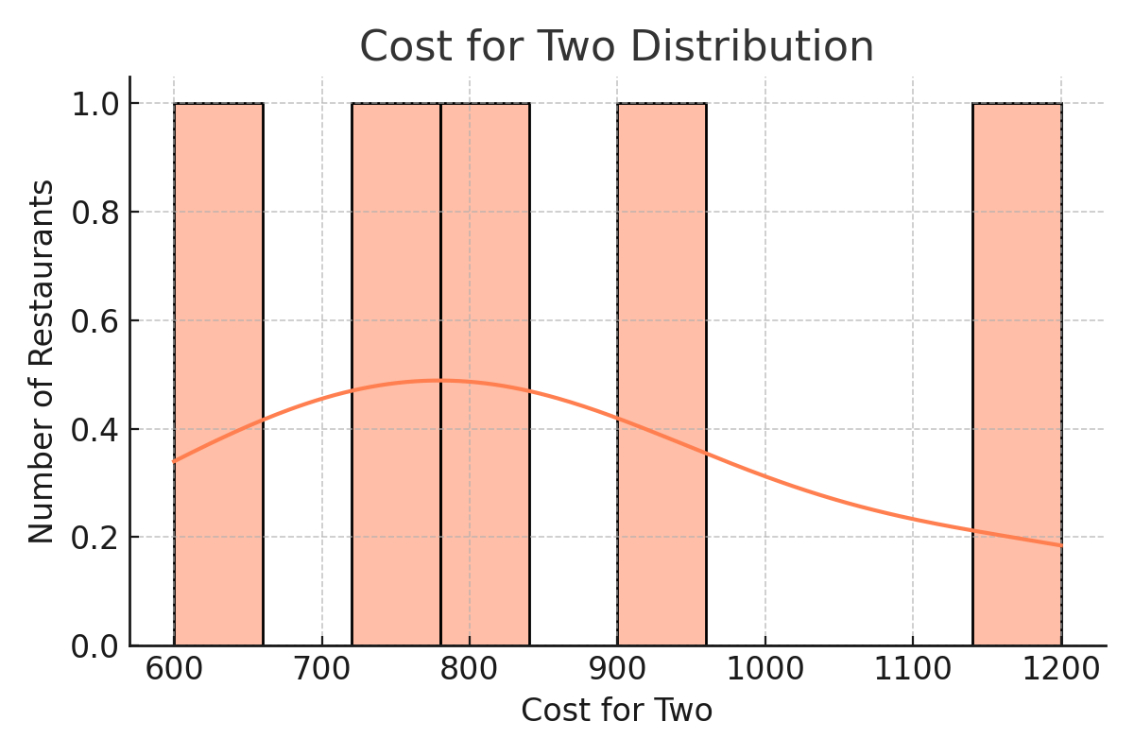
Cost for Two Distribution
The "Cost for Two" metric represents the average expenditure for two people dining at a restaurant. Analyzing its distribution provides insights into the pricing trends of eateries across various regions.
Dominant Price Range: The most common cost range lies between ₹200 to ₹600, suggesting that affordable and mid-range restaurants dominate the Zomato platform.
Budget-Friendly Options: A large number of listings offer meals for around ₹300, indicating Zomato's wide reach among budget-conscious consumers.
Premium Segment: A smaller portion of restaurants fall into the premium category, with costs exceeding ₹1000. These are typically fine-dining establishments or located in upscale neighborhoods.

Slide 8
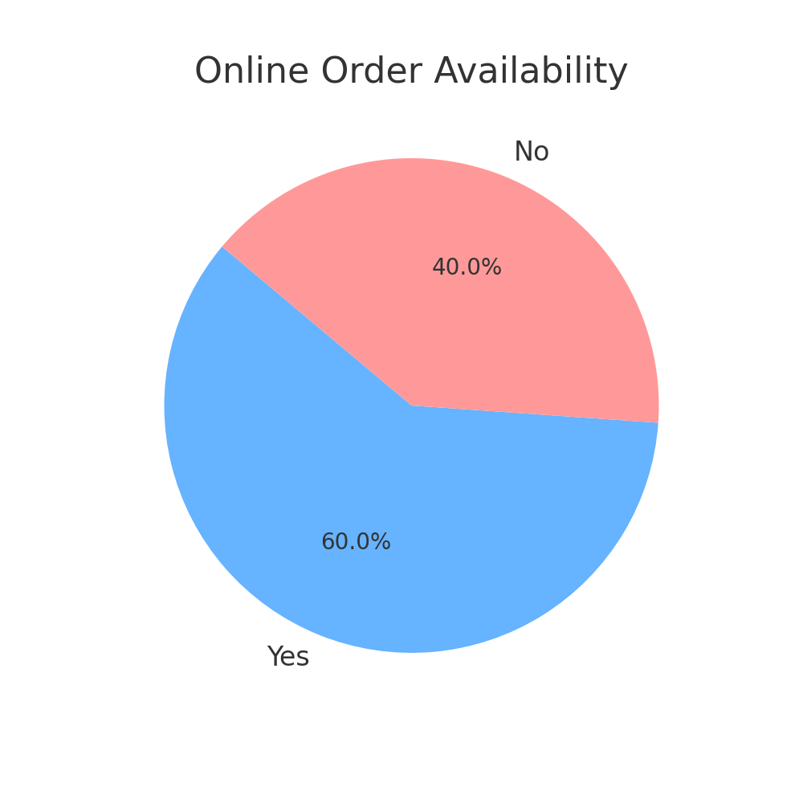
Online Order Availability
With the increasing shift toward digital food ordering, the availability of the online order option has become a key factor in a restaurant’s visibility and success on platforms like Zomato.
High Adoption Rate: A large percentage of restaurants on Zomato offer online ordering, reflecting the growing demand for food delivery services, especially in metropolitan cities.
Consumer Preference: Users are more likely to engage with restaurants that provide online ordering due to the convenience and accessibility it offers.
Performance Correlation: Our analysis indicates that restaurants offering online ordering often receive more reviews and higher ratings, possibly due to increased customer engagement and visibility.

Slide 9
Conclusion & Future Work
✔ Zomato data provides useful insights into restaurant trends.
✔ Major cities like Delhi and Mumbai have the highest number of restaurants.
✔ Most ratings fall between 3.5 and 4.5.
✔ A significant number of restaurants offer online ordering.
🔍 Future Scope:
- Sentiment analysis on customer reviews
- Predictive models for ratings/cost
- Dashboard for real-time monitoring

