Slide 1
Movie Search Box
22AIE111-OOP in JAVA
22AIE112-Data Structure and Algorithm
Team Members:
Rohith Ravi -CB.SC.U4AIE24350
Sri Harini MP - CB.SC.U4AIE24358
Vignes VM -CB.SC.U4AIE24359
Yashwanth B - CB.SC.U4AIE24360
Notes:
ID=d924773e-9a16-4d6d-9803-8cb819e99682 Recipe=text_billboard Type=TextOnly Variant=0 FamilyID=AccentBoxWalbaum_Zero

Slide 2
Introduction
The Movie Search Box is a smart movie search that enhances user experience through intelligent data structures. It allows users to search movies by name or actor, view top-rated films.

Slide 3
Problem Statement
Traditional movie search boxes are limited in capability ,require exact movie names, do not handle actor-based lookups, lack intelligent suggestions or auto-completion,do not learn from user interactions and cannot prioritize based on movie quality (e.g., IMDb).
These limitations result in a poor discovery experience.

Slide 4
Real-life Applications
Can be used in malls or cinemas to let users search for movie details without needing an internet connection.
Can serve as a backend data management system for bigger apps like streaming services, movie review platforms, or recommendation engines.

Slide 5
Existing Solutions and their Drawbacks
Existing Solution | Drawbacks
IMDb | Too much information; can be overwhelming for casual users. Contains ads.
Rotten Tomatoes (provides aggregated critic and audience ratings) | Focuses mainly on ratings and reviews, less on detailed movie info.

Slide 6
Objectives
To build a robust backend system using Python and MongoDB that can store, retrieve, and manage movie information.
To provide efficient search functionality (case-insensitive, optimized) for users to find movie details based on name.
To implement modular, encapsulated code for easy maintenance and future scalability.
To demonstrate real-world use cases like intelligent recommendations and user behaviour analysis

Slide 7
Concepts used:
Subject | Concepts
I) Object Oriented Programming | Encapsulation Abstraction
II) Data Structure and Algorithms | TRIE Priority Queue Hashmap Graph Theory

Slide 8
Description of Our Approach
We use MongoDB to store a structured movie database, allowing fast queries.
A Python-based interface (via the MovieDataManager class) manages connection, data loading, and searching.
The system loads movie data into memory for fast retrieval using Python dictionaries.
Encapsulation is used to separate database logic from the interface, ensuring code modularity and readability.

Slide 9
Work-Flow
Searching movies
Searching through the textbox
Top-Rated Movies
Input(No. of top-movies)
PRIORITY QUEUE
TRIE
Searching actors
Search History
GRAPH
Movies featured by actors.

Slide 10
API (Application Programming Interface)
A typical API interaction follows these steps:
Frontend (Client) Sends a Request:The user interacts with the frontend (e.g., clicking a button).
Backend Processes the Request:The API routes the request to the appropriate function.The backend processes the data, interacts with the database, and performs necessary logic.
Backend Sends a Response:The API returns a structured response (usually in JSON format) to the frontend.
Frontend Updates the UI:The frontend parses the API response and updates the UI accordingly.
API = Set of rules for how software components talk to each other
Flask = The tool you use in Python to build and host those APIs

Slide 11
Trie (Prefix Tree)
Purpose-Efficiently stores and retrieves movie names for prefix-based search.
Functions:
insert(movie_name)
Use: Adds a movie name to the Trie.
DSA Concept: Insertion in Trie (O(M) time complexity, where M is the length of the movie name).
search(prefix)
Use: Finds and returns movie names that start with a given prefix.
DSA Concept: Prefix search using Trie (O(M) time complexity).
collect_movie_names(node)
Use: Collects all movie names beneath a Trie node recursively.
DSA Concept:Traversal on Trie (O(K) time, where K is the number of stored movie names).

Slide 12
Why do we have MovieTrieManager?
Method | Description
__init__() | Initializes the manager with two empty tries: movie & actor
insert_movie(name) | Inserts a movie name into the movie trie
search_movies(prefix) | Returns a list of movie names that start with the given prefix
insert_actor(name) | Inserts an actor name into the actor trie
search_actors(prefix) | Returns a list of actor names that start with the given prefix
Fast & Efficient Search:
Uses a Trie (Prefix Tree) to quickly search for movie or actor names.
Great for autocomplete features based on prefixes.
Organized Data Handling:
Separates logic for movie names and actor names using two different Tries.
Clean structure for inserting and querying names independently.
Scalable Design:
Can handle thousands of entries with low memory overhead.
Time complexity for search is only O(k) where k = length of prefix.

Slide 13
Abstraction in Trie Structure
Abstraction means hiding complex implementation details and exposing only the essential features to the user.
The user calls insert() and search() without needing to understand how the TrieNode structure works internally.
_collect_names() is an internal helper, not exposed to the user.
It hides the recursion and traversal logic.
This makes search() easy to use without the user needing to understand the data structure.
.

Slide 14
Priority Queue (heapq module)
Purpose: Efficiently finds the top N movies by IMDb score.
Functions:
get_top_rated_movies(N=10)
Use: Returns the N highest-rated movies using IMDb scores.
DSA Concept: Heap Sort (O(N log K) time complexity)…where K is the total number of movies.
We have used Min-Heap in your code. It gives the smallest number at the top
So better movies have smaller priority numbers, and they go to the top of the heap.

Slide 15
Encapsulation in PriorityQueue
Private Attributes:
The internal attributes _heap and _size are protected (denoted by the leading underscore).
This prevents direct access from outside the class, ensuring that the internal state is protected.
Controlled Data Access:
Methods like enqueue(), dequeue(), and peek() provide controlled access to the private data.
Users of the class can interact with the priority queue only through these public methods, which manage the state safely.

Slide 16
HashMap (Dictionary) – For Fast Movie Lookup
Purpose: Quickly retrieves movie information based on the movie name.
Functions:
get_movie_data (HashMap Creation)
Use: Stores movie information where the key is the lowercase movie name and the value is the movie object.
DSA Concept: Hashing (O(1) average time complexity for lookup).
get_movie_details(movie_name)
Use: Fetches a movie’s details from the HashMap.
DSA Concept: HashMap Lookup (O(1) time complexity).

Slide 17
Search History
The class SearchHistoryManager helps keep track of which movies each user has searched for, all stored in memory (not in a database).
_search_history: { user_id: [movie names] }
save_search(user_id, movie_name): This method saves a searched movie name for a given user.
get_search_history(user_id):Returns the user's search history list.

Slide 18
Encapsulation in Search History
Data Hiding:
The _search_history dictionary is protected, preventing direct access and modification, ensuring the integrity of user data.
Controlled Access:
Public methods (save_search, get_search_history) provide a controlled interface to interact with the internal data, ensuring valid and consistent operations.

Slide 19
Graph (NetworkX) – For Actor-Movie Relationships
Purpose: Models relationships between movies and actors for advanced recommendations.
Functions:
Graph Initialization (graph.add_node() and graph.add_edge())
Use: Builds a bipartite graph where:
Nodes: Movies and Actors
Edges: Actor-Movie connections.
DSA Concept: Graph Construction (O(N + E) complexity where N is nodes and E is edges).get_movies_by_actor(actor_name)

Slide 20
Conclusion
The project successfully demonstrates how intelligent data structures can significantly enhance the movie search and recommendation experience.
Unlike traditional search boxes, this system supports features such as autocomplete, actor-based discovery, personalized recommendations, and search history tracking.
By integrating a user-friendly frontend with a powerful Flask API backend and MongoDB database, the project delivers a fast, intuitive, and engaging solution for real-world movie exploration needs.

Slide 21
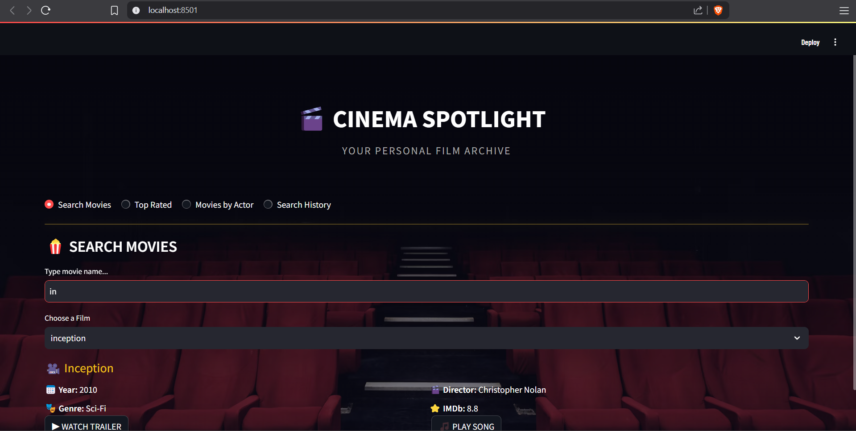
Searching Movies:

Slide 22
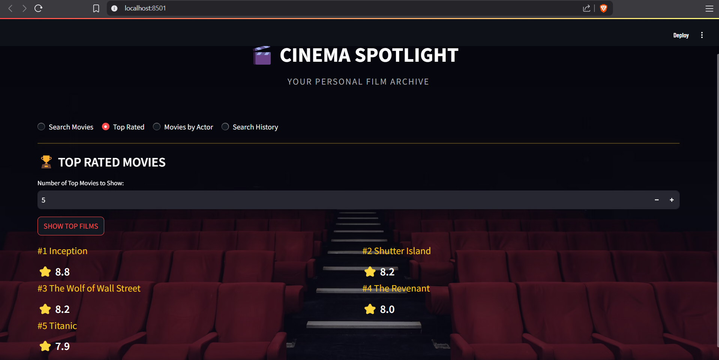
Searching the top-rated movies:

Slide 23
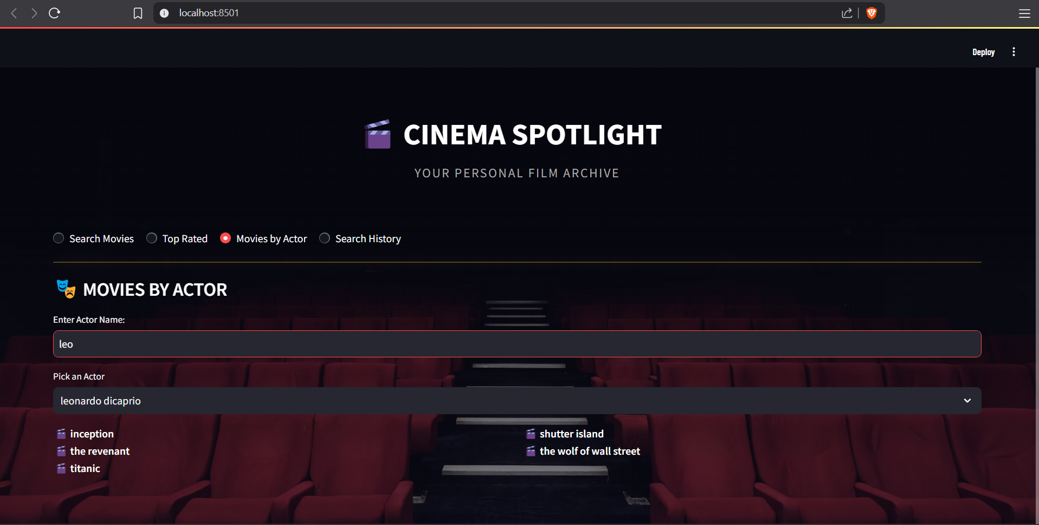
Searching movies by the actors:

Slide 24
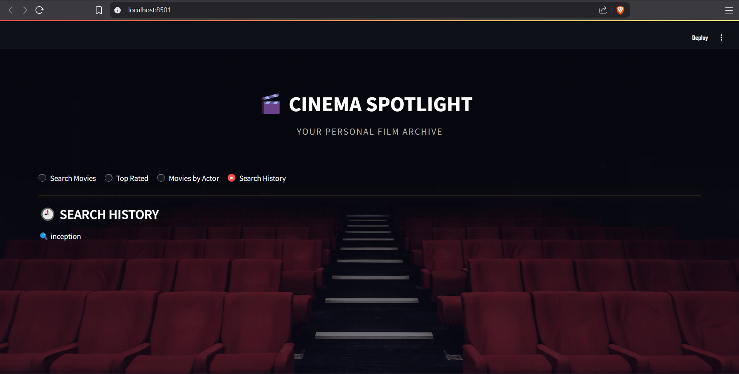
Search History:

