Slide 1

Employee Management System
A Relational Database Management System Using MySQL
Presented By:
Rohith Sunkari
Sherla Vaishnavi

Slide 2
Meet the Team
Sherla Vaishnavi | Rohith Sunkari
Background: B.Tech – CSE (AI & ML) | Background: B.Tech – CSE (AI & ML)
Why Data Science? Passionate about solving real-world problems using data and building analytical solutions. | Why Data Science? Interested in data-driven decision making and database technologies.
Work Experience: Fresher | Work Experience: Fresher
LinkedIn: Linkedin_URL | LinkedIn: Linkedin_URL
GitHub: GitHub_URL | GitHub: GitHub_URL

Slide 3
Objective :
Designing an Employee Management System using SQL.
Store and manage employee-related information efficiently.
The system maintains details such as employee, department, salary, leave, qualification, and payroll records.
Enable easy data retrieval and reporting through a relational database for better HR management.

Slide 4
Problem Statement :
Managing employee records manually is time-consuming and error-prone.
Employee data is often scattered across multiple records.
Maintaining payroll, leave, and salary information becomes difficult.
A centralized SQL database is needed to organize employee information efficiently.

Slide 5
Overview :
Technologies Used :
MySQL
SQL
MySQL Workbench
Key Features :
Employee Information Management
Department & Job Role Management
Salary and Payroll Processing
Leave Tracking
Qualification Tracking

Slide 6
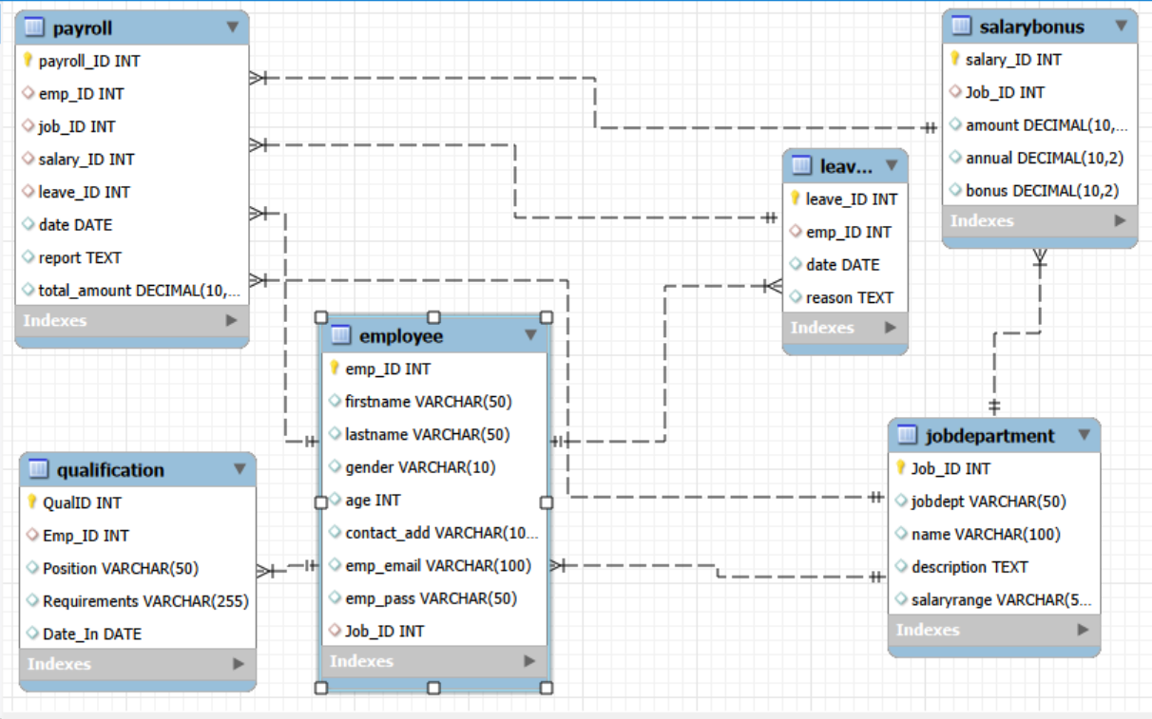
ER Diagram :

Slide 7
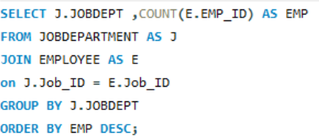
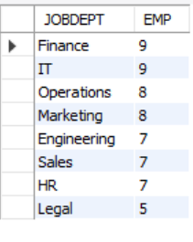
Employee Analysis :
Q. Which departments have the highest number of employees?
Query : Output :
Key Insights :
Finance and IT departments have the highest workforce, with 9 employees each, indicating greater staffing requirements.
The Legal department has the fewest employees (5), suggesting it operates with a smaller team compared to other departments.

Slide 8
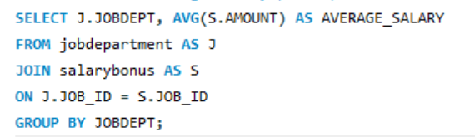
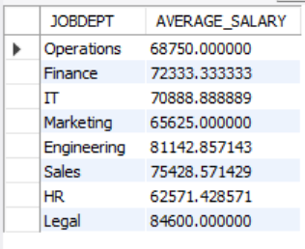
Employee Analysis :
Q. What is the average salary per department?
Query : Output :
Key Insights :
The Legal department offers the highest average salary (₹84,600), indicating higher compensation compared to other departments.
The HR department has the lowest average salary (approximately ₹62,571), while most other departments have average salaries between ₹65,000 and ₹81,000.

Slide 9
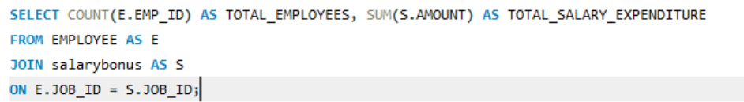
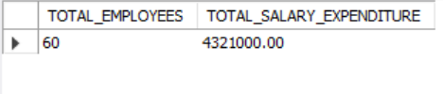
Employee Analysis :
Q. What is the total salary expenditure across the company?
Query : Output :
Key Insights :
The company has a total of 60 employees with an overall salary expenditure of ₹43,21,000.
The total salary expenditure provides a clear view of the company's payroll budget, helping in financial planning and resource allocation.

Slide 10
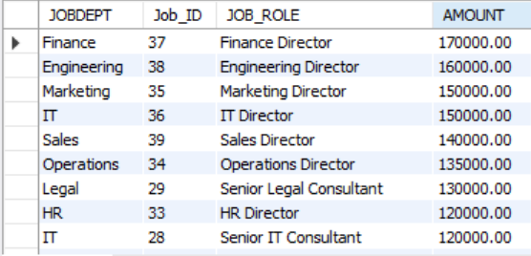
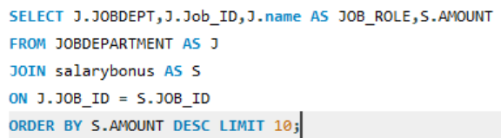
Job Role & Department Analysis :
Q. Which job roles offer the highest salary?
Query : Output :
Key Insights :
Finance Director is the highest-paid job role with a salary of ₹170,000, followed by Engineering Director (₹160,000) and Marketing Director (₹150,000).
Director-level positions dominate the top salary rankings, highlighting that leadership roles receive the highest compensation across departments.

Slide 11
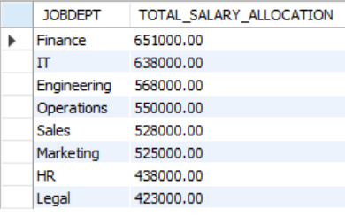
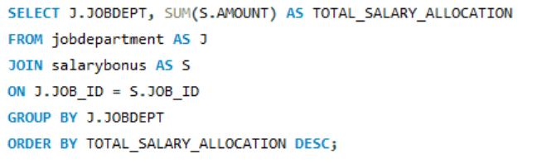
Job Role & Department Analysis :
Q. Which departments have the highest total salary allocation?
Query : Output :
Key Insights :
The Finance department has the highest total salary allocation (₹651,000), indicating the largest payroll investment among all departments.
The Legal department has the lowest total salary allocation (₹423,000), reflecting a comparatively smaller salary budget.

Slide 12
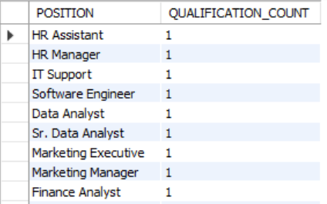
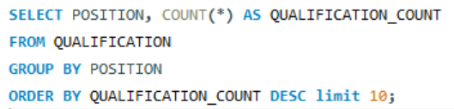
Qualification Analysis :
Q. Which positions require the most qualifications?
Query : Output :
Key Insights :
All listed positions have an equal qualification count of 1, indicating that no single position requires more qualifications than the others.
The qualification requirements are uniformly distributed across different job roles, suggesting consistent qualification criteria in the dataset.

Slide 13
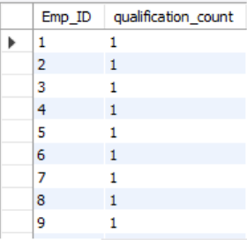
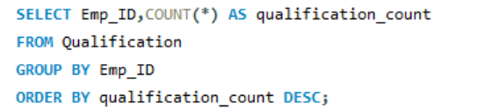
Qualification Analysis :
Q. Which employees have the highest number of qualifications?
Query : Output :
Key Insights :
All employees have an equal qualification count of 1, indicating that no employee has more qualifications than the others.
The qualification records are evenly distributed, suggesting each employee is associated with one recorded qualification in the dataset.

Slide 14
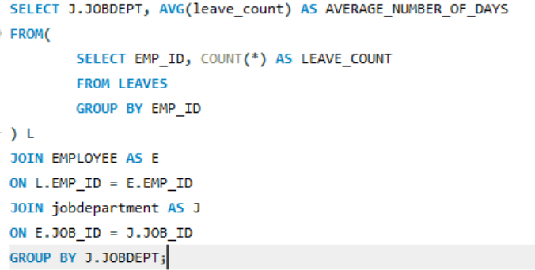
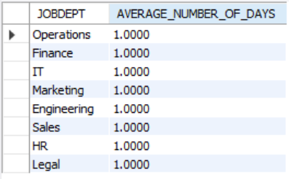
Leaves and Absence Analysis :
Q. What is the average number of leave days taken by its employees per department?
Query : Output :
Key Insights :
All departments have the same average leave count of 1 day per employee, indicating a uniform leave pattern across the organization.
There is no significant variation in leave usage between departments, suggesting consistent leave management practices.

Slide 15
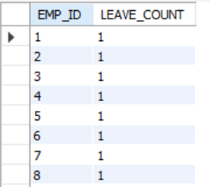
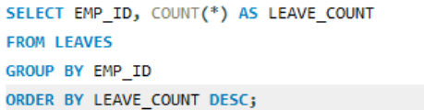
Leaves and Absence Analysis :
Q. Which employees have taken the most leaves?
Query : Output :
Key Insights :
All employees have taken one leave each, indicating that no employee has taken more leaves than the others.
Leave records are evenly distributed among employees, suggesting a balanced leave pattern in the dataset.

Slide 16
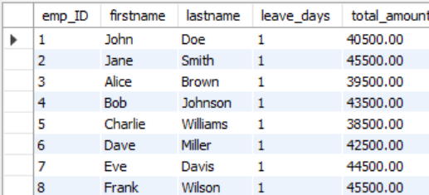
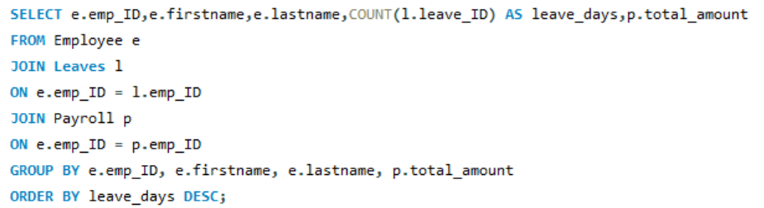
Leaves and Absence Analysis :
Q. How do leave days correlate with payroll amounts?
Query : Output :
Key Insights :
All employees have taken one leave day, but their payroll amounts differ based on their respective salary structures.
Since the leave count is the same for all employees, there is no noticeable correlation between leave days and payroll amounts in this dataset.

Slide 17


Payroll and Compensation Analysis :
Q. What is the total monthly payroll processed?
Query : Output :
Key Insights :
The company processes a total monthly payroll of ₹277,800, representing the combined salary payments to all employees.
The total monthly payroll provides a clear overview of the organization's monthly salary expenditure, supporting payroll planning and budgeting.

Slide 18
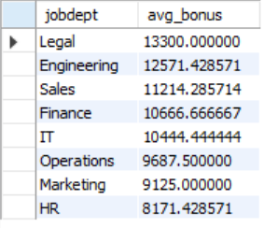
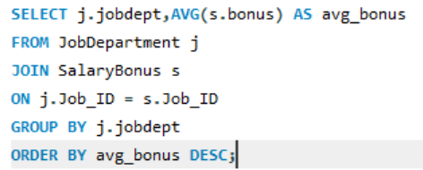
Payroll and Compensation Analysis :
Q. What is the average bonus given per department?
Query : Output :
Key Insights :
The Legal department receives the highest average bonus (₹13,300), indicating the highest bonus allocation among all departments.
The HR department has the lowest average bonus (₹8,171.43), while the average bonuses of other departments range between ₹9,125 and ₹12,571.

Slide 19
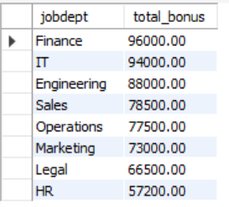
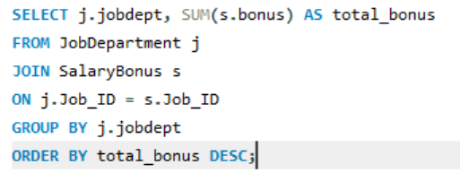
Payroll and Compensation Analysis :
Q. Which department receives the highest total bonuses?
Query : Output :
Key Insights :
The Finance department receives the highest total bonus (₹96,000), indicating the largest overall bonus allocation among all departments.
The HR department has the lowest total bonus (₹57,200), while the bonuses of other departments range from ₹66,500 to ₹94,000.

Slide 20
Challenges Faced :
Designed proper relationships between tables using Primary Keys and Foreign Keys.
Maintained data integrity using constraints like ON DELETE CASCADE, ON UPDATE CASCADE, and SET NULL.
Wrote complex SQL JOIN queries to retrieve data from multiple related tables.
Handled date fields in the YYYY-MM-DD format for accurate analysis.
Prevented duplicate records by applying UNIQUE constraints, especially for employee email addresses.

Slide 21
Conclusion :
I had Successfully designed and implemented an Employee Management System using SQL.
Created a relational database with 6 interconnected tables using Primary and Foreign Keys.
Performed SQL analysis to generate insights on employees, departments, salaries, qualifications, leaves, and payroll.
Ensured data integrity using constraints and relationships.
Demonstrated how SQL can efficiently manage and analyze HR data for better decision-making.

Slide 22

THANK YOU

