Slide 1

PHISHSHIELD AI
Real-Time Adaptive Phishing Detection & Prevention System
Powered by Machine Learning • Browser Extension • Real-Time Protection
Major Project Presentation | 2025-2026
1/10

Slide 2
PROBLEM STATEMENT
3.4 Billion+
$17,700
83%
36%
Phishing emails sent daily worldwide
Average cost per minute of a phishing attack
Organizations experienced phishing in 2023
Data breaches caused by phishing attacks
⚡ Traditional blacklist-based detection is reactive and cannot detect zero-day phishing URLs
🔗 Attackers use sophisticated techniques like typosquatting, homograph attacks, and URL obfuscation
🕔 Existing solutions have significant lag between URL creation and blacklist inclusion
📱 Users lack real-time, in-browser protection with explainable threat warnings
🧠 Need for an intelligent system that adapts to evolving phishing strategies using ML
2/10

Slide 3
OBJECTIVES
ML-Powered Detection
Develop a machine learning model using ensemble methods (Random Forest, XGBoost, Gradient Boosting) to classify URLs as phishing or legitimate with high accuracy.
01
Comprehensive Feature Engineering
Extract 30+ URL-based features including lexical analysis, entropy calculation, structural patterns, typosquatting detection, and homograph attack identification.
02
Real-Time Browser Protection
Build a Chrome/Firefox MV3 browser extension that intercepts navigation and blocks phishing URLs before the user reaches the malicious page.
03
Admin Dashboard & Analytics
Create a Next.js admin dashboard for monitoring scan history, threat statistics, whitelist/blacklist management, and real-time analytics.
04
Explainable AI Decisions
Provide human-readable reasons for each detection (e.g., suspicious TLD, typosquatting, IP-based URL) so users understand why a URL was flagged.
05
3/10

Slide 4
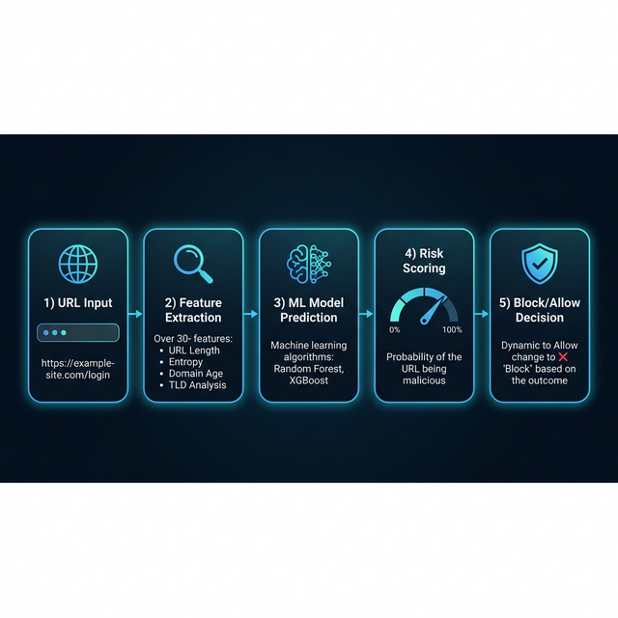
METHODOLOGY
1
2
3
4
5
URL Input
Feature Extraction
ML Classification
Risk Scoring
Action & Feedback
User navigates to a URL; the browser extension intercepts the request.
30+ features extracted: URL length, entropy, TLD, typosquatting signals, etc.
Ensemble models (RF, XGBoost, GB) predict phishing probability.
Score 0.0–1.0 generated; threshold at 0.60 for phishing classification.
URL blocked/allowed; reasons displayed; result stored in DB.
4/10

Slide 5
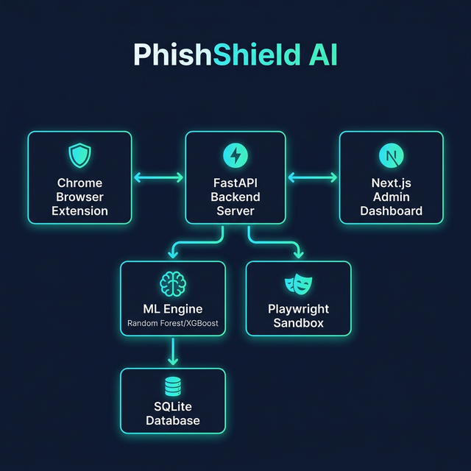
PROPOSED ARCHITECTURE
5/10

Slide 6
SYSTEM COMPONENTS
Browser Extension
FastAPI Backend
ML Engine
Chrome MV3 extension intercepts navigation events, sends URLs to backend API, caches results, and blocks malicious pages in real-time.
High-performance Python backend with RESTful API endpoints for scoring, feedback, statistics, and whitelist/blacklist management.
Ensemble ML models (Random Forest, XGBoost, Gradient Boosting) trained on URL features. Includes heuristic fallback for robustness.
Next.js Dashboard
Playwright Sandbox
SQLite Database
Admin panel for viewing scan history, threat analytics, managing user whitelists/blacklists, and monitoring system health.
Headless browser sandbox for deep URL analysis: screenshot capture, login form detection, and external resource analysis.
Persistent storage for scan results, user lists, feedback data, and statistics. Uses SQLAlchemy ORM for database operations.
6/10

Slide 7
ML MODEL & FEATURE ENGINEERING
Feature Categories (30+ Features)
Model Comparison & Selection
Length Features
URL length, domain length, path length, query length, domain-URL ratio, path-URL ratio
Models Evaluated:
Statistical
Shannon entropy (URL, domain, path), randomness measurement
▸ Random Forest
200 trees, max_depth=20
▸ Gradient Boosting
150 estimators, lr=0.1
Structural
Subdomain count, dot count, dash count, path depth, query parameters
▸ XGBoost
200 estimators, lr=0.1
Character Analysis
Digit ratio, letter ratio, special char ratio, uppercase ratio, vowel/consonant ratio
▸ LightGBM
200 estimators, 31 leaves
Training Pipeline:
Pattern Detection
IP address check, typosquatting, homograph attack, URL shortener, @ symbol, redirects
• Dataset → Feature Extraction → StandardScaler
• 80/20 stratified train-test split
• 5-fold stratified cross-validation
• Best model selected by F1-Score
• Metrics: Accuracy, Precision, Recall, ROC-AUC
Security
HTTPS usage, encoded chars, HTTP-in-path, HTTPS token in domain
7/10

Slide 8
IMPLEMENTATION PLAN
Phase 1
Phase 2
Phase 3
Phase 4
Phase 5
Weeks 1-3
Weeks 4-7
Weeks 8-11
Weeks 12-15
Weeks 16-18
Research & Data Collection
Feature Engineering & Model Training
Backend & API Development
Frontend & Extension
Testing & Deployment
• Literature survey on phishing detection
• Design 30+ URL-based features
• FastAPI backend with RESTful endpoints
• Chrome MV3 browser extension
• Unit & integration testing
• URL dataset collection (phishing + legitimate)
• Implement Feature Extractor class
• Score, Feedback, Stats, User Lists APIs
• Real-time URL interception & blocking
• Performance benchmarking
• Study of ML algorithms for classification
• Train & compare 4 ML models
• SQLite database integration
• Next.js admin dashboard
• Docker containerization
• Technology stack selection
• Model optimization & selection
• Whitelist/Blacklist management
• Analytics & scan history UI
• Documentation & final presentation
8/10

Slide 9
TECHNOLOGY STACK
Backend
ML / AI
Frontend
Extension
DevOps
Python 3.14+
scikit-learn
Next.js
Chrome MV3
Docker
Core language
ML framework
React framework
Manifest V3
Containerization
FastAPI
XGBoost
TypeScript
WebNavigation API
Docker Compose
REST API framework
Gradient boosting
Type-safe JS
URL interception
Orchestration
SQLAlchemy
Pandas / NumPy
Tailwind CSS
Background SW
PostgreSQL
Database ORM
Data processing
Utility-first CSS
Service worker
Production DB
SQLite
Random Forest
Chart.js
Block Page
Redis
Persistent storage
Ensemble classifier
Analytics charts
Custom warning
Caching layer
Uvicorn
StandardScaler
Responsive UI
URL Caching
MinIO
ASGI server
Feature scaling
Mobile-ready
Performance opt
Object storage
9/10

Slide 10
THANK YOU
Questions & Discussion
PhishShield AI • Real-Time Adaptive Phishing Detection
Built with Python • FastAPI • Machine Learning • Chrome Extension • Next.js
10/10

