Slide 1
Assignment 1(LMS)
10 marks (weightage 0 to 7)

Slide 2
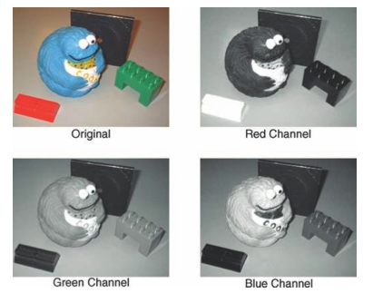
Question 1
starters
Choose an RGB image (Image1); Plot R, G, and B separately (Write clear comments and observations)

Slide 3
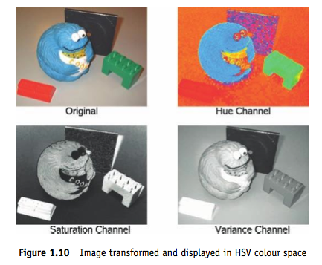
Question 2
starters
Convert Image 1 into HSL and HSV. Write the expressions for computing H, S and V/I.
(Write clear comments and observations)

Slide 4
Question 3
starters
Convert Image 1 into L*a*b* and plot

Slide 5
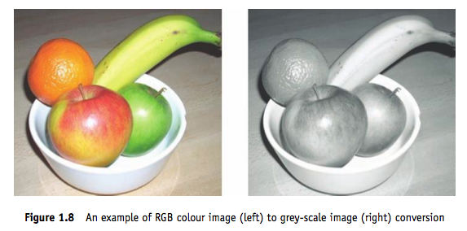
Question 4
starters
Convert Image 1 into Grayscale using the default OpenCV function. Write the expressions used for the conversion.

Slide 6
Question 5
starters
Take a grayscale image (Image 3) and illustrate
Whitening
Histogram equalization

Slide 7
Question 6
starters
Take a low illumination noisy image (Image 4), and perform Gaussian smoothing at different scales. What do you observe w.r.t scale variation?

Slide 8
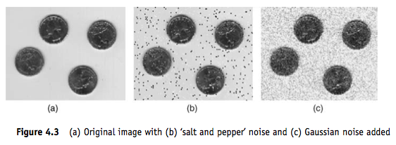
Question 7
starters
Take an image (Image 5) and add salt-and-pepper noise. Then perform median filtering to remove this noise.

Slide 9
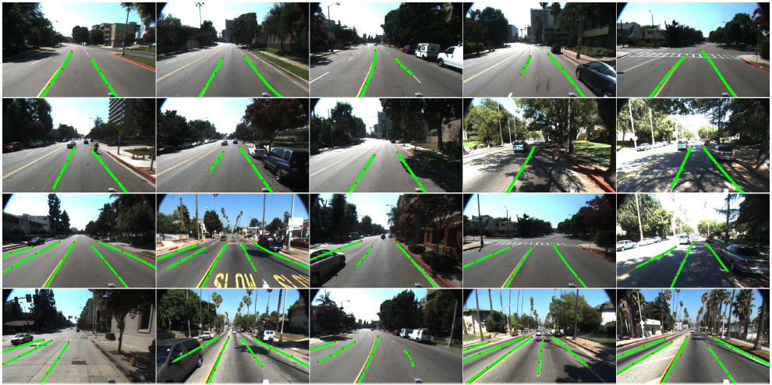
Question 8
main course
Detect Road land markers

Slide 10
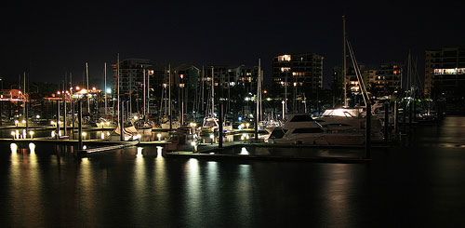
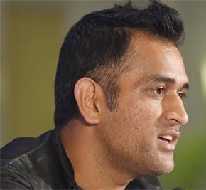
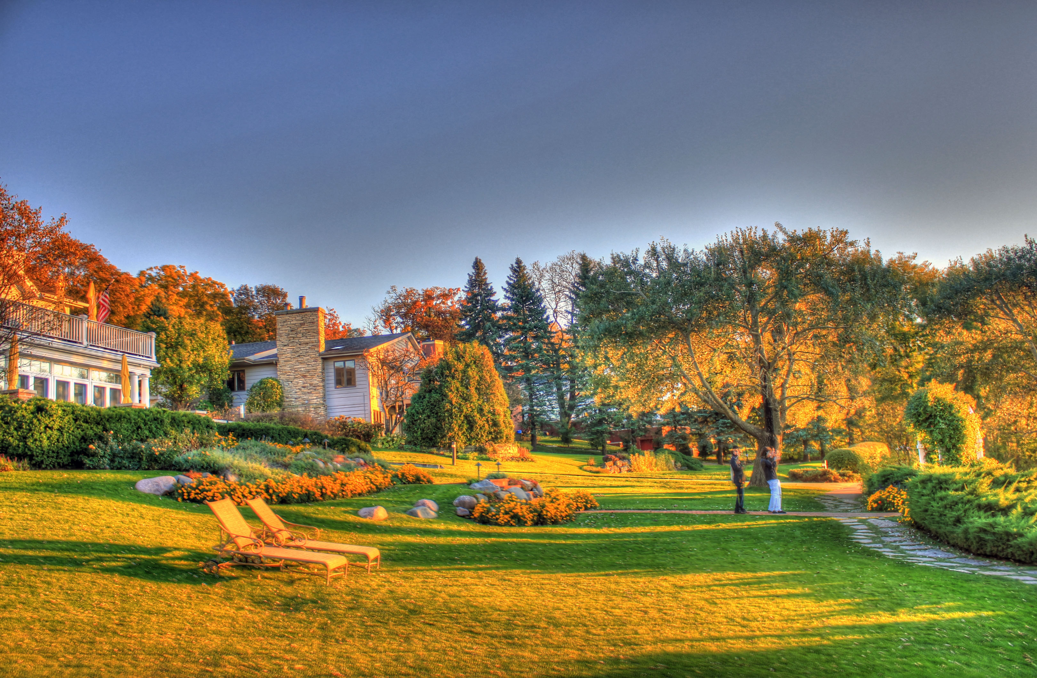
Question 9
main course
Classify modes:
Night; Portrait;
Landscape
Design features, use NN

Slide 11
Instructions
Write clear comments and observations
Submit a zip file with PDF, OpenCV code as well
Who submits? Team lead
Feb 1: Final submission on LMS

