Slide 1



Slide 2
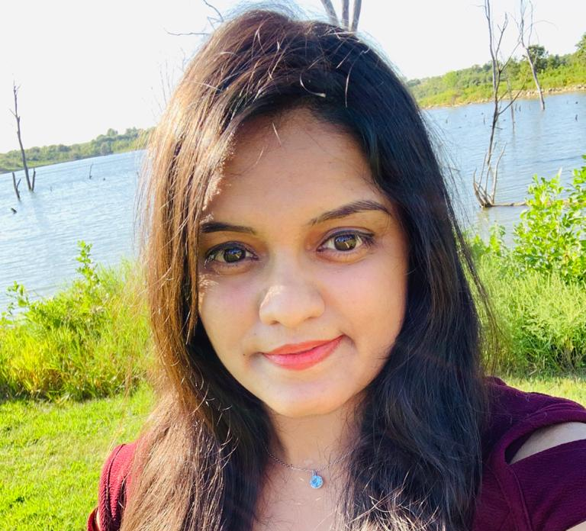
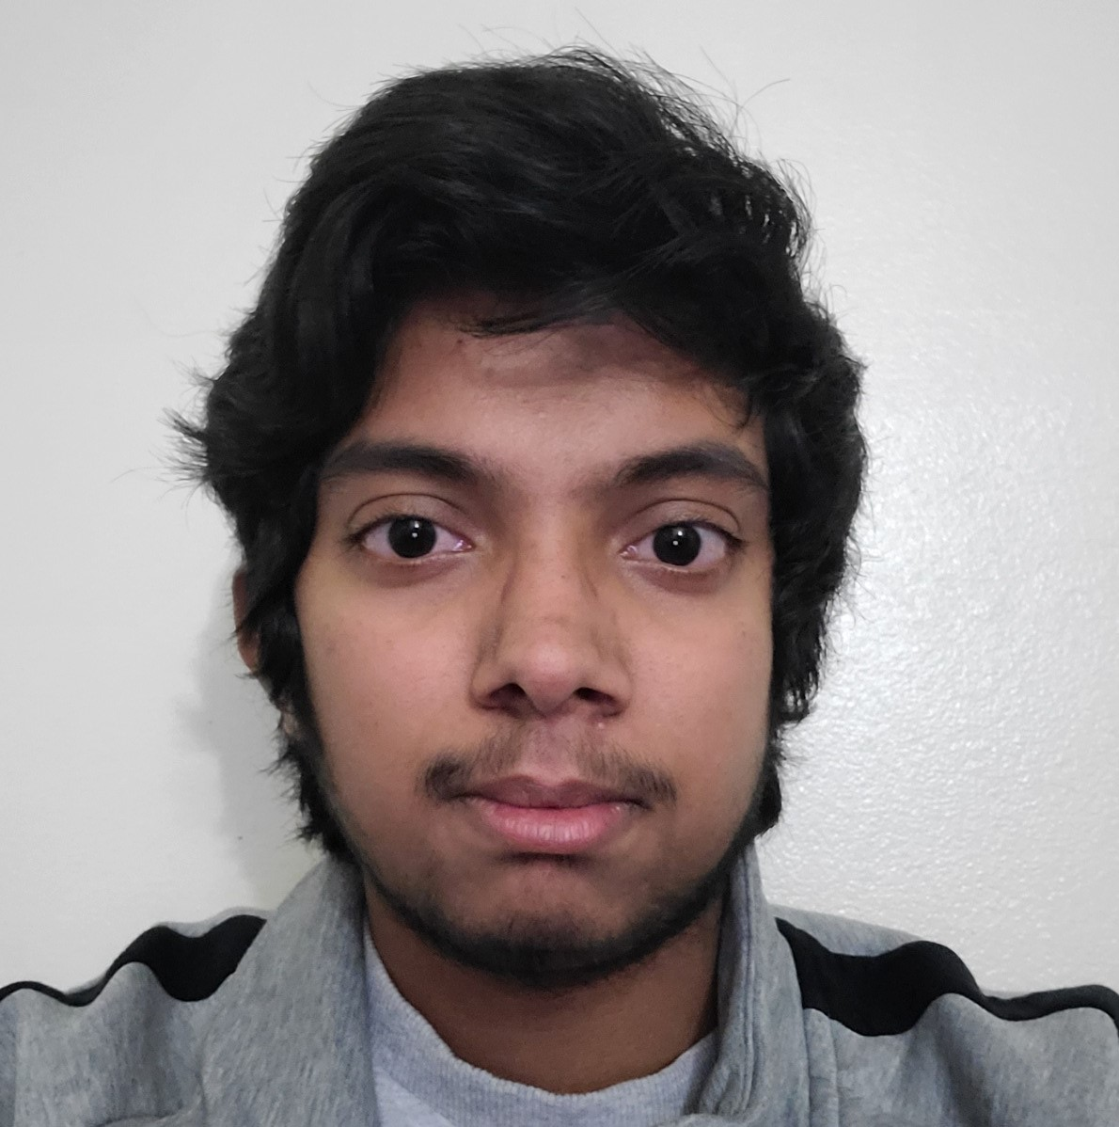
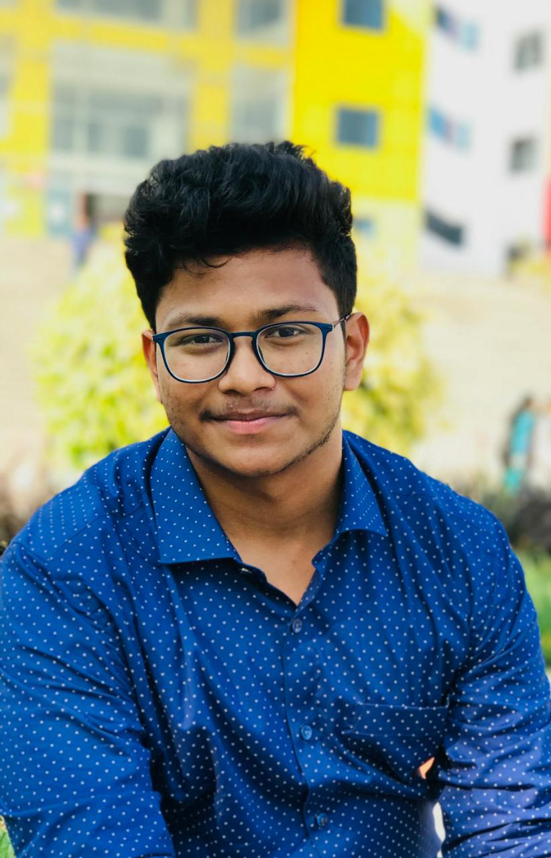
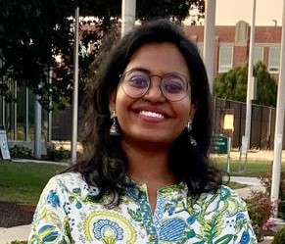
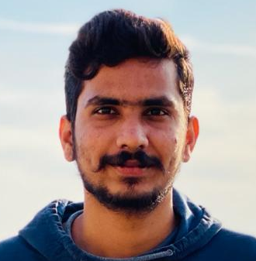
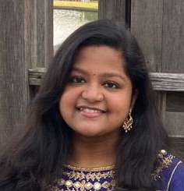
Team Members:
Name: Sindhuja Valeti
Designation: Project Manager
Name: Tarun Sarpanjeri
Designation: Team Lead
Name: Neelesh Saladi
Designation: UI Developer
Name: Annie Chandolu
Designation: Full Stack Developer
Name: Vigneshwar Reddy
Designation: Database Engineer
Name: Alekhya Jaddu
Designation: Front-End Developer

Slide 3
Overview
Users can monitor their daily activity and understand to improve or manage accordingly.
Personal Goals can be set for activities like walking, sleeping, eating and drinking enough water. A daily logging system is created to do so.
Users and administrators can create challenges which can be taken as a group or be specific to an individual.
Administrators have access to all data within the app and determine the winners of the challenges.
Data gathered will be used for further research.

Slide 4
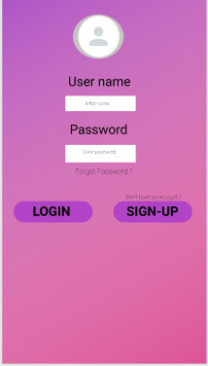
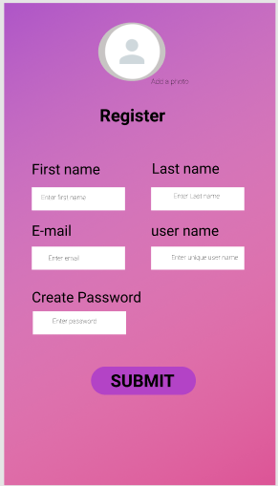
UI Design 1

Slide 5
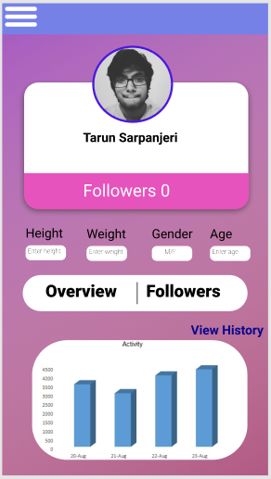
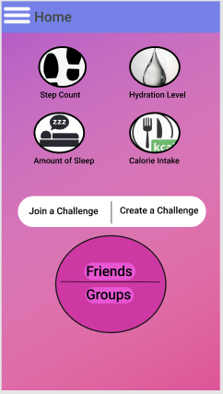
UI Design 2

Slide 6
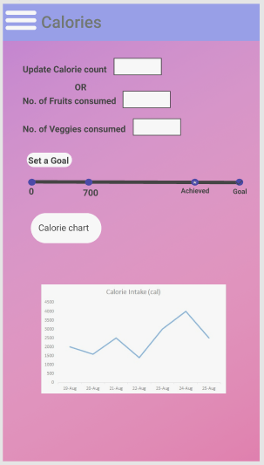
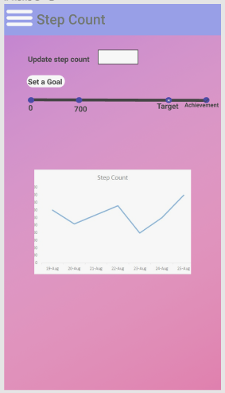
UI Design 3

Slide 7
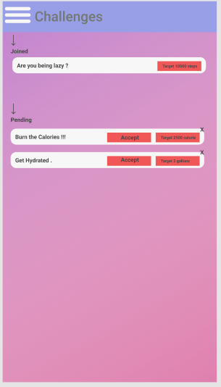
UI Design 4

Slide 8
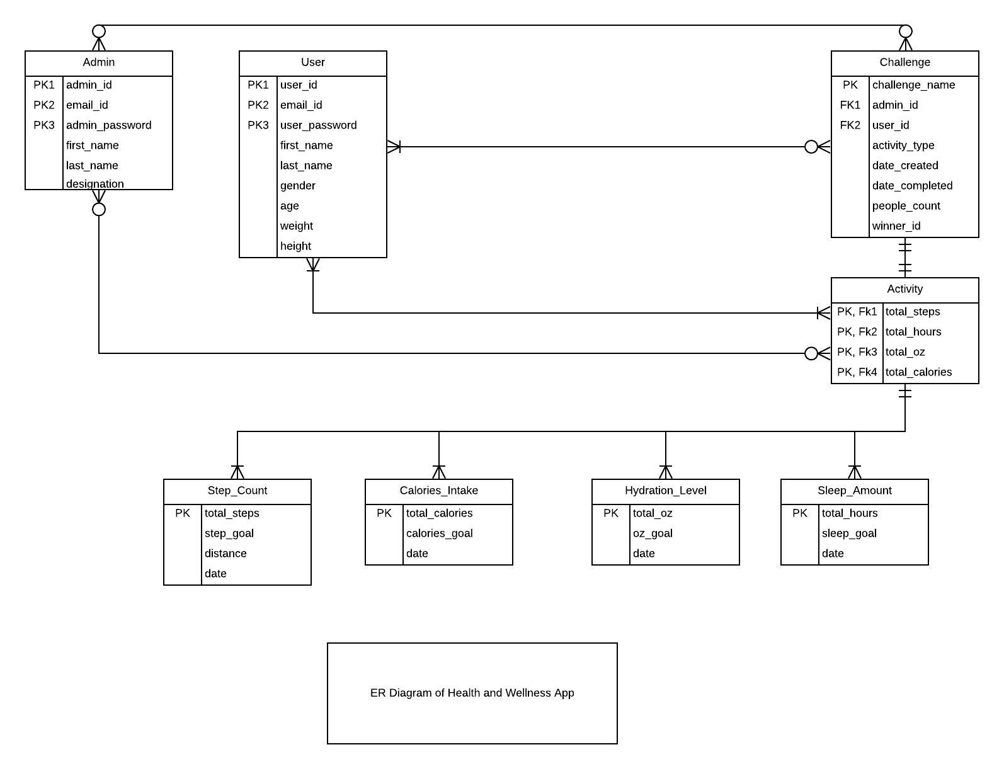
Entity Relation Diagram

Slide 9
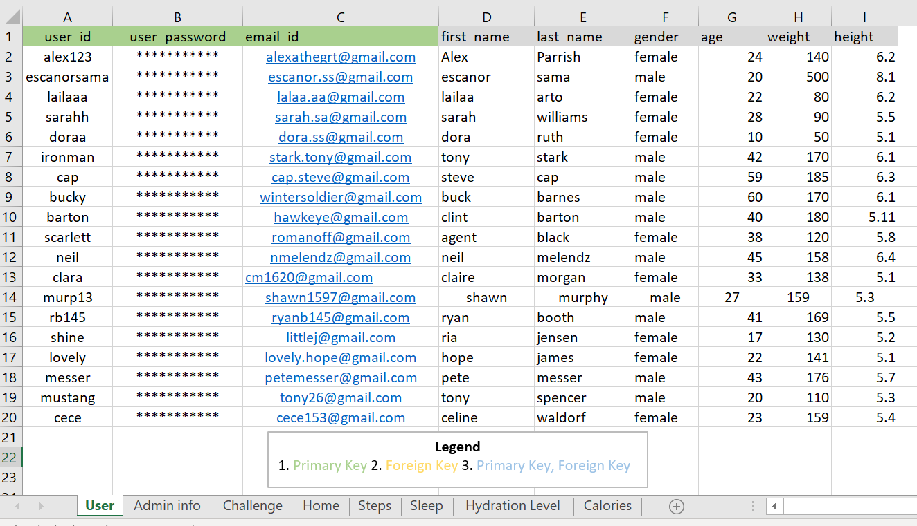
Seeded Data in Excel - User database:

Slide 10
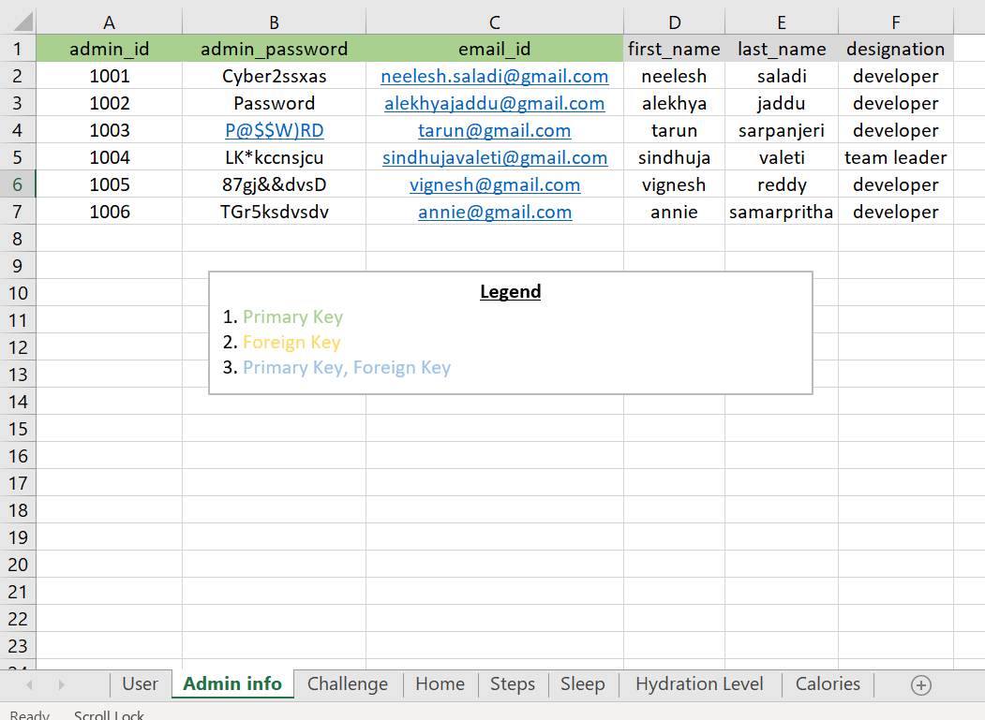
Seeded Data in Excel - Admin database:

Slide 11
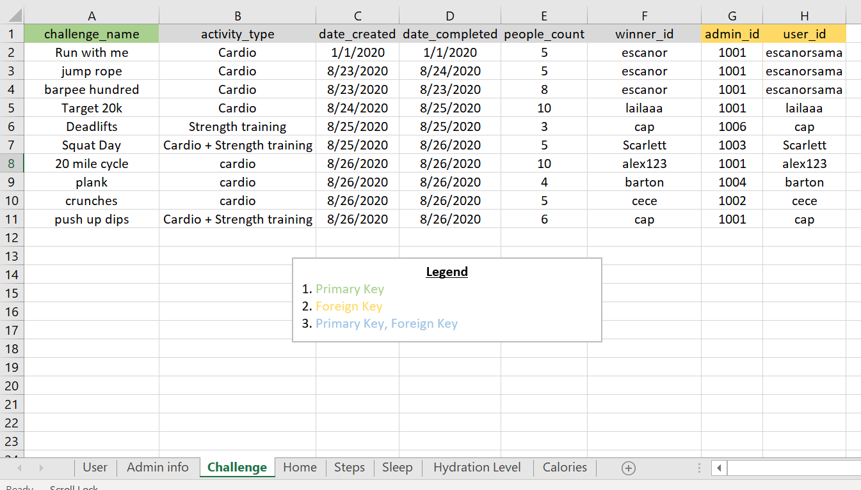
Seeded Data in Excel - database:

Slide 12
Enhanced Features
Redefining new tasks for automated updation.
Collab with google maps API, and step count apps.
Adding group challenges as well as setting up user challenge creation.
Creating a food chart with predefined calories.
Changing the colors of the application as desired by the user.

Slide 13
References
Original RFP: https://github.com/cbadami/rfp-health-and-wellness
Link to group repository: https://github.com/annie0sc/gdp_group4
Link to the published site: https://annie0sc.github.io/gdp_group4/

Slide 14


