Slide 1



Slide 2
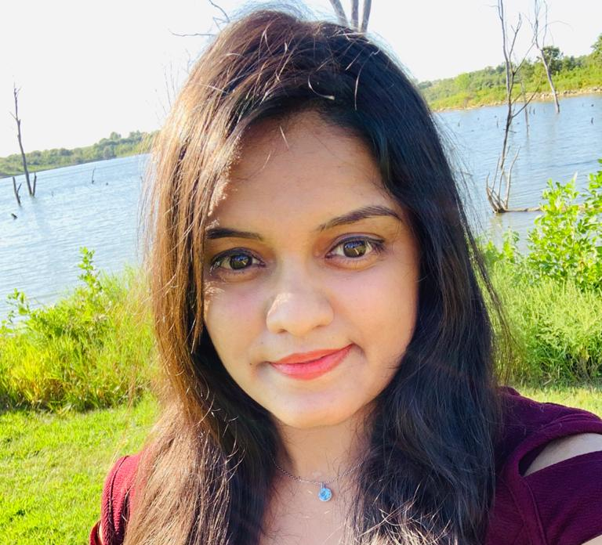
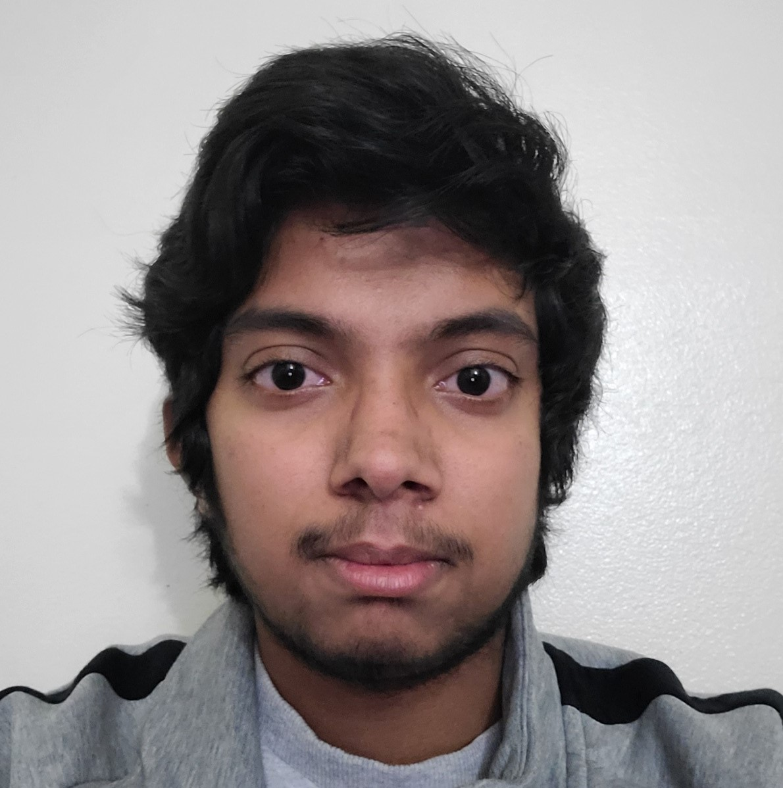
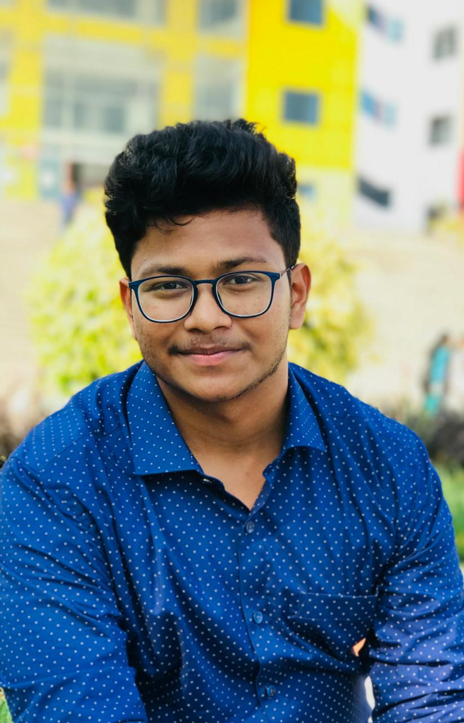
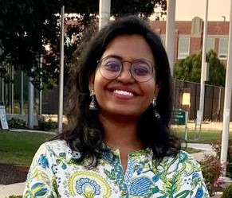
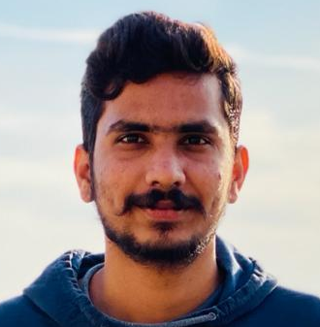
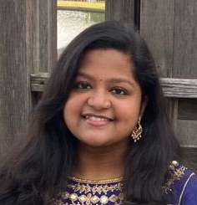
Team Members:
Name: Sindhuja Valeti
Designation: Project Manager
Name: Tarun Sarpanjeri
Designation: Team Lead
Name: Neelesh Saladi
Designation: UI Developer
Name: Annie Chandolu
Designation: Full Stack Developer
Name: Vigneshwar Reddy
Designation: Database Engineer
Name: Alekhya Jaddu
Designation: Front-End Developer

Slide 3
Overview
Using this app, the user can monitor their activity and understand how they can improve or manage daily activities.
With this app, users can set goals they want to reach, such as losing or gaining weight. To let users monitor their eating habits, apps of this type should have a food logging feature.
Every user can set a personal goal for each activity and see if they can reach it or not.
They can accept challenges created by admins and also can create their own challenge among their friends or groups.

Slide 4
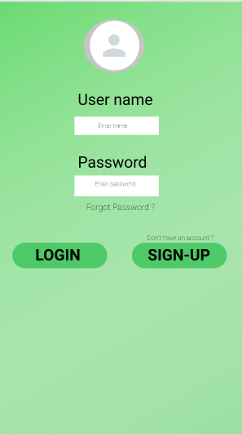
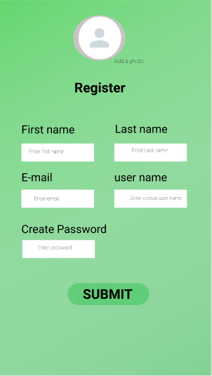
UI Design 1

Slide 5
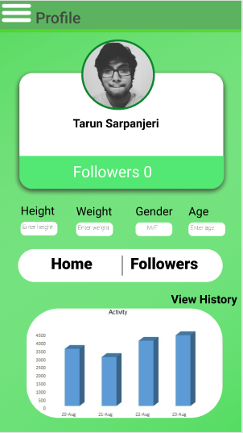
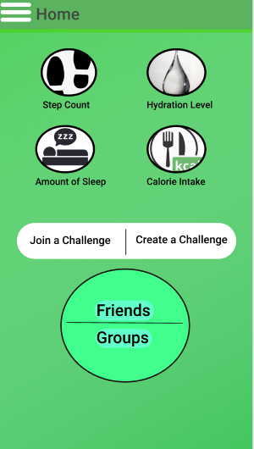
UI Design 2

Slide 6
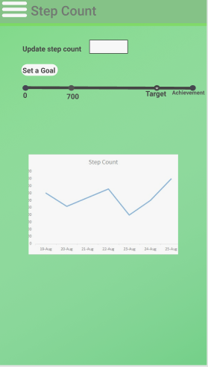
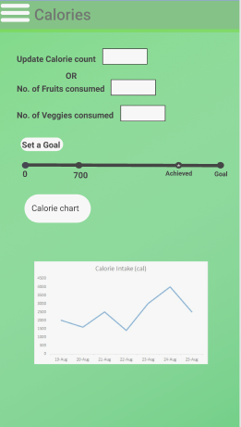
UI Design 3

Slide 7
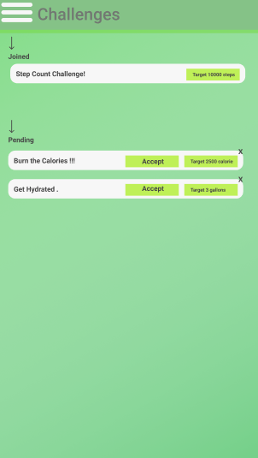
UI Design 4

Slide 8
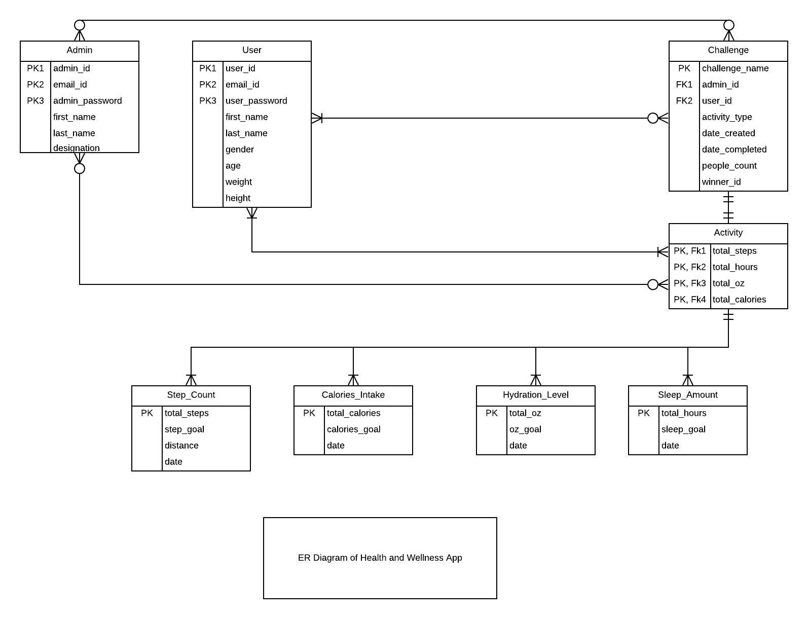
Entity Relation Diagram

Slide 9
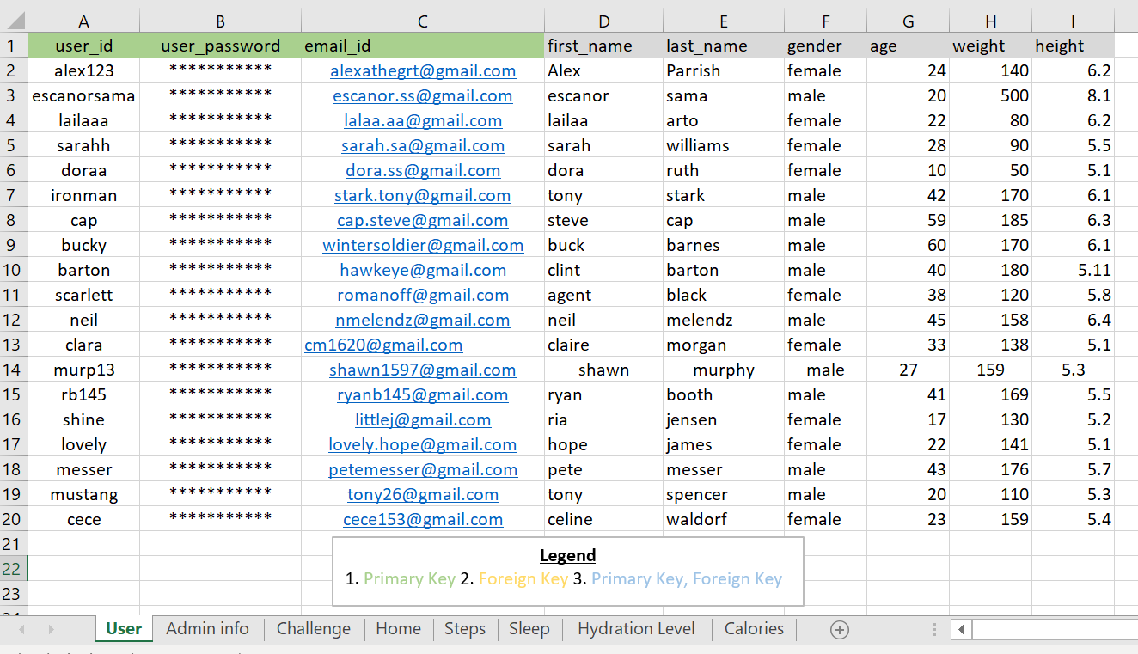
Seeded Data in Excel - User database:

Slide 10
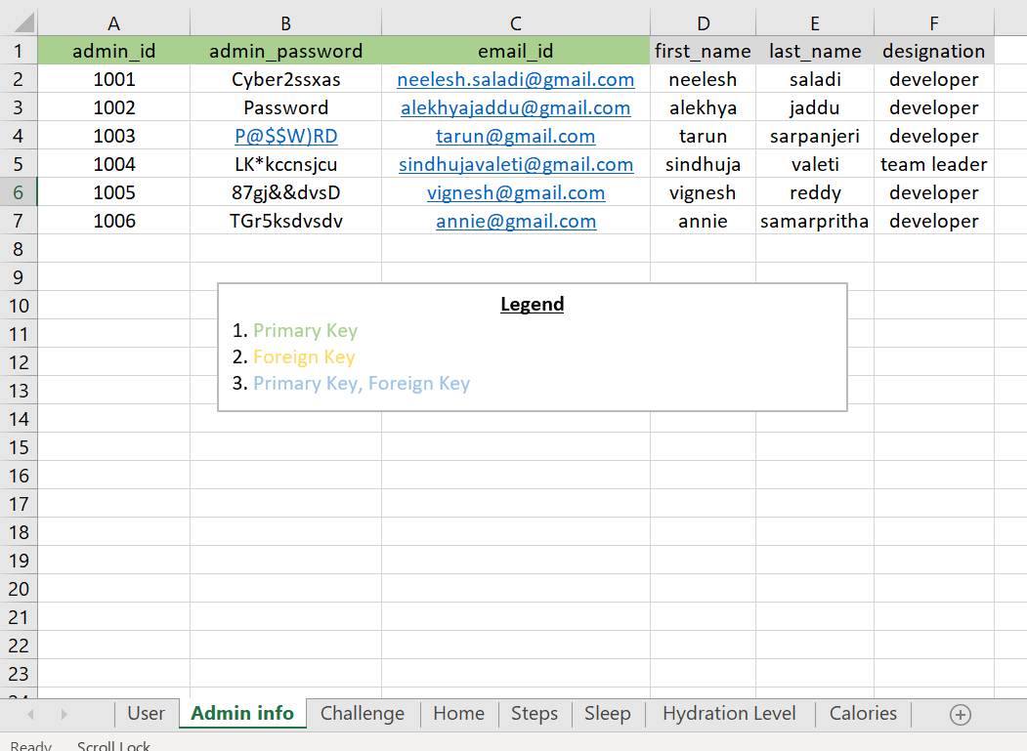
Seeded Data in Excel - Admin database:

Slide 11
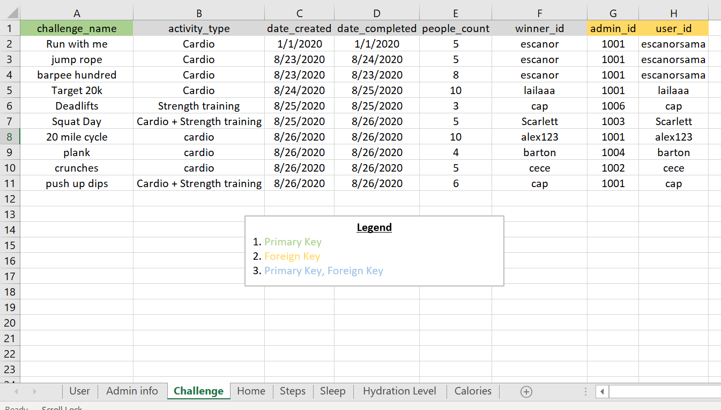
Seeded Data in Excel - database:

Slide 12
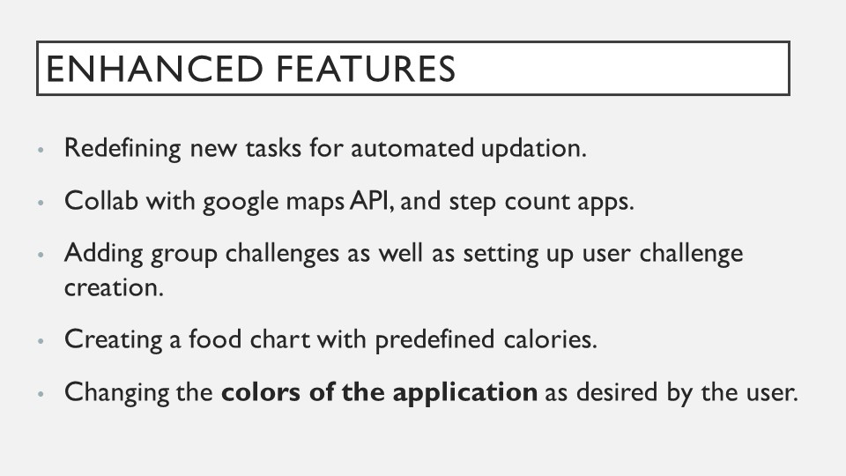

Slide 13
References
Original RFP: https://github.com/cbadami/rfp-health-and-wellness
Link to group repository: https://github.com/annie0sc/gdp_group4
Link to the published site: https://annie0sc.github.io/gdp_group4/

Slide 14
