Slide 1


DATA ANALYSIS USING PYTHON
BY
C.Sri Samhita
Rohitha Reddy
Batch - 133

Slide 2




MOST FEASIBLE WEBSITE

Slide 3




PROCESS

Slide 4








LIBRARIES

Slide 5
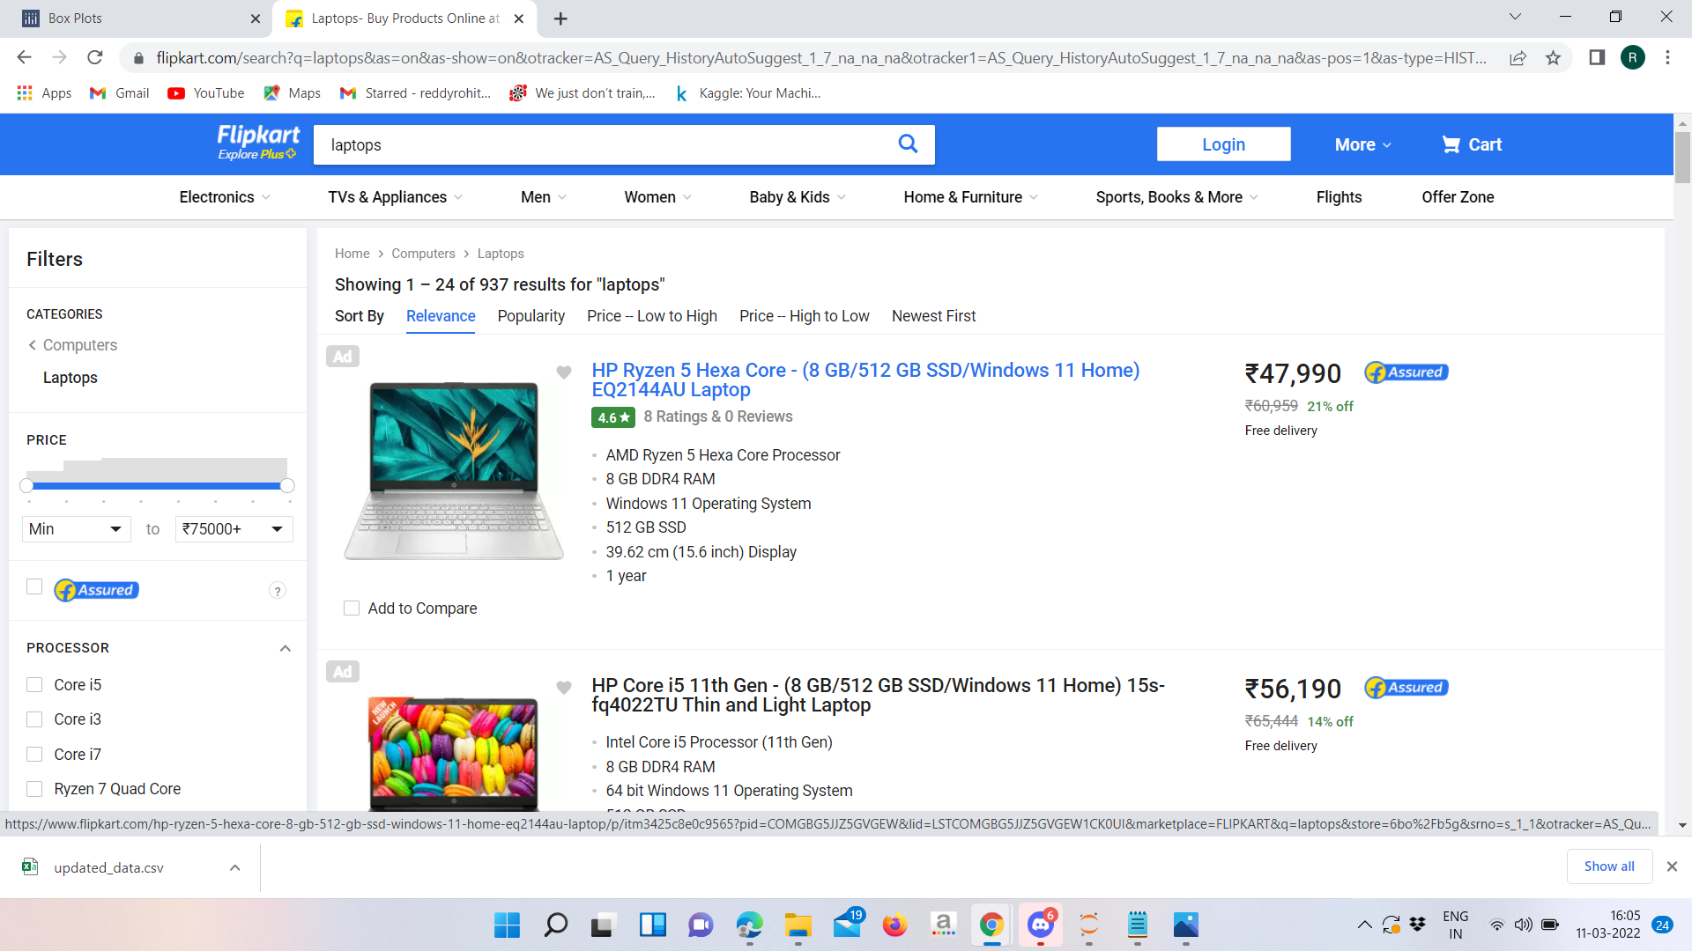
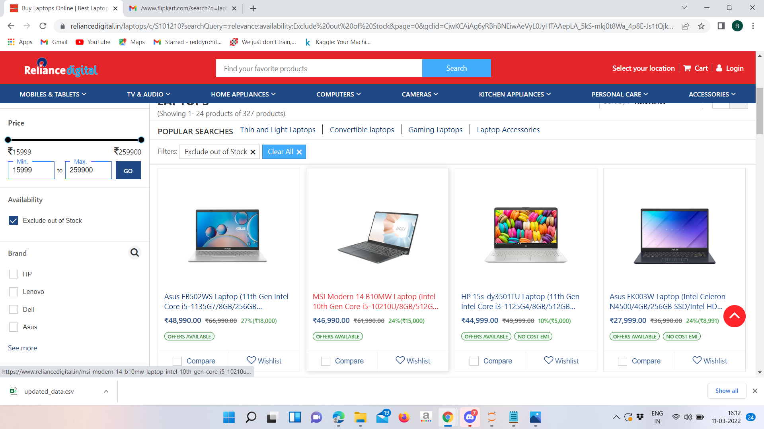
WEBSITE’S USED

Slide 6
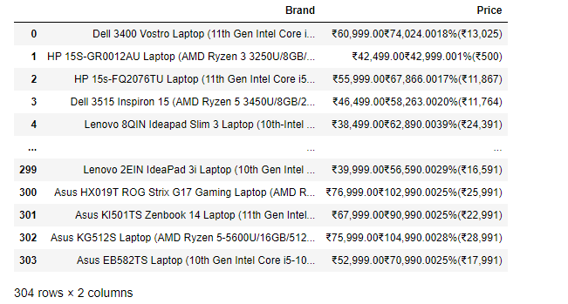
DataFrame

Slide 7
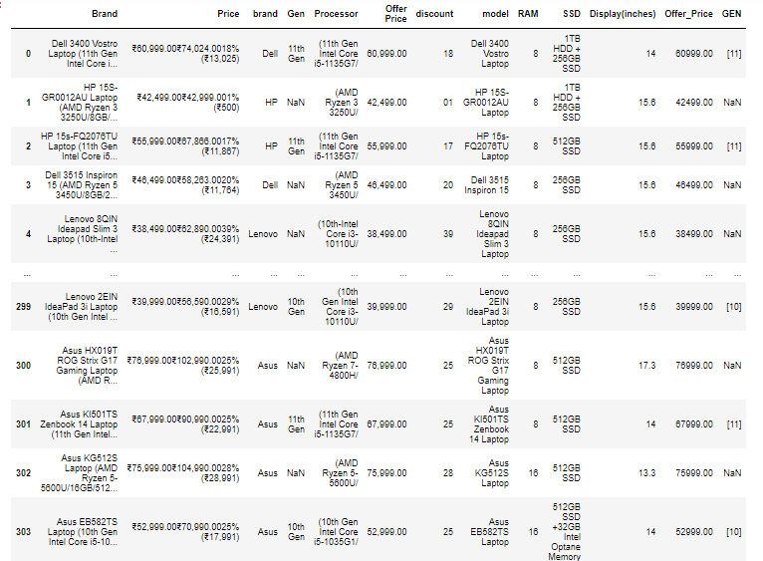
DataFrame

Slide 8
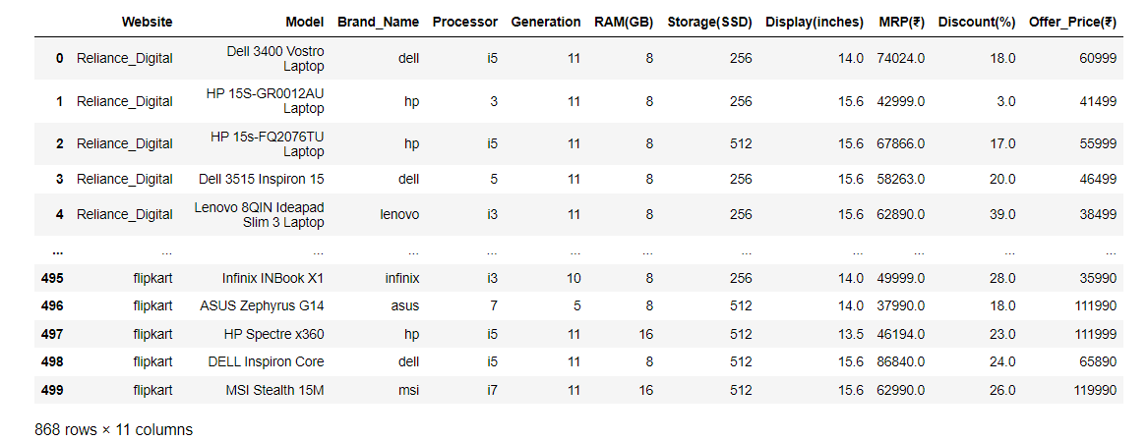
DataFrame after Cleaning
Categorical
Numerical

Slide 9

Factors considered:-
Availability of different brands
Discounts offered
Price Comparision

Slide 10
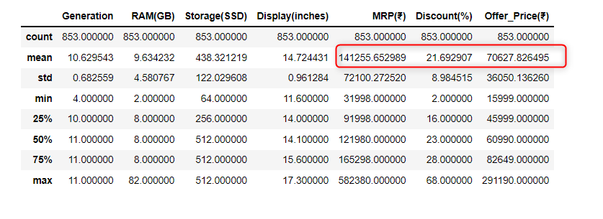
DESCIPTIVE STATISTICS

Slide 11


Slide 12
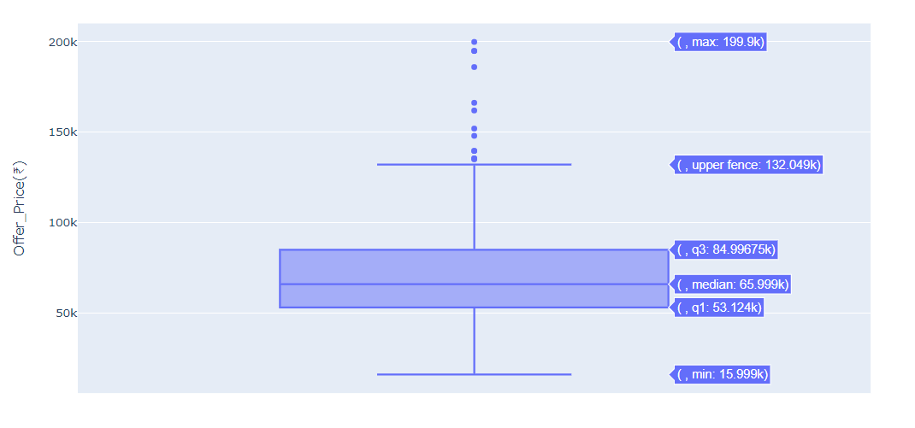
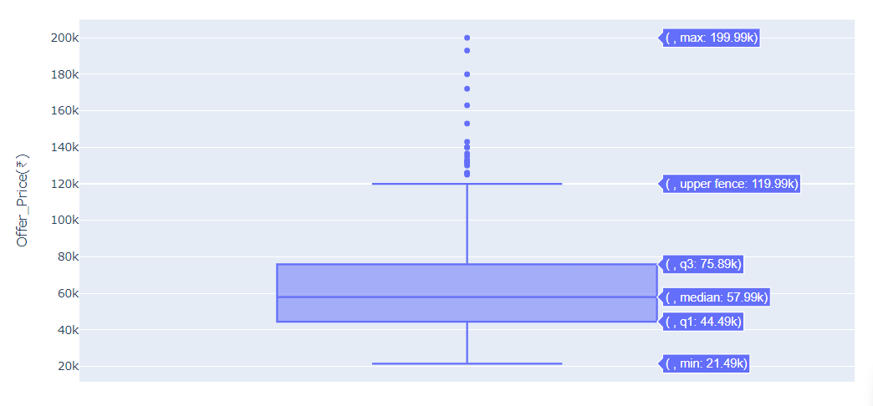
OFFER PRICE
RELIANCE
FLIPKART

Slide 13
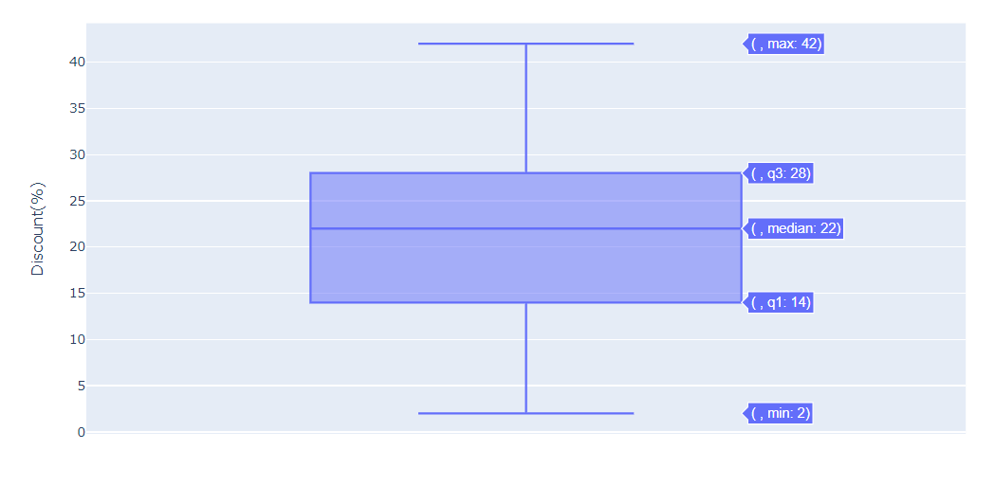
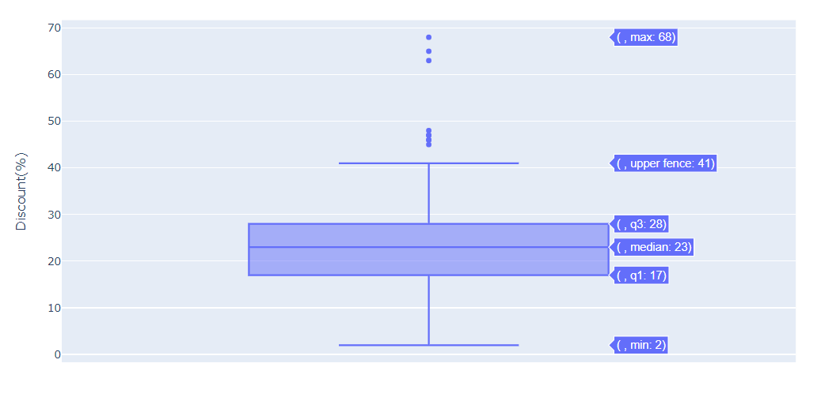
DISCOUNT
RELIANCE
FLIPKART

Slide 14
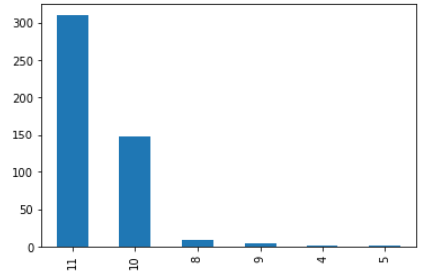
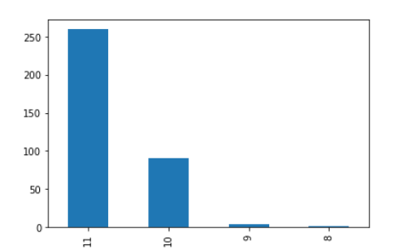
GENERATION
FLIPKART
RELIANCE

Slide 15
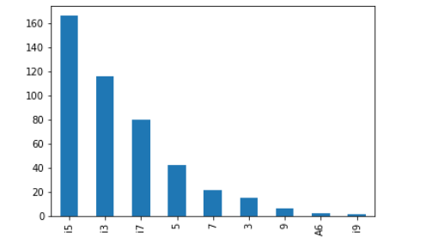
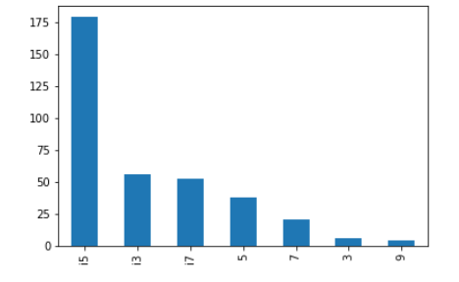
PROCESSOR
FLIPKART
RELIANCE

Slide 16
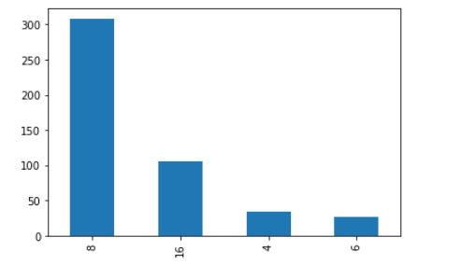
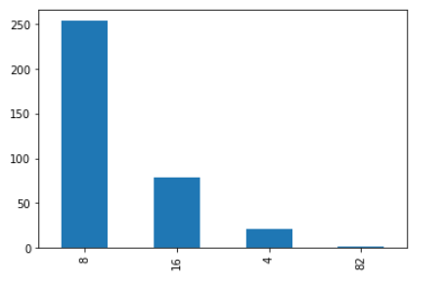
RAM
FLIPKART
RELIANCE

Slide 17
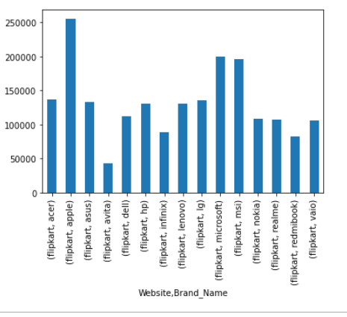
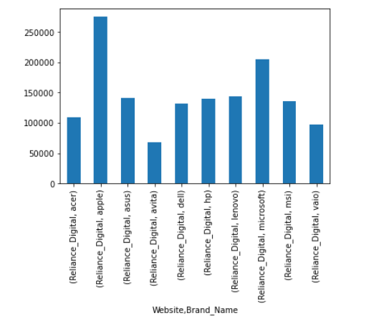
MRP
FLIPKART
RELIANCE

Slide 18

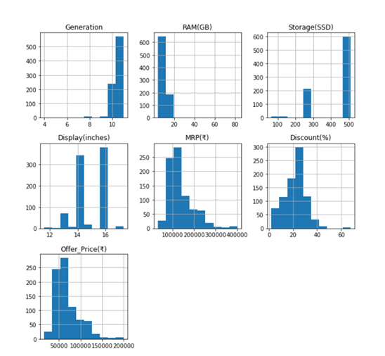

Slide 19


Slide 20
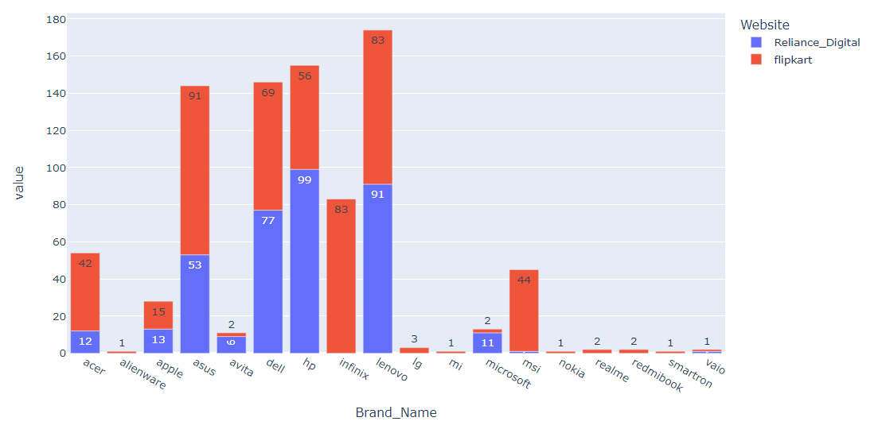
BRAND’S AVAILABLITY

Slide 21
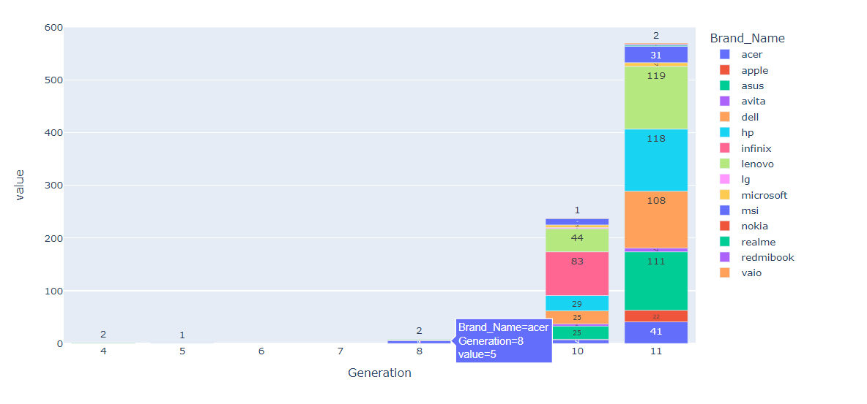
GENERATION’S AVAILABLITY

Slide 22
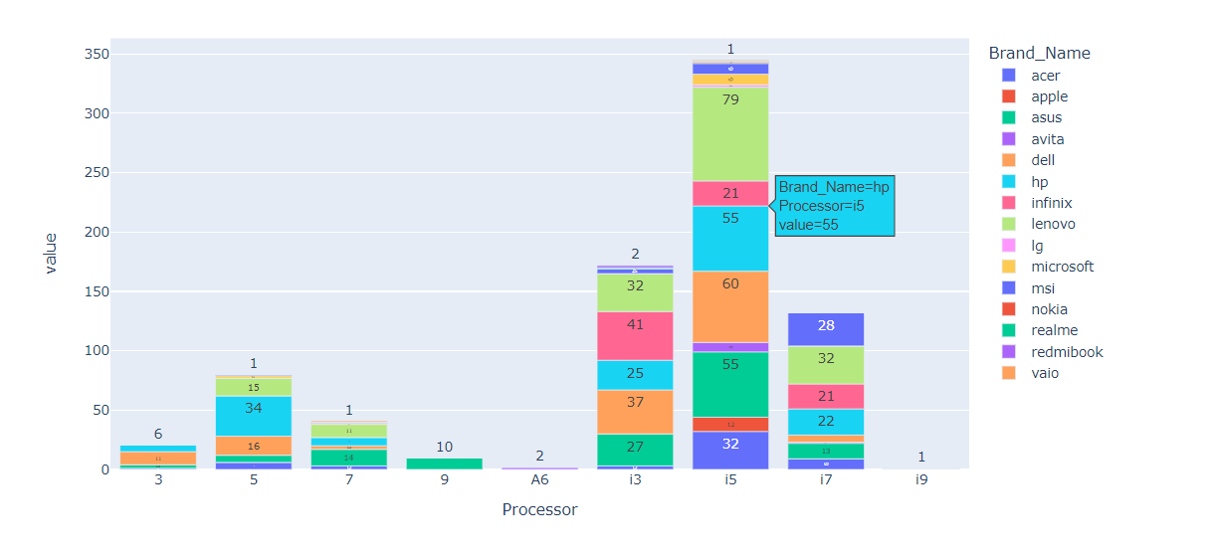
PROCESSOR’S AVAILABLITY

Slide 23
Conclusion :-
Flipkart offers more brand choice and offers more discount compared to Reliance. So, we would suggest Flipkart as the most feasible e-commerce for the purchasing the laptops.

Slide 24
CHALLENGES :-
Spotting the right website
Extracting the data
Different patterns
Drawing the inferences

Slide 25


Slide 26


