Slide 1


Presentation On Predictive Analytics for well being and to overcome Chronic Kidney Diseases Using Machine Learning PROJECT BATCH NO : 312
Presented by :
K.SAMATHA(170030531)
M.ROHITHA REDDY(170030842)
P.FAIZAL KHAN(170031003)
R.AKHIL CHOWDARY(170031124)
Project Guide : ‪Dr. PVRD PRASADA RAO, Professor, CSE
DEPARTMENT OF COMPUTER SCIENCE ENGINEERING

Slide 2
CONTENTS
Abstract
Introduction
Proposed Idea
Requirements
Work Flow
Results
Conclusion

Slide 3
Abstract
Machine learning has earned a remarkable position in healthcare sector because of its capability to enhance the disease prediction in healthcare sector. Artificial intelligence and Machine learning techniques are being used in healthcare sector. Nowadays, kidney disease (KD) is becoming a major public health problem worldwide. It is increasing day by day because of not maintaining proper food habits, drinking less amount of water and lack of health consciousness. For that reason, there should have one or more approaches that can effectively keep tracking and monitoring people’s kidney and health condition in an application view. Here, we have proposed an approach for real time kidney disease prediction. Our aim is to find the best and efficient machine learning (ML) application that can effectively recognize and predict the condition of chronic kidney disease. In this work, five important machine learning classification techniques were considered for predicting chronic kidney disease which are KNN, Logistic Regression, Random Forest Classifier, SVM and Decision Tree Classifier. In this process, the data has been divided into two sections. In one section train dataset got trained and another section got evaluated by test dataset. The analysis results show that Decision Tree Classifier and Logistic Regression algorithms achieved highest performance than the other classifiers, obtaining the accuracy of 98.75% followed by random Forest, which stands at 97.5%.

Slide 4
Introduction
Kidney disease, also called kidney failure, describes the gradual loss of kidney function.
Chronic kidney disease includes conditions that damage your kidneys and decrease their ability to keep the person healthy by doing the jobs listed.
Kidney disease can progress to end-stage kidney failure, which is fatal without artificial filtering (dialysis) or a kidney transplant.
Our aim is to predict the kidney disease, analyzing the data using five classification techniques of machine learning that which techniques give us the maximum rate of accuracy to predict the disease.
Five classification techniques are used, namely K- Nearest Neighbours Classifier, Support Vector Classifier (SVC), Decision Tree Classifier (DT), Random Forest Classifier (RF), and Logistic Regression.

Slide 5
Proposed idea
We use five algorithms viz KNN ,DT, SVC, RF and Logistic Regression which are trained on dataset which contains different indices like age, bp, sugar, blood urea, pus cell, hypertension.
Dataset is analyzed and the algorithms are trained.
These trained algorithms are then used to predict weather a person will suffer from kidney disease or not.
The best algorithm will be chosen among them.

Slide 6
Requirements
HARDWARE:
Processor: Intel i5
Ram: 8gb
Hard Disk 1TB
SOFTWARE:
Python v3.7
Libiraries Required: Pandas, Sklearn, Matplotlib

Slide 7
Work Flow
Module 1: Data Collection:
First, the data was obtained from the UCI Machine Learning Repository..
The dataset contained 25 indices which relate to kidney disease.
Next, the shape of the dataset was obtained and it was found to be 400X26, i.e 400 records and 26 features were given.
In the given dataset, classification was the target and the others were predictors.

Slide 8
Module 2: : Data pre-processing and Analysis:
It was found that some categorical data was missing in the dataset.
The index id did not have any effect on the disease, so it was dropped.
A set of operations were performed to remove the presence of the missing categorical values and then all the values in it were converted into numerical.
First, a heat map of the categories was generated and it was found that sg, hemo, sod, pcv and rc indices are negatively correlated with classification, i.e with their decrease, the disease was found to be decreasing.
Next, boxplots were grouped for al, htn and dm indices by the classification.
Next, Histograms were plotted for all the indices.
Then, the data was normalized using minmax function

Slide 9
Module 3: Applying Algorithms:
The dataset is split into Training and Testing Dataset.
Five models viz Decision Tree, KNN, SVC, Logistic Regression and Random Forest models are trained with the training data.
The normalized data previously generated, is given as input for the model for training.

Slide 10
Module 4: Evaluating the Algorithms:
All the classifiers are separately trained with the training data.
The training and testing data are labeled datasets.
After Training, these algorithms are tested for accuracy score and cross validation score using the test data.
Then, these scores are compared with that of training data.
For evaluating the performance of models, we have used the confusion matrix to calculate accuracy, roc , sensitivity, recall, and specificity.
Confusion matrix describes the performance of a model on a set of test data. It gives two types of correct predictions and two types of incorrect predictions for the classifier.TP is the predicted output as true positive, TN is the predicted output as true negative, FP is the predicted output as false positive, and FN is the predicted output as a false negative.

Slide 11
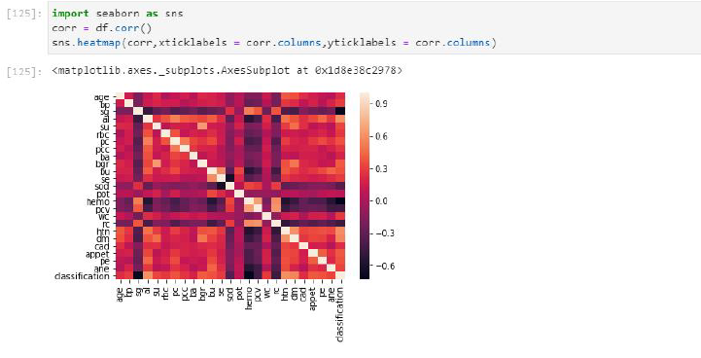
Results
Fig : Heat Map of the Dataset

Slide 12
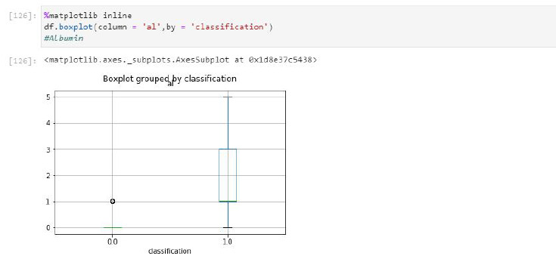
Fig: Boxplot of al grouped by classification

Slide 13
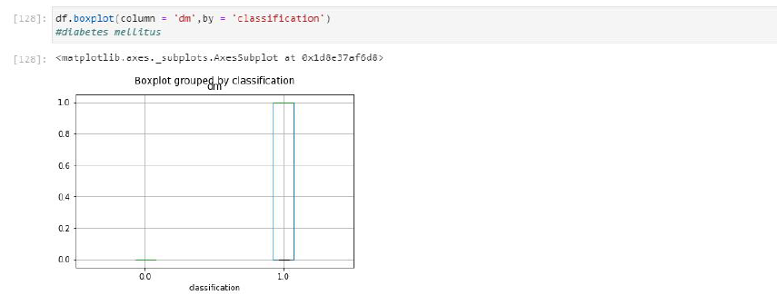
Fig :Boxplot of dm grouped by classification

Slide 14
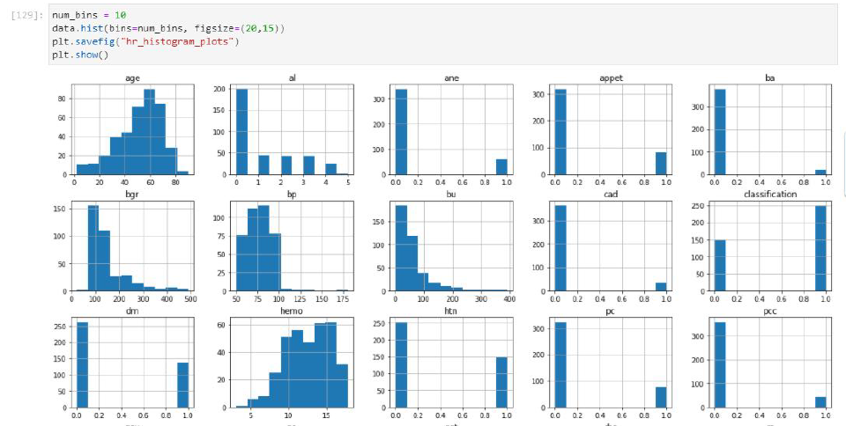
Fig :Histogram of Indices in the Dataset

Slide 15
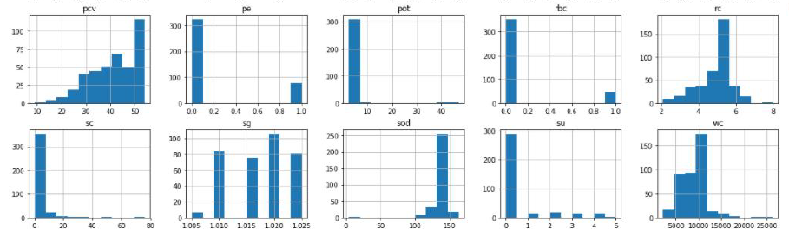
Fig : Histogram of Indices in the Dataset Continued

Slide 16
Algorithm | Accuracy | Recall score | ROC score | Sensitivity | Specificity
KNN | 71.25% | 62.74% | 74.47% | 0.568181 | 0.888888
Logistic Regression | 98.75% | 100% | 98.27% | 1.0 | 0.98
SVC | 63.75% | 100% | 50% | Nan | 0.6375
DTC | 98.75% | 98.03% | 99.01% | 0.97 | 1.0
RF | 97.5% | 98.3% | 97.29% | 0.96 | 0.98
Table : Comparison of performance of different algorithms
Algorithm | True Positive | False Positive | True Negative | False Negative
KNN | 25 | 4 | 32 | 19
Logistic Regression | 28 | 1 | 51 | 0
SVC | 0 | 29 | 51 | 0
DTC | 29 | 0 | 50 | 1
BCRF | 28 | 1 | 50 | 1
Table : Confusion Matrix for different algorithms

Slide 17
Conclusion
It had been found that the decision tree algorithm, logistic regression and random forest algorithms are more efficient in the prediction of chronic kidney diseases. Their accuracy was found to be 98.75%, 98.75 and 97.5% respectively. In the future, this work can be upgraded by building up a web application based on these algorithms and using a bigger dataset when contrasted with the one utilized in this examination. This will help in giving better outcomes and help healthcare experts in the prediction of kidney diseases adequately and productively.

Slide 18
Thanks to All

