Slide 1
ANALYZING AIRLINE DELAYS
W205.Sec3
Rohitha Bhushan

Slide 2
DATASETS
1. Publicly available airline data
(US Dept. of Transportation, Bureau of Statistics)
http://www.transtats.bts.gov/DL_SelectFields.asp?Table_ID=236
2. Airports & Routes
http://openflights.org/data.html
2. Climate Dataset from data.gov
(NOAA-National Oceanic & Atmospheric Administration)
http://www.ncdc.noaa.gov/cdo-web/datasets/

Slide 3
QUESTIONS
Total number of flights cancelled/diverted
Effect of flight distance on diversions/cancellations
Relationship between distance & flight delays
Airports with total number of departure/arrival delays
Airports with maximum delays due to weather
Correlation between departure delays & arrival delays(Cascading delays)

Slide 4



ARCHITECTURE
Airports
Airlines
Routes

Slide 5
DEMYSTIFYING DATA
ETLs to weed out incomplete entries & unnecessary fields
Distinction between fields Arr_delay & Dep_delay
Obtain age of aircraft to analyze airline performance
Number of cascading delays caused by arrival delay
Analyze results using statistical data analysis

Slide 6
EXPERIMENTAL RESULTS
Least arrival delays are in the morning flights
Cascading delays analyzed by calculating correlation between departure & arrival delays
Highest number of flights cancelled have a distance <1000 mi
ATL faces huge delays all year round.

Slide 7
ENHANCEMENTS
Compare methodology with ATC Stream to better compute delay
REST API to serve the data
Apache Spark Graph Frames for faster analysis
Machine learning to make predictions
Pair with additional datasets

Slide 8
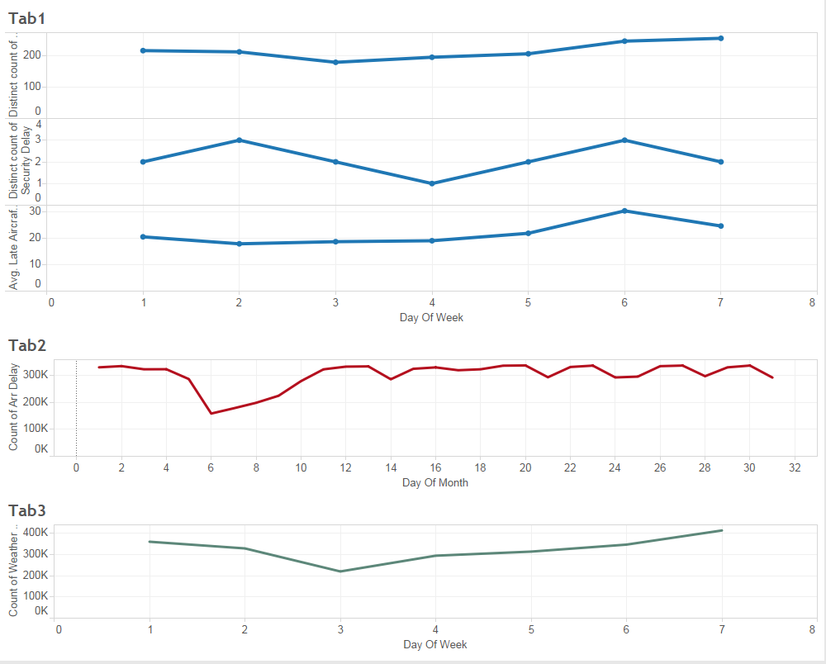
TABLEAU

