Slide 1
ECE1005 – SENSORS & INSTRUMENTATION
OBSTACLE DETECTION MINI ROBOT
REVIEW I
Team Numbers:
17BLC1007-AVULA ROHITHA
17BEC1118 -SANTHOSHA.A
17BEC1185-INUMELLA SRAVYA

Slide 2
Objective & Motivation
Our main objective of this project is to avoid the situations that are harmful and learn ways to avoid road accidents.
The motivation for doing this project is primarily an interest of undertaking one of the best challenging J-component project in an interesting area of research i.e., Sensors.
We hope that this is the opportunity to learn about a new area of computing covered in lectures.
This obstacle detection is possibly an area that we might’ve worked upon, if we were in that stream. But now we’ve luckily got a chance to show up our self by this J-component.

Slide 3
Principle
The sensing component in the circuit is IR sensor, more the amount of infrared light falling on the IR sensor more is the current flowing through resistor.
Current when flows through the resistor causes potential difference to develop.The magnitude of this voltage is given by ohm’s law(V=IR).As the value of resistor is constant the voltage is directly proportional to current flowing, which in turn is directly proportional to the amount of Infrared rays incident on IR sensor. Therefore , if current increases voltage at the resistor increases.

Slide 4
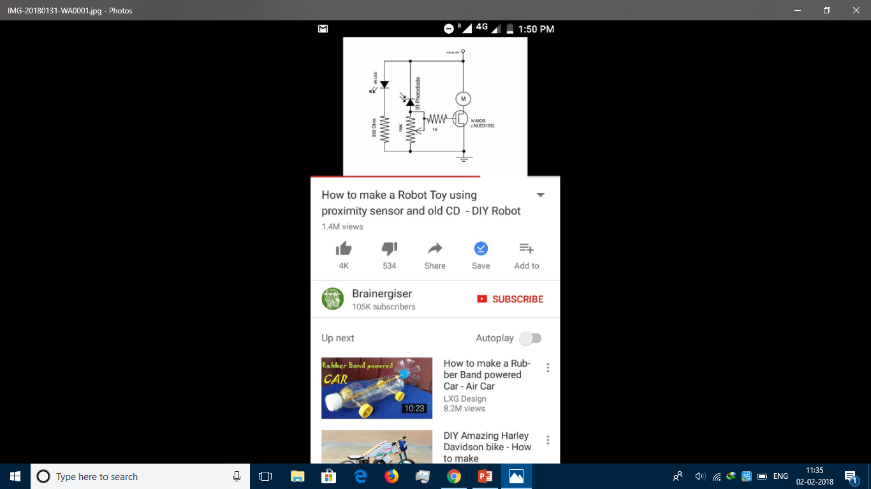
Circuit Diagram

Slide 5
Project Description
In this project the transmitter section includes an IR Sensor , which transmits continuous IR rays to be received by an IR Receiver Module .An IR output terminal of the receiver varies depending upon its receiving of IR rays .
Since this variation cannot be analyzed as such, therefore this output can be fed to a comparator circuit. Here an amplifier(op-amp) of LM358 is used as comparator circuit.
When the IR receiver does not receive the signal, the potential at the inverting input goes higher than the non inverting input of LM358.Thus the output of the comparator goes slow.

Slide 6
When the IR receiver module receives signal to the potential at the inverting input goes low. Thus the output of LM358 goes high.
Resistors R1,R2,R3 are used to ensure that minimum current passes through IR LED devices. Variable resistor is used to adjust the output terminals and is used to set the sensitivity of circuit diagram.A motor is joined to IC to rotate the wheel of the car.

Slide 7
Components used
Resistors(330 ohm,100k ohm,1k ohm)
IR Sensor
LM358
DC Motor
Battery
Photodiode
Jump wires
POT

Slide 8
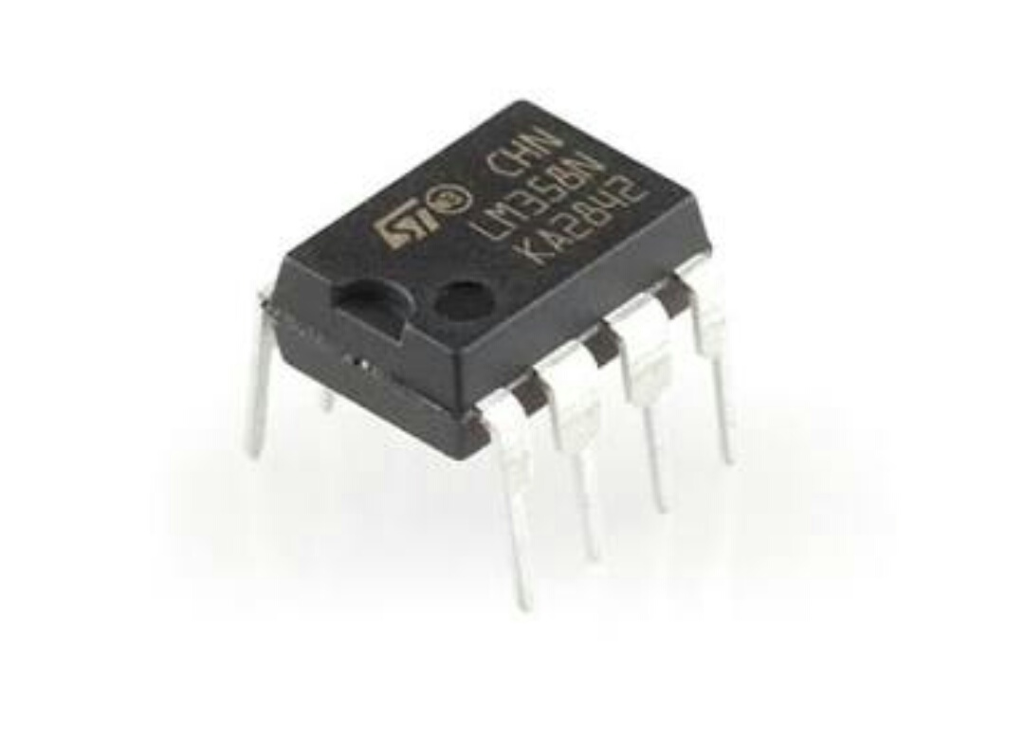
Components Explanation
LM358:
The LM358 is a low power dual operational amplifier
Integrated circuit originally introduced by National Semiconductor. It is used in detector circuits.

Slide 9
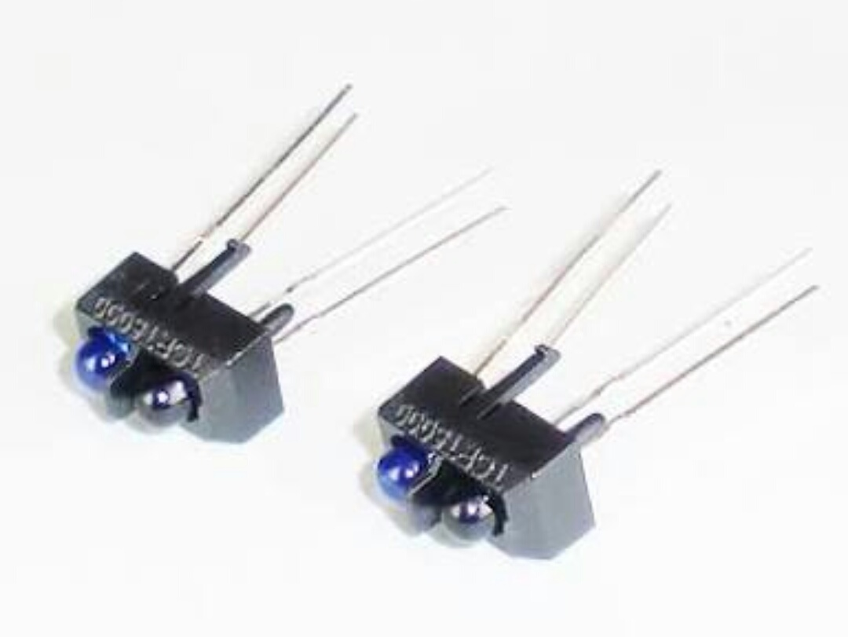
IR SENSOR:
An Infrared Sensor is an electronic device, that emits in order to sense some aspects of the surroundings. An IR sensor can measure the heat of an object as well as detects the motion. These types of sensors measures only infrared radiation, rather than emitting it that is called as a passive IR sensor.

Slide 10
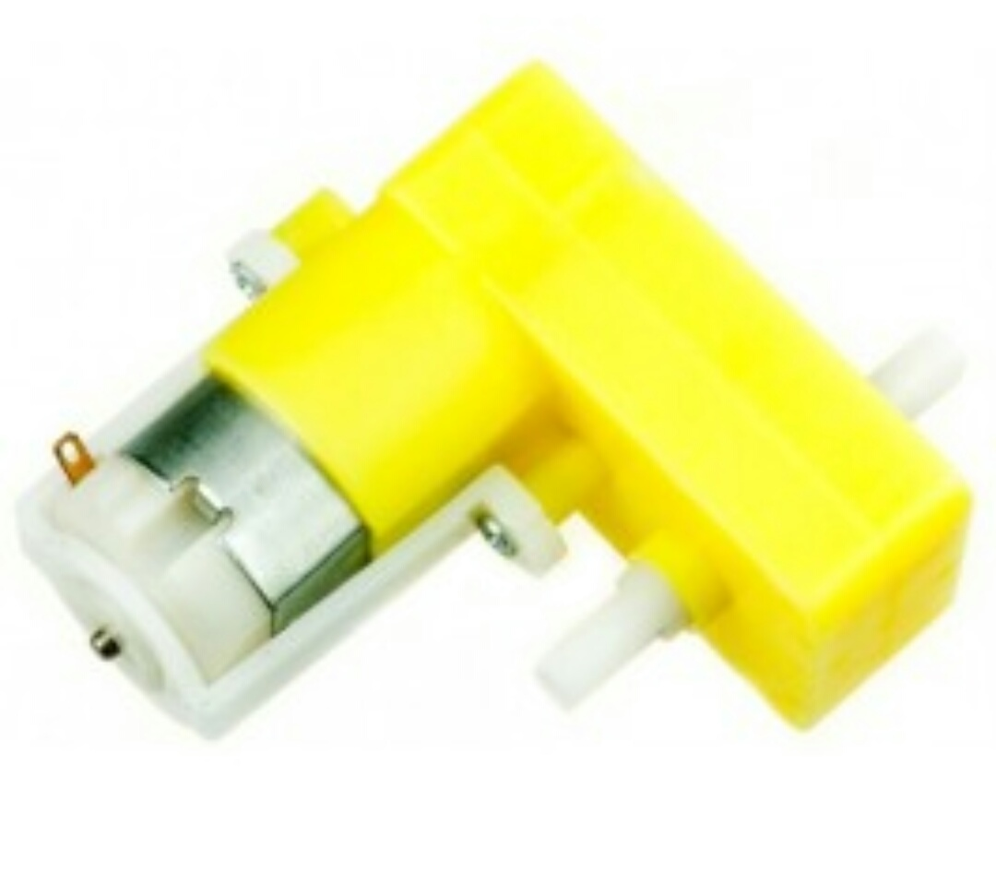
DC MOTOR:
A DC motor is any of a class of rotary electrical machines that converts direct current electrical energy to mechanical energy .The most common types rely on the forces produced by magnetic fields.

Slide 11
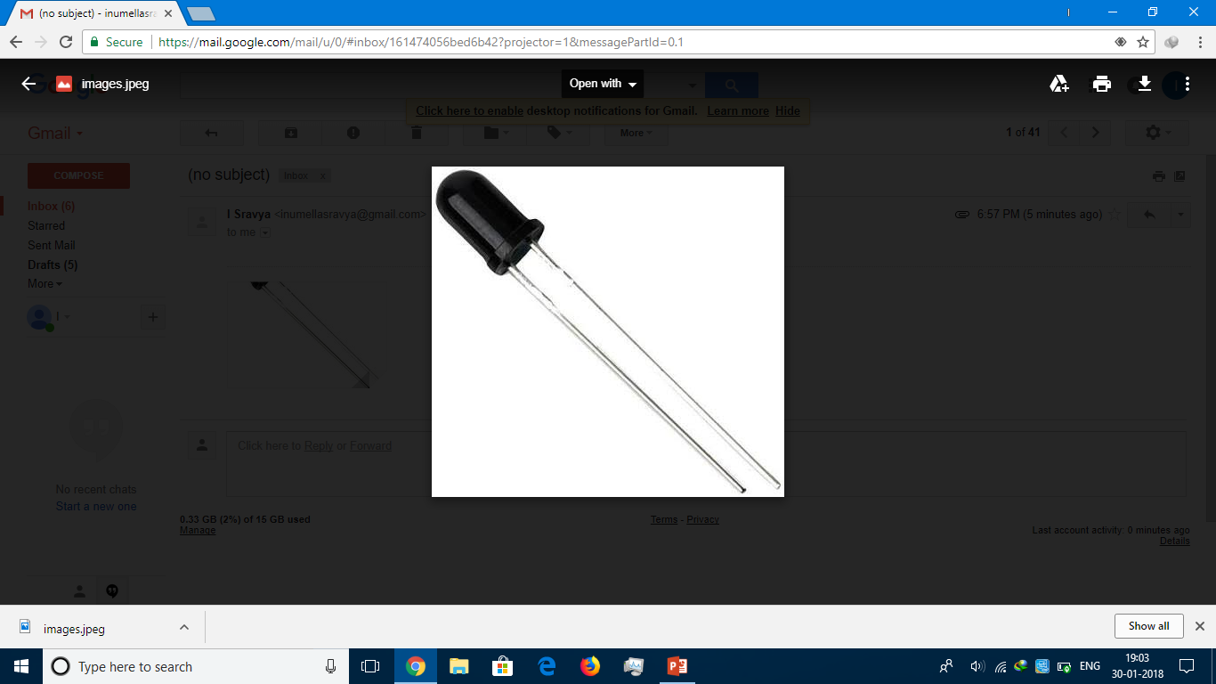
PHOTODIODE
A photodiode is a semiconductor device that converts light into an electrical current . The current is generated when photons are absorbed in the photodiode. Photodiodes may contain optical filters, built-in lenses, and may have large or small surface areas.

Slide 12
Implementation Methodology
The latest mobility assistive devices are equipped with this function as a safety precaution for the users to avoid obstacles in their path .In this project, a wireless,low cost , obstacle detection system is proposed.

Slide 13
Work plan
JANUARY | FEBRUARY | MARCH | APRIL
Understanding the objectives of the project and the procedure to make it. | Collecting the components required for the project. Preparing the model of the project. | Preparing the project, modifications, advancements and testing it. | Analyzing if any mistakes found. Implementation of the project.

Slide 14
Team Member’s Contribution
Santhosha.A
Detailing and construction
Inumella Sravya
Design and documentation
Avula Rohitha
Testing and troubleshooting

