Slide 1
Predictive maintenance on EDFA & SFP telemetry
AI/ML Engineer II take-home · Commtel Networks
Runs end-to-end from the raw files in 93 s on a 4-core laptop CPU
Notes:
Two EDFAs and one SFP multiplexer, three months of raw telemetry. The deck follows the brief: data, preprocessing, insights, detector, evaluation, deployment. Everything shown is reproduced by run.py / the Kaggle notebook.

Slide 2
The short version
Most of what looks like a fault in this data is the monitoring system, not the equipment
22/88
0
24/24
16 wk
days with EDFA optics
device faults confirmed
injected ageing ramps caught
SFP lasers to 70 °C
Collector gaps of 23 and 21 days hit every asset at once
Every alert traces to a shift with a monitoring signature
0 / 24 alerts on explained hot afternoons
At the Jan–Mar warming rate (70 °C limit assumed)
Approach: context-aware physics residuals (cooler | case temperature, pump current | input, pump power per mA, pump temperature | set-point), robust z-scores with physical floors, 15-minute persistence. Validated with injected faults, an Isolation Forest cross-check and an independent data-integrity rule.
Notes:
Four numbers: coverage, verdict, evaluation and the one actionable maintenance item. The approach line is the whole method in one sentence.

Slide 3
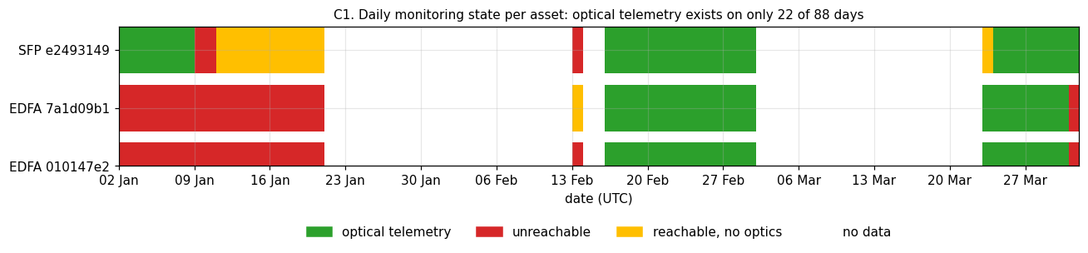
What arrived, and how it was shaped
5.58 M long-format readings → one row per asset per 1-minute polling slot, every sensor classified
1
Kept the 41% nobody mapped
60 SFP ids, 1.78 M rows: kept as UNMAPPED_<id>, role inferred from values (−48 V feeds, chassis temperature)
2
Aligned on 1-minute slots
Sensor groups poll at :13, :21–33, :51, :53. Clustering by gap would chain them, so floor to the minute and count collisions
3
Classified from data, not names
Pump2 = junk (single-pump units), Uptime (hardware) = 0, Current: Timestamp = 0 sentinel; 130 k duplicate rows removed
Notes:
The coverage strip is the most important context for everything after: EDFA optics only exist 16 Feb–1 Mar and 23–31 Mar. January was unreachable (93.5% ICMP loss), and two collector gaps remove 46 days for all assets. Uptime counters never reset, so the devices ran throughout.

Slide 4
Preprocessing decisions
Every rule is logged with what it touched; nothing is dropped silently
Outages masked, never filled
ICMP loss 100% (+5 min guard): 51 k EDFA asset-minutes
Share of SFP readings outside the physical envelope
1
Metric | Current | Prev 15min | Current Day | Prev Day
Laser Voltage | 0.0% | 0.0% | 23.8% | 0.0%
Laser Bias | 0.0% | 0.0% | 1.8% | 0.0%
Transmit Power | 0.0% | 0.0% | 1.0% | 0.0%
Laser Temperature | 0.04% | 0.03% | 0.5% | 0.0%
Received Power | 0.0% | 0.0% | 0.3% | 0.0%
Impossible values → point anomalies
4 EDFA sentinels (1.0 mA, 1.0 mW); 30,859 SFP incl. 448 zero voltages
2
SFP window = Current
Only window with no impossible values that is aligned to poll time
3
Previous 15min also runs 49–94 min ahead of the poll clock, so Current is the only usable 15-min view; the day windows stay as a cross-check.
5 min EDFA, 15 min SFP medians
Per-asset scaling: the two EDFAs run at 15 and 7 dBm
4
Notes:
Full preprocessing log is generated by the code (preprocessing_log.md). The window table is the evidence behind the SFP window choice.

Slide 5
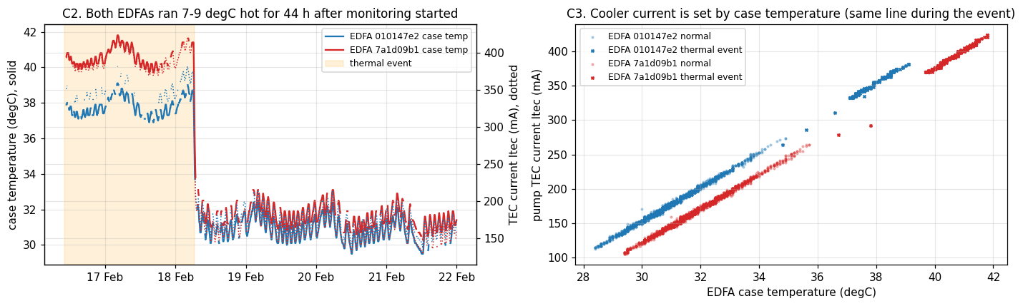
A heat event that was the site, not the EDFAs
16 Feb 10:41 – 18 Feb 06:30 UTC: both units hot together, coolers handled it
1
+7–9 °C on both units at once
Case 37.7 / 40.4 °C vs 30.8 / 31.6 °C after; the two units' temperatures correlate at r = 0.995
2
Cooler current ×2, pump held 25 °C
Itec 349 / 386 mA vs 173 / 161 mA; pump chip never left its set-point
3
Itec = 25 mA per °C of case
r = 0.997 on both units; the room is warmest 02:00–05:00 IST (scheduled HVAC?)
Notes:
A raw Itec threshold would have paged twice for a facilities problem. The right health check is Itec given case temperature, which is exactly the cooler model in the detector. The inverted daily cycle is plausible-not-verified.

Slide 6
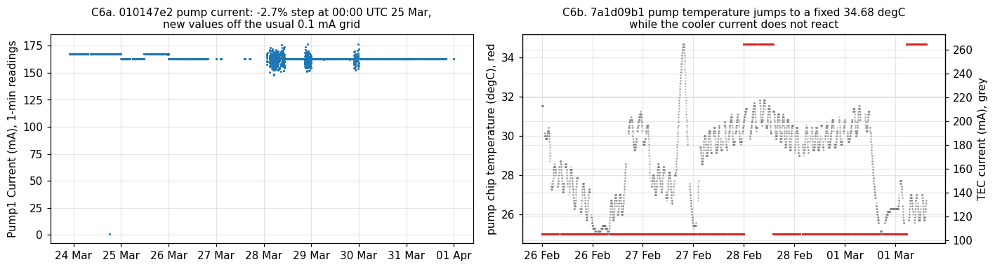
Pump faults the physics does not support
Three EDFA shifts start at exactly 00:00 UTC with values the sensor never produced before
1
7a1d09b1 pump power −28%
26.0 → 18.6 mW on 22/24 Feb; current and POUT flat. A real pump loss would sag POUT
2
010147e2 pump current −2.7%
167.2 → 162.67 mA from 25 Mar, off its 0.1 mA grid. Ageing pumps need more current, not less
3
7a1d09b1 pump temp stuck
Fixed 34.68 °C (+9.7 °C) while the cooler current does not react at all
Notes:
Recommendation: route these to the monitoring team and verify pump power locally before any pump swap. Files are named *_anomalies_f.csv, so these may be injected test anomalies; either way they are not device behaviour. The detector flags all three regardless.

Slide 7
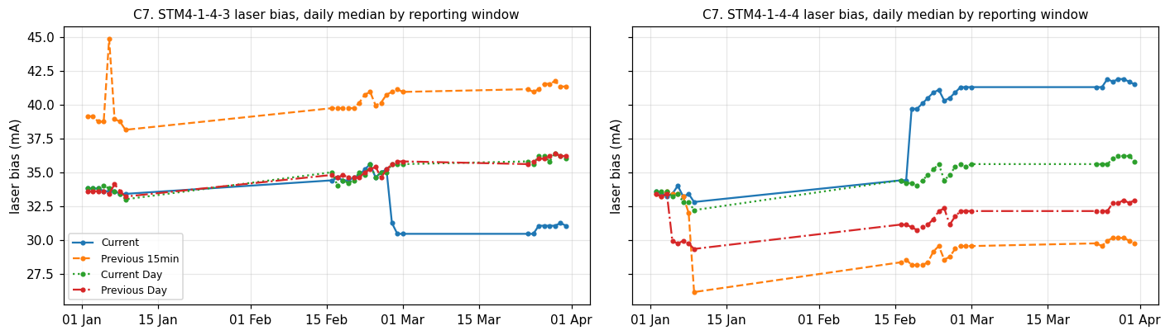
SFP reporting windows disagree
Every SFP step change lives in a single window, so it is the reporting path, not the laser
1
Current steps alone
1-4-3 Tx −12% (6 Jan) · 1-4-4 bias +16% (18 Feb) · 1-4-3 bias −4.4 mA (27 Feb); day windows flat
2
Current Day is corrupted
23.8% impossible voltages, negative bias and Tx; 1-4-3 Rx 2–6 dB off
3
Previous 15min clock is fast
Window stamps 49–94 min ahead of the poll; bias offset +5.3 mA on 1-4-3. No port flaps in 88 days
Notes:
A laser that really aged 16% would move every window the module computes. Comparing windows is a free, label-free integrity check and became one of the SFP detectors.

Slide 8
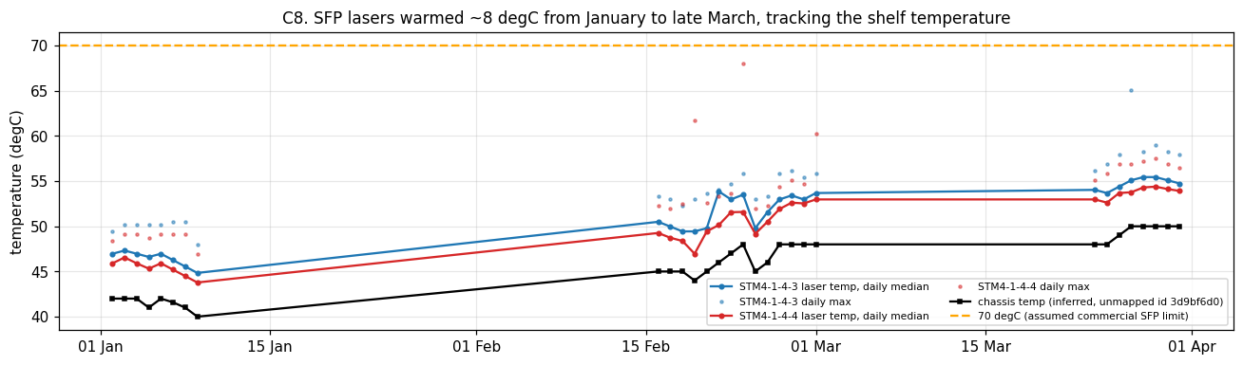
The near-term SFP risk is heat, not ageing
Both lasers warmed ~8 °C from January to late March, tracking the shelf
1
0.73 °C per week
46.6 → 55.0 °C and 45.6 → 53.9 °C; late-March daily peaks 58.1 / 56.9 °C
2
~16–18 weeks to 70 °C
Mid-July at this rate, before the Indian summer adds more (70 °C commercial limit assumed)
3
Bias rise is physics
+0.29–0.31 mA per °C fitted; inferred shelf sensor correlates r = 0.81 / 0.92
Notes:
Action: check shelf fans/cooling at this site and confirm the SFP temperature grade before May. The chassis temperature comes from an unmapped id; the inference is plausible, not verified.

Slide 9
Detector: four physics questions
Contextual residuals of 1–3-coefficient models; one robust z-score per question
1
Cooler
2
Pump drive
3
Pump efficiency
4
Pump temp
Itec given case temperature
≈ 25 mA/°C, R² 0.99
floor 3 mA
Current given PIN and temperature
POUT pinned by the loop
floor 0.8 mA
Pump power per mA
primer's degradation signature
floor 0.01 mW/mA
Chip vs its 25 °C set-point
lost thermal regulation
floor 0.25 °C
Alert rule |z| > max(4, training 99.9th percentile) for 15 min · incident stays open until clear for 6 h · trained 18–21 Feb: after the heat event, no outages, before the first shift
Rejected: autoencoder / LSTM (no labels, ~22 days per unit, not explainable) · raw thresholds (fire every warm night) · Isolation Forest as the main detector (evaluated on the next slide). Scoring costs a few multiply-adds per bin on any CPU.
Notes:
Each residual answers one physical question an engineer would ask. Physical floors stop quantised sensors (near-zero training spread) from alerting on one rounding step.

Slide 10
Evaluation without labels
12 random placements per fault per unit, frozen models; only new alerts caused by the injection count
Ageing ramps alert at ~2% drift on 010147e2. The forest cannot split on a signal that was constant in training (7a1d09b1 pump power), and it alerts on variation that context explains. That contrast is why the framing is contextual.
Notes:
Counts: ageing 24/24, cooler 23/24, pump power 12/12 (only 010147e2 had a clean placement), explained hot afternoon 0/24 vs IF 8/24, spike 0/24 by design. Also validated against the independent quantisation-break rule. The evaluation cannot tell us whether real faults look like these injections, or the false-alarm rate over a year.

Slide 11
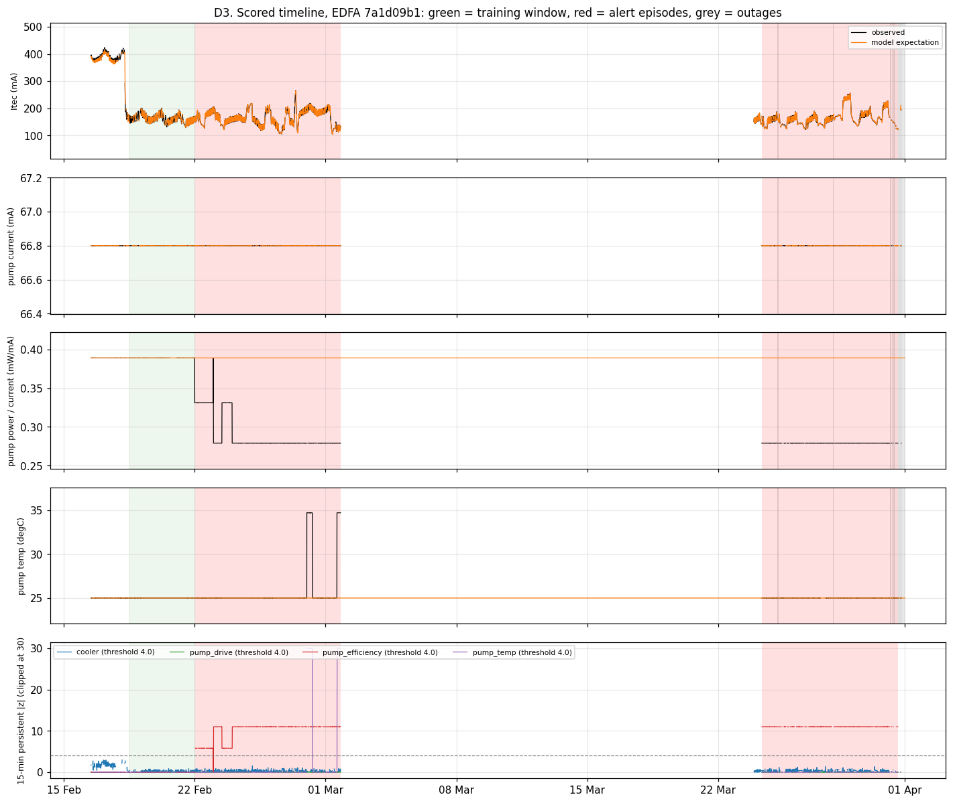
What it flagged on the real data
Zero alerts in training or on the cooler model; three root causes, all judged monitoring-side
Asset · signal | Period (UTC) | Verdict
7a1d09b1 · pump power −28% | 22 Feb – 1 Mar, 24–31 Mar | Monitor / reporting path; verify on site
7a1d09b1 · pump temp 34.68 °C | 28 Feb, 1 Mar (hours) | Stuck value; cooler unaffected
010147e2 · pump current −2.7% | 25–31 Mar, on and off | Monitoring artefact, low severity
010147e2 · pump temp −0.007 °C | from 22 Feb | Correctly ignored (below 0.25 °C floor)
SFP · single-window steps | 6 Jan, 18 Feb, 27 Feb | Reporting path; day windows flat
No gradual trend exists to extrapolate: every slope is produced by a single step, so no lead time is claimed.
Notes:
About one alert episode per unit per week, each with a visible cause in the raw sensors. Device-vs-monitoring verdicts rest on physics and timing, not labels.

Slide 12
Deploying it on site
The model is the smallest part of the system
Deployment sketch
With 10× the data and two more weeks
1
Every 5 minutes
pandas/numpy job beside the NMS poller; writes incidents tagged device or monitoring
1
A year of gap-free data
seasonal cooler model, real ageing slopes, honest lead times
2
Monthly refit
or on hardware, firmware or set-point change (visible in config sensors)
2
Vendor limits
pump EOL current, TEC max, SFP part numbers: z-scores become margins
3
Feedback
engineer closes each incident real / explained / false; false windows leave the next refit
3
Tickets as weak labels
calibrate floors and verdicts
4
Compute
1 vCPU, 1 GB RAM per 100 assets; no GPU, no internet
4
Data-quality monitor
window consistency, quantisation breaks, collector gaps, reported separately
Notes:
Retraining triggers come from the config/identity sensors that Part A classified. The data-quality monitor would have caught most of what the detector flagged here.

