Slide 1
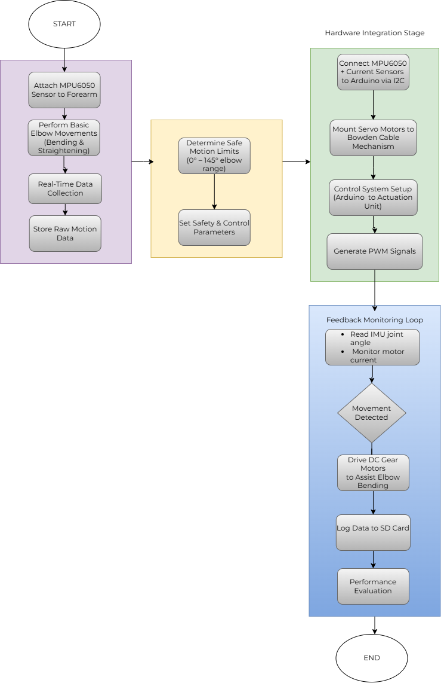
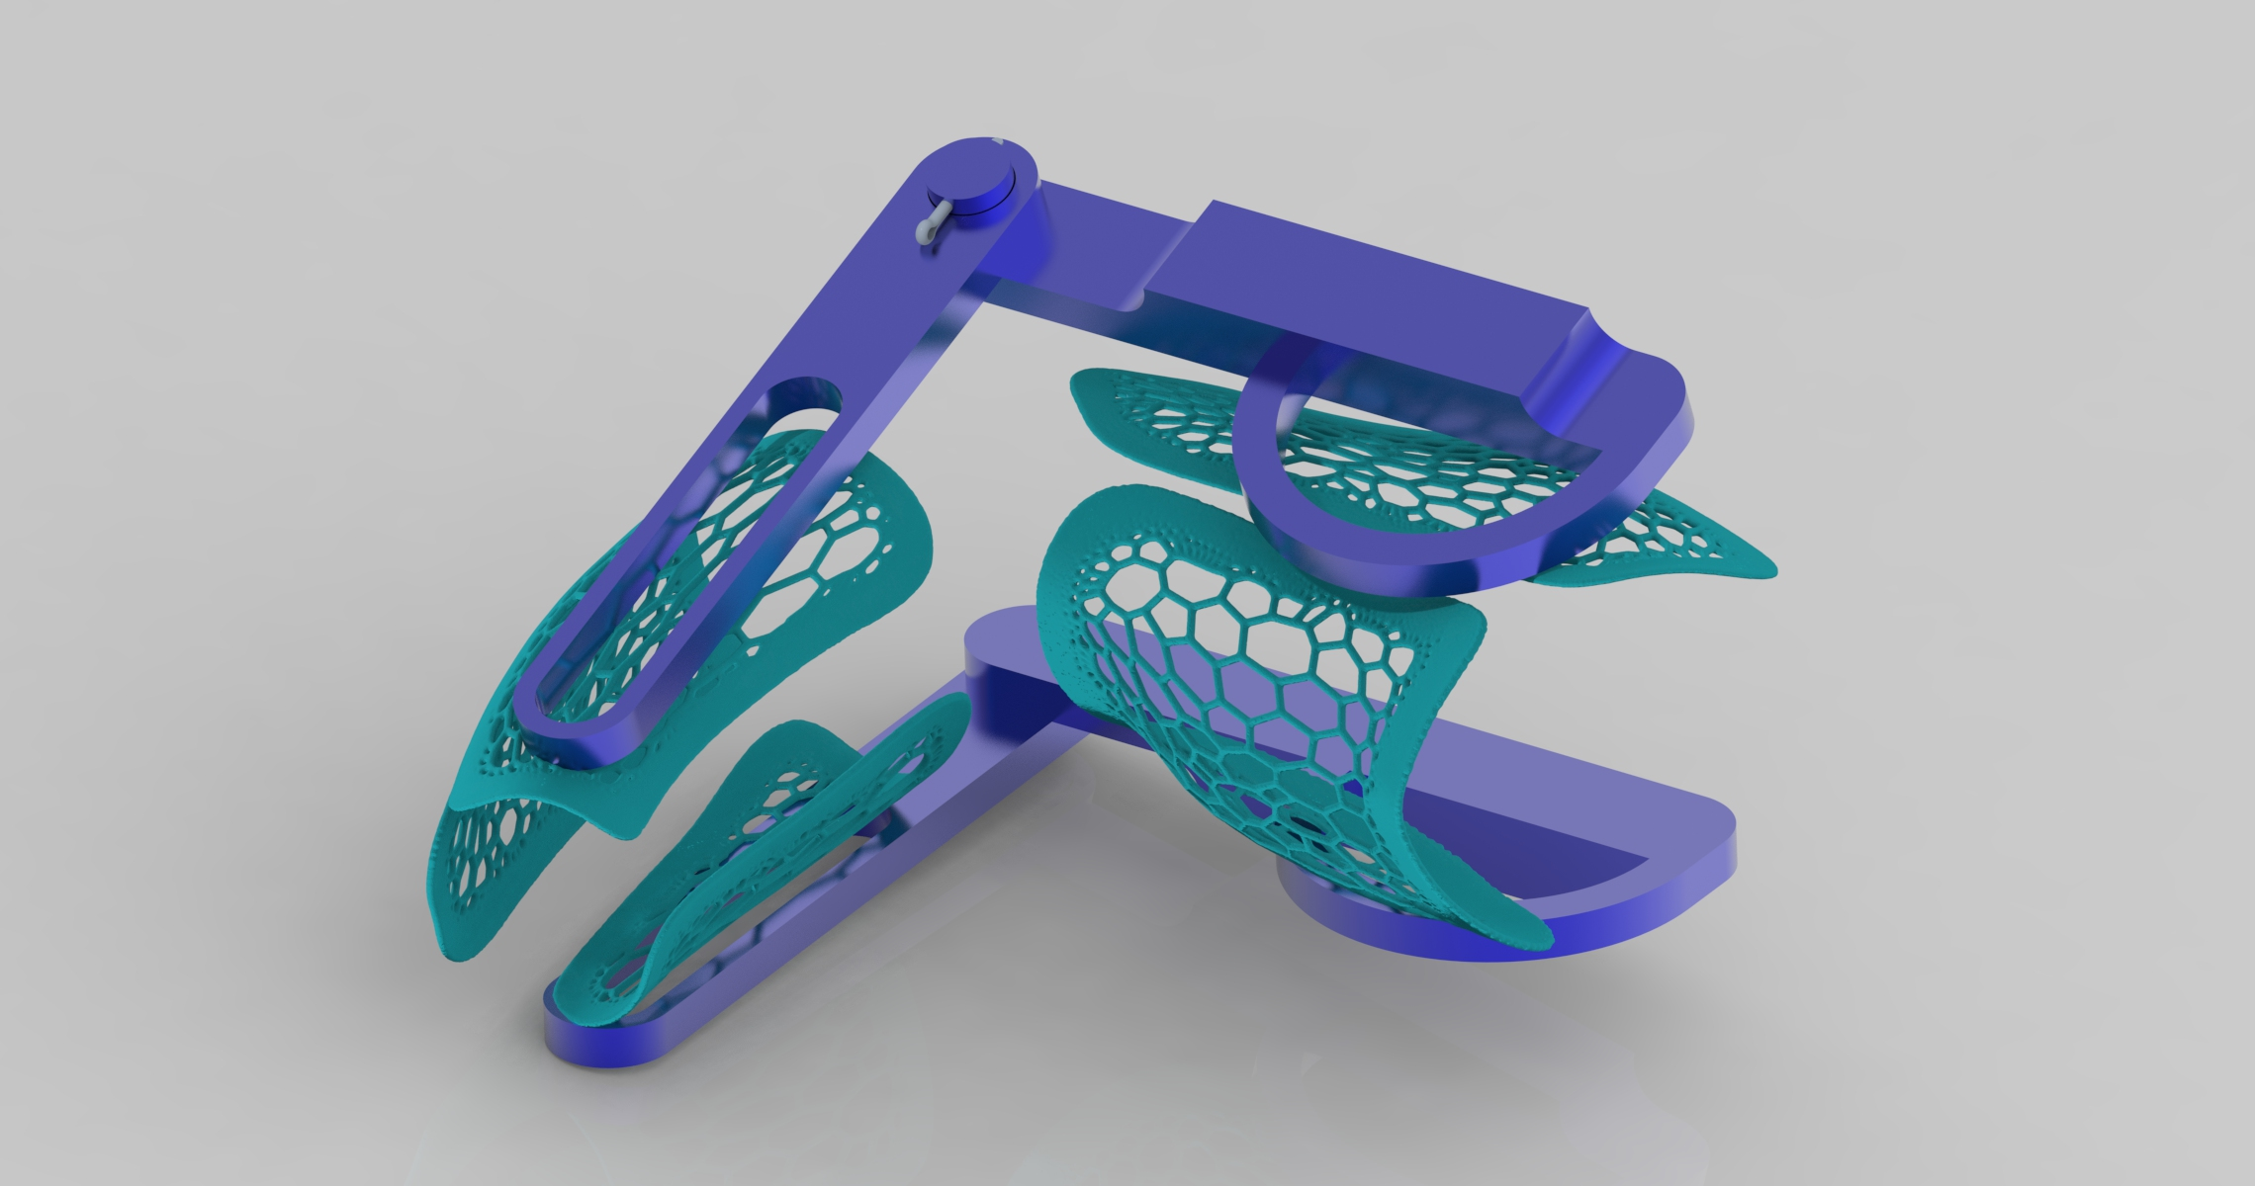
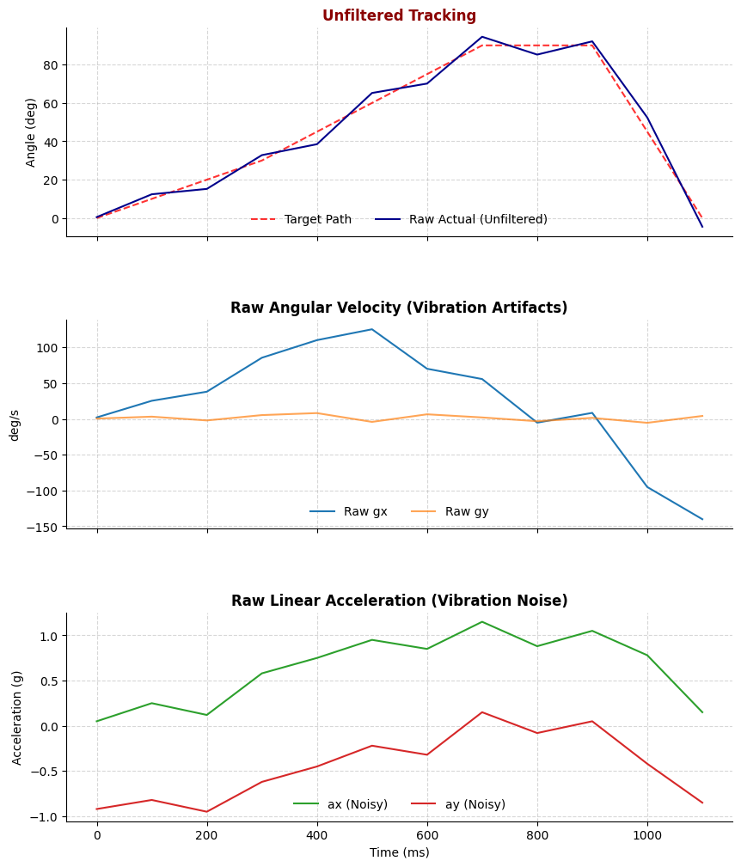
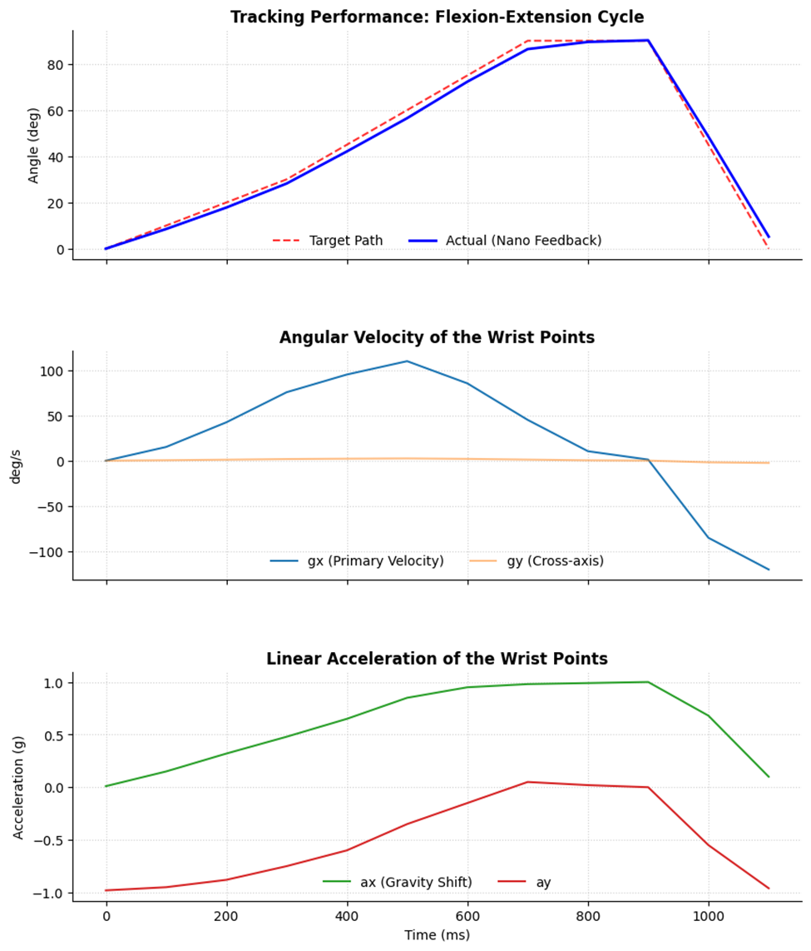
Project Based Learning – Batch 2023-27
Title of the project – Development and Motion Analysis of an Elbow Exoskeleton for Assisted Movement
• Wearable robotic systems designed to support, aid, or rehabilitate human joint movement
• To create a lightweight, task-adaptive solution that reduces muscular activity while maintaining user safety and comfort
• Relevance: The elbow is vital for daily tasks but vulnerable to stress, musculoskeletal conditions, and fatigue .
Developed a functional prototype featuring 3D-printed ABS cuffs with a hinged ergonomic mechanism for easy donning/doffing .
Centralized backpack unit housing high-torque motors, minimizing distal limb inertia for the user.
Successfully achieved an assistive torque of 7.21 Nm via a cable transmission mechanism.
INTRODUCTION
METHODOLOGY
RESULTS :
Developing a cable-driven elbow exoskeleton to assist with rehabilitation and lifting. It utilizes real-time sensor feedback and compliant actuation to ensure safe, synchronized physical support.
PROBLEM STATEMENT
The cable-driven architecture successfully balances power, user comfort, and ergonomic safety.
Proved that functional assistance is achievable using inexpensive, off-the-shelf components and 3D printing
CONCLUSIONS: :
Fig 1. Methodology followed in this study
To develop a functional exoskeleton prototype capable of producing palmar flexion and dorsiflexion movements of the arm.
To measure and observe the motion response of the exoskeleton mechanism using IMU-based sensors.
To evaluate the stability and performance of the exoskeleton during repetitive motion cycles.
OBJECTIVES
RESULTS :
Name of Students and Guide/s
Name of the Students Lav (23070127033) Rohit (23070127046) Uriel (23070127047) Jafar (23070127074) | Name of the Guide Dr. Hemanth Kumar C
Fig2. IMU Sensor values for flexion and extension with and without filtering
Robotics and Automation Department

