Slide 1


SIMATS ENGINEERIN Saveetha Institute of Medical and Technical Sciences Chennai-602105.
Capstone Project Title
Online Food Ordering System with Real-Time Order Tracking
Presentation By: P.Rohith(192311161)
course code:CSA4307
course:Internet Programming
Supervisor:
L.REETHA

Slide 2
Content
Aim
Abstract
Introduction
Algorithm
Flow chart
Pseudocode
Data Sets Used
Input/output
Results
References

Slide 3
Aim
Develop an interactive web-based platform for food ordering from multiple restaurants.
Implement real-time order tracking to enhance transparency and reduce customer uncertainty.
Streamline the order lifecycle from placement to delivery for both users and restaurants.
Ensure a secure, scalable backend for managing users, orders, and payments.
Improve customer satisfaction through a reliable and intuitive user experience.

Slide 4
Abstract
The project introduces an online food ordering system integrated with real-time GPS-based tracking.
It bridges the gap between customers, restaurants, and delivery agents through a centralized platform.
The system allows users to register, browse restaurants, place orders, and monitor delivery in real time.
Notifications and order status updates keep users informed at every stage.

Slide 5
Introduction
The rapid growth of online food delivery highlights the need for efficient, tech-driven solutions.
Traditional food ordering methods lack real-time communication and transparency.
Users demand convenience, speed, and reliability in food delivery.
Restaurants benefit from an automated system that reduces manual errors and delays.
This project aims to fulfill modern user expectations through digital transformation.

Slide 6
Algorithm
Start with user authentication (login/registration).
Fetch and display available restaurants and menus dynamically.
Accept food selection and place order upon successful payment.
Assign a delivery agent and update order status: Preparing → Out for delivery → Delivered.
Use live location tracking to show the agent’s movement until order completion.

Slide 7
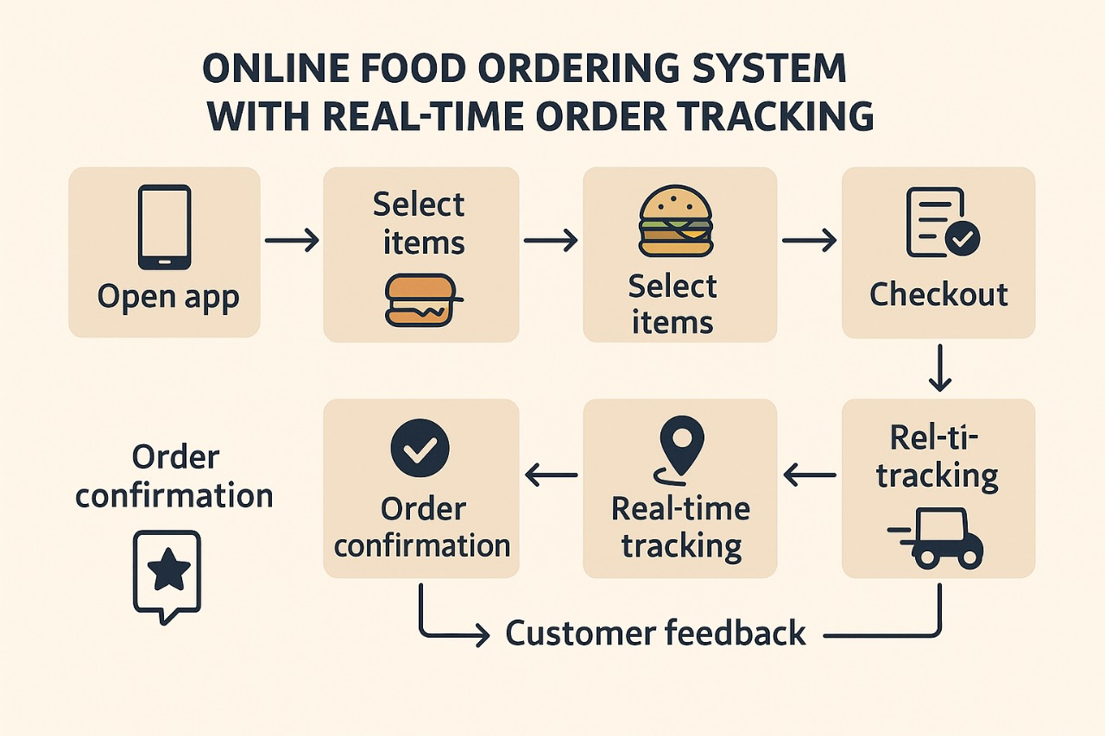
Flow Diagram

Slide 8
Input/Output
Input:
User credentials, selected items, delivery address, and payment method.
Restaurant status updates (order accepted, prepared).
Outputs:
Order confirmation messages and tracking interface
Real-time tracking updates and ETA.
Final delivery notification and feedback form.

Slide 9
Dataset Used
User Database: Login credentials, addresses, order history, and preferences.
Restaurant Database: Menus, pricing, availability, and operating hours.
Order Records: Order ID, timestamps, item details, status logs.
Delivery Agent Location Data: Real-time GPS coordinates.
Payment Logs: Transaction IDs, amounts, payment method, and status.

Slide 10
Result Analysis
Improved order accuracy and reduced customer wait times.
Real-time tracking increased trust and reduced user anxiety.
Higher restaurant throughput due to streamlined processes.
Scalable backend capable of handling concurrent users and orders.
Positive user feedback and high retention rates due to enhanced UX.

Slide 11
References
IEEE Xplore – Papers on real-time tracking systems and food delivery architectures.
Google Maps API Documentation – For real-time geolocation and tracking.
Firebase and MySQL – For backend data management and user authentication.
Research articles on Swiggy, Zomato, and Uber Eats system design.
UX/UI best practices from Nielsen Norman Group and Material Design guidelines.

Slide 12
Thank You
Query Please

