Slide 1

CHICAGO, ILLINOIS
Airbnb Price Prediction, Guest Sentiment Analysis & Topic Modeling using ML, NLP & Neural Networks
SCH-MGMT 661 - APPLICATIONS OF AI MODELS
Group 5
Rohith Reddy Kolanu
Allen Joe Winny Tharigopala
Ruthwik Reddy Kolanu
Gianni Colonero
01 / 14

Slide 2
AIRBNB CHICAGO · ML / NLP / NEURAL NETWORKS
GROUP 5
Presentation Roadmap
01
Problem Statement & Objectives
02
Time Series Plot (Reviews per year)
03
Reviews Data Preprocessing
04
Sentiment Analysis (VADER & Hugging Face)
05
Zero-Shot Classification
06
Topic Modeling (LDA, NMF & LSA)
07
Listings Data Preprocessing & Feature Selection
08
Exploratory Data Analysis
09
Neural Network & XGBoost Models
10
Model Comparison & Selection
11
Insights, Recommendations & Conclusion
SCH-MGMT 661 · Applications of AI Models
02 / 14

Slide 3
AIRBNB CHICAGO · ML / NLP / NEURAL NETWORKS
GROUP 5
Problem Statement & Objectives
PROBLEM STATEMENT
OBJECTIVES
Airbnb hosts in Chicago struggle to understand what guests truly value and to price listings competitively in a saturated market. This project bridges that gap by applying sentiment analysis, zero-shot classification, and topic modeling to transform unstructured guest reviews into measurable experience indicators across cleanliness, safety, amenities, location, and service, then integrating these NLP-derived signals with structured property attributes to build neural network and machine learning models that deliver actionable pricing insights for hosts, guests and Airbnb.
01
Guest Experience Analysis (NLP)
Apply text preprocessing, sentiment analysis, zero-shot classification, and LDA, NMF, LSA and BERT topic modeling to Chicago Airbnb reviews to quantify guest perceptions across amenities and property types, and surface actionable themes for hosts.
02
Price Prediction (Neural Networks + ML)
Build neural network and regression models that combine structured listing attributes with NLP-derived sentiment, zero-shot, and topic scores to test whether guest perception signals improve price prediction accuracy.
SCH-MGMT 661 · Applications of AI Models
03 / 14

Slide 4
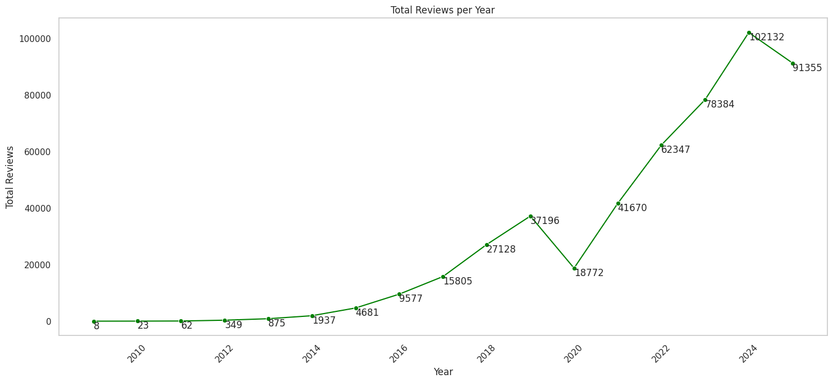
AIRBNB CHICAGO · ML / NLP / NEURAL NETWORKS
GROUP 5
DATA EXPLORATION
Reviews Over Time
KEY INSIGHTS
01
Reviews scaled from fewer than 100 annually in 2009 to 2011 to a peak of 102,132 in 2024, roughly a thousandfold increase over the period.
02
Review volume collapsed to 18,772 in 2020, a roughly 50% year over year drop and the only major break in the upward trend.
03
Reviews rebounded from 18,772 in 2020 to over 102,000 by 2024, more than five times the 2020 low, signaling a strong post-pandemic demand recovery.
04
Recent reviews from 2021 onward carry the strongest signal for current pricing and guest sentiment, justifying the decision to filter the analysis to 2023 through 2025.
Fig. 1 - Total Airbnb reviews per year, Chicago (2009–2025)
SCH-MGMT 661 · Applications of AI Models
04 / 14

Slide 5
AIRBNB CHICAGO · ML / NLP / NEURAL NETWORKS
GROUP 5
Reviews Text Preprocessing Pipeline
01
02
03
04
AGGREGATE
CLEAN TEXT
STRIP HTML
LANGUAGE
Listing Level Rollup
Normalize & Reduce
Markup Removal
English Only
Filter to the most recent reviews per listing, then concatenate the review text into a single document for each listing.
Strip URLs and non-alphabetic characters via regex, lowercase all text, tokenize, remove stopwords, then lemmatize with WordNet.
Decode HTML entities with html.unescape, then parse and remove residual tags using BeautifulSoup with the html.parser backend.
Detect language with the Hugging Face xlm‑roberta‑base model and retain only English reviews for downstream NLP tasks.
CLEAN, ENGLISH ONLY LISTING DOCUMENTS, READY FOR SENTIMENT, ZERO SHOT, AND TOPIC MODELING
SCH-MGMT 661 · Applications of AI Models
05 / 14

Slide 6
AIRBNB CHICAGO · ML / NLP / NEURAL NETWORKS
GROUP 5
NLP · SENTIMENT ANALYSIS
Sentiment Analysis: VADER & Hugging Face
01
VADER · LEXICON BASED
02
VADER · DISTRIBUTION
Method & Variables
Three Class Output
SentimentIntensityAnalyzer applied to each listing's aggregated review text. Returns four scores per listing: compound, positive, neutral, negative. Compound ≥ 0.5 → POSITIVE, ≤ −0.5 → NEGATIVE, else NEUTRAL.
Across 5,982 Chicago listings: POSITIVE 93.96 percent, NEGATIVE 1.15 percent, NEUTRAL 4.88 percent. Strong positive skew reflects guest tendency to leave favorable reviews after completing a stay.
03
HUGGING FACE · TRANSFORMER
04
HUGGING FACE · PRICE MODEL
Method & Variables
Proportion and Use in Pricing
distilbert-base-uncased-finetuned-sst-2-english pipeline applied to each listing's review text, truncated to 512 tokens. Returns a binary sentiment label and a confidence score per listing.
The model classified 67.95% of listings as POSITIVE and 32.05% as NEGATIVE, with the confidence score retained as a listing-level feature for price prediction alongside structural property and host attributes.
SCH-MGMT 661 · Applications of AI Models
06 / 14

Slide 7
AIRBNB CHICAGO · ML / NLP / NEURAL NETWORKS
GROUP 5
NLP · ZERO SHOT CLASSIFICATION
Five Guest Experience Themes
CLEANLINESS
METHOD · NLI BASED
01
Tidiness, hygiene, condition of the unit on arrival and throughout the stay.
Zero-Shot Classification
SAFETY
typeform/distilbert-base-uncased-mnli, applied via the Hugging Face transformers pipeline with PyTorch GPU acceleration. No labeled training data required.
Multi label scoring: each listing receives a relevance score across all five categories. Output is zero_shot_df with review_id plus five numeric score columns.
02
Neighborhood security, alarms, locks, lighting, overall peace of mind during the stay.
AMENITIES
03
In unit features such as Wi-Fi, kitchen, laundry, heating and cooling, workspace, parking.
LOCATION
04
Proximity to attractions, transit access, walkability, surrounding neighborhood character.
SERVICE
05
Host responsiveness, communication quality, check in experience, problem resolution.
USE IN PRICE MODEL · Five category scores merged with the Listings dataset on review_id and added as listing level features alongside property and host attributes.
SCH-MGMT 661 · Applications of AI Models
07 / 14

Slide 8
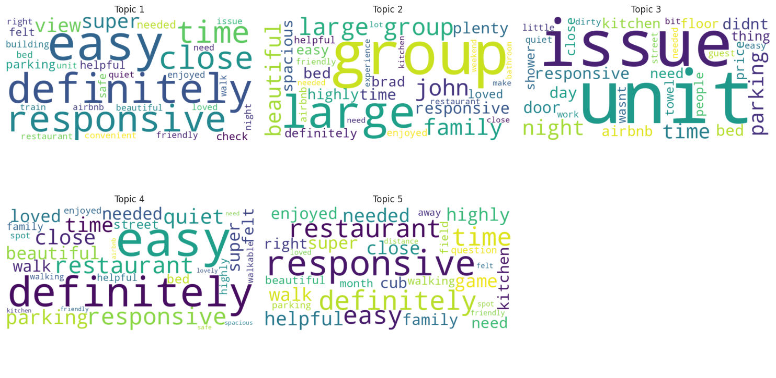
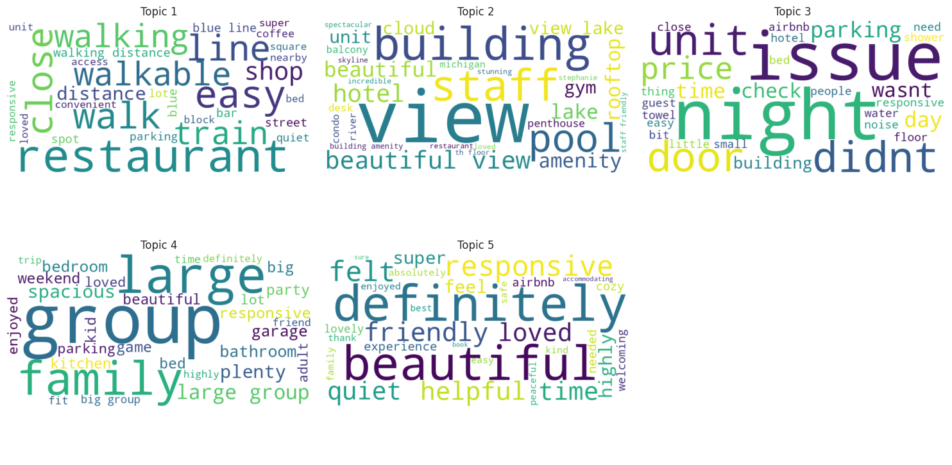
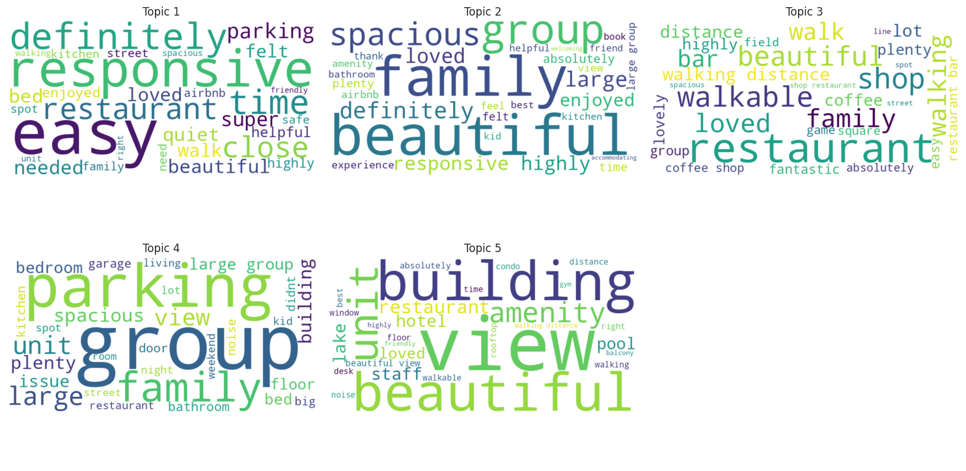
AIRBNB CHICAGO · ML / NLP / NEURAL NETWORKS
GROUP 5
NLP · TOPIC MODELING
Topic Modeling: LDA, NMF, LSA
LDA
Latent Dirichlet Allocation
BoW matrix, topic scores were integrated with structured listing attributes for price prediction model
Accessibility & host responsiveness · Group & family stays · Property issues & overnight experience · Neighborhood & dining proximity · Local exploration & activities
NMF
Non-Negative Matrix Factorization
TF‑IDF matrix
Walkability & local conveniences · Upscale property features & views · Property issues & negative experiences · Group & family accommodations · Overall guest sentiment & host quality
LSA
Latent Semantic Analysis
Truncated SVD on BoW
Host responsiveness & general accessibility · Family & group travel experience · Walkability & neighborhood amenities · Larger property characteristics & issues · Premium building features & urban views
SCH-MGMT 661 · Applications of AI Models
08 / 14

Slide 9
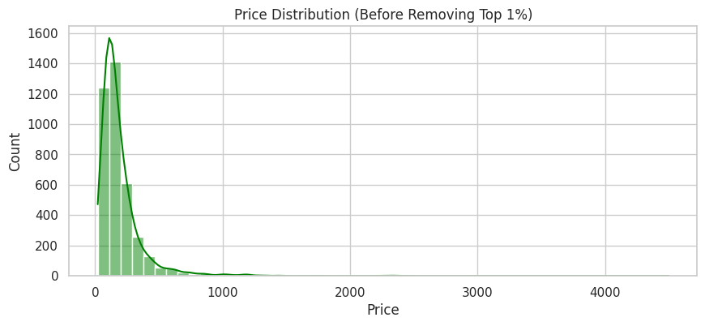
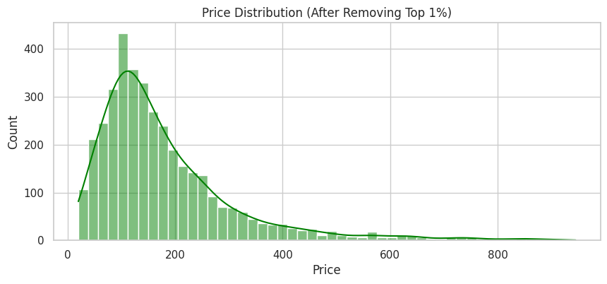
AIRBNB CHICAGO · ML / NLP / NEURAL NETWORKS
GROUP 5
Listings Preprocessing Pipeline
01
MERGE DATASETS
02
FEATURE SELECTION
03
FEATURE ENGINEERING
Handling outliers in target variable
Inner joins on listing id with HF sentiment, zero-shot scores, and LDA topic scores. Result: 4,164 records, 96 columns.
24 columns retained across six groups: property, location, host, reviews, sentiment, zero-shot, LDA. Price set as target.
price stripped of $ and , then cast to float. host_acceptance_rate stripped of % and cast to float. No duplicates detected.
Before · max $4,500
04
MISSING VALUES
05
INDEPENDENT OUTLIERS
06
TRAIN / TEST SPLIT
After · capped near $900
Dropped 324 missing price rows. Imputed bedrooms by median, host_is_superhost by mode, host_acceptance_rate by superhost group median. Final shape: 3,840 × 24.
IQR detection. Selective Winsorization on host_acceptance_rate, review_scores_rating, n_reviews. Property size and bounded NLP based scores retained as is.
Drop lat, lon. 70 / 30 split, random_state=1 → training set shape: 2,660 × 23, test set shape: 1,141 × 23. Keras Normalization layer adapted on training set only to avoid data leakage
SCH-MGMT 661 · Applications of AI Models
09 / 14

Slide 10
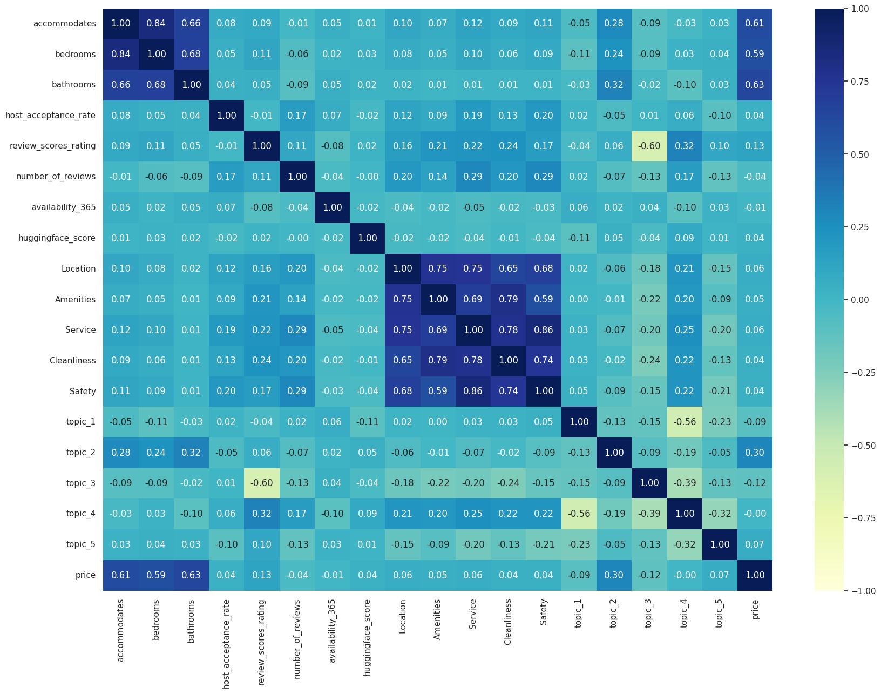
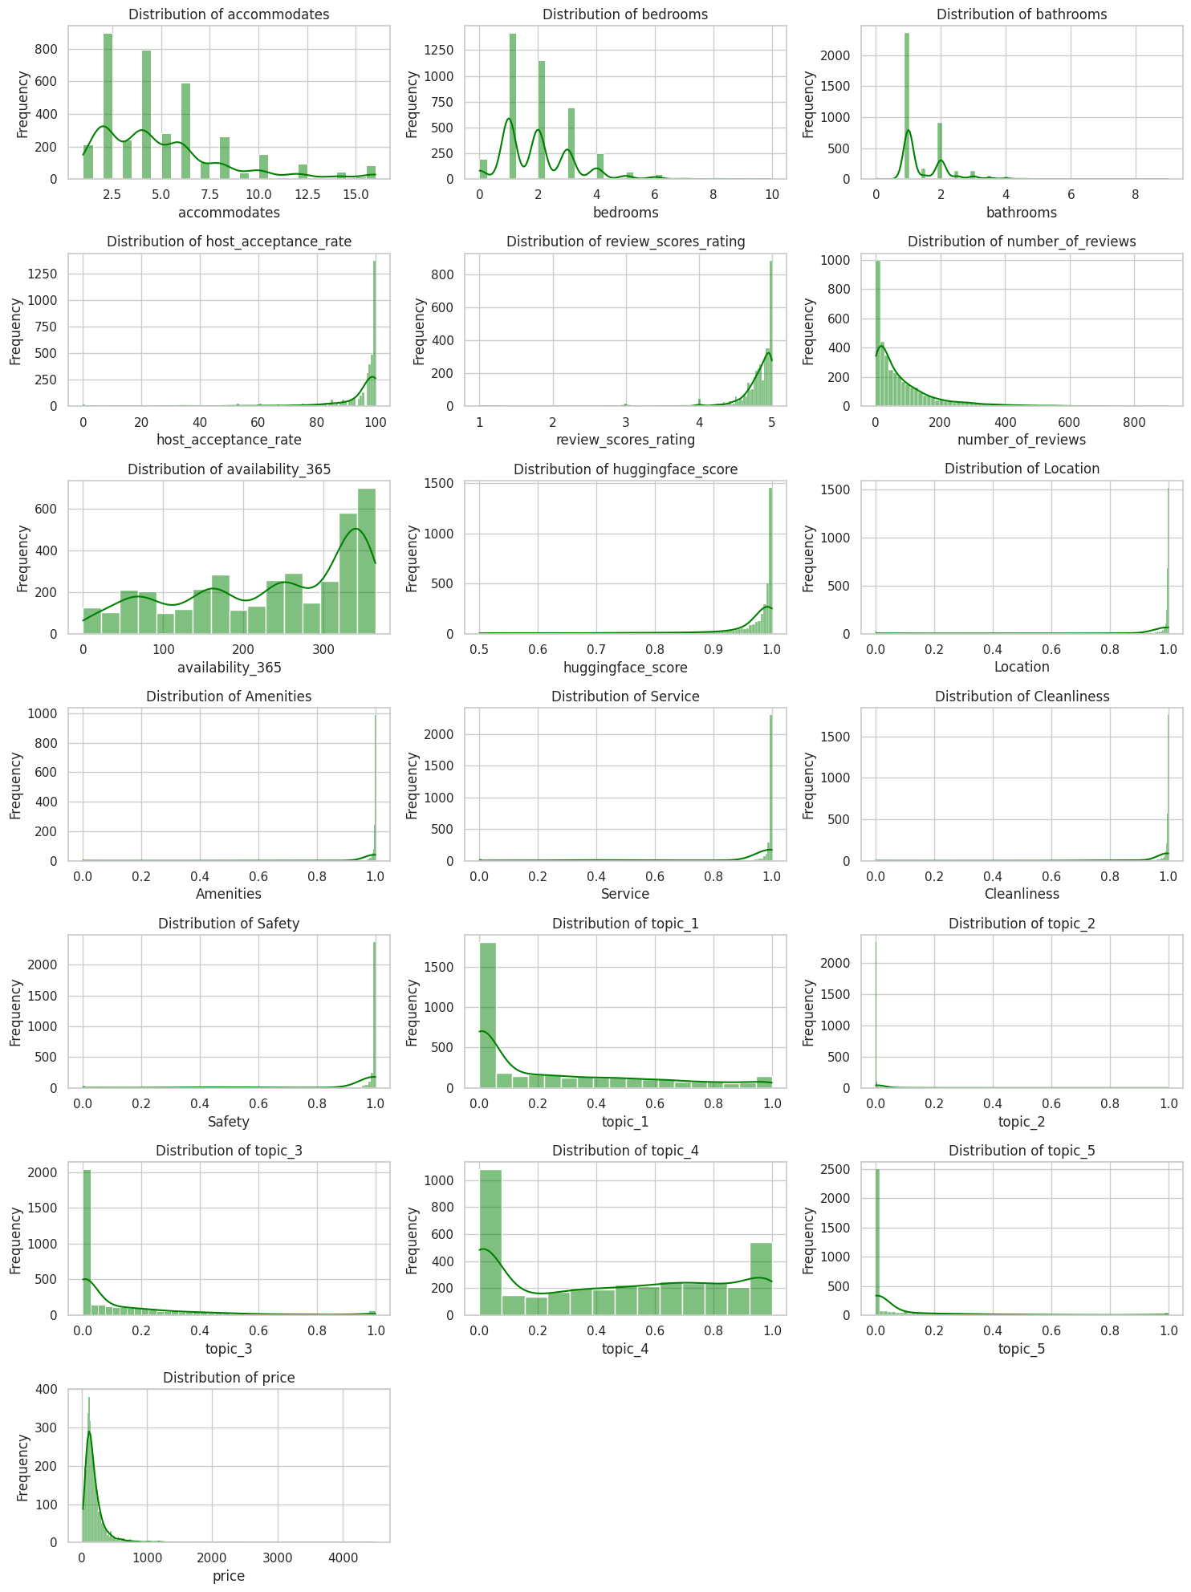
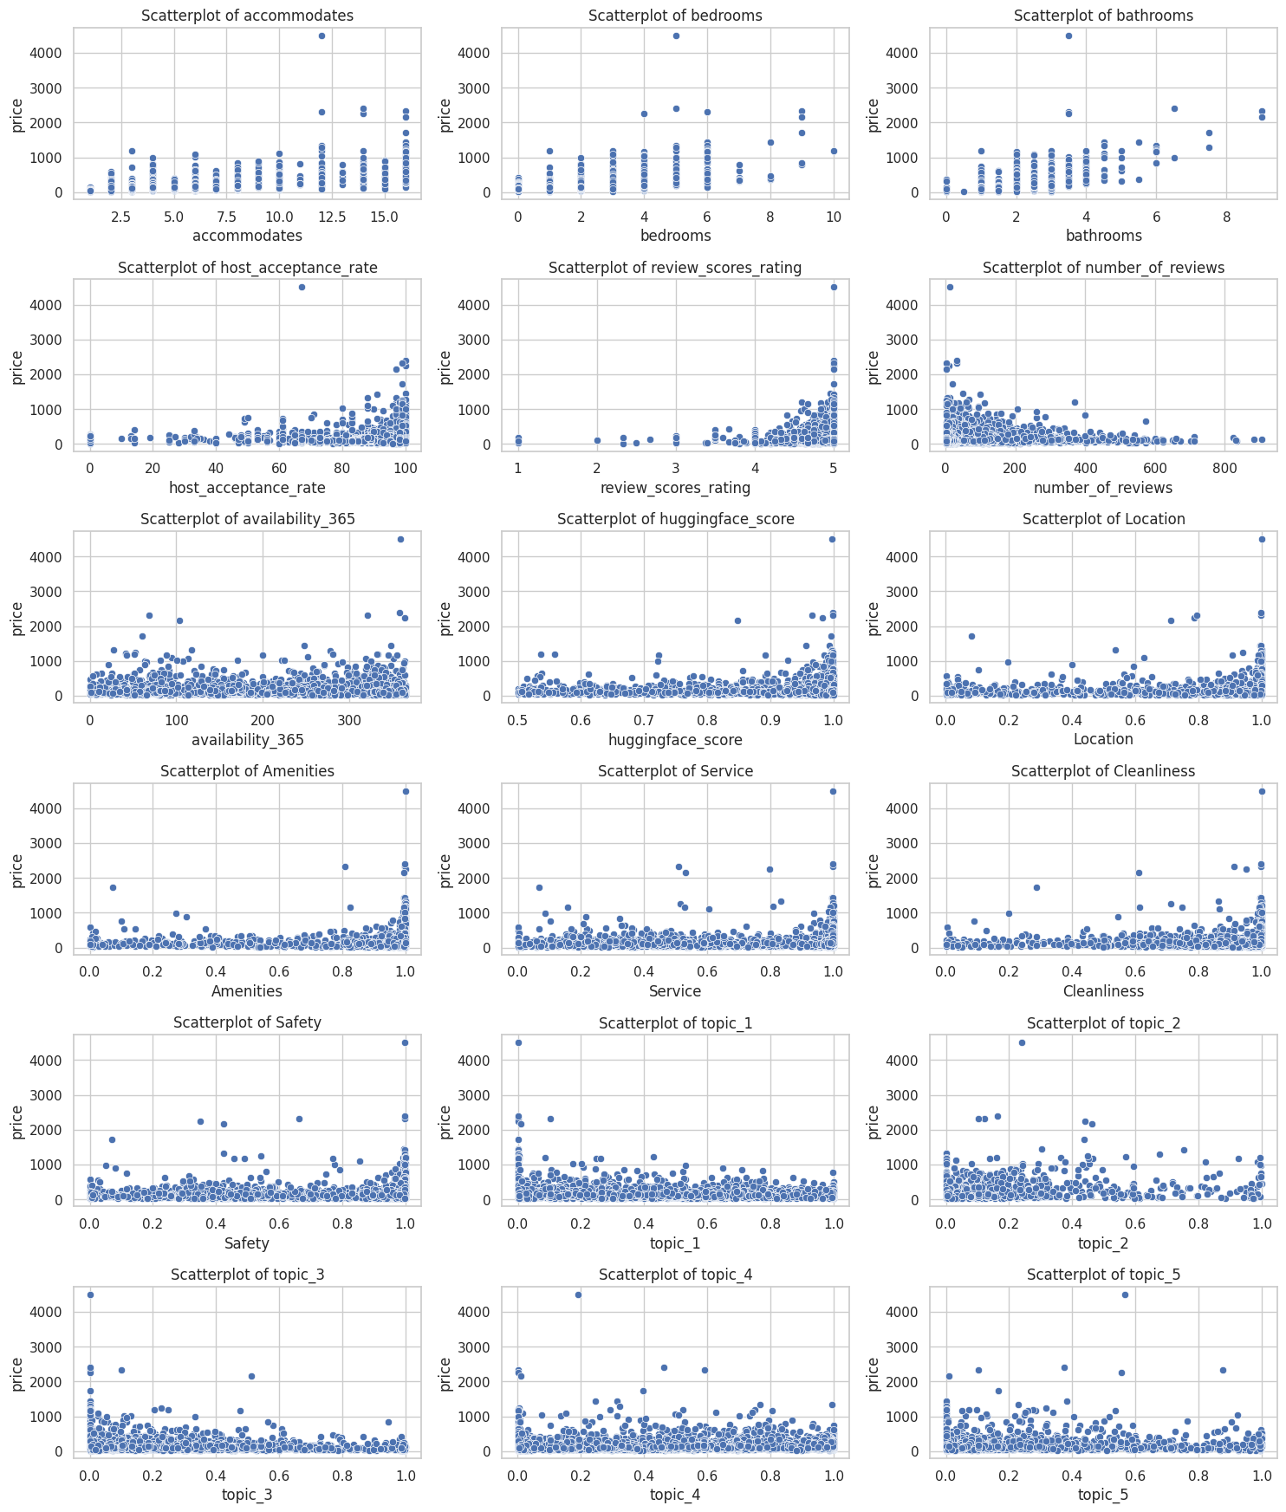
AIRBNB CHICAGO · ML / NLP / NEURAL NETWORKS
GROUP 5
DATA · EXPLORATORY ANALYSIS
Exploratory Data Analysis
01
UNIVARIATE
02
BIVARIATE
03
Distributions of key features
Features against price
CORRELATION · PRICE DRIVERS
Price right skewed: median $144, mean $192, tail to $4,500
accommodates, bedrooms, bathrooms trend up with price
accommodates multimodal at 2, 4, and 6 guests
review_scores_rating: top prices cluster near 5.0
review_scores_rating clusters tightly at 5.0
STRONGEST PRICE CORRELATIONS
HF sentiment and zero-shot scores skew toward 1.0
number_of_reviews and availability_365 flat vs price
0.63
0.61
0.59
0.30
topic_2, topic_3, topic_5 near zero for most listings
NLP scores show diffuse, indirect price signal
bathrooms
accommodates
bedrooms
topic_2
SCH-MGMT 661 · Applications of AI Models
10 / 14

Slide 11
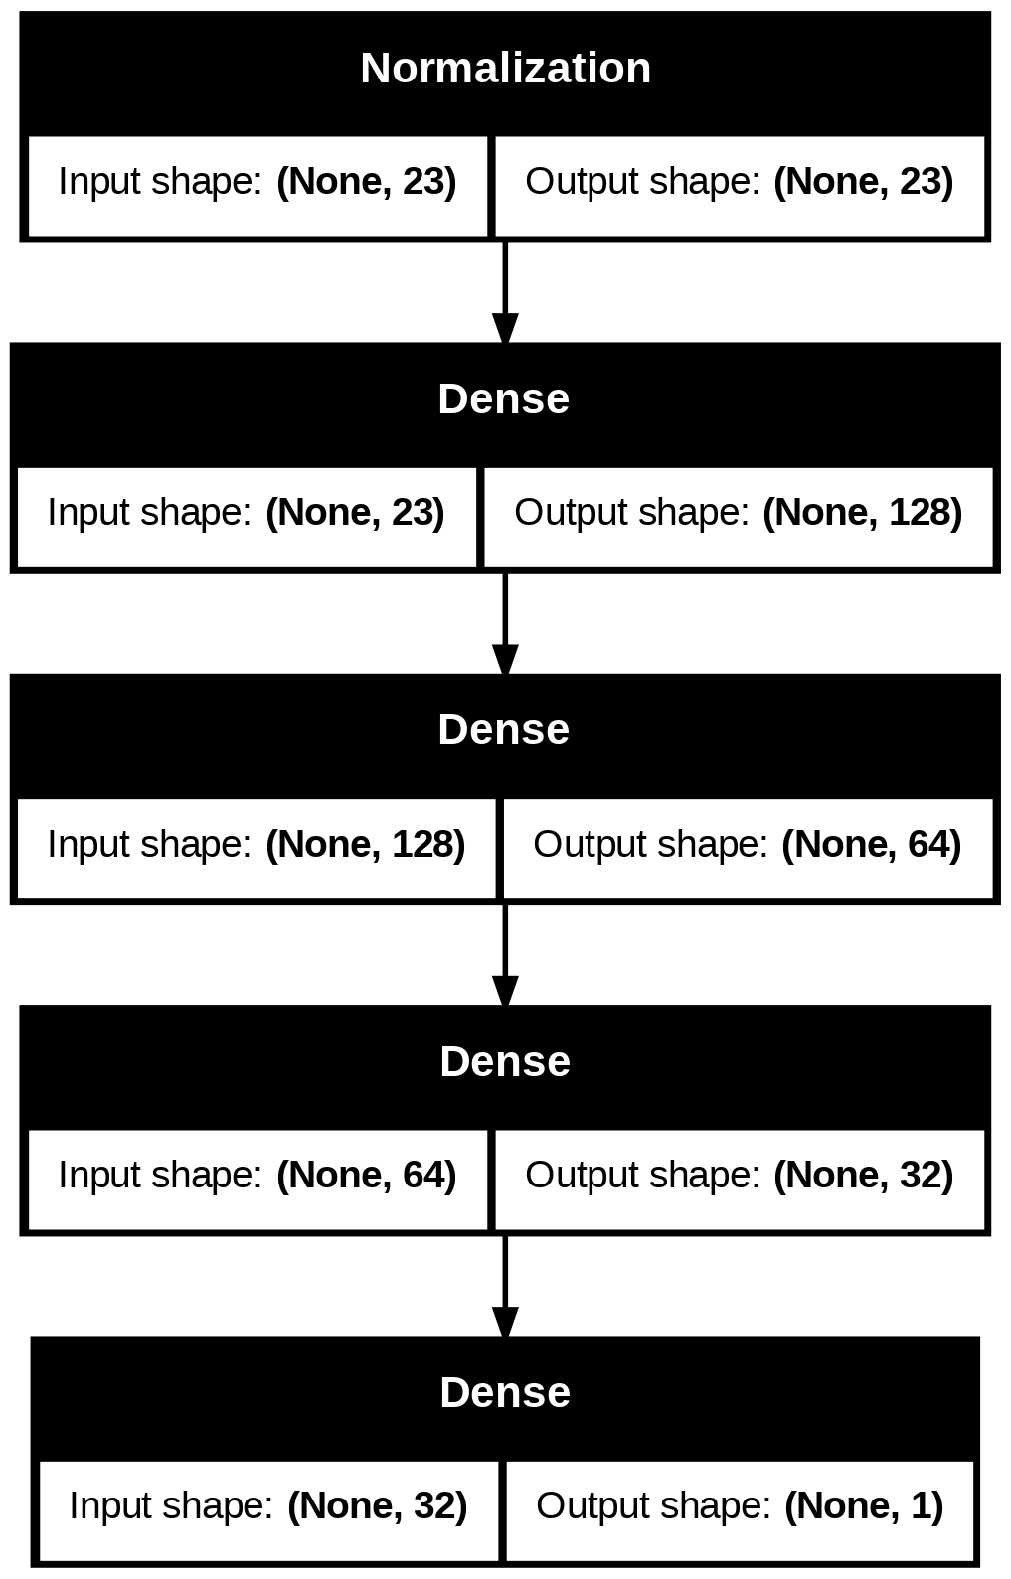
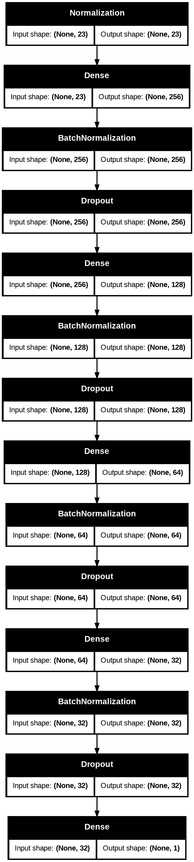
AIRBNB CHICAGO · ML / NLP / NEURAL NETWORKS
GROUP 5
MODELS · PRICE PREDICTION
Neural Networks & XGBoost
01
NN MODEL 1
02
NN MODEL 2
03
XGBOOST MODEL
Baseline architecture
Regularized, early stopping
eXtreme Gradient Boosting Regressor
ARCHITECTURE
ARCHITECTURE
APPROACH
Sequential: Input(23) → Normalization → Dense 128 ReLU → Dense 64 ReLU → Dense 32 ReLU → Dense 1.
Input(23) → Normalization → four hidden blocks of Dense(ReLU, L2=0.0004) + BatchNormalization + Dropout, with widths 256, 128, 64, 32 and dropout rates 0.3, 0.2, 0.1, 0.1 → Dense 1.
XGBRegressor(random_state=1) trained on the same 23 features. Tuned hyperparameters via GridSearchCV; best estimator refit on the full training set.
COMPILE
Optimizer Adam, loss MSE, metrics MAE and MSE.
COMPILE
SEARCH SPACE
Optimizer Adam, learning_rate 0.001. Loss MSE, metrics MAE and MSE.
n_estimators 100 / 300 / 500. learning_rate 0.03 / 0.05 / 0.1. max_depth 3 / 4 / 5. min_child_weight 5 / 10. subsample 0.7 / 0.9. colsample_bytree 0.3 / 0.5 / 0.7 / 0.9. gamma 0.1 / 0.2.
TRAINING
100 epochs, batch size 32, validation_split 0.2. No callbacks, fixed epoch budget.
TRAINING
Up to 300 epochs, batch size 32, validation_split 0.2. EarlyStopping on val_loss, patience 20, restore_best_weights True.
GRID SEARCH
GridSearchCV, cv=5, scoring R², n_jobs=-1. Best configuration selected by mean cross-validated R².
SCH-MGMT 661 · Applications of AI Models
11 / 14

Slide 12
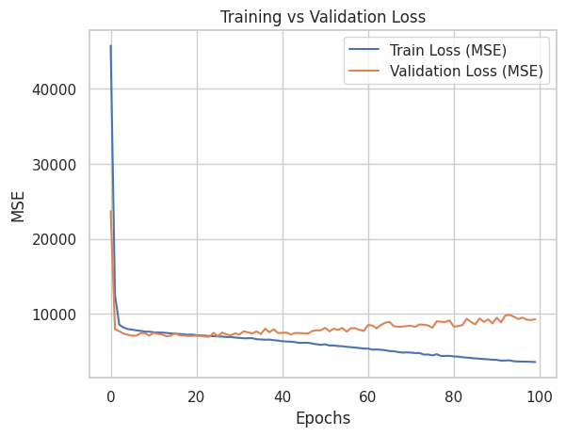
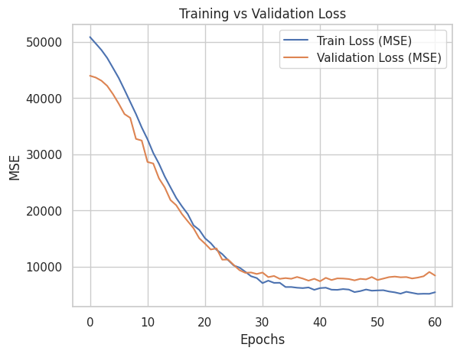
AIRBNB CHICAGO · ML / NLP / NEURAL NETWORKS
GROUP 5
MODELS · PERFORMANCE & SELECTION
Performance, Comparison, Best Model
NN MODEL 1 · TRAIN VS VALIDATION LOSS
NN MODEL 2 · TRAIN VS VALIDATION LOSS
Train loss continues to fall while validation loss flattens then rises after epoch 20, the classic overfitting signature. Test R² 0.5356, RMSE $89.40.
Train and validation losses descend in parallel and converge near epoch 30. EarlyStopping triggered at epoch 60. Test R² 0.5617, RMSE $86.85.
100 epochs, no callbacks
L2 regularization, BatchNormalization, Dropout, Early Stopping
MODEL
SET
RMSE
R²
ADJ R²
BEST MODEL
NN Model 1
Train
$86.08
0.5784
0.5747
XGBoost
NN Model 1
Test
$89.40
0.5356
0.5260
NN Model 2
Train
$86.79
0.5714
0.5677
Highest test R² of 0.6166 and lowest test RMSE of $81.23 across all three models.
NN Model 2
Test
$86.85
0.5617
0.5526
XGBoost
Train
$52.52
0.8431
0.8417
XGBoost
Test
$81.23
0.6166
0.6087
Lower RMSE and higher R² indicate stronger fit. XGBoost delivers the best generalization on test.
SCH-MGMT 661 · Applications of AI Models
12 / 14

Slide 13
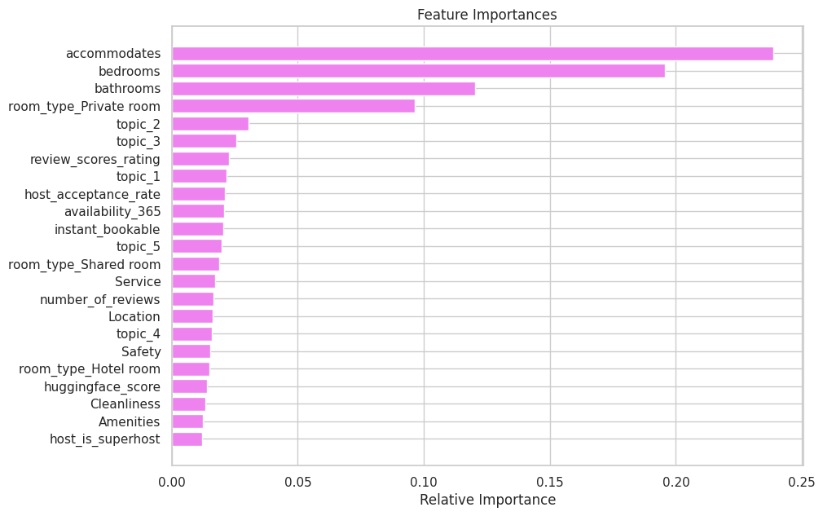
AIRBNB CHICAGO · ML / NLP / NEURAL NETWORKS
GROUP 5
INSIGHTS · RECOMMENDATIONS · CONCLUSION
What the Models Tell Us
FEATURE IMPORTANCE
01
INSIGHTS
XGBoost relative importances across 23 features
Physical capacity attributes (guests accommodated, bedrooms, bathrooms) dominate price prediction, accounting for the majority of the model's signal. NLP-derived features (LDA topics, zero-shot theme scores, transformer sentiment) add meaningful incremental signal, validating that review content carries latent pricing information beyond structured attributes. XGBoost outperforms both neural networks across all absolute error metrics, while the regularized NN (BatchNorm, Dropout, L2, early stopping) achieves the smallest train-to-test gap.
02
RECOMMENDATIONS
Airbnb: build a dynamic pricing tool powered by gradient boosting that combines structured attributes and NLP review signals, extensible beyond Chicago. Hosts: maximize accommodation capacity (guests, bedrooms, bathrooms), the strongest levers on listing price. Guests: filter on review-derived signals (sentiment, cleanliness, service) for a fuller picture of expected experience than star ratings alone.
03
CONCLUSION
Top drivers: accommodates 0.24, bedrooms 0.20, bathrooms 0.12, room_type Private 0.10. NLP topic_2 (upscale features and views) leads review-derived contributors.
XGBoost delivered the strongest fit with test R² of 0.61 and RMSE of $81.23. Property size remains the primary lever, while NLP-derived themes provide a real, modest, incremental signal for valuation. Pairing structured features with review-driven NLP scores is a workable framework for price prediction of Airbnb listings.
SCH-MGMT 661 · Applications of AI Models
13 / 14

Slide 14
AIRBNB CHICAGO · ML / NLP / NEURAL NETWORKS
GROUP 5
Thank You!
QUESTIONS · COMMENTS · DISCUSSION
We welcome your questions and feedback.
SCH-MGMT 661 · APPLICATIONS OF AI MODELS
14 / 14

