Slide 1

BOOK STORE MANAGEMENT
APPLICATION
GROUP 2
ADITHYA N U
ANKITA
AFREEN
ANIL KUMAR SINGH
VENNA ROHITH SAI
SAI ABHISHEK
ADNAN PASHA

Slide 2
REQUIREMENT ANALYSIS
PROBLEM STATEMENT :
To Create an Application for book store Management
Customer should be able to view the list of books order book.
Admin should be able to perform below operations :
1.Book Management
2.Customer Management

Slide 3
REQUIREMENT ANALYSIS
MODULES :
BOOK
Id
Name
Author
Price
Image
USER
Id
Name
Password
Type

Slide 4
REQUIREMENT ANALYSIS
Functions which can be performed :
User login
User can login through username and password
Create one shopping cart
Add/delete/view books from shopping cart
Change shopping carts as orders
Clear the cart

Slide 5
TOOLS & TECHNOLOGIES USED
BACKEND :
Spring boot
Core Java
MYSQL Database
FRONTEND :
HTML,CSS ,JavaScript,BootStrap
Angular
Devoops :
GitHub
SonarLint

Slide 6
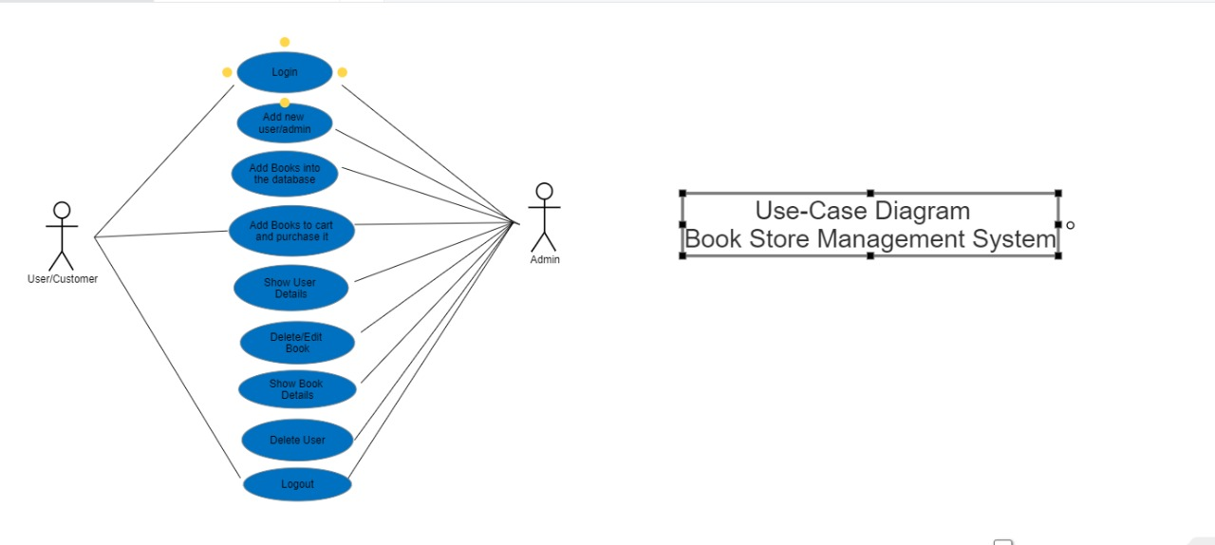
USE CASE DIAGRAM

Slide 7
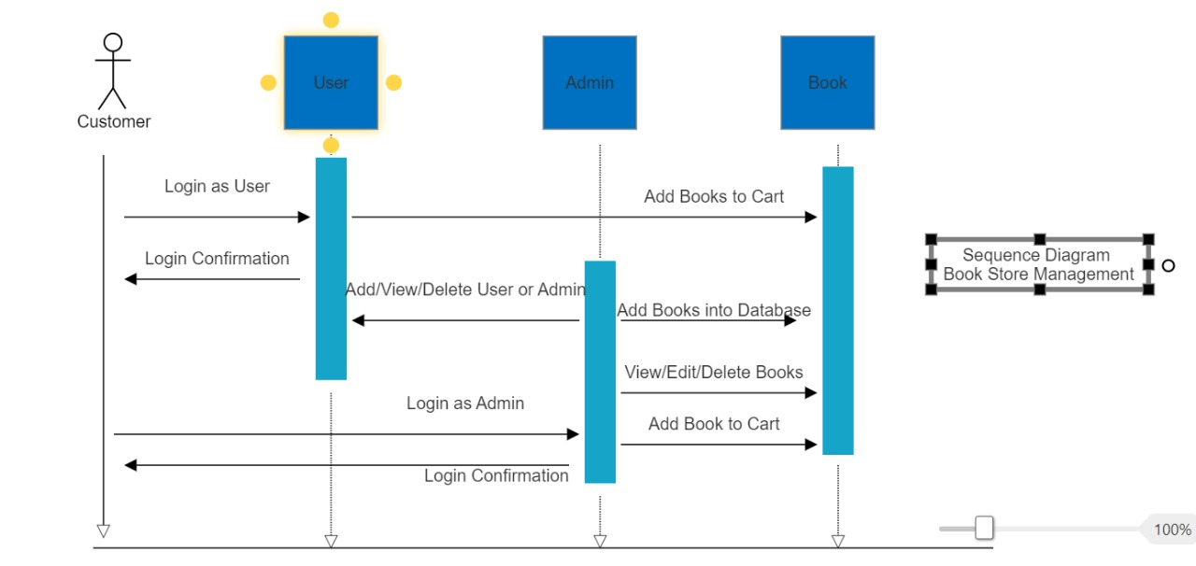
SEQUENCE DIAGRAM

Slide 8
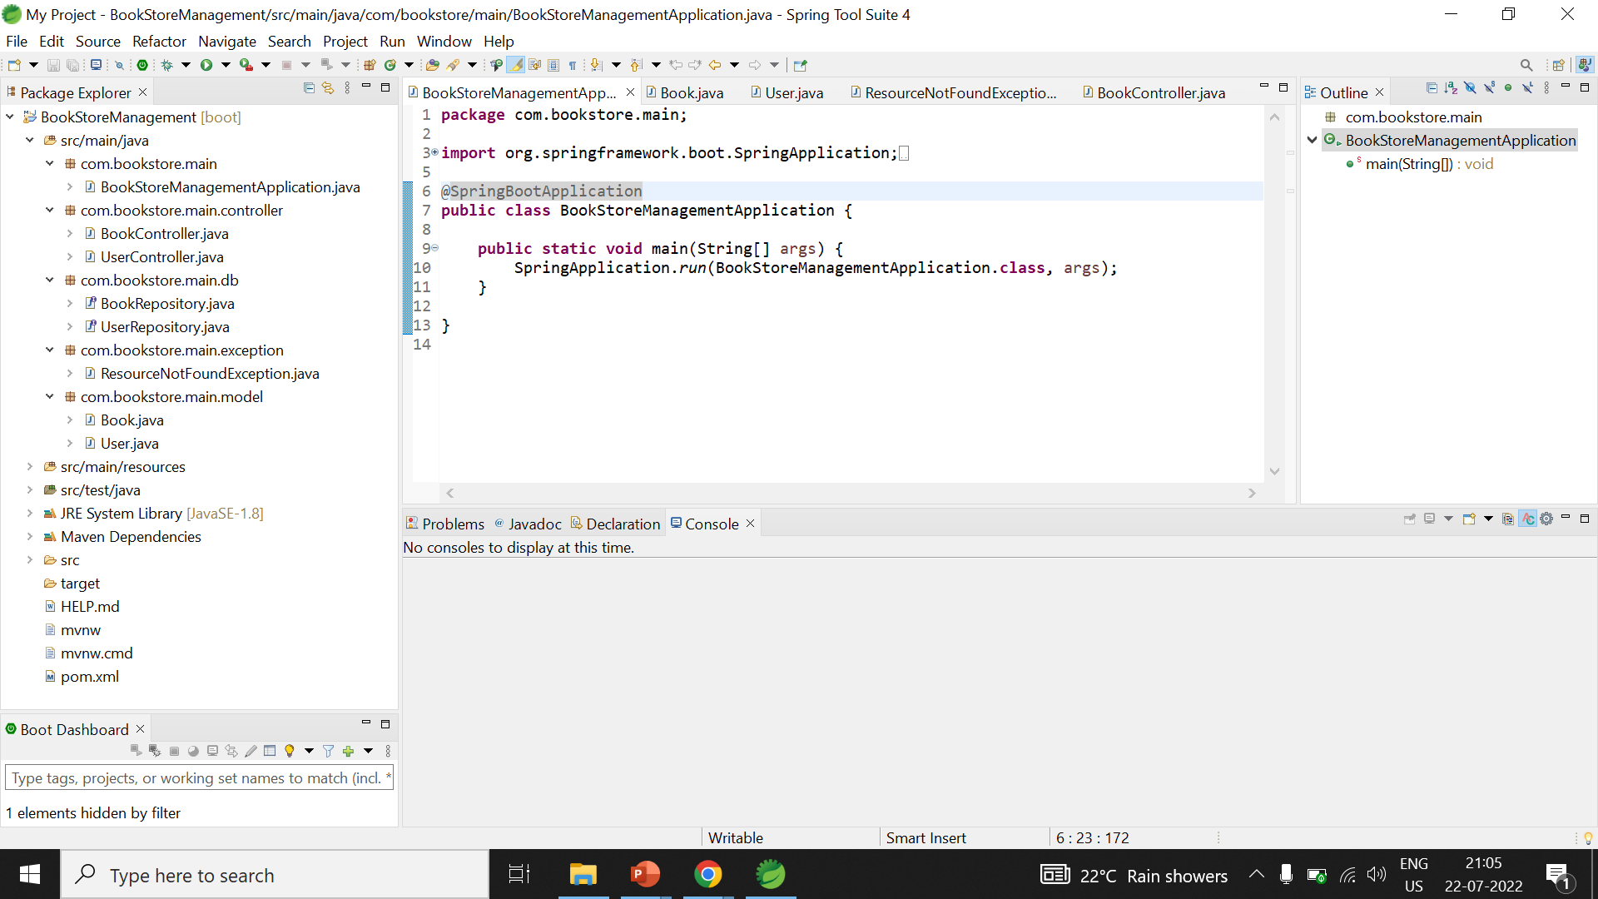
BACKEND PART

Slide 9
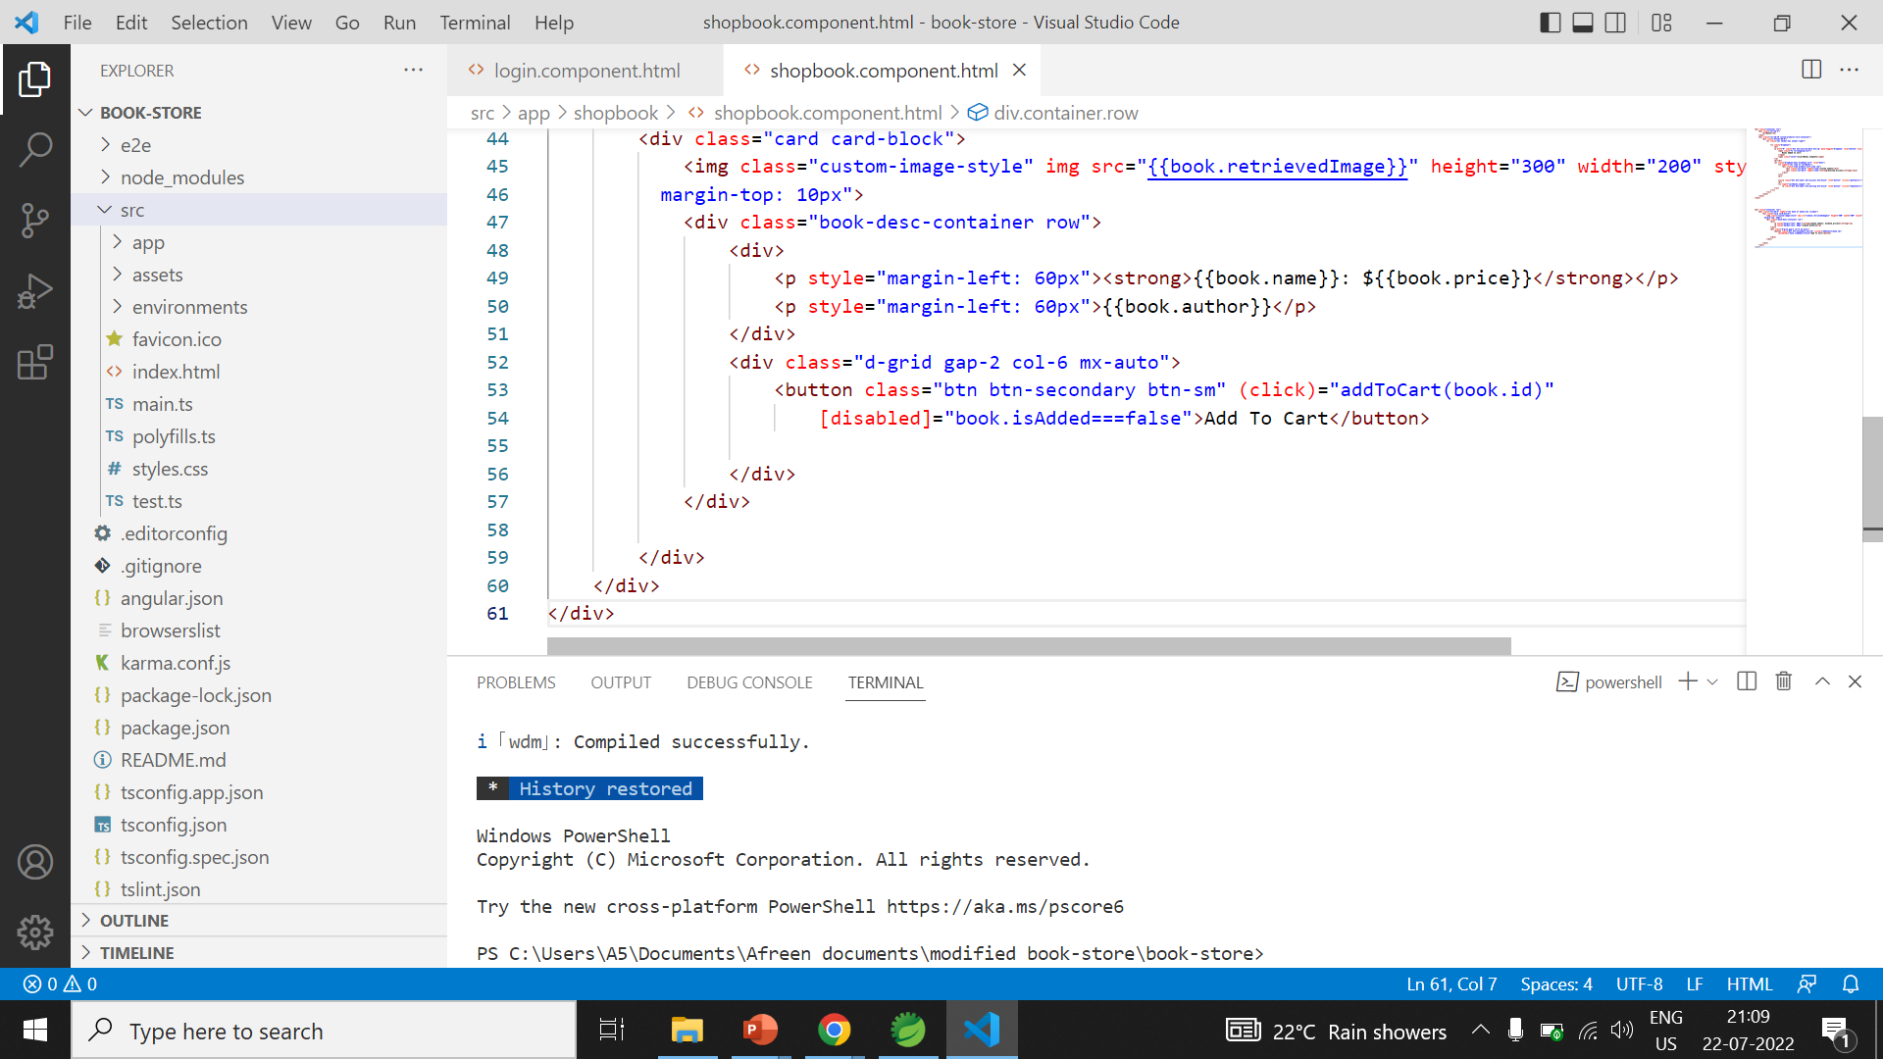
FRONTEND PART

Slide 10
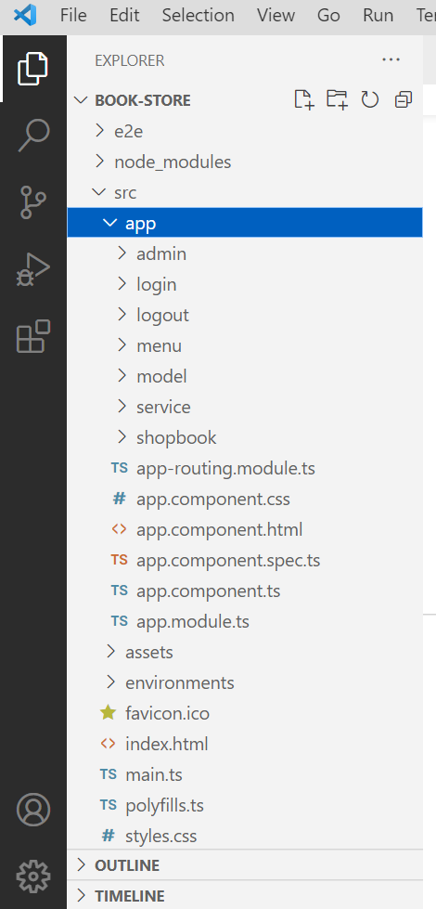
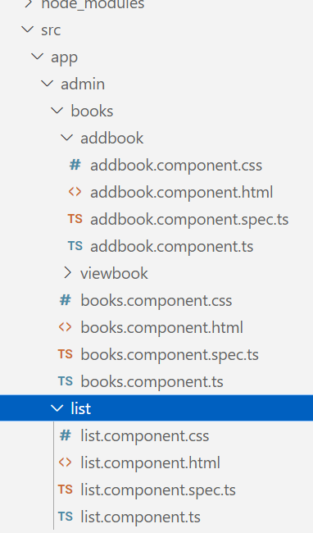
FRONTEND PART…

Slide 11
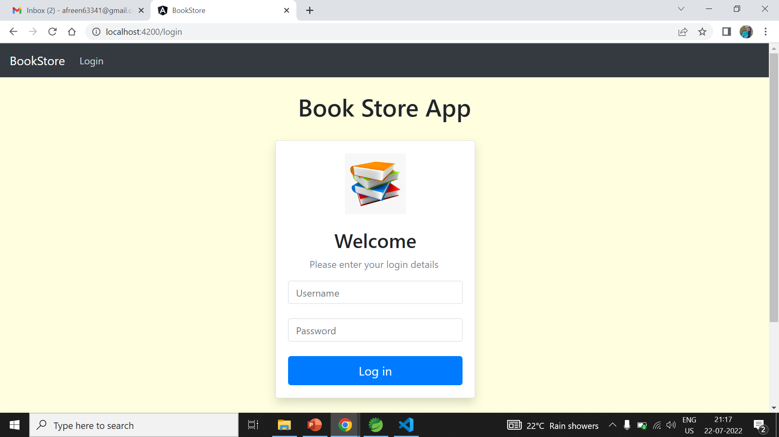
UI/UX (Home page)

Slide 12
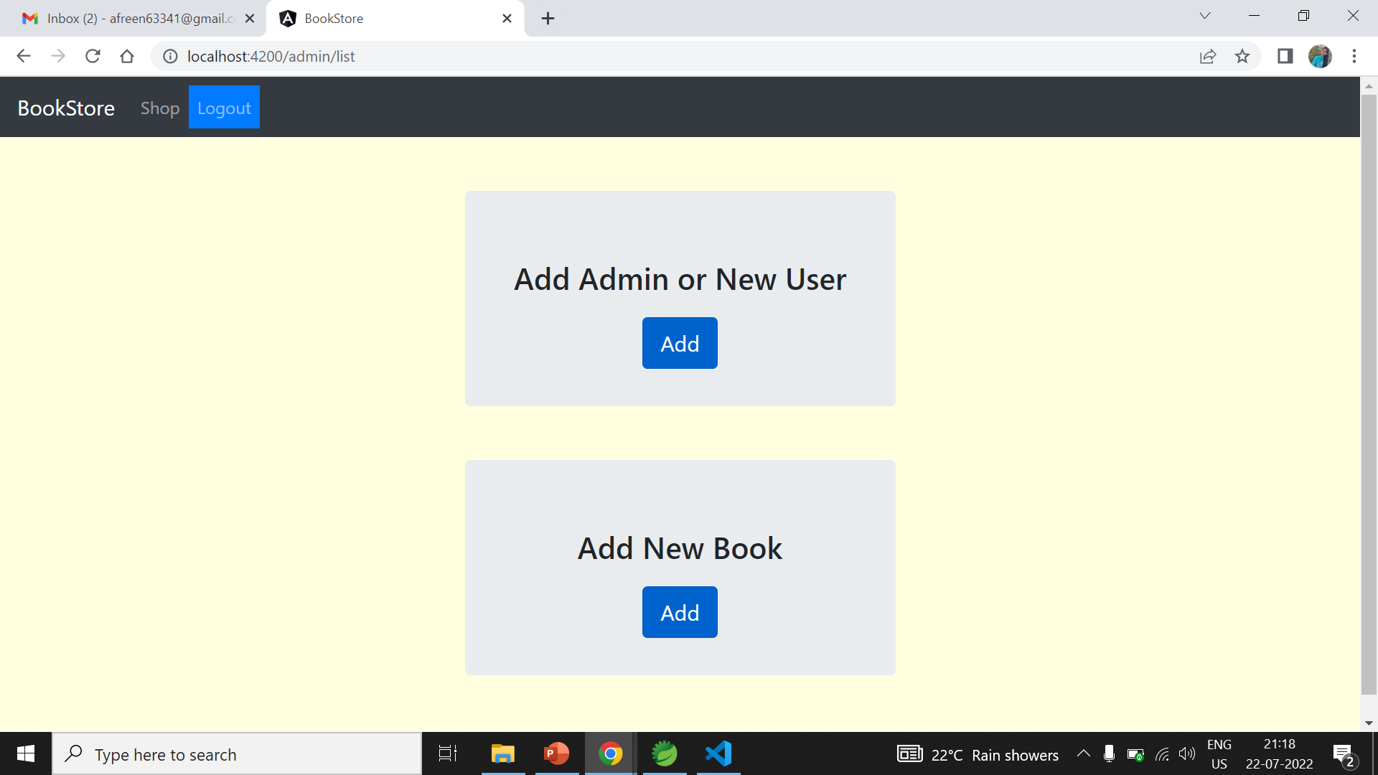
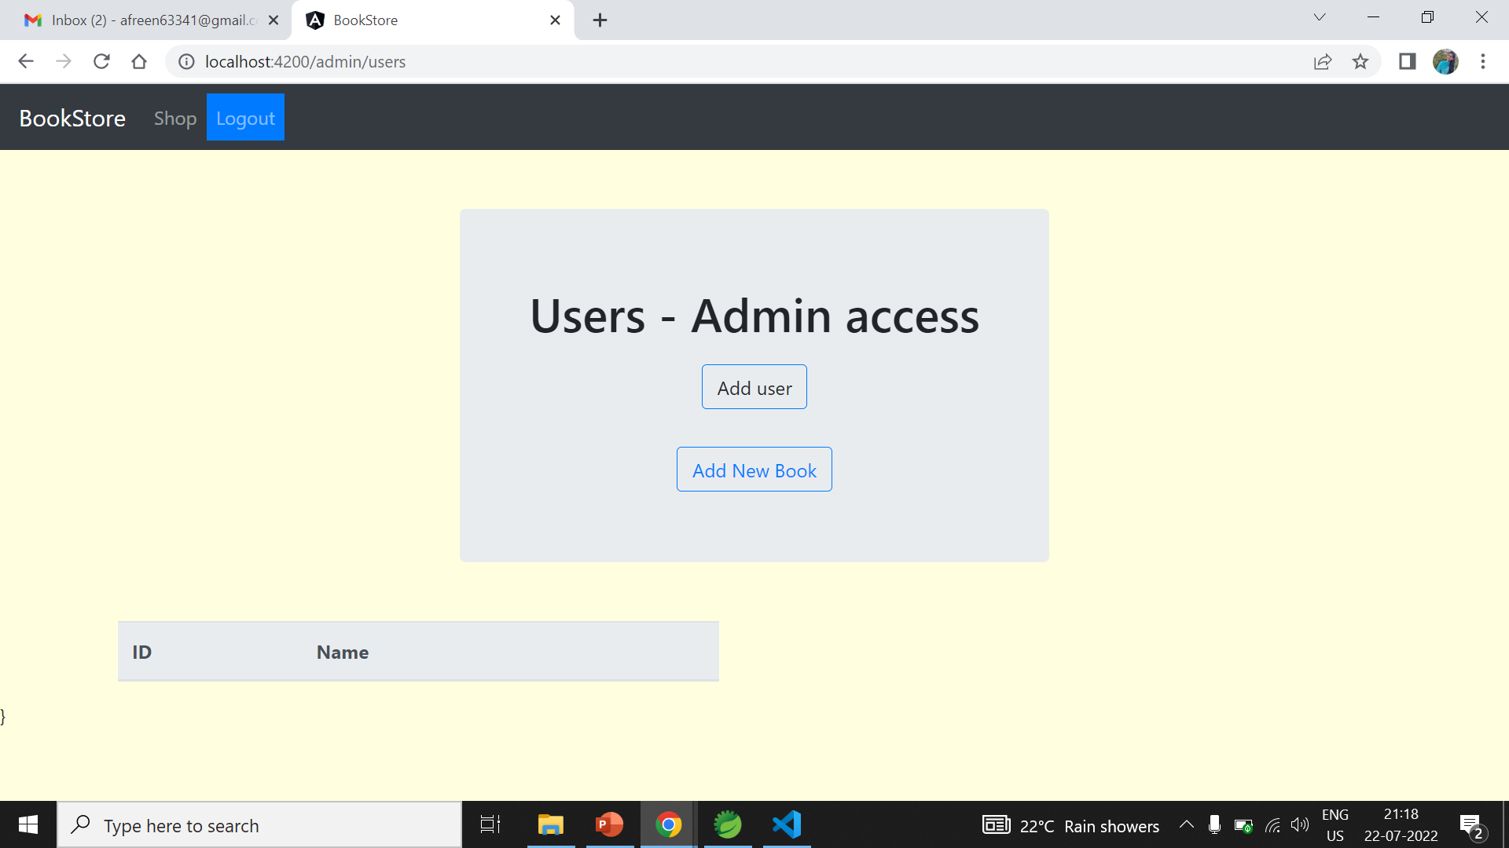
UI/UX (Admin page)

Slide 13
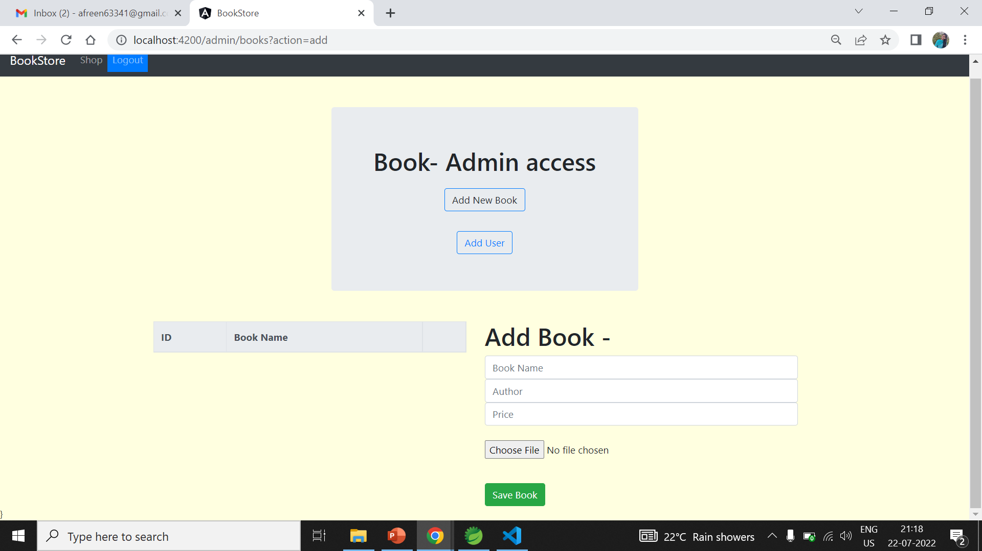
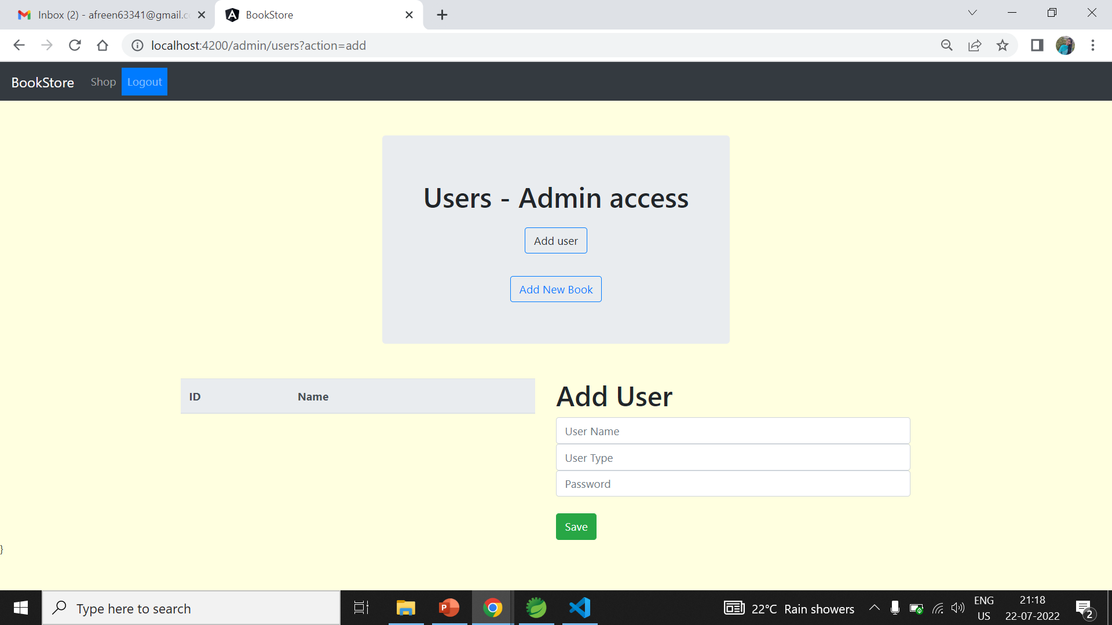

Slide 14
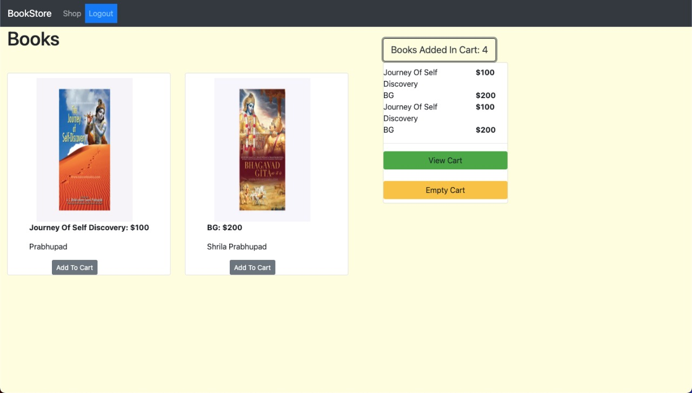
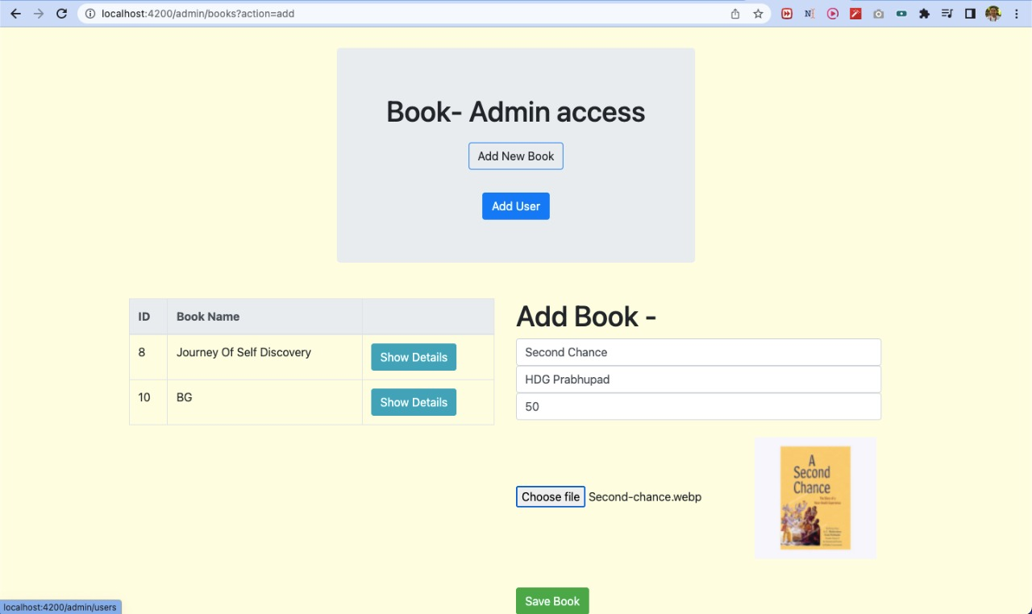

Slide 15
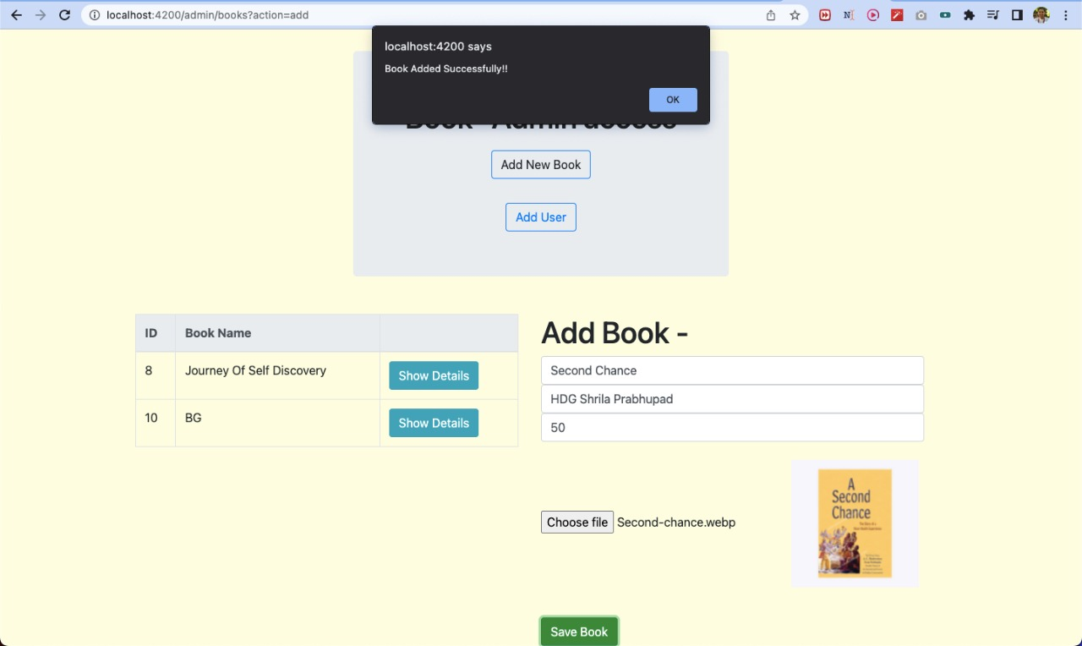

Slide 16
THANK YOU

