Slide 1
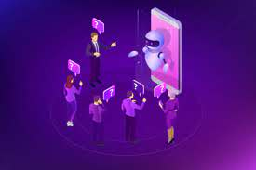
RETRIEVAL-BASED CHATBOT USING NLP AND PYTHON

Slide 2
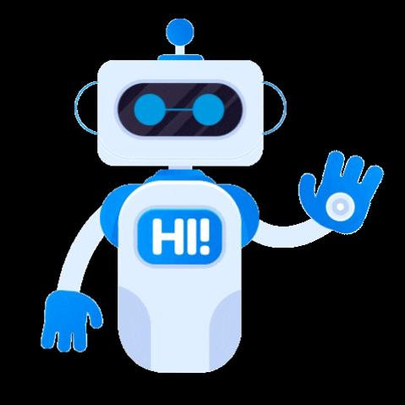
VENNA ROHITH SAI (20181CSE0785)
VINAY K P (20181CSE0790)
VINAY LAKSHMAN M (20181CSE0791)

Slide 3
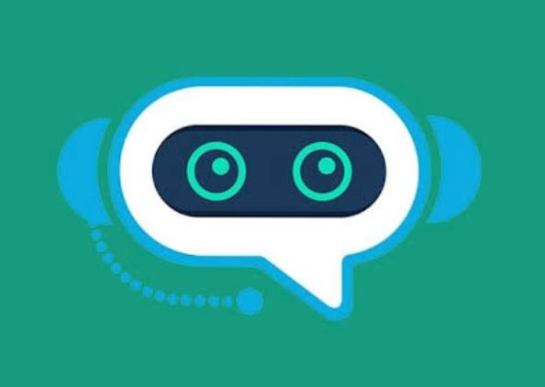
Introduction:
Nowadays there are a variety of chatbots being used all over the internet for all sorts of things. They range from simple rule-based bots to complex generative bots that can have actual conversations with people.

Slide 4
Libraries used in the code:
Random : This module implements pseudo-random number generators for various distributions.
String : The string module provides additional tools to manipulate strings.

Slide 5
Libraries used in the code:
Warnings : Warning messages are displayed by warn() function defined in 'warning' module of Python's standard library.

Slide 6
Libraries used in the code:
Sklearn : Scikit-learn is a free software machine learning library for the Python programming language.
Tfidfvectorizer : Convert a collection of raw documents to a matrix of TF-IDF features.
cosine_similarity(X,Y) : Compute cosine similarity between samples in X and Y.

Slide 7

Libraries used in the code:
NLTK : NLTK is a leading platform for building Python programs to work with human language data.

Slide 8
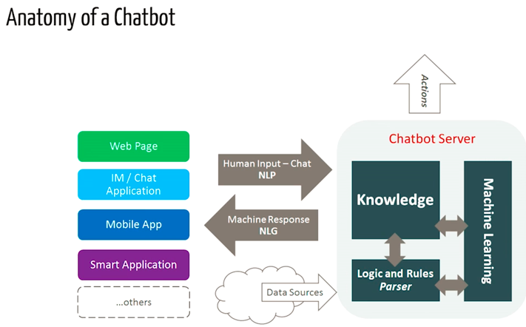
Design and architecture of chatbot:

Slide 9
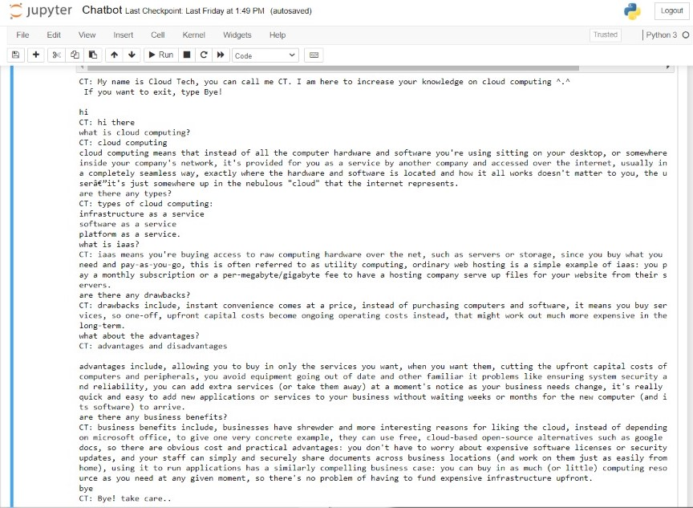
Output screenshot:

Slide 10
Future scope:
There are many existing bot frameworks that can be integrated with the existing code to make the bot respond to complex queries. We can also implement a deep learning algorithm to enable the bot to learn more and more as the user inputs data, thereby enabling the bot the have an actual conversation with people (generative bots).

Slide 11
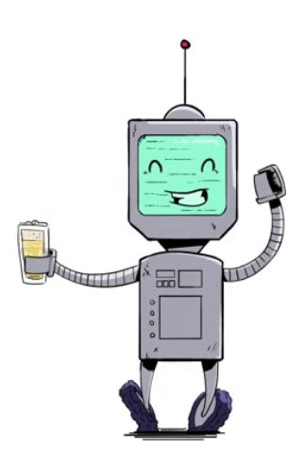
Conclusion:
Though it is a very simple bot with hardly any cognitive skills, its a good way to get into NLP and get to know about chatbots. Though ‘CT (Cloud Tech)’ responds to user input, for a production system we will need one of the existing bot platforms or frameworks, but this example should help us think through the design and challenge of creating a chatbot. The Internet is flooded with resources and this mini-project serves as a great introduction to NLP and the analysis of a chatbot.

Slide 12
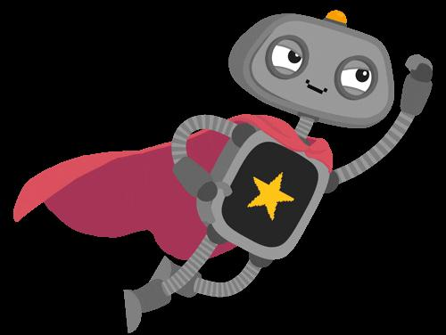
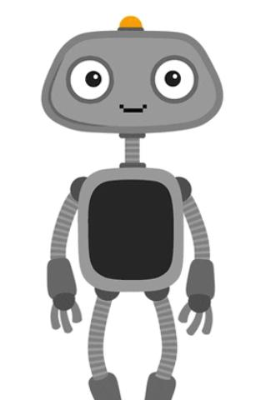
Thank you

