Slide 1
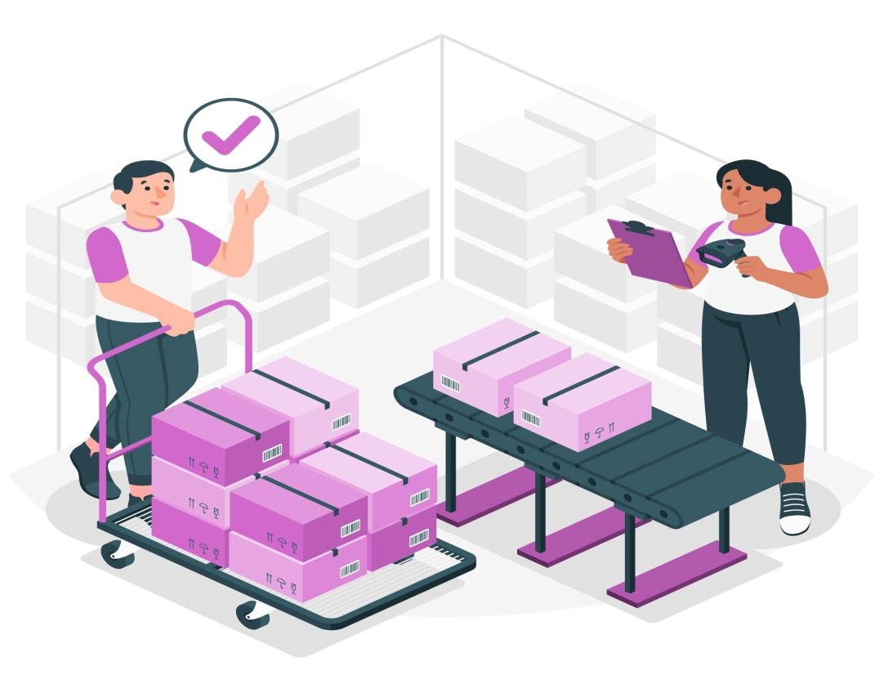
Retail store inventory Data Analysis

Slide 2
Introduction
This project focuses on analyzing and optimizing inventory management to enhance operational efficiency and boost sales. By evaluating key metrics such as sales trends, inventory-to-sales ratios, seasonal patterns, and the impact of promotions, the project aims to provide actionable insights for better inventory forecasting and stock management. The goal is to reduce overstocking, prevent stockouts, and ultimately improve revenue and customer satisfaction across various product categories.

Slide 3
The problem it solves is inefficient inventory management, which can lead to
overstocking, stockouts, and inaccurate demand forecasting.
This project aims to:
Optimize Inventory Levels: By analyzing historical sales data, seasonal trends, and
regional performance, it helps ensure that inventory levels are aligned with actual
demand, reducing excess stock and minimizing the risk of stockouts.
Improve Forecasting: The project uses data-driven insights to enhance demand
forecasting, allowing businesses to predict inventory needs more accurately and avoid
overstocking or understocking.
Increase Revenue and Reduce Costs: By optimizing stock levels and improving
restocking strategies, the project aims to enhance revenue by ensuring high-demand
products are always available while reducing costs associated with excessive inventory
and storage.
In essence, the project helps businesses streamline their inventory management
process, leading to cost savings, improved sales performance, and better overall
operational efficiency.

Slide 4
Objectives
Category-Wise Inventory Summary
Category-Wise Inventory to sale ratio
Regional Inventory Insights
Monthly sales trends
Identify Fast-Moving Products
Identify Slow-Moving Products
Overstock Analysis
Stock out Risk Analysis
Seasonal Trends
Holiday/Promotion Impact
Weather Condition Analysis
Competitor Price Analysis
Discount Effectiveness
Total Revenue by Category

Slide 5
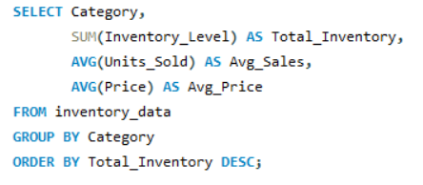
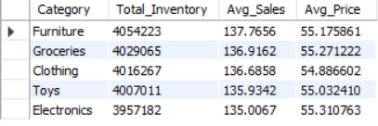
Category-Wise Inventory Summary

Slide 6
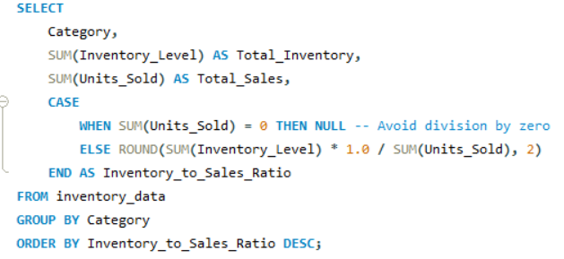
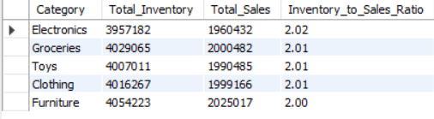
Category-Wise Inventory to sale ratio
Reducing the inventory-to-sales ratio from 2 to 1.6 represents a 20% reduction, improving inventory efficiency while maintaining alignment with sales demand. This reduction minimizes holding costs, optimizes cash flow, and reduces the risk of overstock. It's a strategic move to balance cost savings with customer demand fulfillment.

Slide 7
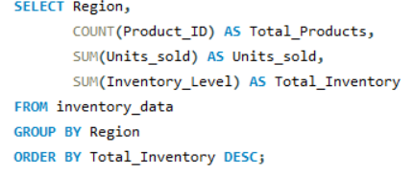
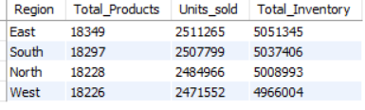
Regional Inventory Insights
The number of total products and units sold is very similar across all regions, suggesting a balanced distribution of demand and supply.
The East region holds the highest inventory level (5,051,345) despite having similar total products and units sold as the other regions. This could indicate overstocking or slower inventory turnover in the East.

Slide 8
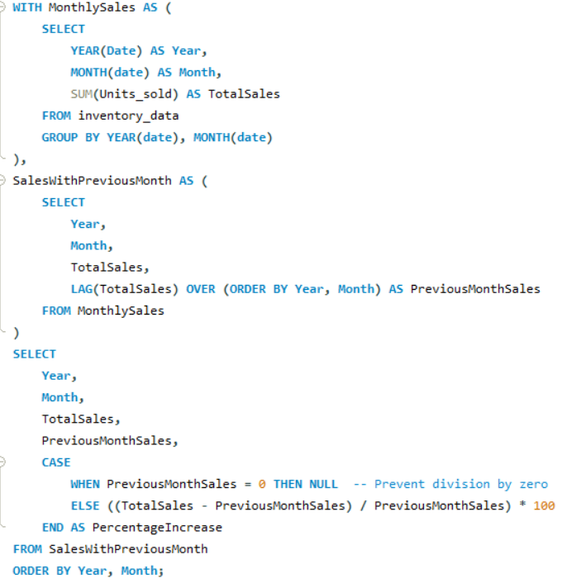
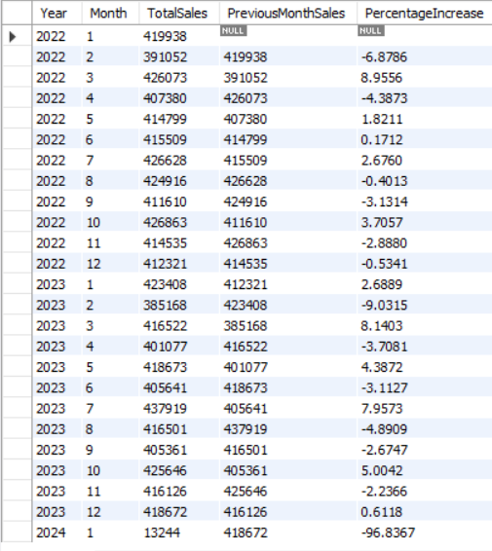
Monthly sales trends

Slide 9
Monthly sales trends
Volatility in Monthly Changes:
There are significant fluctuations in month-over-month percentage changes. For example:
February 2023: A sharp drop of -9.03%.
July 2023: A strong increase of 7.96%.
January 2024: An extreme decline of -96.83%, indicating a potential anomaly or external factor (e.g., operational issues or reporting errors).
Despite the month-to-month fluctuations, the overall trend from 2022 to late 2023 appears relatively stable, with changes typically ranging between -5% and +8%, reflecting consistent demand and operations.
The drastic drop in January 2024 is highly unusual. It could indicate an operational disruption, a significant demand drop, or a data issue.

Slide 10
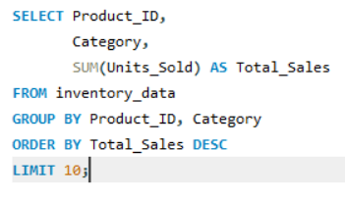
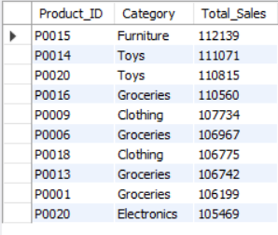
Identify Fast-Moving Products
The fast-moving products are primarily from categories like Toys, Groceries, and Clothing, with the highest sales observed for Furniture (P0015) at 112,139 units. The consistent presence of multiple Groceries products indicates strong demand in this category. Prioritize restocking and promotional strategies for these top-performing products to sustain sales momentum.

Slide 11
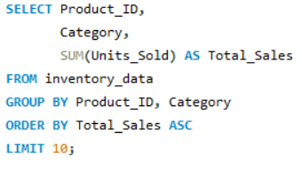
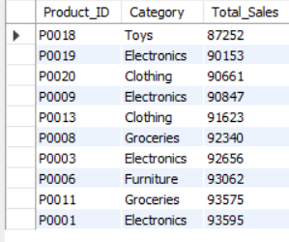
Identify Slow-Moving Products
The slow-moving products are primarily from Electronics and Clothing, with the lowest sales observed for Toys (P0018) at 87,252 units. The repeated appearance of Electronics products suggests potential overstock or low demand in this category. Consider evaluating pricing strategies or running targeted promotions to boost sales for these slow-moving items.

Slide 12
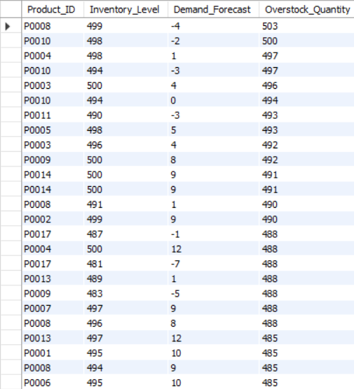
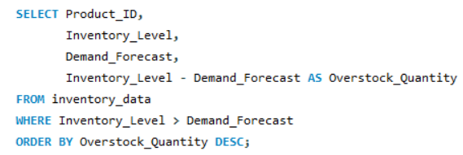
Overstock Analysis
Addressing these overstocked products can optimize storage and reduce costs. Prioritizing inventory adjustments for these items will improve overall efficiency.

Slide 13
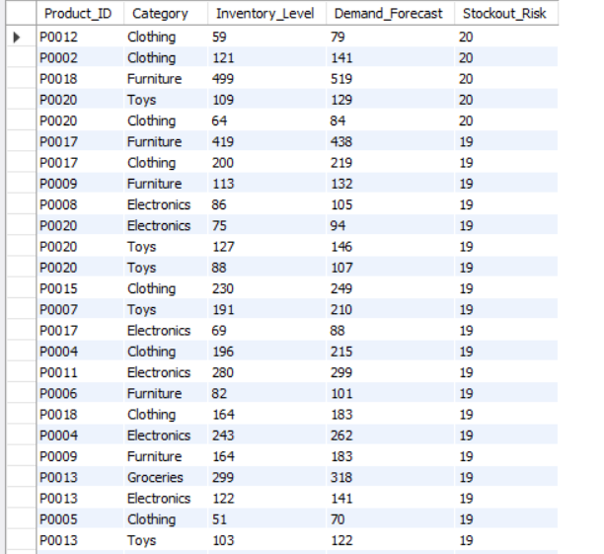
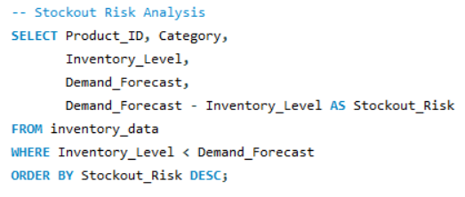
Stock out Risk Analysis
Addressing stock-out risks can prevent missed sales opportunities, while prioritizing restocking ensures customer satisfaction and maintains revenue flow.

Slide 14
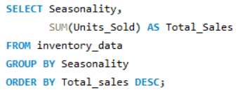
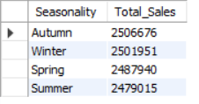
Seasonal Trends
The seasonal sales data reveals that Autumn recorded the highest sales with 2,506,676 units, followed closely by Winter at 2,501,951 units. Spring and Summer had comparatively lower sales, indicating a potential opportunity to enhance sales strategies during these seasons.

Slide 15
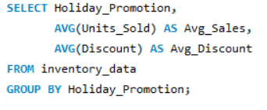

Holiday/Promotion Impact
However, the impact on demand variability (10.0155 vs. 10.0034) is negligible, suggesting that promotions have a limited effect on overall demand dynamics.

Slide 16
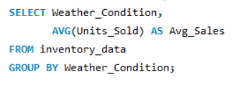
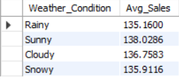
Weather Condition Analysis
The analysis shows that there is minimal impact of weather conditions on sales, as the sales figures for rainy, sunny, cloudy, and snowy days are relatively close.

Slide 17
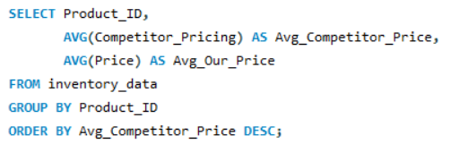
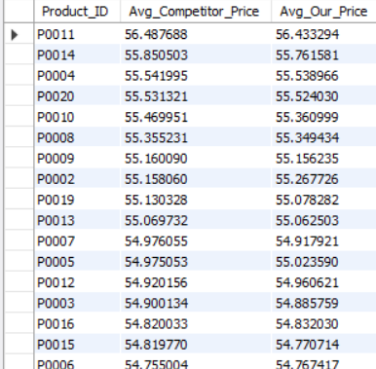
Competitor Price Analysis
Compared to competitor prices, the difference is negligible, so offering discounts and promotions on slow-moving products could help boost sales.

Slide 18
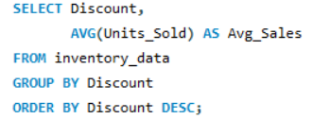
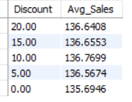
Discount Effectiveness
The analysis shows that discounts have a minimal impact on sales, with the highest sales occurring at a 10% discount (136.77). As the discount decreases to 5% or increases to 20%, the sales figures remain relatively stable.

Slide 19
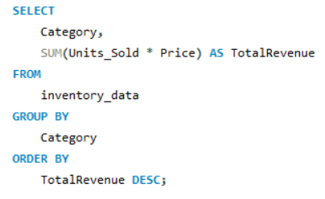
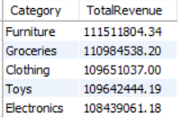
Total Revenue by Category
The total revenue analysis shows that Furniture leads with the highest revenue at $111.5 million, followed closely by Groceries at $111 million. Clothing, Toys, and Electronics contribute similar revenue levels, indicating a strong performance across these categories. Focusing on these high-revenue categories could help sustain growth.

Slide 20
Conclusion: The data reveals consistent sales across regions and categories, with seasonal trends and minimal weather impact on sales. Furniture and Groceries are the highest revenue-generating categories, while slow-moving products could benefit from promotions. Discounts show a small effect on sales, suggesting other factors should be prioritized for inventory management. Tips to Improve Inventory: Optimize Stock Levels: Align inventory with actual sales data to prevent overstocking and stockouts, particularly in high-revenue categories like Furniture and Groceries. Focus on Slow-Moving Products: Implement targeted promotions and discounts for slow-moving products to clear excess inventory and improve turnover. Adjust Seasonal Stocking: Plan inventory according to seasonal trends, ensuring that stock levels are sufficient for peak seasons like Autumn and Winter. Monitor Competitor Pricing: Regularly compare your pricing with competitors and adjust discounts or promotions to remain competitive without sacrificing profitability.

