Slide 1
Product Safety: What Sends People to the ER
Predicting severe consumer product-related injuries using CPSC NEISS data
Rohith Yarramshetty
Product Safety: What Sends People to the ER
1
Notes:
About 45 seconds. Say the project title and your name.

Slide 2
Introduction:
What I wanted to understand
I analyzed consumer product-related injuries treated in emergency departments.
I looked for patterns linked to severe injuries.
I built two models to classify injury records as severe or non-severe.
My main finding was that older adults had the highest observed severe-injury rate in the age groups I analyzed.
Product Safety: What Sends People to the ER
2
Notes:
About 1 minute. Describe the project in plain language.

Slide 3
Problem statement
Why this question matters
Some consumer product-related injuries are more serious than others.
Safety teams need evidence to understand which cases and groups may need more attention.
My question: Can NEISS injury records help identify patterns linked to severe injuries?
The data shows injury patterns; it does not prove that a product caused an injury.
Product Safety: What Sends People to the ER
3
Notes:
About 1 minute. Explain the problem and research question.

Slide 4
Where did I get the data?
2024 National Electronic Injury Surveillance System (NEISS)
Source: U.S. Consumer Product Safety Commission (CPSC).
The notebook contains 361,672 injury records.
Variables include age, sex, product code, diagnosis, body part, disposition, and injury narrative.
NEISS is based on a sample of emergency departments, not every injury in the country.
Data source: https://www.cpsc.gov/Research--Statistics/NEISS-Injury-Data
Product Safety: What Sends People to the ER
4
Notes:
About 1 minute. Name CPSC NEISS and describe what the records contain.

Slide 5
Data preprocessing
Steps I took before modeling
Checked the dataset structure, variables, missing values, and duplicate records.
Cleaned invalid age values and created age groups.
Created Severe_Injury from the Disposition variable.
Used 1 for severe (disposition codes 4, 5, and 6) and 0 for the other records.
Filled missing age values with the median for model training.
Product Safety: What Sends People to the ER
5
Notes:
About 1.5 minutes. Explain cleaning, age groups, target creation, and median imputation. Verify disposition-code meaning if asked.

Slide 6
The target variable
Most records were labeled non-severe
Severe: 48,823
Non-severe: 312,849
The classes are imbalanced, so accuracy alone is not enough.
Product Safety: What Sends People to the ER
6
Notes:
About 1 minute. Explain that the target is imbalanced: only 48,823 records are labeled severe.

Slide 7
How I used both models
I trained and tested both models on the same data so I could compare their results.
Logistic Regression
• I used it as my starting model because it is a common, easier-to-understand classifier.
• It estimated whether each injury record was severe or non-severe using the selected patient, injury, product, and incident details.
• I paid attention to recall because finding more severe cases was important for this project.
Random Forest
• I trained it as a second model to compare with Logistic Regression.
• It combines many decision trees, allowing it to learn more complicated patterns in the data.
• I compared its test results with Logistic Regression using the same evaluation measures.
For both models: 80% training data • 20% testing data • class imbalance was taken into account

Slide 8
The two models I used
Both models classify records as severe or non-severe
Logistic Regression: a common baseline model that estimates the chance of a severe outcome.
Random Forest: combines many decision trees and can learn more complex patterns.
I used an 80% training set and a 20% test set.
I compared accuracy, precision, recall, F1-score, and ROC-AUC.
Product Safety: What Sends People to the ER
7
Notes:
About 1 minute. Explain both models and the train/test split.

Slide 9
Comparing the two models
Recall is especially important for this project
Product Safety: What Sends People to the ER
8
Notes:
About 2 minutes. Walk through the metric chart. Logistic Regression recall is about 70%, Random Forest about 37%.

Slide 10
Which model is better for my goal?
It depends on what we want the model to do
Logistic Regression recall: about 70%.
Random Forest recall: about 37%.
Recall tells us how many of the actual severe cases the model finds.
I chose Logistic Regression for this project because I wanted to catch more severe cases.
Trade-off: Logistic Regression has lower precision, so it produces more false alarms.
Product Safety: What Sends People to the ER
9
Notes:
About 1.5 minutes. Explain why recall mattered for your project, and acknowledge false positives.

Slide 11
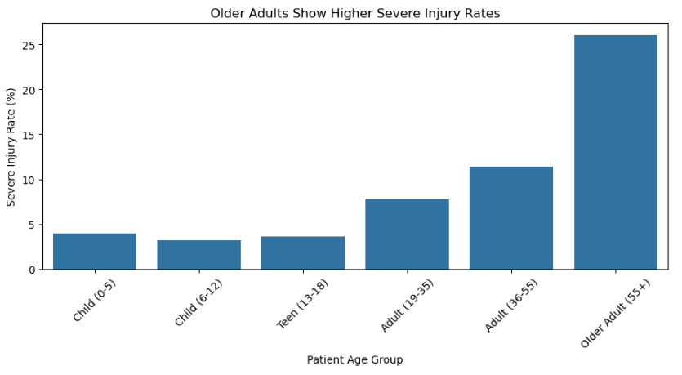
Main finding: older adults had the highest rate
Redesigned chart from my Week 5 assignment
What I found
The older-adult group (55+) had the highest observed severe-injury rate.
The analysis did not use NEISS statistical weights.
Product Safety: What Sends People to the ER
10
Notes:
About 1.5 minutes. Explain the actual redesigned chart from Week 5. Rates are unweighted.

Slide 12
Limitations and conclusion
What I learned from this project
The age-group rates need to be checked using NEISS statistical weights.
The data does not show how many people use each product, so I cannot call one product the most dangerous.
The results show an association, not proof that age causes severe injury.
Next, I would improve categorical preprocessing, validate the models, and explore narrative text features.
Overall, the results suggest that older adults deserve attention in further injury-prevention research.
Product Safety: What Sends People to the ER
11
Notes:
About 1.5 minutes. Be honest about limitations and future improvements.

Slide 13
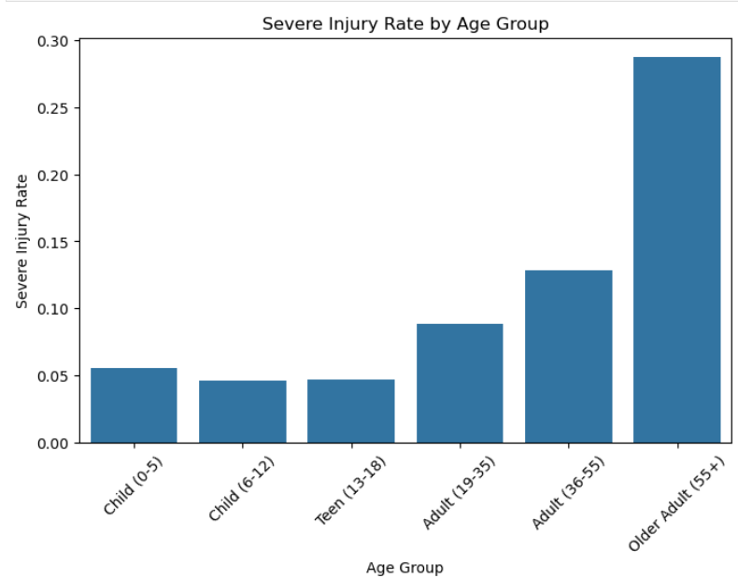
Appendix: chart before and after
Week 5 chart redesign
Original chart
Redesigned chart
Product Safety: What Sends People to the ER
12
Notes:
Use only if asked how the chart was improved: clearer title, percentage units, labels, and zero baseline.

