Slide 1

Department of Master of Computer Applications
Common Phishing Attacks and Prevention
By
Rohit Kulkarni
1MS24MC087
Under the Guidance of
Dr. Shazia Mannan
Assistant Professor

Slide 2

Agenda
Introduction
Social Impact
Implementation
Impact of Credential Theft
Prevention Techniques
Best Security Practices
Conclusion
References

Slide 3
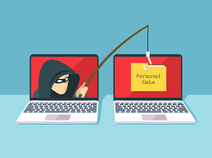
Introduction
Phishing:
Phishing is a type of cyberattack in which attackers deceive users into revealing sensitive information such as usernames, passwords, OTPs, banking details, and social media credentials. These attacks are commonly carried out through fake emails, fraudulent websites, SMS messages, or social media platforms that appear legitimate to the victim. Phishing attacks mainly rely on social engineering techniques, where attackers manipulate human trust, fear, curiosity, or urgency to trick users into taking harmful actions. According to various cybersecurity reports, phishing remains one of the leading causes of account compromise and data theft worldwide.

Slide 4
Introduction
Common Types of Phishing:
Email Phishing — Fake emails pretending to be from trusted companies.
Spear Phishing — Personalized phishing attacks targeting specific individuals.
Clone Phishing — Copy of a legitimate email with malicious links added.
Smishing — Phishing through SMS or mobile messages.
Vishing — Voice-call-based phishing attacks.
Social Media Phishing — Fake login alerts, copyright warnings, or verification requests.

Slide 5
Introduction
Technical Characteristics of Phishing
Uses social engineering and protocol abuse.
Commonly exploits SMTP, HTTP/HTTPS, and DNS protocols,
Relies on credential harvesting techniques.
Often hosted on spoofed or obfuscated domains.

Slide 6
Social Impact
Psychological Impact
Victims often experience stress, fear, anxiety, and loss of trust after account compromise.
Personal conversations, photos, and private information may be exposed publicly.
Financial Impact
Stolen social media accounts are sometimes used for online scams and fraud.
Victims may suffer monetary losses due to linked payment accounts or fake fundraising scams.
Impact on Individuals
Identity theft and impersonation damage personal reputation.
Compromised accounts may spread phishing links to friends and family.
Impact on Organizations
Employees falling for phishing attacks can expose company systems and confidential data.
Organizations may face financial loss, operational disruption, and reputational damage.
Impact on Society
Large-scale phishing campaigns reduce trust in digital communication platforms.
Cybercrime activities continue to increase due to lack of cybersecurity awareness among users.

Slide 7
Social Impact
Technical Consequences
Session hijacking
Credential reuse attacks
Unauthorized API access
Malware delivery through compromised accounts
Botnet-based phishing campaigns

Slide 8
Implementation
Step 1 — Fake Email Creation
Attacker designs a professional-looking email using Instagram logos and branding.
Step 2 — URL Masking
Malicious links are hidden behind legitimate-looking text.
Step 3 — Victim Clicks the Link
User trusts the email and opens the fake website.
Step 4 — Credential Theft
Username and password are entered into the fake login page.
Step 5 — Unauthorized Access
Attacker uses stolen credentials to access the victim’s account.

Slide 9
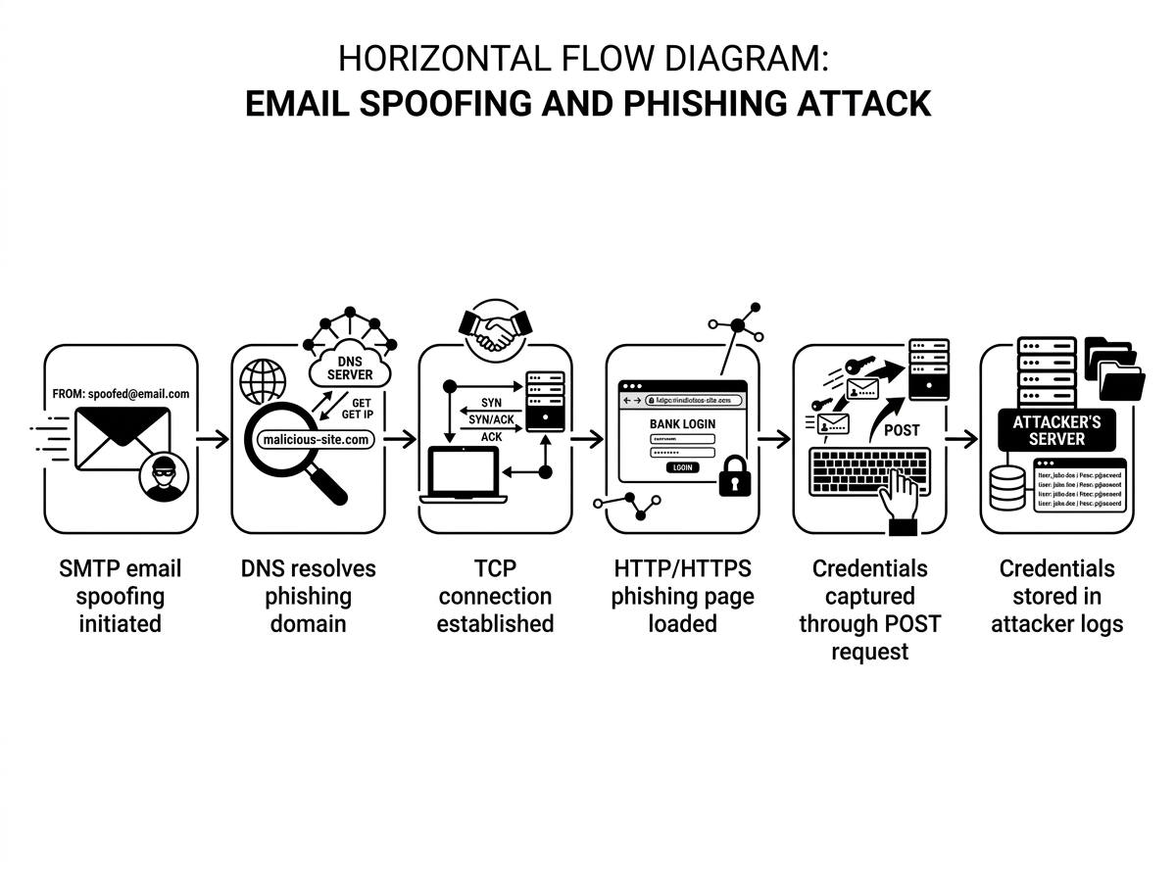
Implementation – Technical Flow of Attack

Slide 10
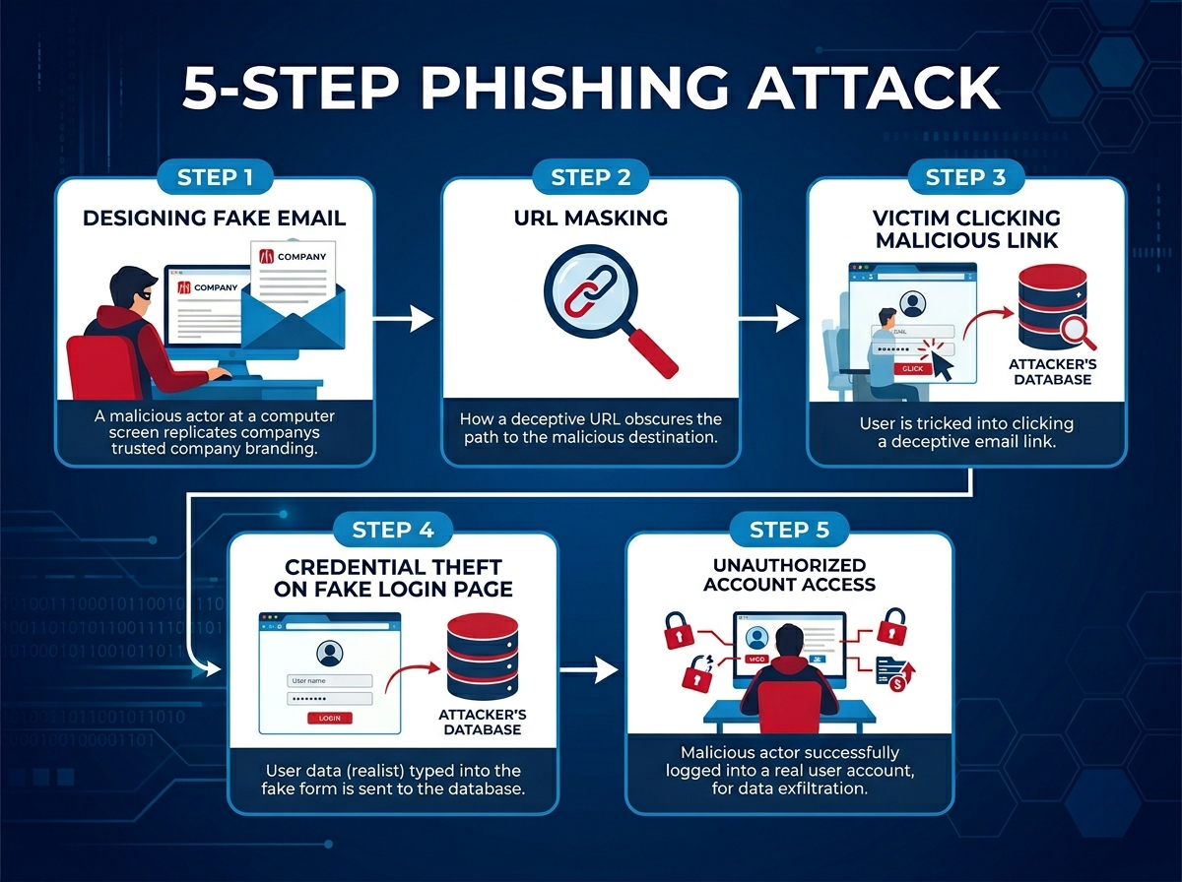
Implementation – Flow of attack

Slide 11
Implementation – Tools Used
Tools | Purpose
Oracle Virtual Box | Attack Hosting
Zphisher Tool | Phishing Simulation
Emkei Mailer | Email Spoofing
Internet Browser | Link Inspection

Slide 12
Functionality of Tools used:
Oracle Virtual Box
Used to host Ubuntu VM which provides an isolated and secure environment to safely host and demonstrate phishing attack simulations without affecting the main operating system.
Zphisher
Emkei Mailer
Uses PHP server to host phishing pages.
Captures credentials through HTML form submission.
Supports tunneling services like Cloudflared.
Demonstrates SMTP sender spoofing.
Shows weakness in email authentication systems.

Slide 13
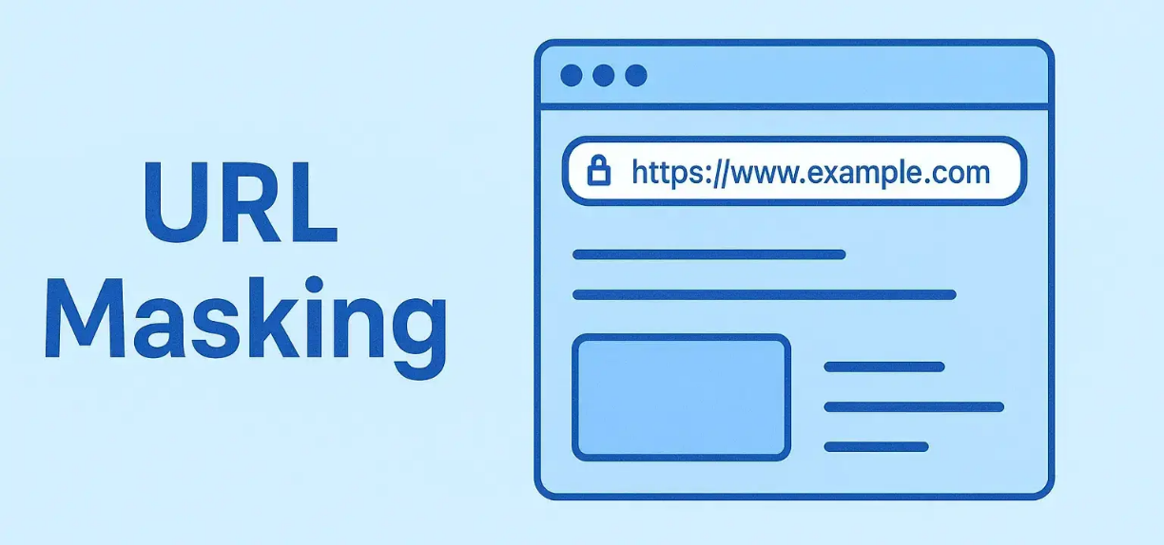
Example of a Masked Link
Displayed Link:
https://instagram-security-help.com
Actual Destination:
http://instagrarn-security-help.com
Observation:
User only sees the displayed text.
Hidden URL redirects to attacker website.
Small spelling changes are difficult to notice.
rn = m

Slide 14
Impact of Credential Theft
Unauthorized access to social media accounts.
Identity theft and impersonation .
Financial scams using compromised accounts.
Privacy breaches involving chats and personal data.
Malware spreading through hacked accounts .
Reputation damage for victims .

Slide 15
Prevention Techniques
User-Level Prevention
Verify sender email addresses carefully.
Hover over links before clicking.
Avoid logging in through email links.
Enable Multi-Factor Authentication (MFA).
Use strong and unique passwords.
Technical Prevention
AI-based phishing detection
Heuristic URL analysis
Threat intelligence feeds
Browser reputation systems
Sandboxing suspicious links

Slide 16
Best Security Practices
Use password managers –
Password managers generate and securely store strong unique passwords for different accounts.
Regularly update passwords –
Changing passwords frequently reduces the risk of long-term account compromise.
Enable login alerts –
Login notifications help users quickly detect unauthorized account access attempts.
Avoid public Wi-Fi for sensitive logins –
Public networks are vulnerable to interception and cyberattacks.
Keep browsers and systems updated –
Software updates patch security vulnerabilities that attackers may exploit.
Conduct cybersecurity awareness training –
User awareness training helps individuals identify and avoid phishing attacks.

Slide 17
Conclusion
Phishing attacks remain one of the biggest cybersecurity threats today.
Fake masked links are highly effective because they exploit human trust.
Social media accounts are frequent targets due to widespread usage.
User awareness combined with technical security controls can significantly reduce phishing risks.
Prevention through education is the strongest defense against phishing attacks.

Slide 18
References
[1] Anti-Phishing Working Group (APWG), Phishing Activity Trends Report.
[2] Google, Google Safe Browsing: Protecting Users from Dangerous Websites.
[3] National Institute of Standards and Technology (NIST), Cybersecurity Framework and Phishing Guidance.
[4] Verizon, 2025 Data Breach Investigations Report (DBIR).
[5] Jain, A. K., and Gupta, B. B., “Towards Detection of Phishing Websites, Springer, 2018.
[6] IEEE Xplore Digital Library, Understanding Phishing Attacks and Countermeasures.

Slide 19
Thank You

