Slide 1
Pay slip generator using html,css and javascript
Rohit K
karpuramrohit@gmail.com
3/4 IT B.tech,Andhra University

Slide 2
PROJECT OVERVIEW
INTERNSHIP ROLE:INTERN AT SYMBIOSIS TECHNOLOGIES
PROJECT DURATION:MAY-JUN,24
OBJECTIVE:TO CREATE A WEBSITE THAT AUTOMATES THE PAYSLIP GENERATION WITH THE HELP OF EMPLOYEE NUMBER
TOOLS USED:
HTML
CSS
JAVASCRIPT

Slide 3
IMPORTANCE OF HTML
HTML (Hypertext Markup Language) is the standard language used to create and
structure content on the web. Here are some key reasons why HTML is important:
1. Foundation of Web Pages
HTML provides the basic structure of web pages, allowing text, images, videos, and other content to be displayed in browsers. Without HTML, there would be no standardized way to create web pages.
2. Semantics and Accessibility
HTML uses semantic elements (like <header>, <footer>, <article>, etc.) to give meaning to web content. This helps search engines and assistive technologies (like screen readers) understand and interpret the content better, improving SEO and accessibility.
3. Interactivity with CSS and JavaScript
HTML works alongside CSS (Cascading Style Sheets) and JavaScript to create visually appealing and interactive web experiences. While HTML structures the content, CSS styles it, and JavaScript adds dynamic behavior.
4. Cross-Platform Compatibility
HTML is a platform-independent language, meaning web pages created using HTML can be viewed on any device with a web browser, including desktops, smartphones, tablets, and more.
5. Web Development Standards
HTML is maintained by the World Wide Web Consortium (W3C) and the Web Hypertext Application Technology Working Group (WHATWG), ensuring that it evolves to meet the needs of modern web development.

Slide 4
IMPORTANCE OF CSS
CSS (Cascading Style Sheets) is a critical technology in web development that enhances the presentation and design of web pages. Here’s why CSS is important:
1. Separation of Content and Design
CSS separates the content of a web page (HTML) from its visual presentation, allowing developers to manage and style the layout, colors, fonts, and other visual aspects independently. This separation makes content easier to manage and update.
2. Consistency Across Pages
By using external CSS files, you can ensure a consistent look and feel across multiple web pages. This makes the website more professional and cohesive, as the same styles can be applied universally.
3. Responsive Design
CSS allows developers to create responsive designs that adapt to different screen sizes and devices, such as smartphones, tablets, and desktops. Media queries and flexible grid layouts enable content to be displayed optimally on any device.
4. Improved User Experience
A well-designed CSS layout enhances user experience by making websites more visually appealing and easier to navigate. Good design can increase user engagement and retention.
5. Accessibility
CSS can improve web accessibility by providing options to hide or reveal content, adjust font sizes, and control color contrast, making websites more usable for people with disabilities.

Slide 5
IMPORTANCE OF JAVASCRIPT
JavaScript (JS) is a versatile and essential programming language that plays a key role in modern web development. Here are some reasons why JavaScript is important:
1. Interactivity and Dynamic Content
JavaScript enables the creation of interactive and dynamic web pages. It allows developers to build features like image sliders, form validations, drop-down menus, modal windows, and real-time content updates without requiring a page reload.
2. Client-Side Functionality
JavaScript runs directly in the user’s browser, providing immediate feedback and interactions. This client-side execution reduces server load and allows for faster, more responsive user experiences.
3. Asynchronous Programming (AJAX)
JavaScript enables asynchronous communication with servers through technologies like AJAX (Asynchronous JavaScript and XML). This allows web pages to fetch data in the background and update parts of the page without reloading the entire page, enhancing performance and user experience.
4. Cross-Platform Compatibility
JavaScript is platform-independent, running on all major browsers and operating systems. This makes it a universal language for web development, ensuring that applications work consistently across different environments.
5. Full-Stack Development
With the rise of Node.js, JavaScript is no longer limited to client-side development. It can be used for server-side programming as well, enabling full-stack development. This unification allows developers to use a single language across the entire web development stack.

Slide 6
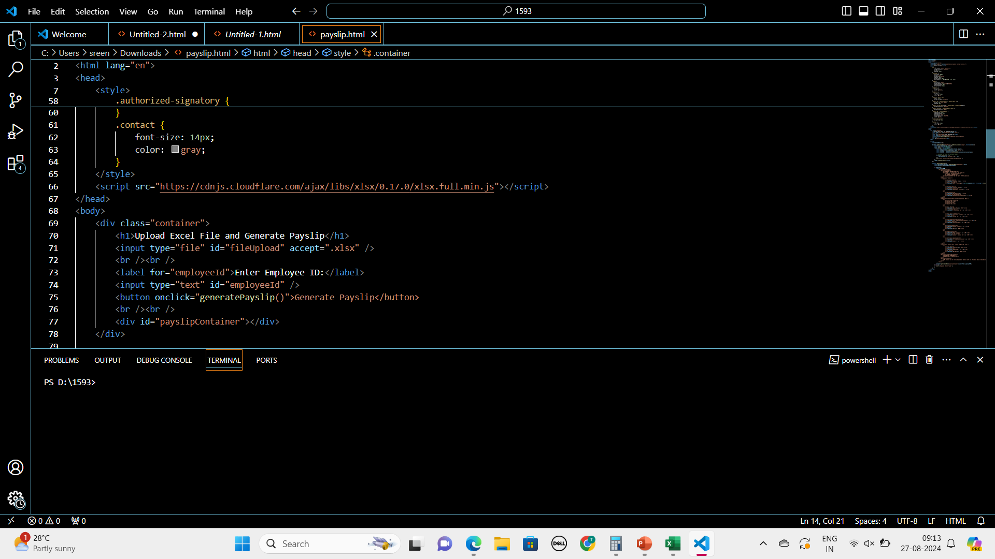
Packages used in creation
External JavaScript Library
SheetJS (XLSX): The program uses the xlsx.full.min.js library from the SheetJS project, which is loaded via a CDN. This library allows the program to
read and parse Excel files in .xlsx format, making it possible to extract and manipulate data from uploaded files.

Slide 7
functionality
JavaScript Functionality
File Upload Handling:
A change event listener on the file upload input triggers the reading of the uploaded Excel file.
The FileReader reads the file as an array buffer.
XLSX.read() is used to parse the file, converting it into JSON data.
Employee data is stored in an employeeData object, keyed by employee IDs.
Generate Payslip:
When the "Generate Payslip" button is clicked, the generatePayslip() function is called.
The function retrieves the employee data corresponding to the entered employee ID.
If the employee ID is found, a payslip is generated using the data and displayed in the payslipContainer div.
If not, an alert is shown.

Slide 8
Use cases
Payroll Processing
Payroll Automation: Payroll teams can upload bulk employee data and quickly generate payslips for the entire organization, ensuring consistency and accuracy.
Deductions and Taxes: The application could be expanded to calculate taxes, provident funds, or other deductions, making it a comprehensive payroll solution.
Here it creates a ease to download the payslips without any external source
Record Keeping: The generated payslips serve as official records for both employers and employees, useful during audits, compliance checks, or financial assessments.

Slide 9
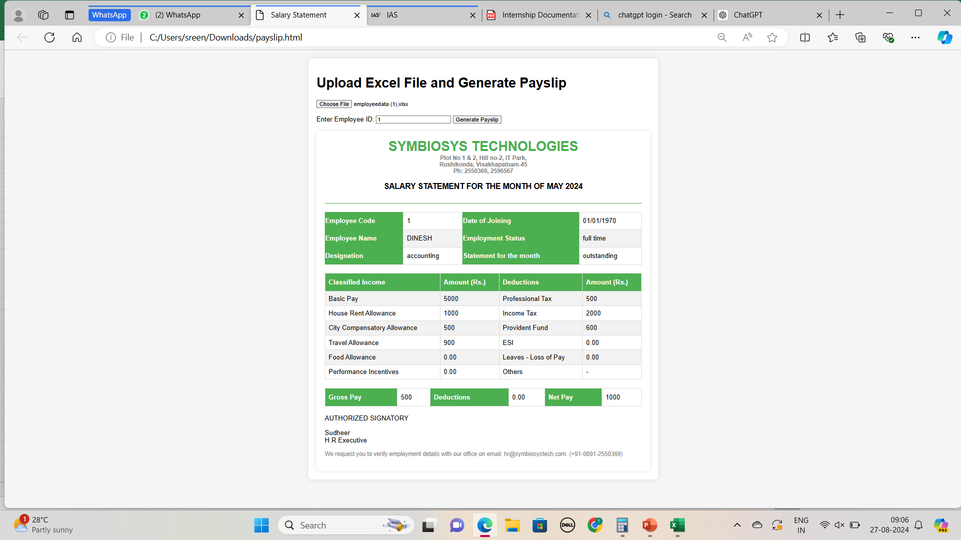
Output:

