Slide 1
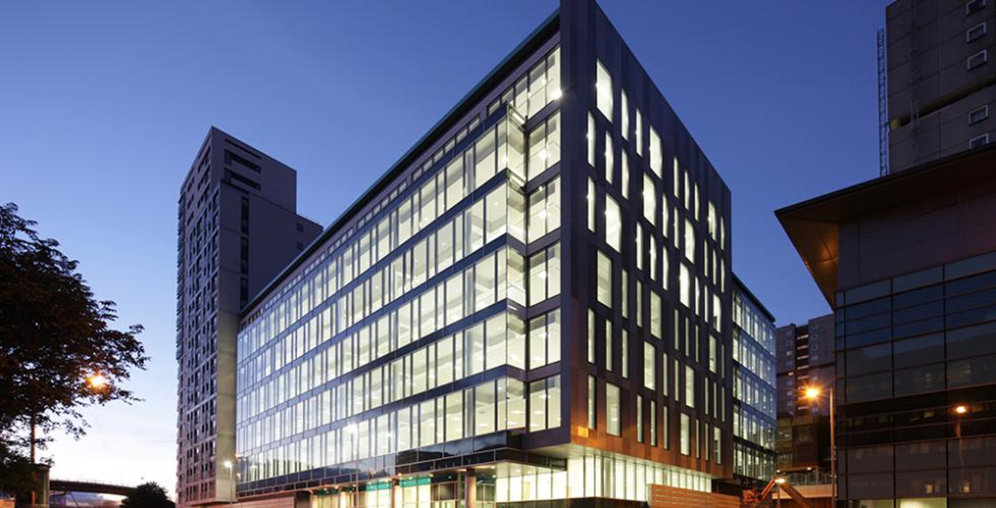
SAS Scotland
Leaders of Analytics

Slide 2
SAS
What do we do as a company?
Our software helps organizations collect, analyze and visualize data across a range of industries.
Banking
Education
Health Care
Insurance
Life Sciences
Manufacturing
Public Sector
Retail & Consumer Goods
Small & Midsize Businesses
Telecom & media

Slide 3

SAS
Some statistics
50 Years of analytics innovation
12,000+ Employees across 140 countries
1,400+ Partners

Slide 4
SAS
Some info about SAS in Glasgow!
SAS acquired a Scottish company, Memex, in 2010
Glasgow office headcount has grown 40% in the last two years
We’re Located on Argyle Street, 5 minutes away from Glasgow Central
Hybrid working
Glasgow office is one of the three main SAS R&D centers

Slide 5
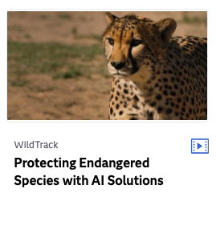

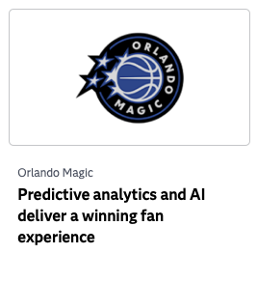

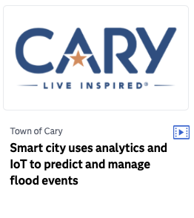
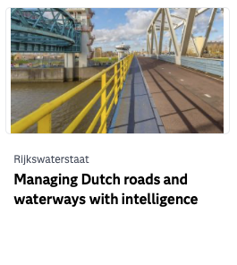


Some SAS Stories

Slide 6
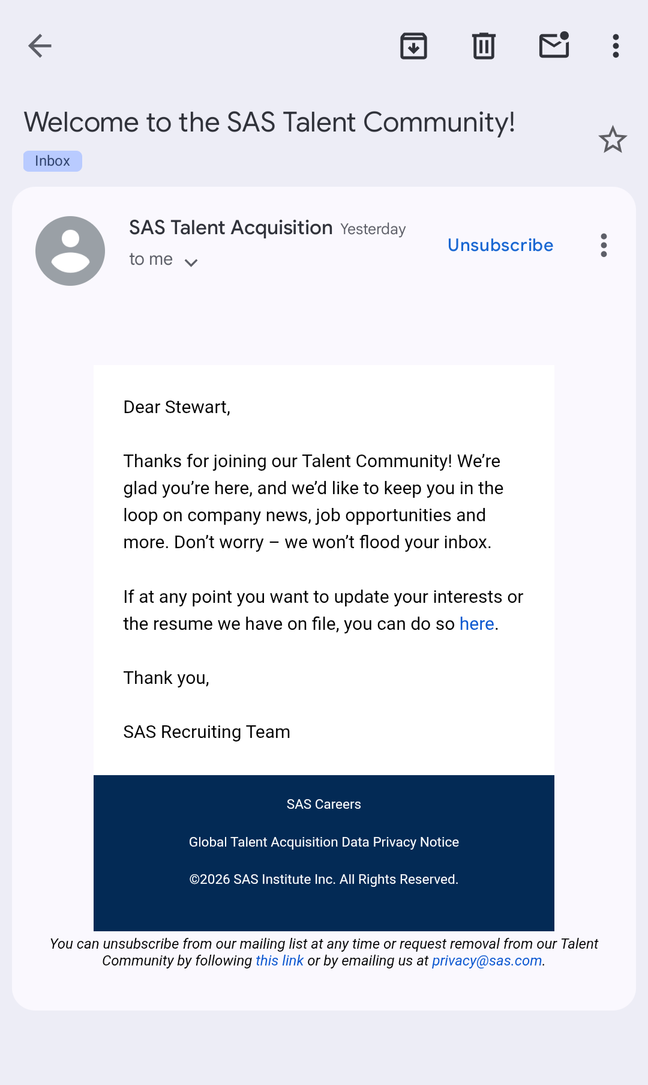
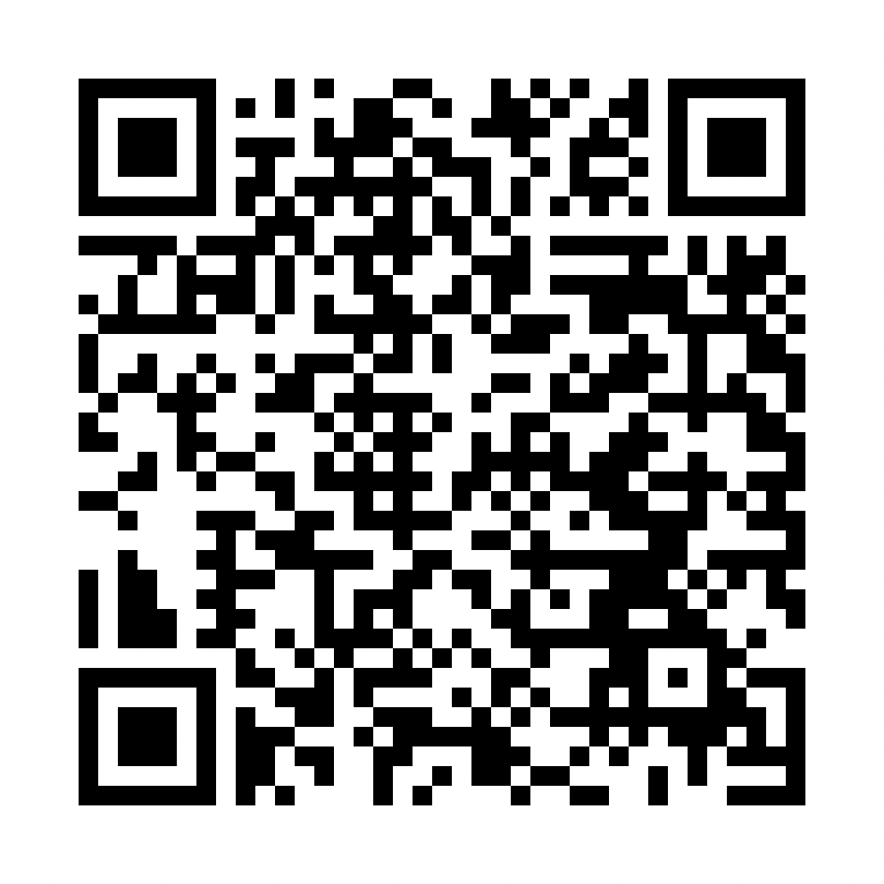
Internship Applications
If you’re looking for a dynamic, fulfilling internship coupled with flexibility and world-class employee experience, you’ll find it here.

Slide 7
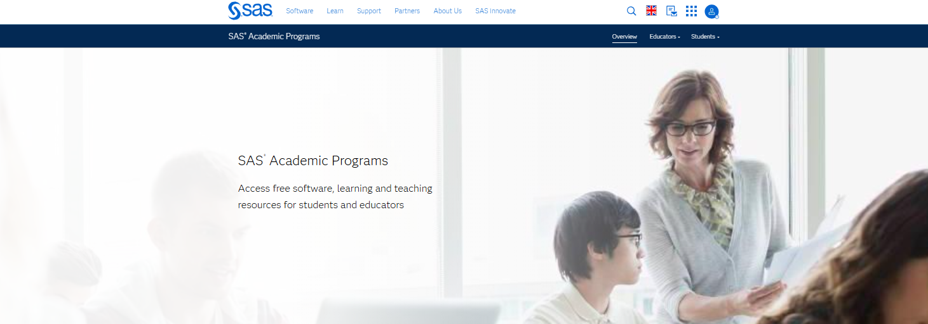
SAS Global Academic Program
Notes:
Our Global Academic Program is designed to help students build real-world analytics skills, get certified, and connect with employers. Let’s explore what’s available to you.”

Slide 8
Our Hackathon Challenge…

Slide 9
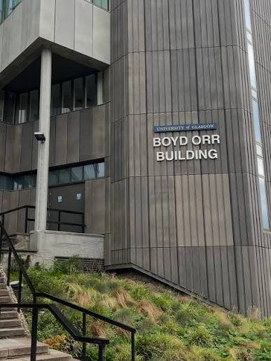
Challenge
Recognise this building?
Remember remember, the 5th of November, Gunpowder, treason, and a thousand fireworks in the Boyd Orr building!
Security at the University of Glasgow have received an anonymous tip which alerted them of a sinister plot to set off 1000 fireworks in the Boyd Orr Building.... this bonfire night!

Slide 10

Challenge
Security are on the case
The security team were fast at work, and collected security log data of student activity from the day prior, desperate to analyse and spot anything that looked out of place!
The security officers also interviewed a sample of the students to hear exactly what they were doing the day before, to ensure no suspicious behaviour was going on!

Slide 11

Challenge
Security encounter a problem…
Trying to correlate their logs and statements together is the point at which campus security’s investigation began to falter. The data is hard to work with given its multiple sources and unintuitive formats.
The campus security team needs a way to visualise their data clearly, ideally in ways that could help highlight inconsistencies.

Slide 12

Challenge
The challenge to you
Create a piece of software that can help campus security catch the conspirators!
Key Points:
Visualise the campus security data in the most creative ways possible
Use these visualisations to conclude who the conspirators are, and who the kingpin of the operation might be!

Slide 13

Challenge
Creativity is key!
Interactively show movement activity
Filter or showcase data using timelines
Graphs that show threats
Dashboard for a high-level overview
Entity Information (students, buildings)
Testimony annotation?
Reusability for future cases
Other tools useful for a security guard…
Solutions should have character!

Slide 14
Our side Challenge...

Slide 15
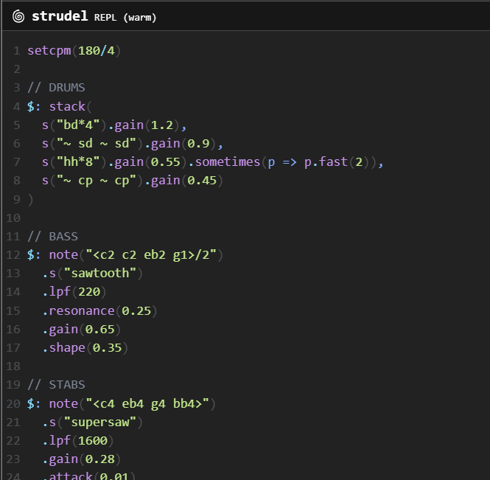
Algorave
Code a song using code ♫⋆｡♪ ₊˚♬ﾟ.
Code your own song in Studel, using the online IDE
Share your song with us, we’re excited to see what you can create!

Slide 16

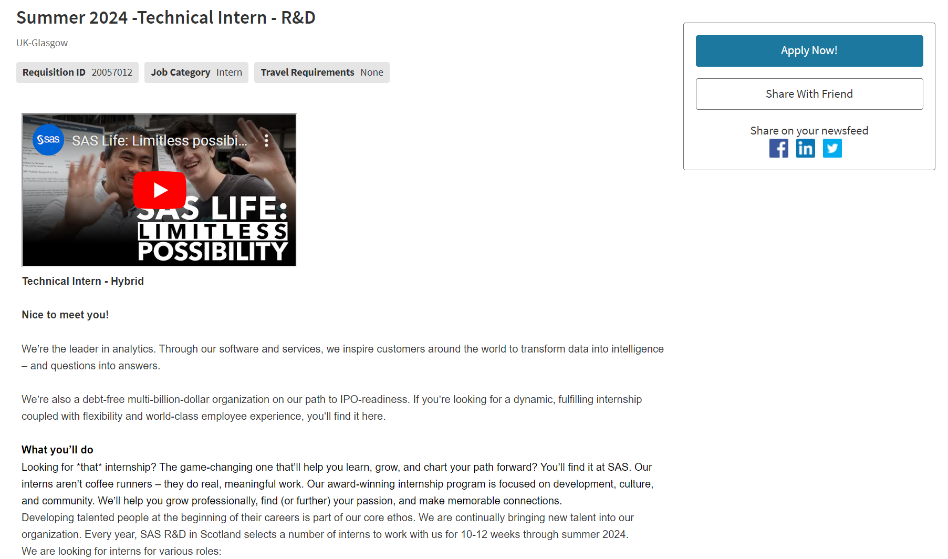
Internship Applications!
6
QR code will also be at our table… come see us with any questions!
Copyright © SAS Institute Inc. All rights reserved.
Notes:
Easy, relaxed process to apply! All we need is your CV no cover letter or other documents.

Slide 17
Let’s Chat!
?
We will be here all weekend!

