Slide 1

Customer Shopping Behavior Analysis
Uncovering insights from 3,900 purchases to guide strategic business decisions.

Slide 2
Dataset Overview
3,900
18
37
Transactions
Features
Missing Values
Purchase records analyzed
Data points per transaction
Review ratings imputed
Key features include customer demographics, purchase details, and shopping behavior metrics.

Slide 3

Revenue by Gender
Key Finding
Male customers generated $157,890 in revenue, while female customers generated $75,191.
This significant difference suggests gender-targeted marketing opportunities.

Slide 4
Product Performance Insights
Top-Rated Products
Most Discounted
Best Sellers
Gloves (3.86 avg)
Sandals (3.84 avg)
Boots (3.82 avg)
Hats (50% discounted)
Sneakers (49.66%)
Coats (49.07%)
Jewelry (171 orders)
Blouses (171 orders)
Pants (171 orders)

Slide 5

Shipping & Discount Analysis
Express Shipping
Average purchase: $60.48
Standard shipping: $58.46
Express drives higher-value purchases.
High-Spending Discount Users
839 customers used discounts while spending above average.
Discounts effectively drive volume without sacrificing revenue.

Slide 6
Subscription Impact
Subscriber Base
Revenue Generated
1,053 subscribers vs. 2,847 non-subscribers
Subscribers: $62,645
Average Spend
Non-subscribers: $170,436
Subscribers: $59.49
Key Insight
Non-subscribers: $59.87
Repeat buyers (over 5 purchases) show higher subscription rates.

Slide 7
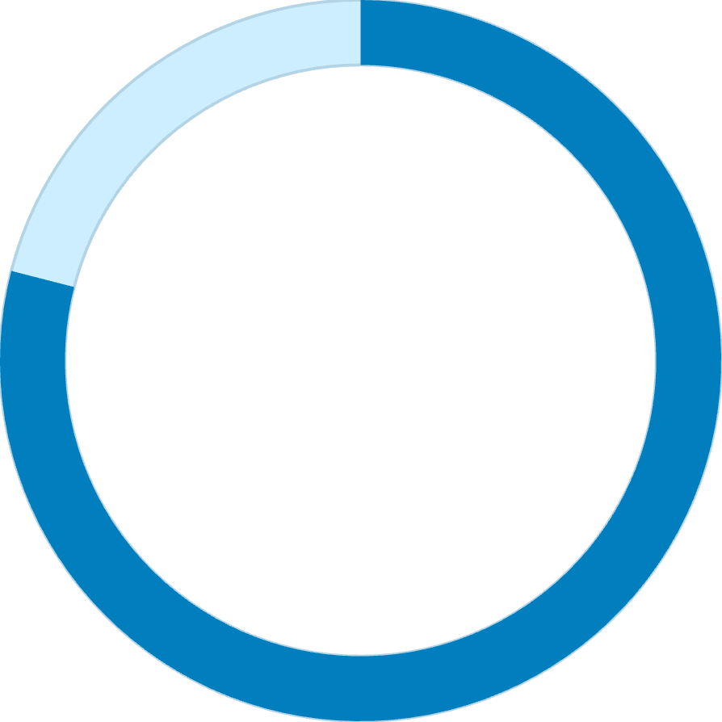
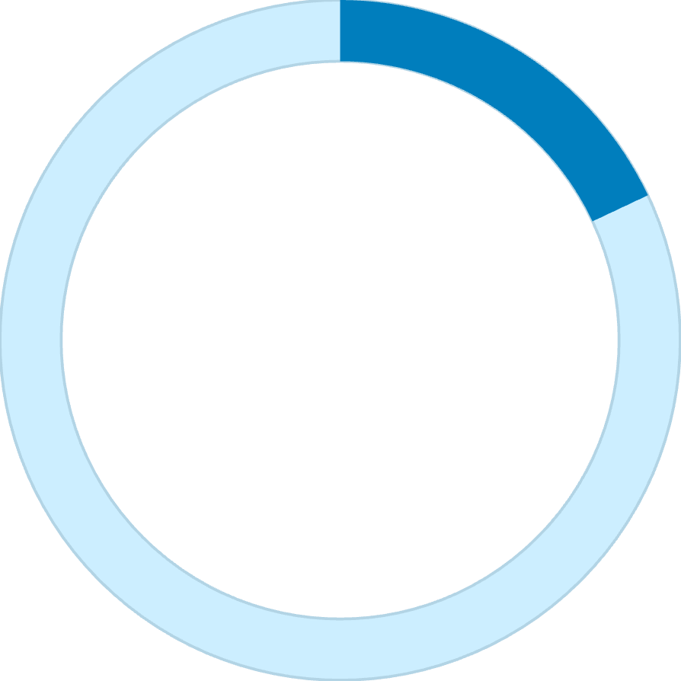

Customer Segmentation
79%
18%
2%
Loyal Customers
Returning
New
3,116 customers with consistent purchase history
701 customers making second purchases
83 first-time buyers in dataset

Slide 8
Revenue by Age Group
27%
25%
Young Adult
Middle-aged
$62,143 total revenue
$59,197 total revenue
24%
24%
Adult
Senior
$55,978 total revenue
$55,763 total revenue
Young adults drive the highest revenue, presenting a key target segment.

Slide 9
Power BI Dashboard
01
02
03
Interactive KPIs
Dynamic Filters
Visual Analytics
3.9K customers, $59.76 average purchase, 3.75 average rating
Subscription status, gender, category, and shipping type filters
Donut charts, bar charts, and horizontal bars for quick insights

Slide 10


Strategic Recommendations
Boost Subscriptions
Promote exclusive benefits to convert non-subscribers
Customer Loyalty Programs
Reward repeat buyers to move them into loyal segment
Review Discount Policy
Balance sales boosts with margin control
Targeted Marketing
Focus on high-revenue age groups and express-shipping users

