Slide 1

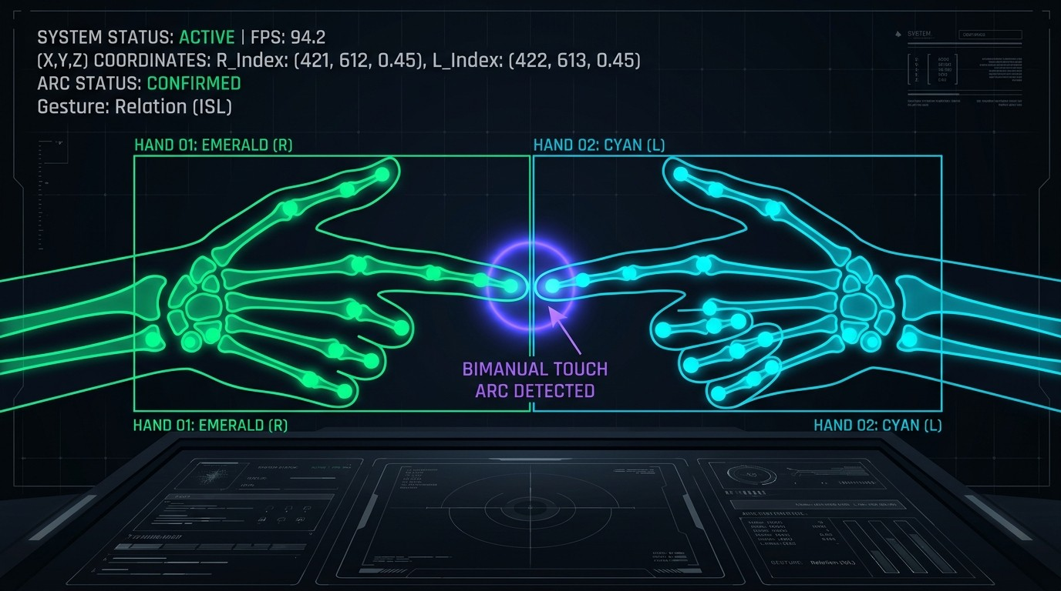
Real-Time Indian Sign Language Recognition and Bidirectional Translation System
B.Tech, Department of Information Technology
Rohit Kumar Gupta (IIT2023185)
Krishna Singh (IIT2023145)
Supervisor: Prof. Satish Kumar Singh
IIIT Allahabad, November 2026
Notes:
Introduce the project: a browser-based system that recognizes Indian Sign Language from a webcam and also translates speech, text and YouTube videos back into sign. Mention supervisor and co-author.

Slide 2



Why ISL needs a technology bridge
18M+
Hearing people rarely know ISL
Hospitals, banks, government desks and classrooms become barriers
people in India live with hearing and speech impairments
Too few certified interpreters
Signers fall back on family or written notes, losing privacy and independence
76%+
ISL is a complete language
Own grammar, with handshape, location, motion and facial markers
of ISL alphabet gestures need both hands
Notes:
18 million people in India live with hearing and speech impairments. ISL is a full language, and more than 76% of ISL alphabet gestures need both hands, which is why systems built for single-handed ASL do not transfer. The thesis cites an acute shortage of certified interpreters; the exact ratio differs between the abstract and the introduction, so quote the shortage qualitatively.

Slide 3



The problem and its constraints
ŷ = argmax P(c | X1:T), c ∈ C
Five research challenges
1
Two-hand occlusion
Under 50 ms per frame, 25+ FPS
2
Look-alike signs (D vs O, V vs W)
Plain webcam: no GPU, gloves or depth sensor
3
Flicker between signs
4
Lighting and background changes
Both directions: sign to text, and speech to sign
5
SOV grammar vs English SVO
Notes:
Formally: given a frame sequence X, choose the sign class c that maximizes P(c given X). Three constraints shape the design: under 50 ms per frame, a plain webcam, and both directions of translation. The five challenges on the right drive the feature design, the hysteresis state machine and the reverse pathway.

Slide 4
Four eras of sign language recognition
2015-18
2019-22
2022-25
2026+
Handcrafted features
CNNs on raw RGB
Landmarks and ensembles
Transformers, multimodal
Skin segmentation with SVM or ANN: 97.1% in the lab, under 70% in clutter
92.8% on 35 classes, but heavy and sensitive to lighting
MediaPipe with Random Forest: 99.95% on 35 classes
Self-attention: 97.4% on 26 letters; speech-to-ISL emerges
Gaps we address: one-way systems, single-hand bias, no deployable web platform
Notes:
Survey of 18 papers. Era 1: handcrafted features and skin segmentation (Ekbote 97.10% with SVM, but under 70% in cluttered scenes). Era 2: CNNs on raw frames (Vashisth 92.83%). Era 3: MediaPipe landmarks with Random Forest (Singhal 99.95% on 35 classes). Era 4: Transformers and multimodal translation (Khakha 97.40%). Gaps: most work is unidirectional, single-hand biased, and not deployed as a usable web platform.

Slide 5





Project objectives
Real-time vision
Invariant features
45-class recognition
21 3D landmarks per hand at 30+ FPS
156-D vector, robust to scale and position
Random Forest benchmarked against an MLP
No false insertions
Reverse translation
Dictionary and practice
Hysteresis state machine with hold confirmation
Text, voice and YouTube to sign
204 signs and a camera practice studio
Notes:
Six objectives: a real-time landmark pipeline, an invariant 156-dimensional feature vector, a benchmark of Random Forest against an MLP on 45 classes, a hysteresis state machine, reverse translation from text, voice and YouTube, and a sign dictionary with a practice studio.

Slide 6
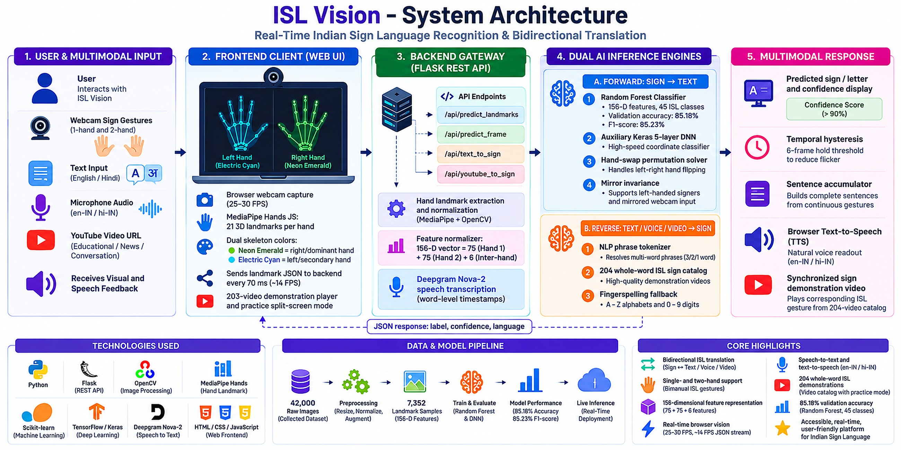
One platform, two pathways
Notes:
Forward pathway: webcam, MediaPipe Hands, 156-D features, Random Forest or MLP, temporal hysteresis, then text buffer and text-to-speech. Reverse pathway: speech, text or YouTube audio, recognition or Deepgram Nova-2, phrase matching, then the 204-entry sign video playback with fingerspelling fallback.

Slide 7
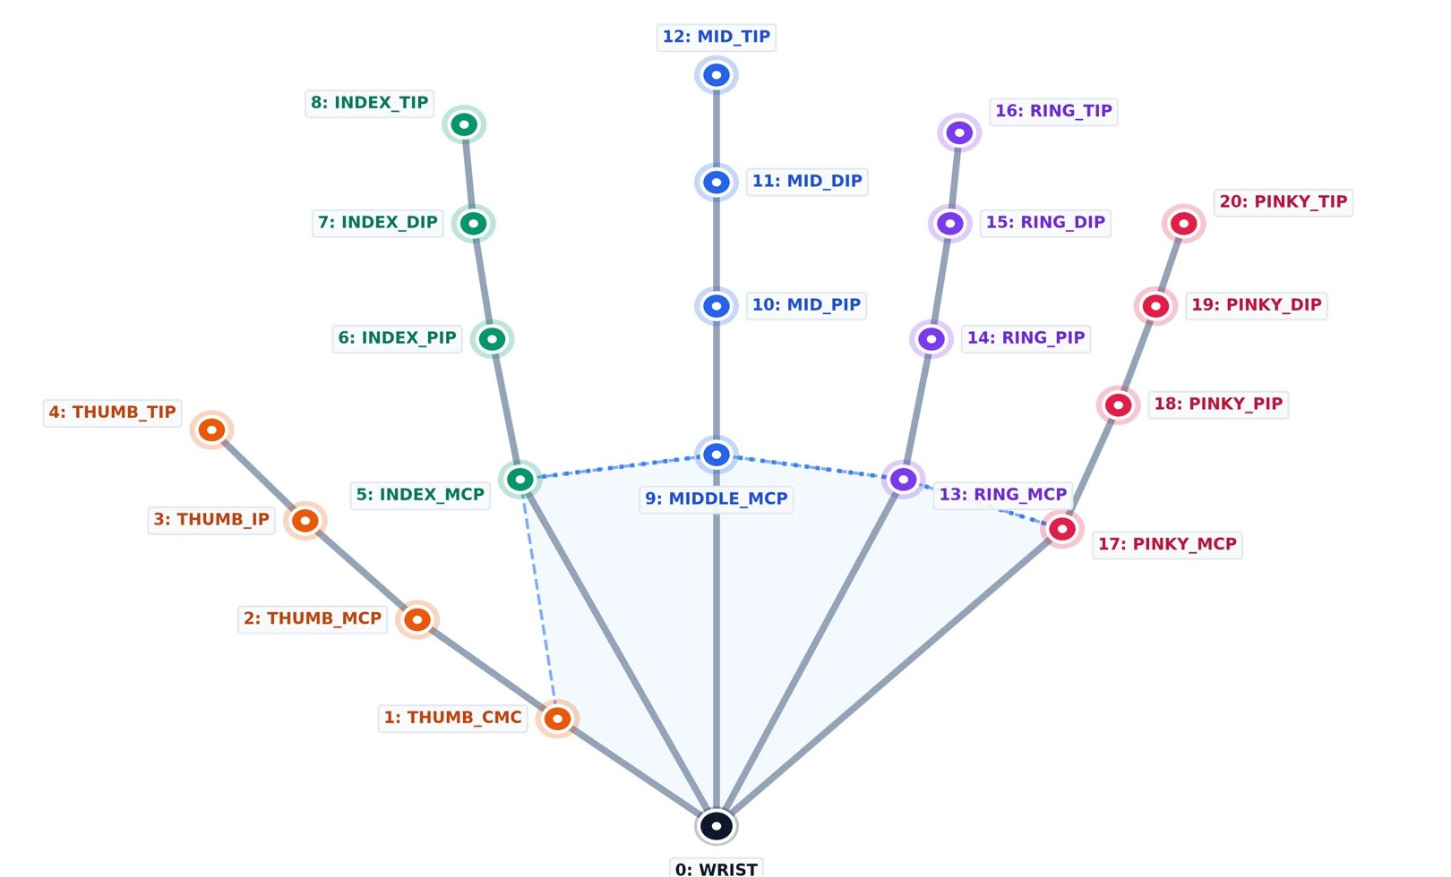
A 156-D bimanual feature vector
Normalize
Wrist-centred, scaled by the largest wrist distance
1
Add geometry
5 tip radii, 4 thumb distances, 3 finger spreads
2
Link the hands
Presence flags, wrist offset and wrist distance
3
21 landmarks per hand, wrist (0) is the origin
Hand 1: 75
Hand 2: 75
Inter-hand: 6
Notes:
Each hand gives 21 landmarks. Coordinates are centered on the wrist for translation invariance and divided by the maximum wrist distance for scale invariance, giving 63 values. Twelve geometric features are added: five fingertip radii, four thumb-to-fingertip distances and three adjacent finger spreads. That is 75 per hand. Two hands give 150, plus 6 inter-hand features (two presence flags, a 3D wrist offset and the wrist distance) for 156. A missing hand is zero-padded.

Slide 8
Two classifiers, one winner
Random Forest
Deployed
MLP baseline
Baseline
100
1.2 ms
128-64
3.4 ms
decision trees
inference
hidden units
inference
Mean of 100 tree probabilities
Robust to feature scale
Batch norm and dropout 0.2
Adam, lr 1e-3, 50 epochs
Notes:
The Random Forest averages the class probabilities of 100 trees and runs in about 1.2 ms on a CPU. The MLP baseline is 156 to 128 to 64 to 45 with batch norm, dropout 0.2, Adam at 1e-3 for 50 epochs. Random Forest scored higher on every held-out metric and is faster, so it is the deployed model.

Slide 9
Hold-to-confirm kills the flicker
Classify each frame
Raw predictions jitter between signs
1
Check confidence
P(y = c) must stay at or above 0.85
2
Hold 1.5 seconds
A progress bar fills while stable
3
Commit and lock
0.5 s lockout stops duplicates
4
Typing speed falls from 32 to 16 chars/min at 1.5 s: the chosen trade-off.
Notes:
Per-frame predictions jitter while a hand moves between signs. A gesture is committed only if its probability stays at or above 0.85 for a continuous 1.5 seconds; a 0.5 second lockout then prevents duplicates. Word error rate drops from 64.2% with no hold to 3.8% at 1.5 s. Going to 2.5 s only gains 0.6 points but nearly halves typing speed (16 to 9 characters per minute).

Slide 10
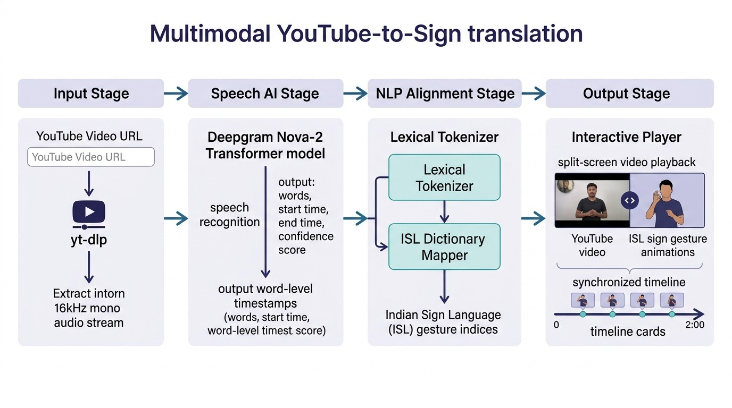
Reverse pathway: from speech to sign
Text-to-Sign
Tokenize, match the dictionary, fingerspell the rest
Voice-to-Sign
Web Speech API in English and Hindi
YouTube-to-Sign
yt-dlp audio, Deepgram Nova-2 timestamps, synced clips
204 signs
203 videos
0.5-2.0x speed
Notes:
Three entry points feed one dictionary of 204 signs backed by 203 demonstration videos. Words not in the dictionary fall back to fingerspelling cards. For YouTube, yt-dlp pulls the audio, Deepgram Nova-2 returns word-level timestamps, and matched sign clips play in sync. Speed control runs from 0.5x to 2.0x.

Slide 11
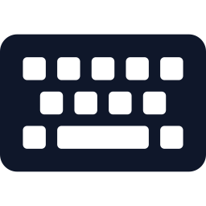




A seven-module web platform
Capture thread
Keeps the newest frame behind a lock
Sign-to-Text camera, skeleton, speech
Text-to-Sign player, fingerspelling
Inference worker
MediaPipe, 156-D features, classifier
Voice-to-Sign en-IN and hi-IN
YouTube-to-Sign transcribe and sync
HTTP server
MJPEG video plus JSON state at 10 Hz
Dataset Studio record, retrain
Dictionary 204 signs, split-screen practice
No video stored: only 156 numbers per sample
Research Gallery 189 figures, 18 papers
Notes:
A single-page app on a lightweight Flask backend. Seven modules cover sign-to-text, text-to-sign, voice-to-sign, YouTube-to-sign, dataset collection with one-click retraining, the dictionary with a practice challenger, and a gallery of 189 research figures. Capture, inference and HTTP serving run on separate threads so video stays smooth. Privacy: no video is recorded; datasets store only the 156 numeric landmark features, and API keys stay on the server.

Slide 12
Dataset: 7,352 samples, 45 classes
4,957
alphabet samples, about 190 per class
1,810
numeral samples, about 201 per class
585
Hello, Thank You, Yes, No, Please and more
80/20 stratified split: 5,881 train, 1,471 test
Notes:
Stratified dataset: 26 alphabet classes (4,957 samples), 9 numeral classes (1,810) and 10 conversational or control classes (585), for 7,352 samples. 80/20 stratified split: 5,881 train and 1,471 test. Conversational classes have far fewer samples, which is worth mentioning as a limitation.

Slide 13
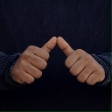

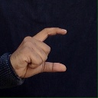
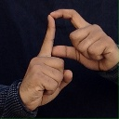
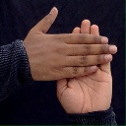
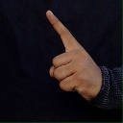
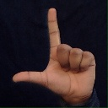
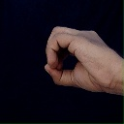
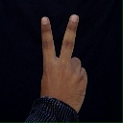
Sample signs from the dataset
A F1 88.7
B F1 83.9
C F1 92.7
D F1 82.8
H F1 90.9
two hands
two hands
one hand
two hands
two hands
4 of these 9 letters need both hands
I F1 89.2
L F1 94.6
O F1 87.1
V F1 90.9
one hand
one hand
one hand
one hand
Notes:
Nine of the sign classes. A, B, D and H need both hands, with fingertip or palm contact between them; C, I, L, O and V are one-handed. F1 scores are from the held-out test set (Table 5.2). L is the best class at 94.6; D, with crossed index fingers, is among the weakest at 82.8.

Slide 14
Classification results
85.2%
test accuracy, 45 classes
84.8%
macro F1-score
Best: L, F1 94.6
Weakest: Thank You, F1 82.1
Notes:
On the held-out test set Random Forest reaches 85.2% accuracy and 84.8% macro F1, ahead of the MLP at 81.6% and 81.5%. Training accuracy is 99.4% for Random Forest, so there is a clear generalization gap; expect a panel question on this. Best class: L (F1 94.6). Weakest: Thank You (82.1), Hello (82.7) and D (82.8), consistent with contact-heavy or dynamic signs being hardest.

Slide 15
27.2 ms end to end, about 37 FPS
27.2 ms
total per frame
36.8 FPS
above the 30 FPS camera
46%
of time is MediaPipe
Notes:
Mean latency over 1,000 continuous frames: capture 6.8 ms, MediaPipe 12.4 ms, features 0.8 ms, Random Forest 1.2 ms, hysteresis 0.5 ms, rendering 5.5 ms; total 27.2 ms, which is 1000/27.2, about 36.8 FPS. MediaPipe is the dominant cost at roughly 46%.

Slide 16
How it compares with the literature
Study | Method | Classes | Accuracy
Singhal et al. 2023 | MediaPipe + Random Forest | 35 | 99.95%
Katoch et al. 2022 | SURF + SVM | 35 | 99.17%
Awalkar et al. 2025 | Dual MediaPipe + Random Forest | 23 | 98.20%
Khakha et al. 2026 | Self-attention Transformer | 26 | 97.40%
Rawat et al. 2024 | MediaPipe + LSTM | 35 | 96.97%
Mishra et al. 2025 | MediaPipe + Random Forest | 36 | 94.50%
Vashisth et al. 2023 | Deep CNN on raw RGB | 35 | 92.83%
This work | 156-D bimanual features + RF | 45 | 85.2%
Smaller vocabularies score higher; this system covers 45 classes, including two-hand signs.
Notes:
Published systems score higher, but on much smaller vocabularies (23 to 36 classes) and mostly single-purpose pipelines. This system covers 45 classes including two-handed signs, digits and conversational phrases, and adds the reverse translation pathway and a deployed web platform. Be upfront that 85.2% is lower than the best reported numbers.

Slide 17


Conclusion and future work
Delivered
Next
Real-time ISL recognition in the browser, 45 classes
Continuous signing with Transformers and CTC
85.2% accuracy, 1.2 ms inference, 27.2 ms pipeline
Face and body cues via MediaPipe Holistic
Word error cut from 64.2% to 3.8% by hold-to-confirm
In-browser inference with TF.js, ONNX, WebGPU
Speech, text and YouTube to sign with 204 signs
User studies with fluent deaf ISL signers
Notes:
Summarize: a real-time browser ISL system with 85.2% accuracy over 45 classes, 1.2 ms classifier inference, 27.2 ms pipeline latency, hysteresis that cuts word error from 64.2% to 3.8%, and a reverse pathway with a 204-sign dictionary. Future work: continuous signing, facial and body cues, in-browser inference, and user studies with fluent deaf signers.

Slide 18

Thank you
Notes:
Invite questions. Likely topics: the train/test accuracy gap, why Random Forest over deep models, vocabulary size versus published results, and plans for continuous signing.

