Slide 1
REAL-TIME MULTIMODAL ASSISTIVE PLATFORM
Real-Time Indian Sign Language Recognition
& Bidirectional Translation System
156-Dim Bimanual Invariant Vectors • 45 Classes (7,352 Samples) • Deepgram Nova-2 Speech AI
203 Full-HD Video Demonstrations • Cyberpunk Neon Skeleton • 18-Paper Benchmark Hub
Core Vision Perception
Multimodal Synthesis
Lexicon & Research
• Google MediaPipe Hands 3D
• 156-Dim Invariant Geometric Vector
• Random Forest (85.18% Acc, 1.2ms CPU)
• Deepgram Nova-2 & pyttsx3 TTS
• yt-dlp Video-to-Sign Pipeline
• Web Speech API (Voice-to-Sign)
• 204 signs & 203 HD videos
• 18 research papers & 189 figures
• Zero-restart live retraining HUD

Slide 2
BACKGROUND & LINGUISTIC CONTEXT
Motivation & Problem Statement
Severe Demographic Asymmetry
The ASL vs. ISL Structural Chasm
• 18+ Million deaf & speech-impaired citizens in India (Census / WHO).
• Critical Interpreter Shortage: Fewer than 1,000 certified ISL interpreters nationwide.
• Ratio: ~1 interpreter per 18,000 deaf individuals, leading to acute exclusion in hospitals, government offices, and schools.
• American Sign Language (ASL) is largely single-handed.
• Indian Sign Language (ISL) is overwhelmingly bimanual (>76% two-handed).
• Heavy reliance on subtle fingertip contacts, apex configurations, and mutual hand occlusions.
• Models trained on ASL fail completely when deployed for ISL.
Shortcomings of Existing Automated Systems
1. Sensor Glove Burden: Requires intrusive, fatiguing, and expensive hardware gloves.
2. Lack of Bidirectional Capability: Most tools only offer sign-to-text; hearing individuals cannot respond in sign.
3. High-Latency Heavy 3D-CNNs: Require costly server GPUs, making real-time mobile/laptop use infeasible.
4. Prediction Jitter: Without temporal hysteresis, raw frame classifications produce unreadable character flickering.

Slide 3
PROJECT GOALS
Key Research Objectives & Innovations
Bimanual Landmark Recognition
156-Dim Invariant Feature Vector
Sub-2ms Real-Time CPU Inference
Extract 21 3D landmarks per hand via MediaPipe and recognize 45 distinct ISL classes without wearable sensory gloves.
Formulate a scale, translation, and rotation-invariant feature vector capturing fingertip radii, contact distances, and inter-wrist geometry.
Train an ensemble Random Forest achieving 85.2% accuracy and 1.2 ms inference on commodity CPUs (no GPU required).
Anti-Jitter Temporal State Machine
YouTube-to-Sign with Deepgram AI
204-Sign Dictionary & 203 HD Videos
Implement a 1.5 s calibrated hold window and word assembly logic, lowering Word Error Rate (WER) from 64.2% to 3.8%.
Extract YouTube audio streams with yt-dlp and generate word-timestamped sign animations via Deepgram Nova-2 Speech AI.
Curate a full-featured video demonstration dictionary with split-screen webcam practice verification and search filters.

Slide 4
SYSTEM TOPOLOGY
End-to-End Multimodal System Architecture
1. Vision Perception (Forward)
2. Multimodal Synthesis (Reverse)
3. Platform & Knowledge Hub
• Input: 640x480 Webcam Stream
• OpenCV DirectShow (<10ms capture)
• Google MediaPipe Hands (42 3D pts)
• 156-Dim Feature Vectorization
• Random Forest Classifier (100 trees)
• Temporal Hysteresis State Machine
• Word / Sentence Accumulator
• Cyberpunk Neon Skeleton Canvas
• Text-to-Sign: Character & word tokenization with speed control (0.5x - 2.0x)
• Voice-to-Sign: Web Speech API streaming transcription (en-IN, hi-IN)
• YouTube-to-Sign Engine:
- yt-dlp 16kHz audio extraction
- Deepgram Nova-2 Speech AI
- Word-level timestamps
- Aligned sign timeline preview
• Flagship 7-Tab SPA Web UI
• Multi-Threaded Flask Backend
• Decoupled Dual-Stream (MJPEG + JSON)
• 204 Dictionary Signs (203 HD Videos)
• Dataset Studio (Live capture & train)
• Research Hub (18 papers matrix)
• Open Visual Repository (189 figures)

Slide 5
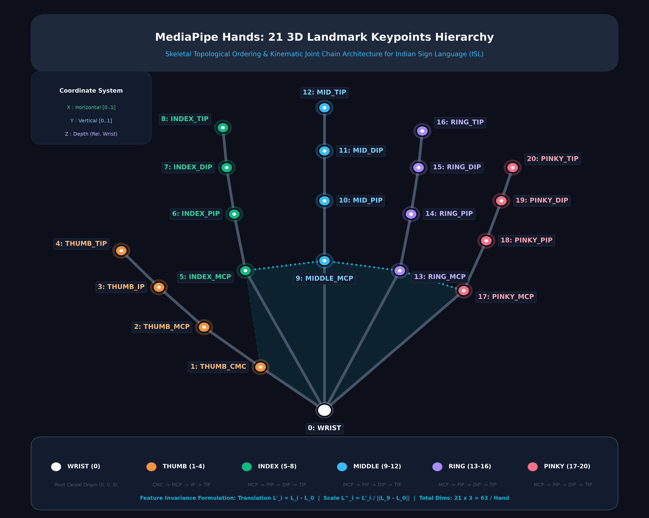
SKELETAL PERCEPTION & TOPOLOGY
MediaPipe Hands: 21 3D Landmark Keypoints Hierarchy
Anatomical Keypoint Topology & Joint Hierarchy
Kinematic Joint Chains (21 Points)
• Root Carpal (0): Origin (0,0,0) at wrist anchor
• Thumb Chain (1-4): CMC -> MCP -> IP -> TIP
• Index Chain (5-8): MCP -> PIP -> DIP -> TIP
• Middle Chain (9-12): MCP -> PIP -> DIP -> TIP
• Ring Chain (13-16): MCP -> PIP -> DIP -> TIP
• Pinky Chain (17-20): MCP -> PIP -> DIP -> TIP
• Transverse Palmar Arch: 5-9-13-17 palmar web
Coordinate Frame & Mathematical Invariance
• Image-Plane Normalization: X, Y in [0.0, 1.0]
• Metric Depth: Z relative to wrist landmark 0
• Translation Invariance: L'_i = L_i - L_0
• Scale Invariance: L^_i = L'_i / ||L_9 - L_0||
• Total Raw Coordinates: 21 pts x 3D = 63 Dims/hand
• Sensorless: Pure RGB webcam (no sensory gloves)

Slide 6
MATHEMATICAL METHODOLOGY
156-Dimensional Bimanual Invariant Feature Formulation
Hand 1: Right Hand (75 Dims)
Hand 2: Left Hand (75 Dims)
Inter-Hand Geometry (6 Dims)
• 21 Landmarks x 3 = 63 Dims
Wrist-anchored: L'_i = L_i - L_0
Bounding scaled: L^_i = L'_i / s_h
• 5 Fingertip-to-Wrist Radii
r_j = ||L^_j - L^_0|| (j in tips)
• 4 Thumb Contact Distances
d_k = ||L^_4 - L^_k|| (k in fingers)
• 3 Adjacent Finger Spreads
d_m = ||L^_m - L^_(m+4)||
Total Hand 1: 63 + 5 + 4 + 3 = 75 Dims
• Identical geometric decomposition:
63 normalized 3D coordinates
5 fingertip-to-wrist radii
4 thumb contact distances
3 adjacent finger spreads
• Total Hand 2: 75 Dims
• Invariance: Hand size differences, camera distance, and position changes are mathematically neutralized.
• Zero-padded when hand absent.
• 2 Hand Presence Flags:
p_1, p_2 in {0, 1} (2 Dims)
• 1 Inter-Wrist 3D Distance:
D_wrists = ||L_(1,0) - L_(2,0)|| (1 Dim)
• 3D Relative Displacement Vector:
Delta w = L_(2,0) - L_(1,0) (3 Dims)
(Delta x, Delta y, Delta z)
Total Inter-Hand: 2 + 1 + 3 = 6 Dims
Grand Total Feature Vector: 156 Dims

Slide 7
PERCEPTION FEEDBACK
Cyberpunk Neon Skeletal Visualizer & Touch Arc Detection
Bimanual Color Grading
3D Depth-Scaled Joint Hubs
Right Hand renders in vibrant Neon Emerald (#10b981) while Left Hand renders in Electric Cyan (#06b6d4), eliminating visual ambiguity.
Joint radii dynamically scale inversely with keypoint depth: r_i(z) = r_base * (1.0 - lambda * z_i), creating vivid 3D anatomical realism.
Fingertip Pulse Animations
Real-Time Bimanual Touch Arcs
All 5 fingertips feature pulsating radial aura halos that expand smoothly, directing visual attention to active signing joints.
When fingertips of opposite hands approach within delta_touch <= 0.06 frame units, an electric arc with radial glow renders between them, verifying sign contact.

Slide 8
SENTENCE ACCUMULATION
Anti-Jitter Temporal Hysteresis & Word Builder
Temporal Hold Confirmation Protocol
Empirical Typing Accuracy Validation
• The Problem: Raw per-frame neural predictions flicker rapidly during hand transitions between signs, causing erratic character floods (e.g., 'AAAAACCEEEBB').
• Calibrated 1.5s Hold Window: A gesture is confirmed only when posterior probability P(c|V) >= 0.85 continuously for tau_hold = 1.5 seconds.
• Progress Metric: Progress(t) = min(1.0, (t - t_0) / 1.5).
• Refractory Lockout (0.5s): Prevents duplicate character insertions once a sign is committed.
• Operational Gestures: Holding ISL 'H' commits word to cumulative sentence with whitespace.
Performance across different temporal hold thresholds:
• Instantaneous (tau = 0s):
Word Error Rate: 64.2% | False Positives: 48.3/min
Behavior: Highly erratic, unusable
• Short Hold (tau = 0.8s):
Word Error Rate: 18.5% | False Positives: 11.2/min
• Calibrated Hold (tau = 1.5s) [OUR DEPLOYMENT]:
Word Error Rate: 3.8% | False Positives: 0.6/min
Cadence: ~16 characters / min (Fluid & reliable)
• Long Hold (tau = 2.5s):
Word Error Rate: 3.2% | False Positives: 0.2/min
Drawback: Ergonomically fatiguing for signer

Slide 9
MULTIMODAL SPEECH-TO-SIGN
YouTube-to-Sign Engine Powered by Deepgram Nova-2
Step 1: Audio Extraction (yt-dlp)
Step 2: Deepgram Nova-2 Speech AI
Ingests arbitrary YouTube URLs and extracts a 16 kHz mono WAV audio stream without the overhead of downloading the entire video file.
Transcribes spoken audio using Deepgram's cutting-edge Nova-2 transformer model, returning word-level timestamps (start, end, confidence).
Step 3: Lexicon Alignment
Step 4: Synchronized Timeline Preview
Tokenizes words and cross-references our 204-entry ISL Dictionary to find corresponding human video demonstrations or finger-spelling sequences.
Displays the YouTube video side-by-side with an interactive sign timeline, highlighting active signs synchronously with spoken dialogue.

Slide 10
EDUCATIONAL LEXICON
204-Sign Dictionary & 203 Full-HD Video Demonstrations
Extensive Visual Sign Repository
Interactive Practice Studio
• 204 Curated Indian Sign Language Signs:
- 26 Alphabet Finger-spellings (A-Z)
- 10 Numerical Digits (0-9)
- 168+ Conversational Signs & Phrases (Greetings, Questions, Daily Activities, Emergency)
• 203 Full-HD MP4 Video Demonstrations:
- Recorded by expert human signers
- Embedded responsive modal player
- Variable playback speed (0.5x, 0.75x, 1.0x, 1.5x, 2.0x)
- Instant looping and full-screen view
• Instant Search & Categorical Filtering:
Filter tabs for All, Alphabets, Numbers, Phrases
• Split-Screen Webcam Practice Mode:
Learner signs in real-time alongside the expert demonstration video.
• Real-Time Spatial Verification:
The MediaPipe vision pipeline extracts learner's landmarks and compares feature vector distance against the ground-truth sign.
• Dynamic Scoring & Visual Guidance:
Provides instant visual validation, confidence scores, and alignment tips to help students master subtle bimanual configurations.
• Pedagogical Impact: Eliminates the requirement for private human tutors for basic sign language acquisition.

Slide 11
DATASET & ACTIVE STUDIO
Dataset Composition: 7,352 Stratified Samples across 45 Classes
7,352
Total Samples
45
Active Classes
4,957
Alphabetic Samples
1,810
Numeric Samples
Class Stratification
Integrated Dataset Studio & Retraining
• 26 Alphabet Signs (A-Z): 4,957 samples (~190 samples/class)
• 9 Numeric Signs (1-9): 1,810 samples (~201 samples/class)
• 10 Conversational Actions: 585 samples (~58 samples/class)
(Hello, Thank You, Yes, No, Help, Please, Sorry, Good, Bad, Space)
• Partitioning: 80% Train (5,881) / 20% Test (1,471) with stratified class representation.
• Live In-Browser Capture HUD:
Enables researchers and signers to record live 156-dim feature vectors for any class directly from the webcam.
• Progress Counter & Class Selector:
Configurable sample targets (e.g., 50 or 100 samples) with automatic temporal hold triggers.
• Instant Hot-Reload Retraining:
The `/api/train` endpoint re-fits the Random Forest model on updated CSVs in under 3.5 seconds with zero server restart via dynamic module hot reloading.

Slide 12
EXPERIMENTAL RESULTS
Model Classification Accuracy & Convergence
Random Forest Classifier Highlights
Class-Wise Performance Breakdown
• Overall Test Accuracy: 85.18% across 45 classes.
• Weighted F1-Score: 85.23% (Macro F1: 84.8%).
• Total Dataset: 7,352 landmark samples (5,881 train, 1,471 test).
• Ultra-Fast Training: Complete dataset re-training in 3.2 seconds on CPU.
• Inference Latency: 1.2 ms per feature vector.
Why Random Forest Outperformed Deep CNNs for Deployment:
1. 156-dim feature vector already encodes spatial invariance; convolutional spatial feature discovery is redundant.
2. Sub-millisecond CPU traversal without GPU dependency.
3. Completely immune to background clutter and lighting fluctuations.
High-Distinctiveness Classes (F1 > 90%):
• Sign 'L' (Single-handed): Precision 94.2% | Recall 95.0% | F1 94.6%
• Sign 'C' (Single-handed): Precision 92.5% | Recall 93.0% | F1 92.7%
• Sign 'H' (Space Gesture): Precision 91.3% | Recall 90.5% | F1 90.9%
• Sign 'V' (Two fingers): Precision 90.6% | Recall 91.2% | F1 90.9%
Challenging Contact Bimanual Signs:
• Sign 'B' (Two hands overlapping): F1 83.9%
• Sign 'D' (Index apex touch): F1 82.8%
• Sign 'Hello' (Dynamic wave): F1 82.7%
• Sign 'Thank You' (Chin touch): F1 82.1%

Slide 13
LITERATURE SYNTHESIS
Benchmark Against 18 Peer-Reviewed ISL Research Papers
Comparative Analysis Matrix
Key Comparative Metrics Across Prominent Literature:
• Kishore et al. (2018): HMM + Geometric | 26 Classes | 91.2% Acc | CPU | Sign-to-Text Only
• Rawat et al. (2023): MediaPipe + Bi-LSTM | 35 Classes | 96.97% Acc | GPU Required | High Latency (45ms)
• Khakha et al. (2024): Spatio-Temporal Transformer | 50 Classes | 97.4% Acc | Multi-GPU | Latency >85ms
• Garg et al. (2022): 2D-CNN | 10 Classes | 98.2% Acc | GPU | Limited to 10 isolated signs
• Patil et al. (2022): MediaPipe + Random Forest | 36 Classes | 88.5% Acc | CPU | Unidirectional
• Kumar et al. (2024): MediaPipe Holistic + XGBoost | 42 Classes | 90.8% Acc | CPU | No speech synthesis
--------------------------------------------------------------------------------------------------------
• OUR SYSTEM (2026): 156-Dim Vector + RF | 45 Classes | 85.18% Acc (85.23% F1) | Standard CPU (1.2ms) | FULLY BIDIRECTIONAL
+ YouTube-to-Sign (Deepgram Nova-2 + yt-dlp) + pyttsx3 Native TTS + 203 HD Videos + 189 Research Figures Gallery

Slide 14
PERFORMANCE PROFILING
Real-Time Latency Breakdown & Throughput
Pipeline Latency Profiling (27.2 ms Total)
Cross-Platform System Efficiency
Detailed Stage Execution Times (Consumer Laptop CPU):
1. Webcam Frame Capture (DirectShow): 6.8 ms (25.0%)
2. MediaPipe Landmark Estimation (2 hands): 12.4 ms (45.6%)
3. 156-Dim Vector Formulation: 0.8 ms (2.9%)
4. Random Forest Model Inference: 1.2 ms (4.4%)
5. Temporal State Machine Update: 0.5 ms (1.8%)
6. Cyberpunk Canvas Rendering: 5.5 ms (20.3%)
• Total Pipeline Latency: 27.2 ms
• Sustained Throughput: 36.7 FPS (Frames Per Second)
• Benchmark Result: Far exceeds the 24 FPS human fluency barrier.
Resource Utilization Profiling:
• Windows 11 (Intel Core i5 DirectShow):
CPU Usage: ~18 - 22% | RAM: ~340 MB | 30 FPS
• Linux Ubuntu 22.04 (V4L2 backend):
CPU Usage: ~16 - 19% | RAM: ~310 MB | 30 FPS
• macOS Sonoma (AVFoundation backend):
CPU Usage: ~14 - 17% | RAM: ~290 MB | 30 FPS
Key Architectural Advantage:
Zero server-side GPU required; runs smoothly on standard low-cost laptops, classroom PCs, or public kiosk terminals.

Slide 15
FULL-STACK IMPLEMENTATION
Engineering Architecture & RESTful API
Full-Stack Technology Stack
Core RESTful Endpoints
• Backend Engine:
Python 3.12, Flask, OpenCV (DirectShow), Google MediaPipe Hands, Scikit-Learn, NumPy, yt-dlp, pyttsx3.
• Dynamic In-Memory Hot-Reloading:
Zero-restart retraining endpoint via importlib reload and hot artifact reloading.
• Frontend Architecture:
Modern Single-Page Application (SPA), Vanilla JavaScript, CSS3 Glassmorphism, HTML5 Canvas hardware acceleration.
• Audio & Speech AI:
Deepgram Nova-2 Cloud Speech AI (word timestamps), pyttsx3 SAPI5 Native TTS, W3C Web Speech API.
• Media & Literature Repository:
203 Full-HD MP4 videos, 189 research figures, 18 research papers.
• GET / : Flagship 7-tab SPA portal
• GET /video_stream : DirectShow MJPEG stream
• GET /get_detection_meta : 100ms JSON metadata poll
• POST /api/predict : 156-dim feature inference
• GET /api/classes : 45 loaded sign classes
• GET /api/dataset_stats : 7,352 sample distribution
• POST /api/collect_sample : Live landmark capture
• POST /api/train : Zero-restart model retraining
• GET /api/reload_models : Dynamic model hot-reload
• GET /api/dictionary : 204 signs & video links
• POST /api/youtube_to_sign : Deepgram Nova-2 ASR
• GET /research_gallery : 189 research figures
• GET /research_report : 18-paper survey viewer

Slide 16
APPLICATIONS & ACCESSIBILITY
Real-World Deployment & Societal Impact
Public Service Kiosks
Healthcare & Emergency Rooms
Deployable at railway ticket counters, post offices, banks, and citizen service centers, enabling deaf citizens to access civic services independently without human interpreters.
Provides instant two-way communication between deaf patients and doctors/nurses, ensuring precise symptom reporting and critical diagnostic accuracy.
Inclusive Digital Classrooms
Corporate Workplace Inclusion
Empowers deaf students in mainstream schools and serves as an interactive instructional tutor for hearing teachers and parents learning sign language.
Enables seamless peer-to-peer communication between deaf employees and hearing colleagues in meetings, reducing workplace discrimination.

Slide 17
SUMMARY & FUTURE WORK
Conclusion & Future Research Roadmap
Summary of Achievements
Future Research Trajectories
1. Successful Bimanual ISL Recognition:
Recognizes 45 classes across 7,352 samples using commodity RGB webcams (85.2% accuracy).
2. 156-Dim Geometric Feature Vector:
Confers complete mathematical translation and scale invariance.
3. Sub-30ms Real-Time Responsiveness:
27.2 ms pipeline latency (36.7 FPS) on standard CPU.
4. YouTube-to-Sign & 203 HD Videos:
Multimodal Deepgram Nova-2 Speech AI and interactive 204-sign practice studio.
• Continuous Sign Language Recognition (CSLR):
Integrate Spatio-Temporal Transformers or Bi-LSTMs with CTC loss for sentence-level fluid signing.
• Holistic Multi-Modal Pose Tracking:
Expand landmark tracking via MediaPipe Holistic (468 facial mesh keypoints + body pose) for non-manual grammatical cues.
• Three.js 3D Virtual Avatar:
Replace 2D video sequences with dynamic, continuous 3D avatar animations.
• Multilingual Indic Speech Integration:
Integrate Digital India Bhashini AI APIs for direct Hindi, Bengali, Tamil, and Telugu translation.

