Slide 1
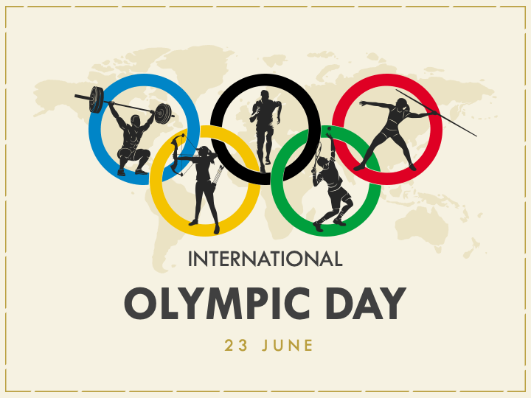

Slide 4

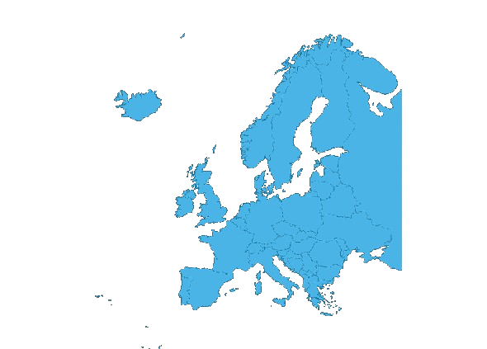




Slide 5
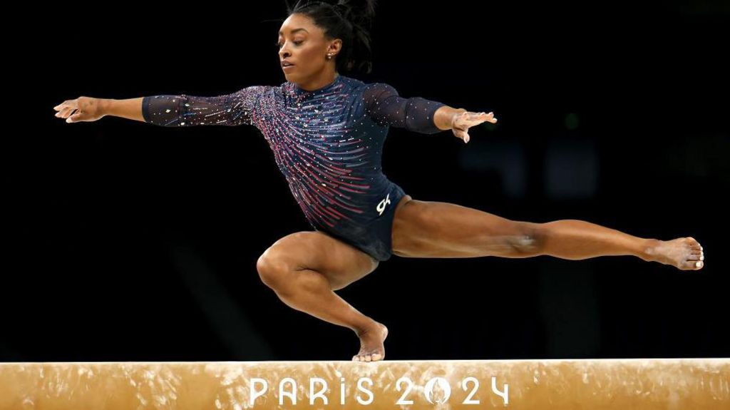
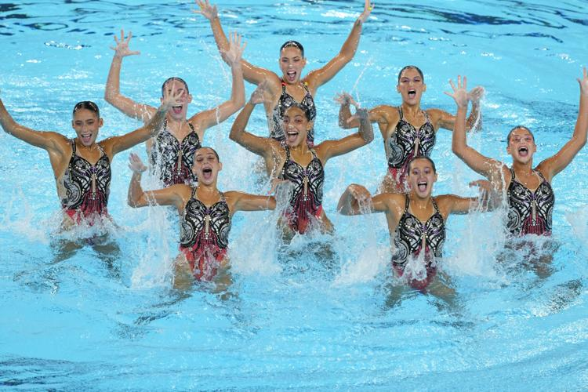
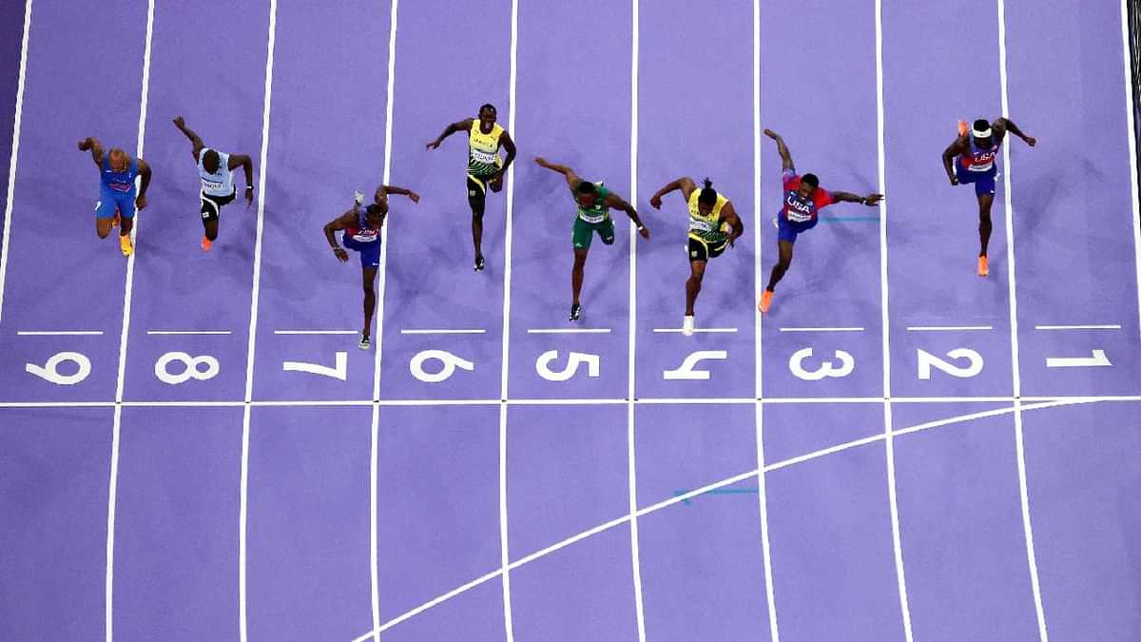
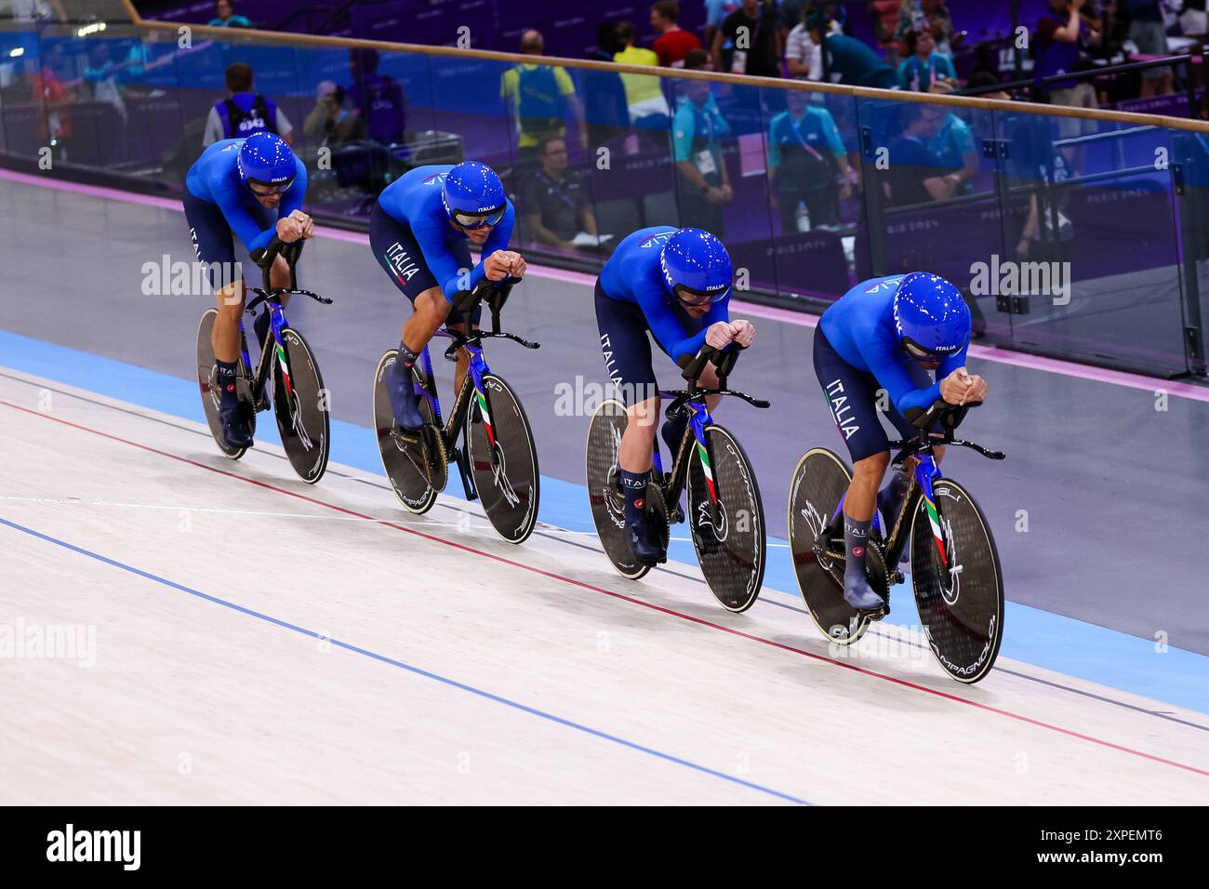
THE OLYMPIC GAMES
GYMNASTICS
Olympic gymnastics includes artists
routines on apparatus, rhythmic
performances with ribbons and hoop
and trampoline acrobatics.
AQUATICS
Olympic aquatics features swimming
races, diving from platforms, artistic
synchronized swimming and water
polo matches.
ATHLETICS
Olympic athletics covers running,
jumping and throwing events, plus
combined events like the decathlon and
heptathlon.
CYCLING
Olympic cycling includes road races,
track events in velodromes, mountain
biking on rough terrain and BMX racing
on dirt tracks.

Slide 6
GYMNASTICS
Olympic gymnastics includes artists
routines on apparatus, rhythmic
performances with ribbons and hoop
and trampoline acrobatics.
THE OLYMPIC GAMES
AQUATICS
Olympic aquatics features swimming
races, diving from platforms, artistic
synchronized swimming and water
polo matches.
ATHLETICS
Olympic athletics covers running,
jumping and throwing events, plus
combined events like the decathlon and
heptathlon.
CYCLING
Olympic cycling includes road races,
track events in velodromes, mountain
biking on rough terrain and BMX racing
on dirt tracks.

Slide 7
GYMNASTICS
Olympic gymnastics includes artists
routines on apparatus, rhythmic
performances with ribbons and hoop
and trampoline acrobatics.
AQUATICS
Olympic aquatics features swimming
races, diving from platforms, artistic
synchronized swimming and water
polo matches.
THE OLYMPIC GAMES
ATHLETICS
Olympic athletics covers running,
jumping and throwing events, plus
combined events like the decathlon and
heptathlon.
CYCLING
Olympic cycling includes road races,
track events in velodromes, mountain
biking on rough terrain and BMX racing
on dirt tracks.

Slide 8
GYMNASTICS
Olympic gymnastics includes artists
routines on apparatus, rhythmic
performances with ribbons and hoop
and trampoline acrobatics.
AQUATICS
Olympic aquatics features swimming
races, diving from platforms, artistic
synchronized swimming and water
polo matches.
ATHLETICS
Olympic athletics covers running,
jumping and throwing events, plus
combined events like the decathlon and
heptathlon.
THE OLYMPIC GAMES
CYCLING
Olympic cycling includes road races,
track events in velodromes, mountain
biking on rough terrain and BMX racing
on dirt tracks.

